Slide 1
Eicosanoids and related drugs

Slide 2
Eicosanoids
“Local hormones”—sphere of action often limited to same anatomical site or tissue
Involved in control of inflammation, fever, blood coagulation, pain perception, labor
Derived from arachidonic acid and other polyunsaturated fatty acids, which occur in membrane phospholipids
Most effects mediated by G protein-coupled receptors
Some effects mediated by ion channels and nuclear hormone receptors

Slide 3
Pathways and key enzymes in eicosanoid synthesis

Slide 4
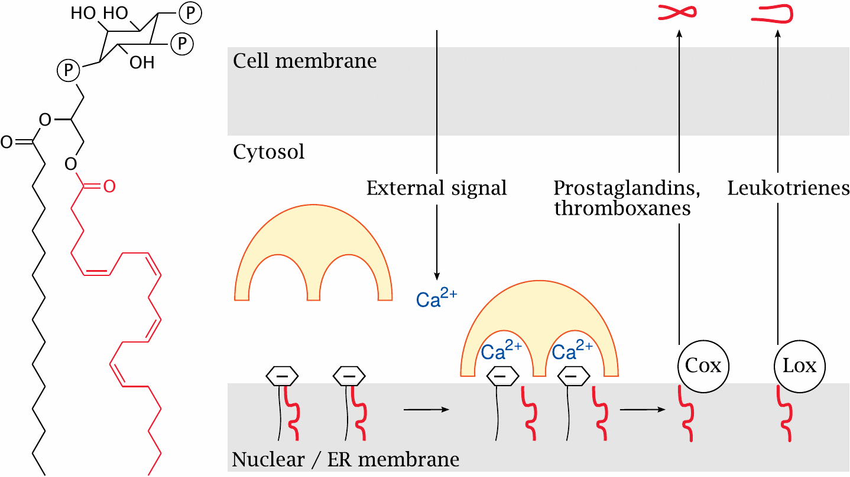
Calcium signals activate cPLA₂ and initiate the synthesis of prostaglandins and leukotrienes

Slide 5
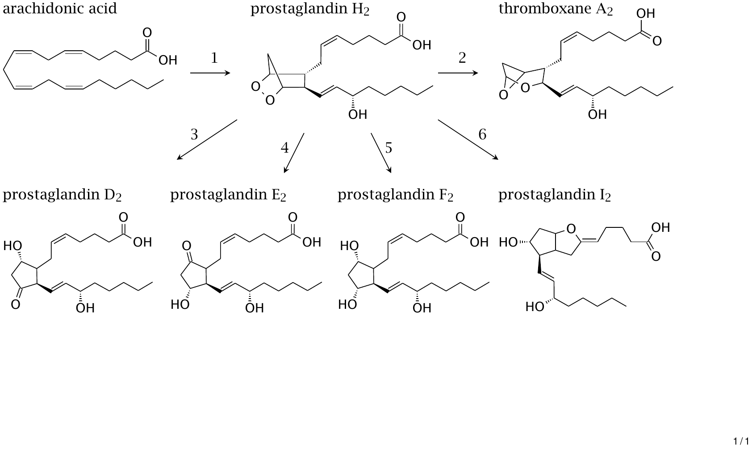
Biosynthetic pathways of prostaglandins and thromboxanes

Slide 6
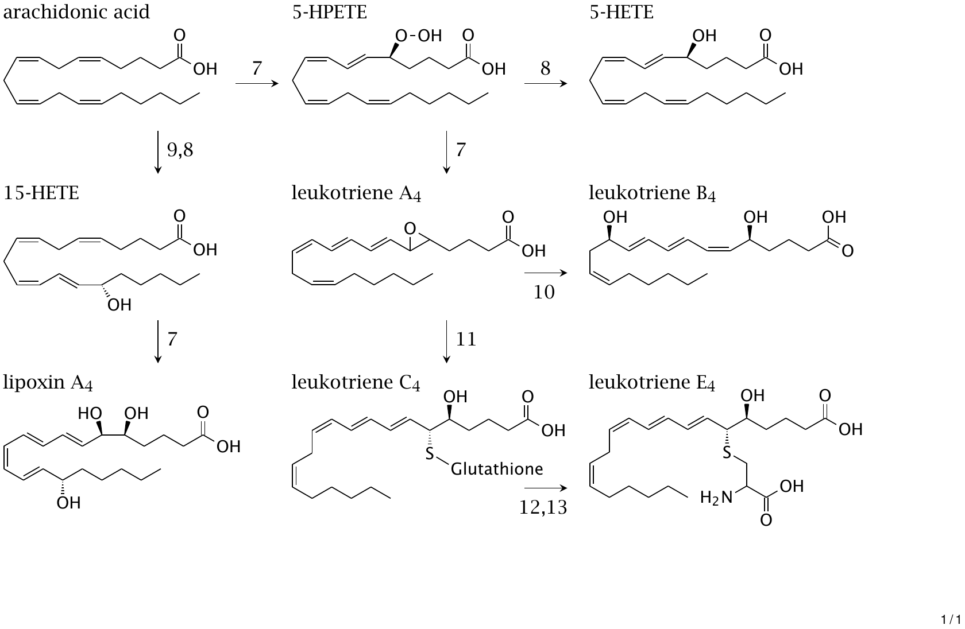
Eicosanoids synthesized by lipoxygenases

Slide 7
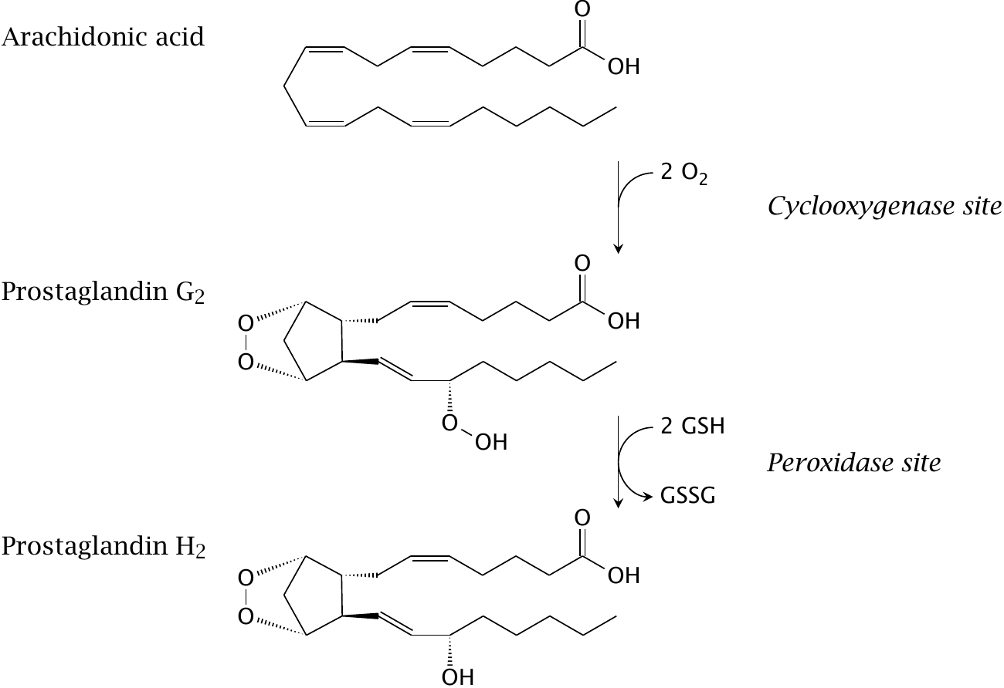
The two steps of the cyclooxygenase reaction

Slide 8
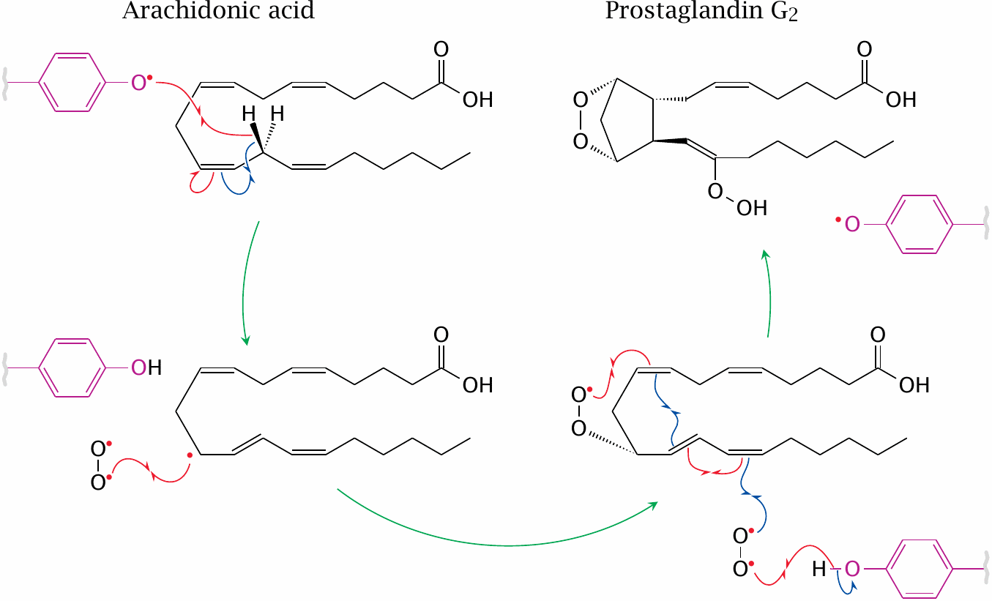
Reactions in the cyclooxygenase site

Slide 9
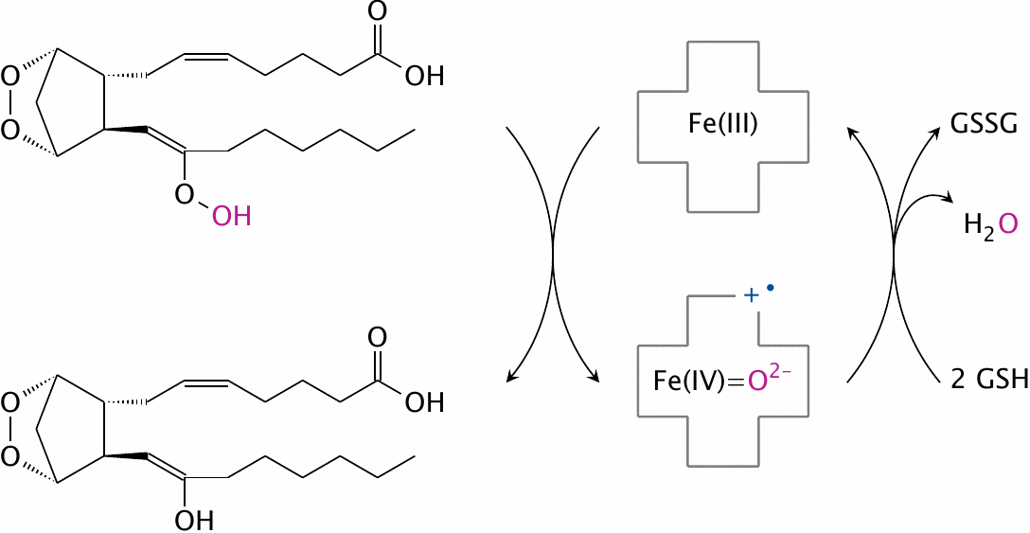
Reduction of prostaglandin G₂ to prostaglandin H₂

Slide 10
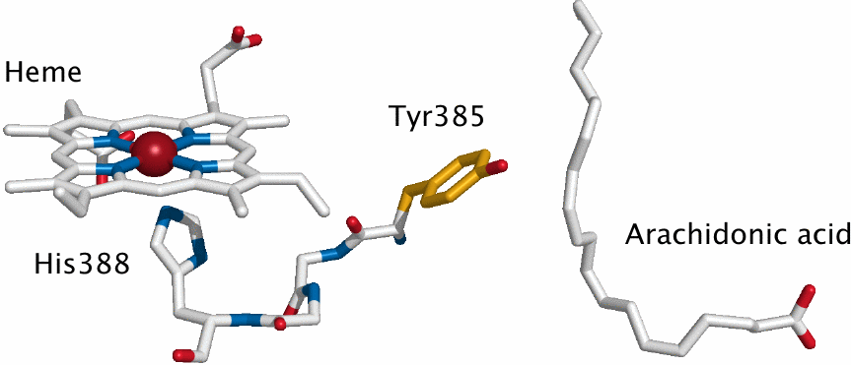
Interaction between the cyclooxygenase and peroxidase sites

Slide 11
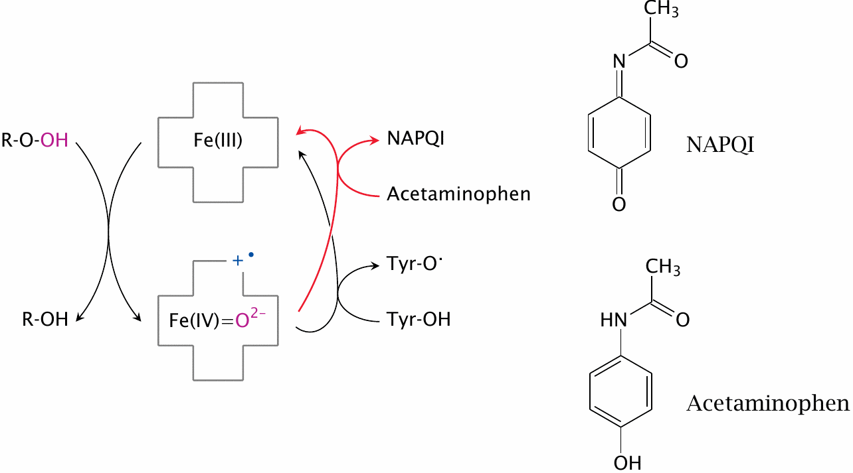
Priming of the active site tyrosine radical, and the action mode of acetaminophen

Slide 12
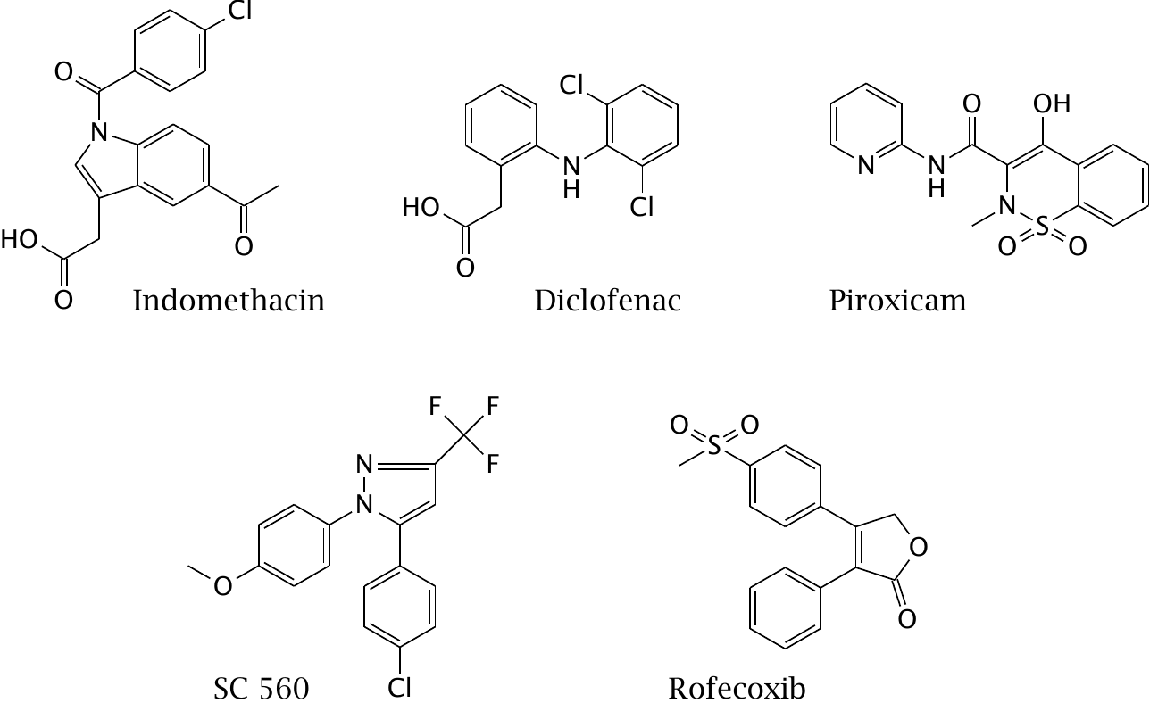
Noncovalent cyclooxygenase inhibitors

Slide 13
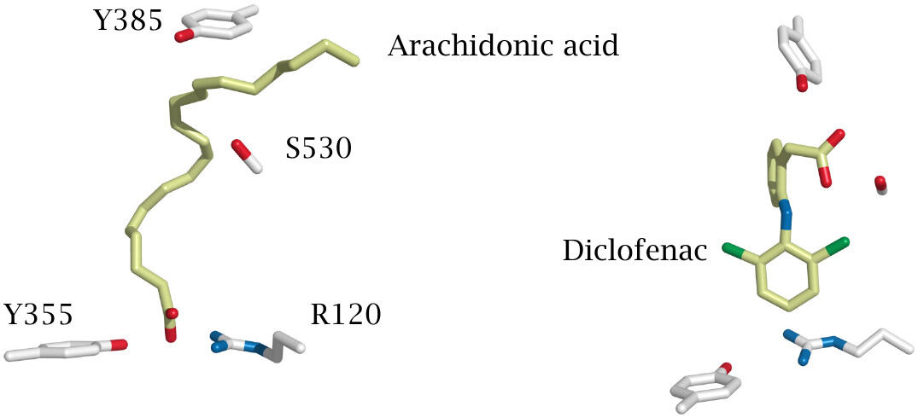
Conformation of arachidonic acid and of diclofenac in the active site

Slide 14
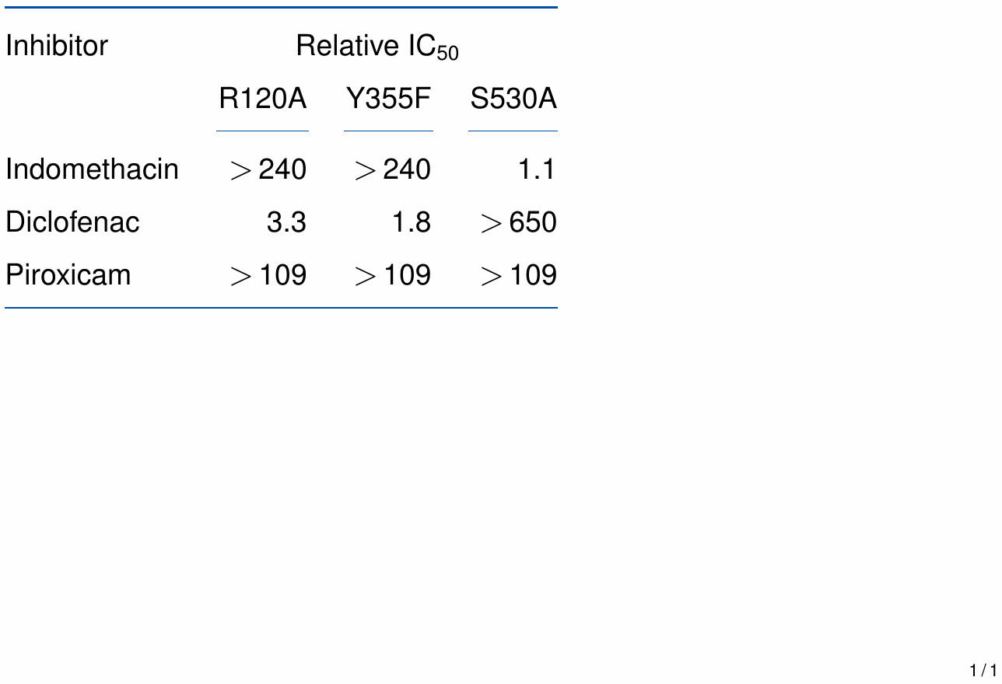
Cox inhibitors and Cox mutants

Slide 15
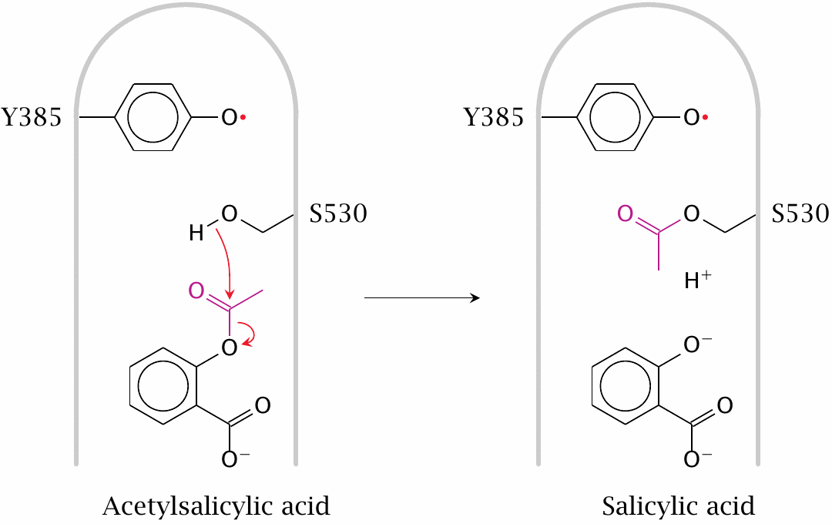
Acetylsalicylic acid is a covalent Cox inhibitor

Slide 16
Rationale of low-dose acetylsalicylic acid treatment

Slide 17
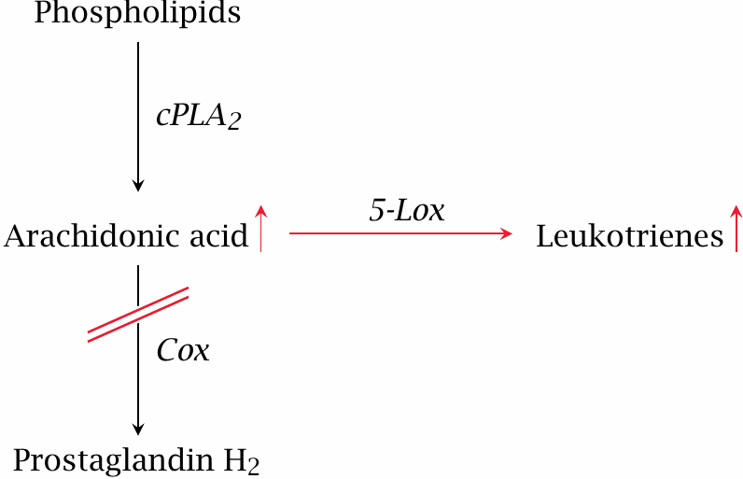
Cox inhibition can promote the synthesis of leukotrienes

Slide 18
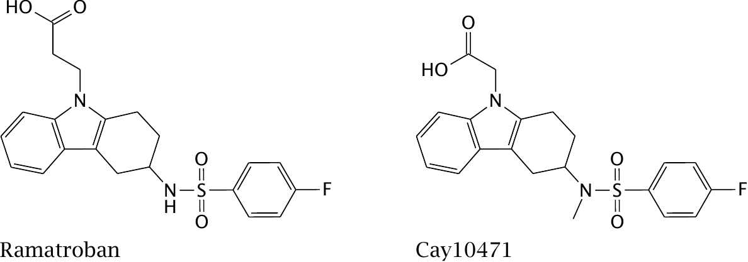
Inhibitors that act downstream of Prostaglandin H₂

Slide 19
Endocannabinoids
Arachidonate-containing, membrane-derived mediators
Synthesis on demand, activated by calcium
Mediate negative synaptic feedback
CB₁ receptors involved in pain perception both in the peripheral and the central nervous system
CB₂ receptors found on immune cells

Slide 20
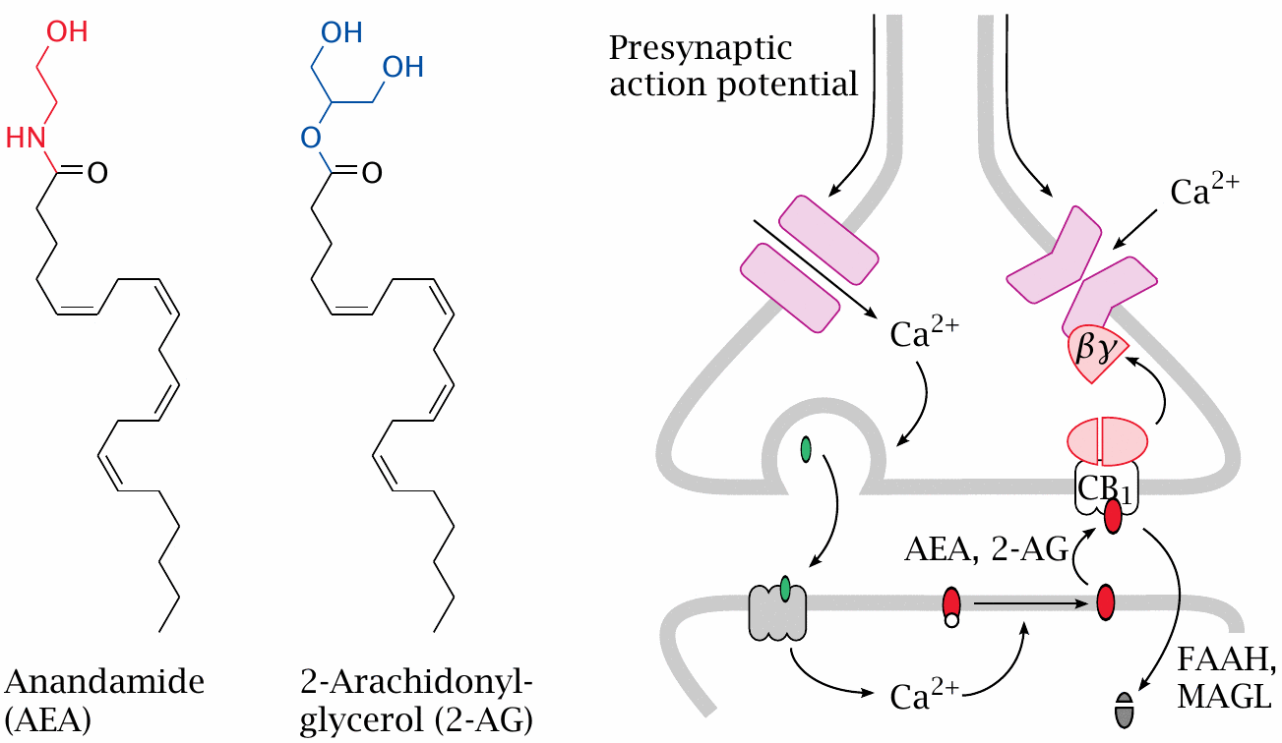
Feedback inhibition of synaptic transmission by endocannabinoids

Slide 21
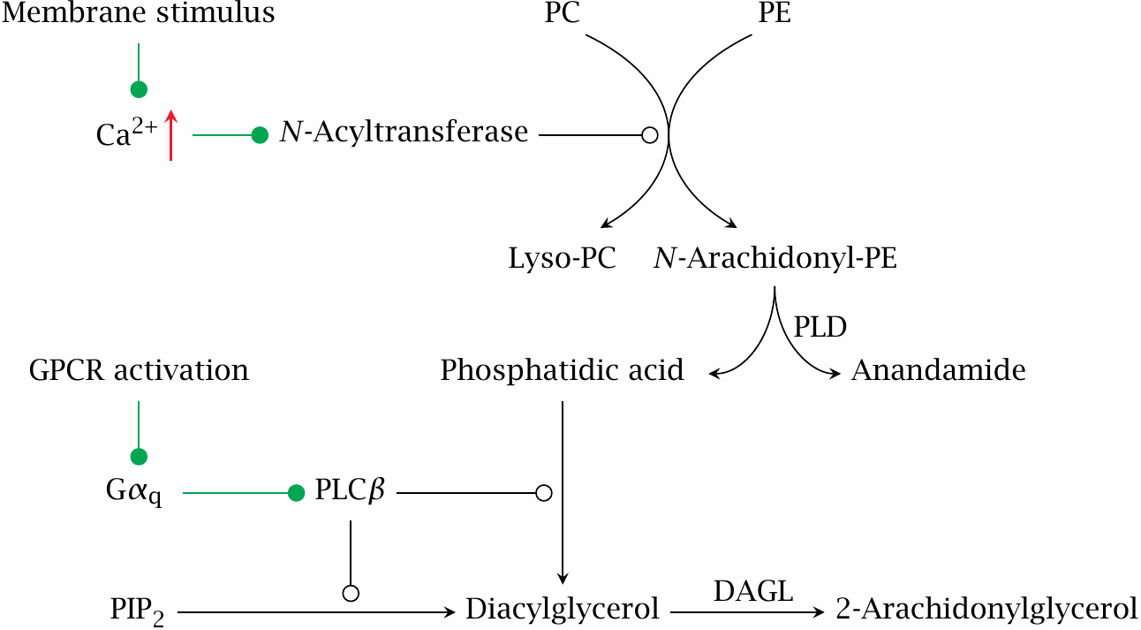
Biosynthesis of endocannabinoids

Slide 22
Degradation of endocannabinoids

Slide 23
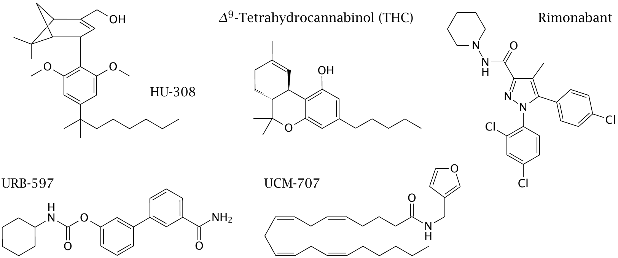
Drugs that interact with the endocannabinoid system

