Slide 1
Pharmacology of nitric oxide

Slide 2
Physiological significance of nitric oxide (NO)
Powerful vasodilator—NO-releasing drugs are used in the treatment of cardiovascular disease
Neurotransmitter—signaling in the CNS and the autonomic nervous system
Inflammatory mediator—inhibition of NO synthesis is of interest as a therapeutic strategy in infection and chronic inflammation

Slide 3
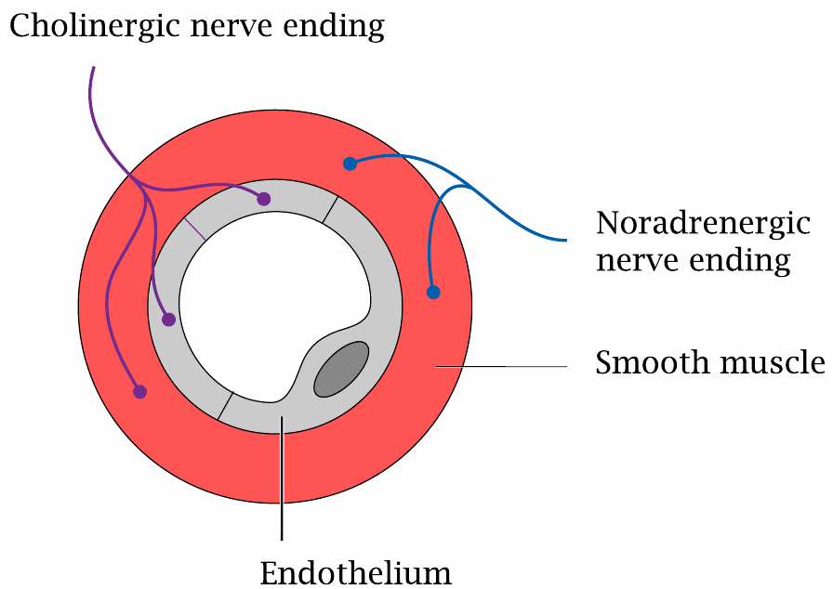
Cholinergic and adrenergic nerve endings in a blood vessel wall

Slide 4
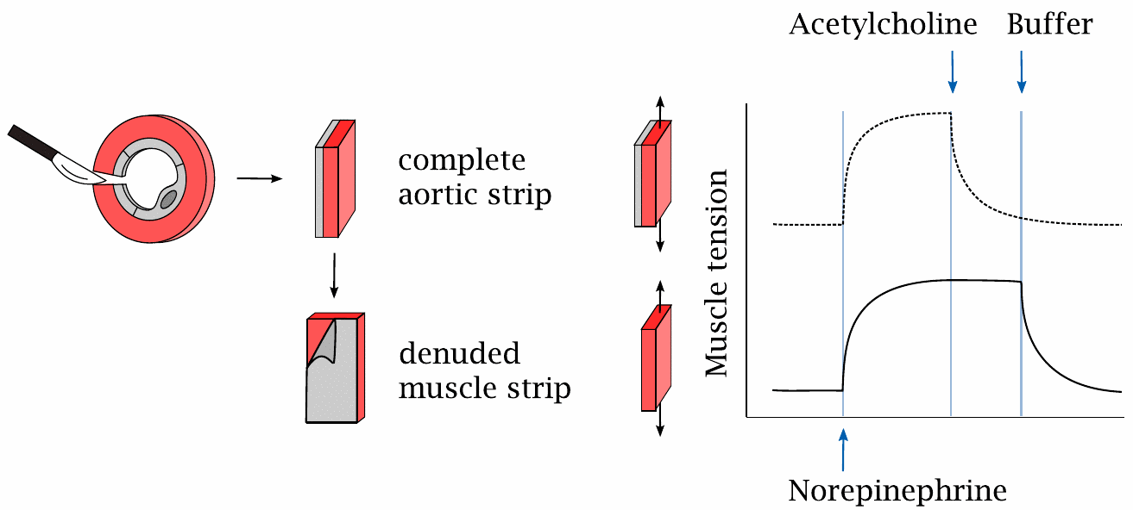
The endothelium is required for vascular relaxation in response to acetylcholine

Slide 5
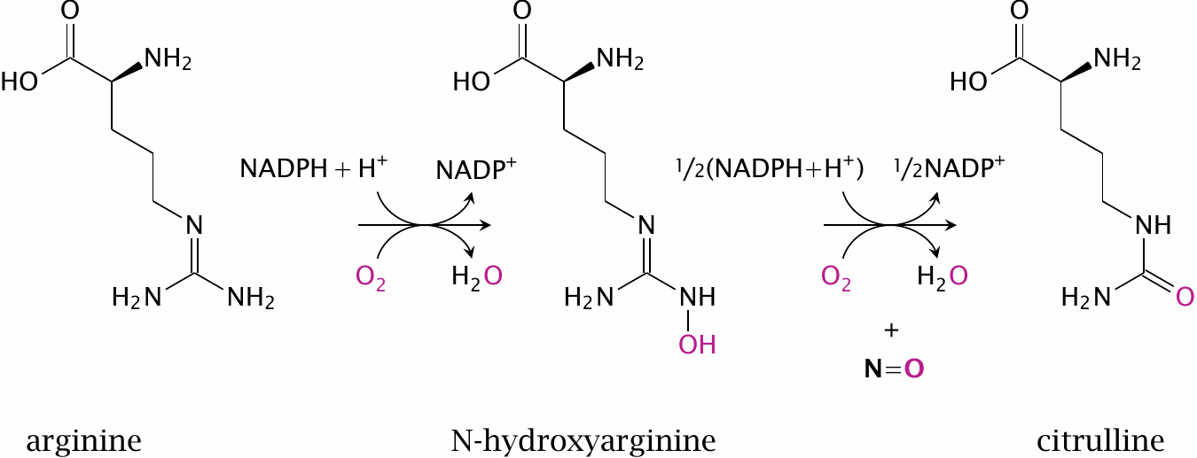
The nitric oxide synthase reaction

Slide 6
Activation of NOS by calcium and calmodulin

Slide 7
NO activates soluble guanylate cyclase (sGC)

Slide 8
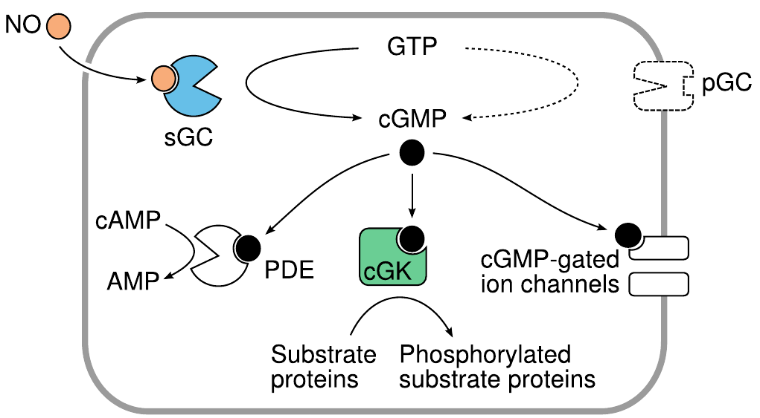
Signaling effects of cGMP

Slide 9
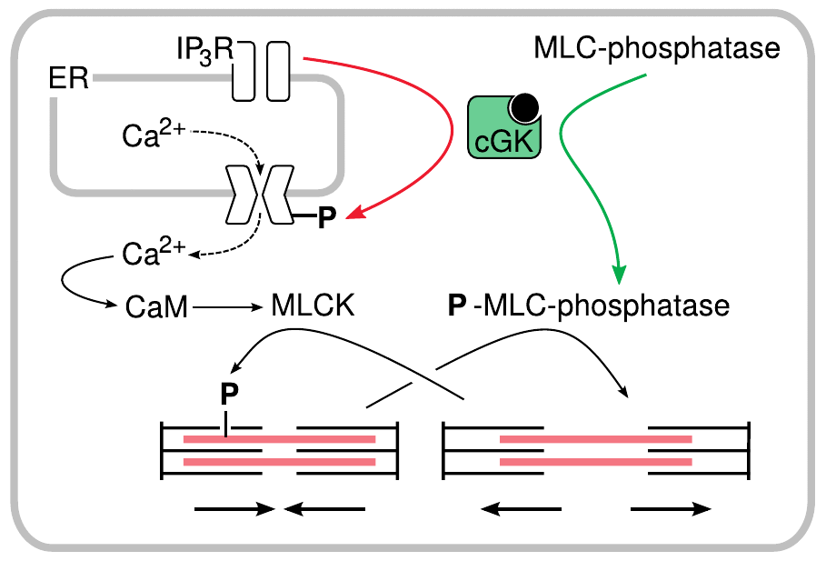
NO-induced relaxation of smooth muscle cells is mediated by cGK

Slide 10
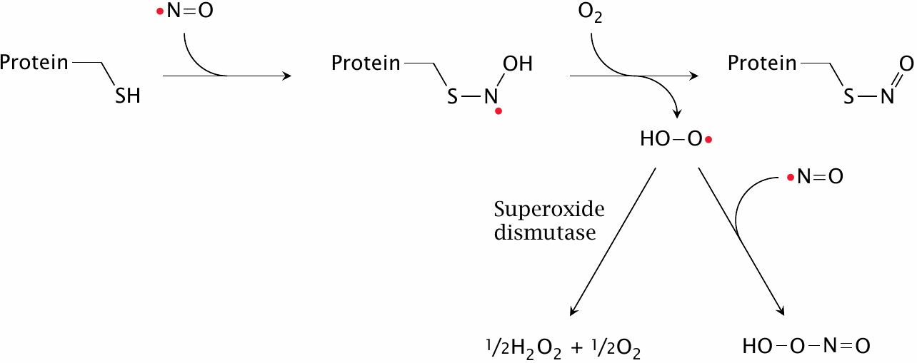
S-nitrosylation of cysteine residues in proteins by NO

Slide 11
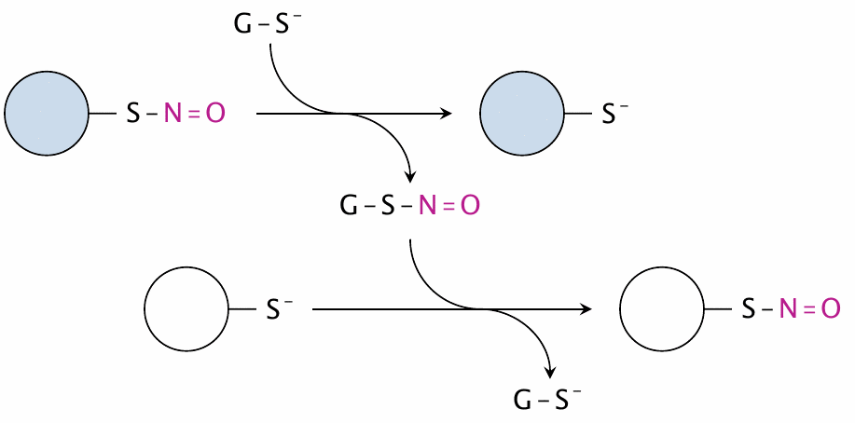
Transfer of nitrosyl groups between proteins by glutathione

Slide 12
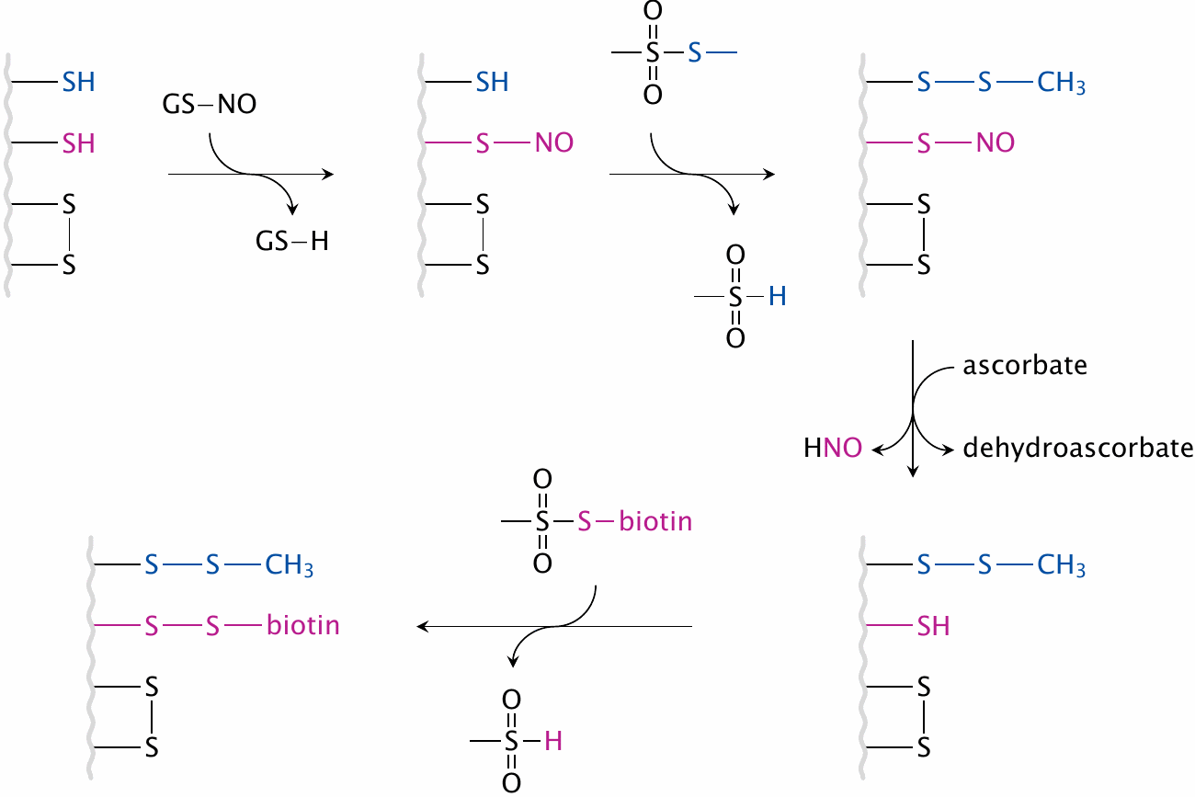
Identification of cysteines affected by S-nitrosylation: The biotin switch method

Slide 13
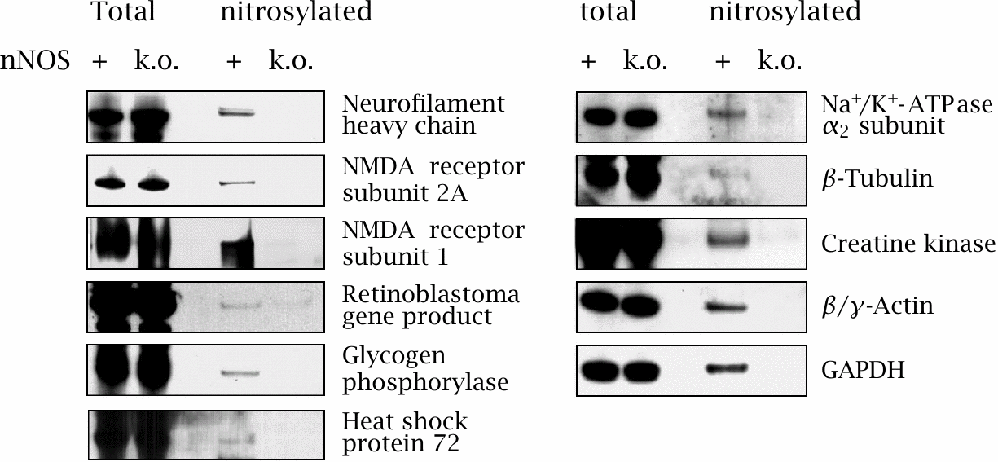
Identification of proteins subject to nNOS-dependent S-nitrosylation

Slide 14
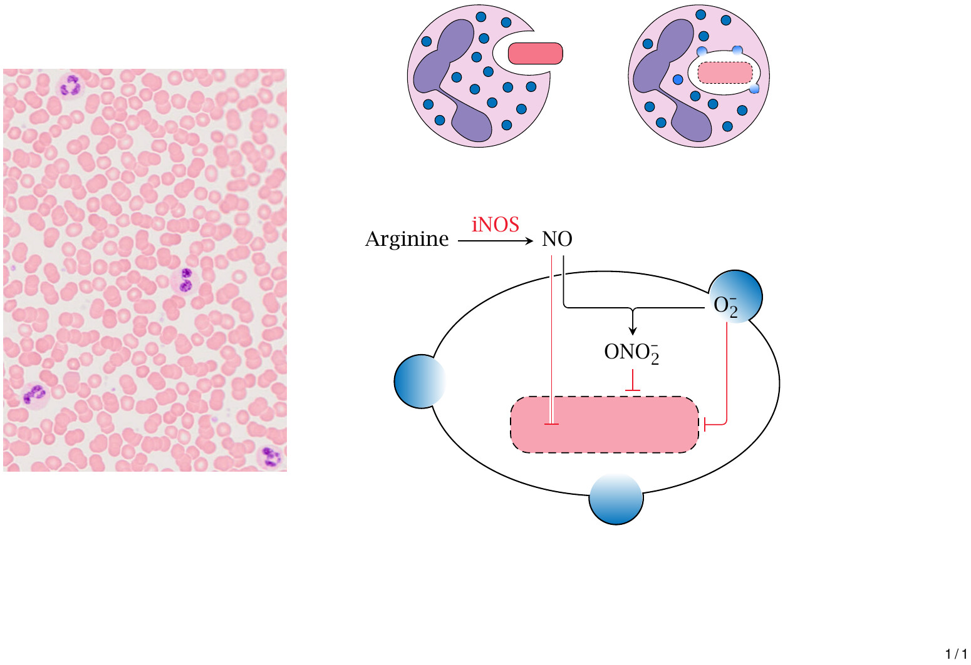
Role of NO and iNOS in the killing of microbes by phagocytes

Slide 15
NO-releasing drugs

Slide 16
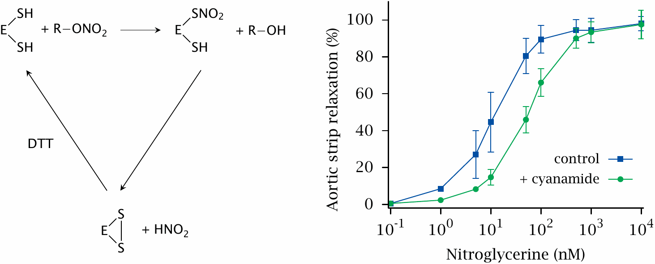
Bioactivation of nitroglycerin by mitochondrial aldehyde dehydrogenase

Slide 17
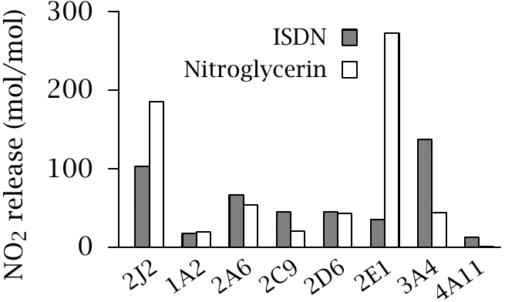
Bioactivation of nitroglycerin and ISDN by human cytochrome P450 isoforms

Slide 18
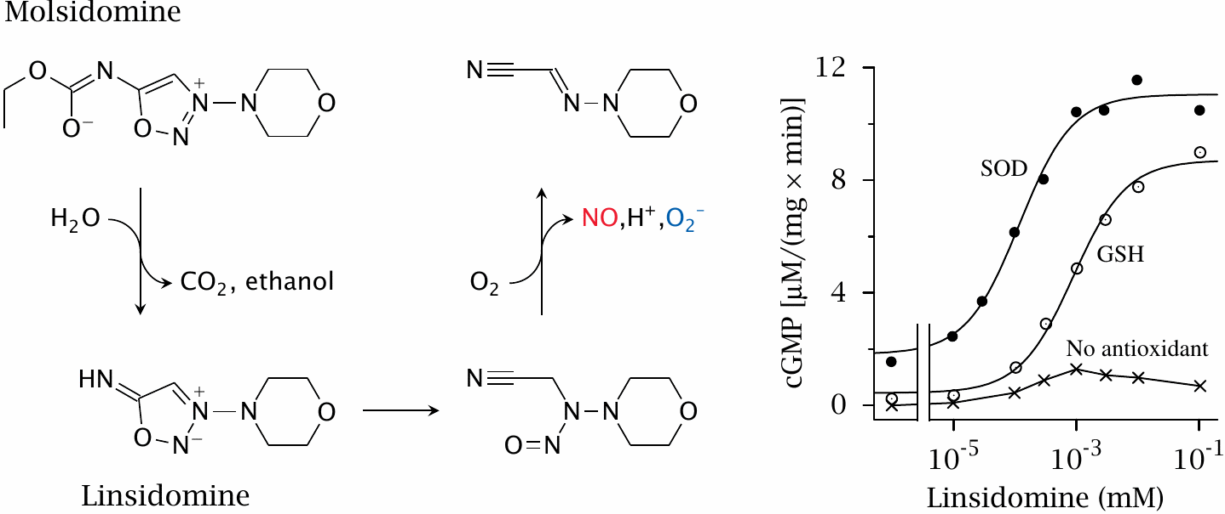
NO release by molsidomine

Slide 19
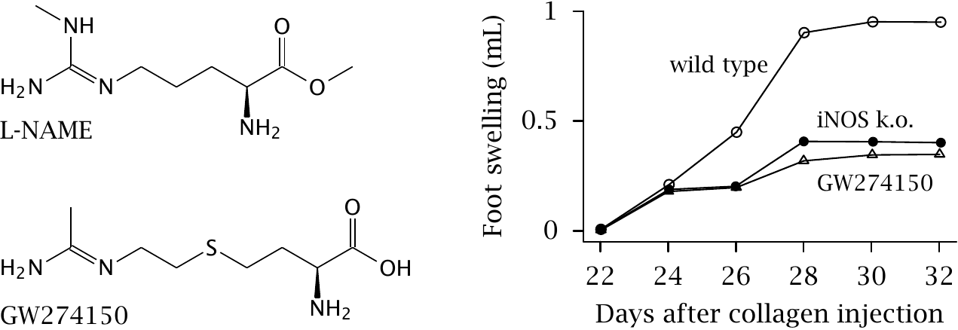
Antiinflammatory effect of iNOS inhibition

Slide 20
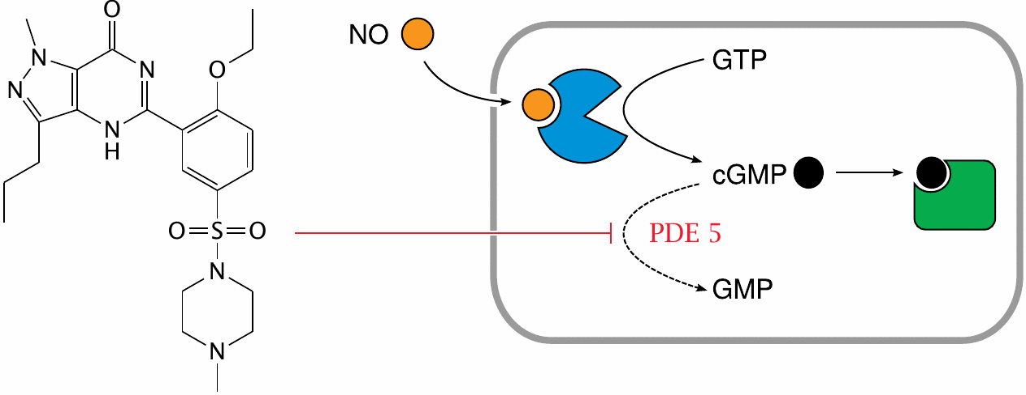
Structure and mode of action of sildenafil (Viagra™)

