Slide 1
Pharmacology of cell excitation

Slide 2
Clinical applications of drugs that influence excitable cell function
blockade of nerve conduction for local anesthesia
reduction of nerve cell excitability in the brain in epilepsy
stabilization of mood in the treatment of bipolar disorder
reduction of vascular smooth muscle tone to reduce blood pressure
suppression of aberrant excitation in cardiac arrhythmia

Slide 3
The nature of cell excitation
all cells have an electrical potential across the cytoplasmic membrane, such that the cell interior is electrically negative relative to the outside (~−70 mV)
in non-excitable cells, this membrane potential is stable; in excitable cells, it forms the resting potential
cell excitation consists in transient reversals of the membrane potential, called action potentials, which spread rapidly across the entire cell membrane
action potentials are spontaneously generated by some cells and transmitted between cells through chemical or electrical synapses

Slide 4
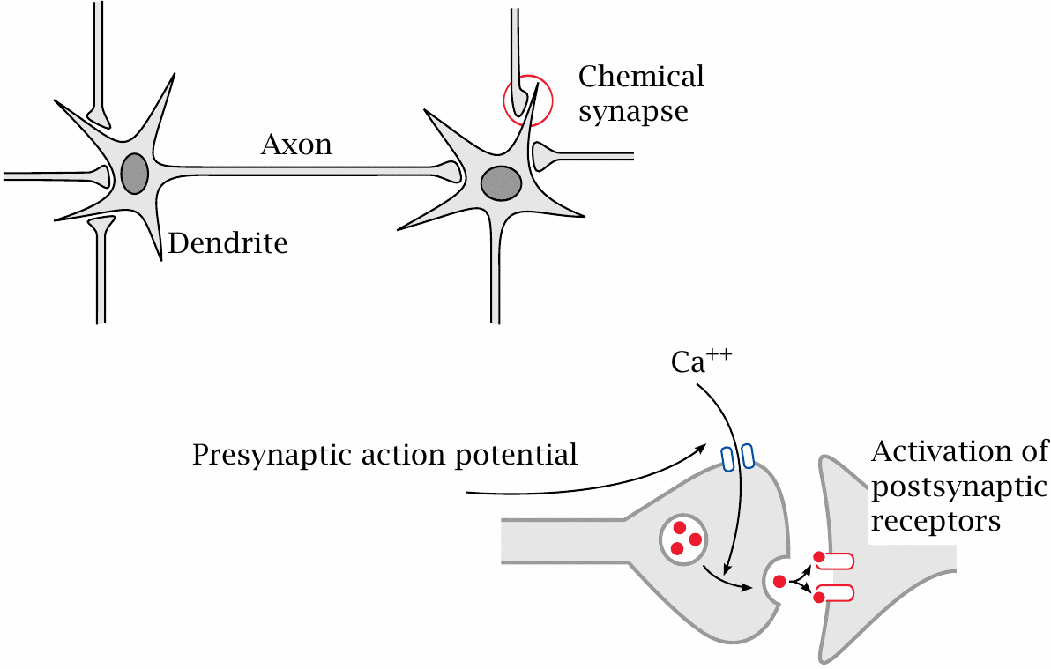
Neurons and synapses

Slide 5
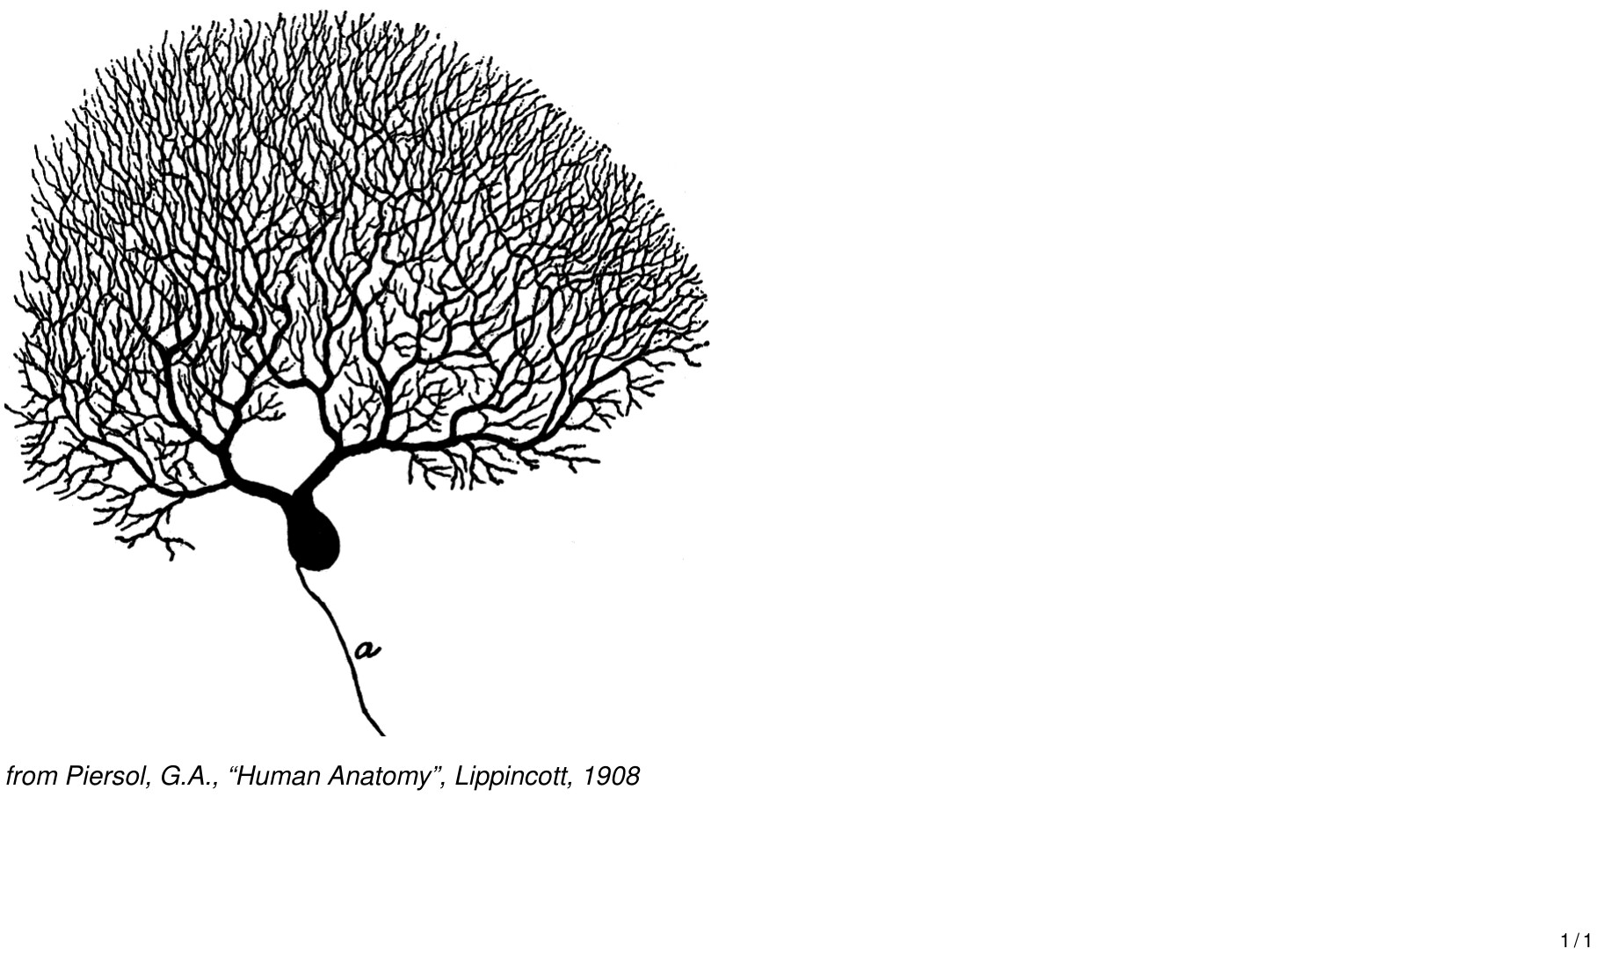
Some nerve cells have huge dendrites and axons

Slide 6
Other types of excitable cells

Slide 7
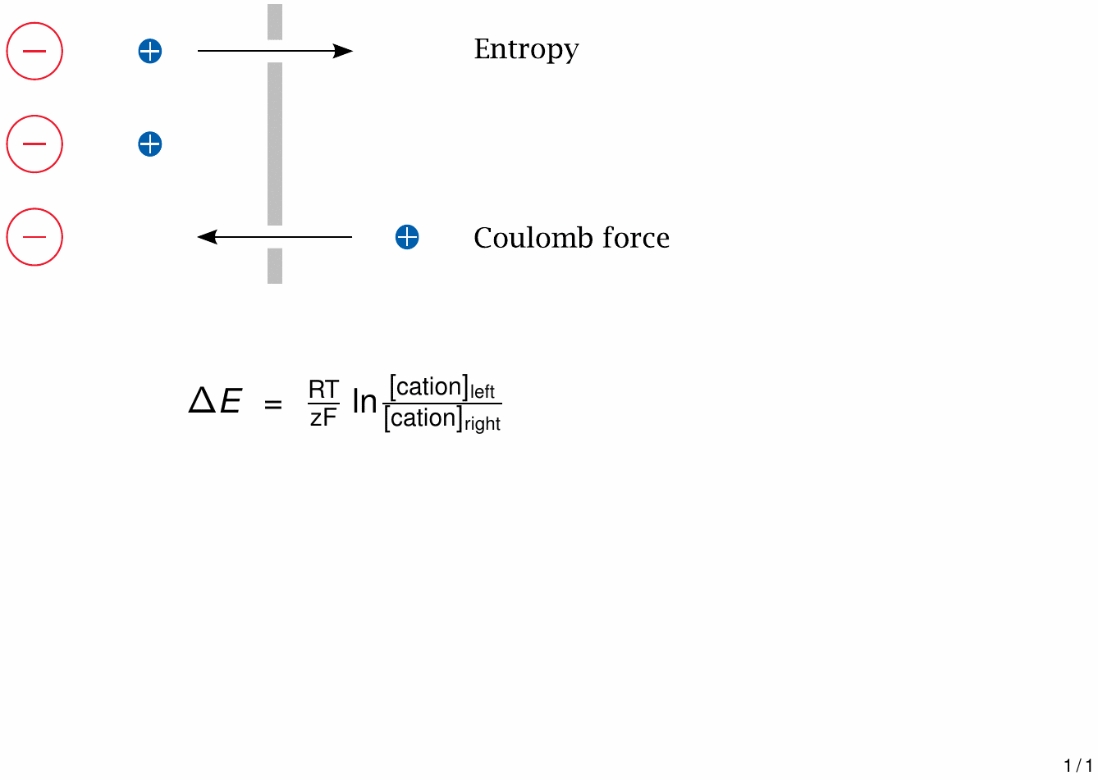
The two driving forces that generate diffusion potentials across membranes

Slide 8
Equilibrium potentials for the major salt ions
Ion | Cytosolic | Extracellular | E₀ at 37∘C
K⁺ | 150 mM | 6 mM | – 86 mV
Na⁺ | 15 mM | 150 mM | + 62 mV
Ca⁺⁺ | 100 nM | 1.2 mM | + 126 mV
Cl⁻ | 9 mM | 150 mM | – 70 mV

Slide 9
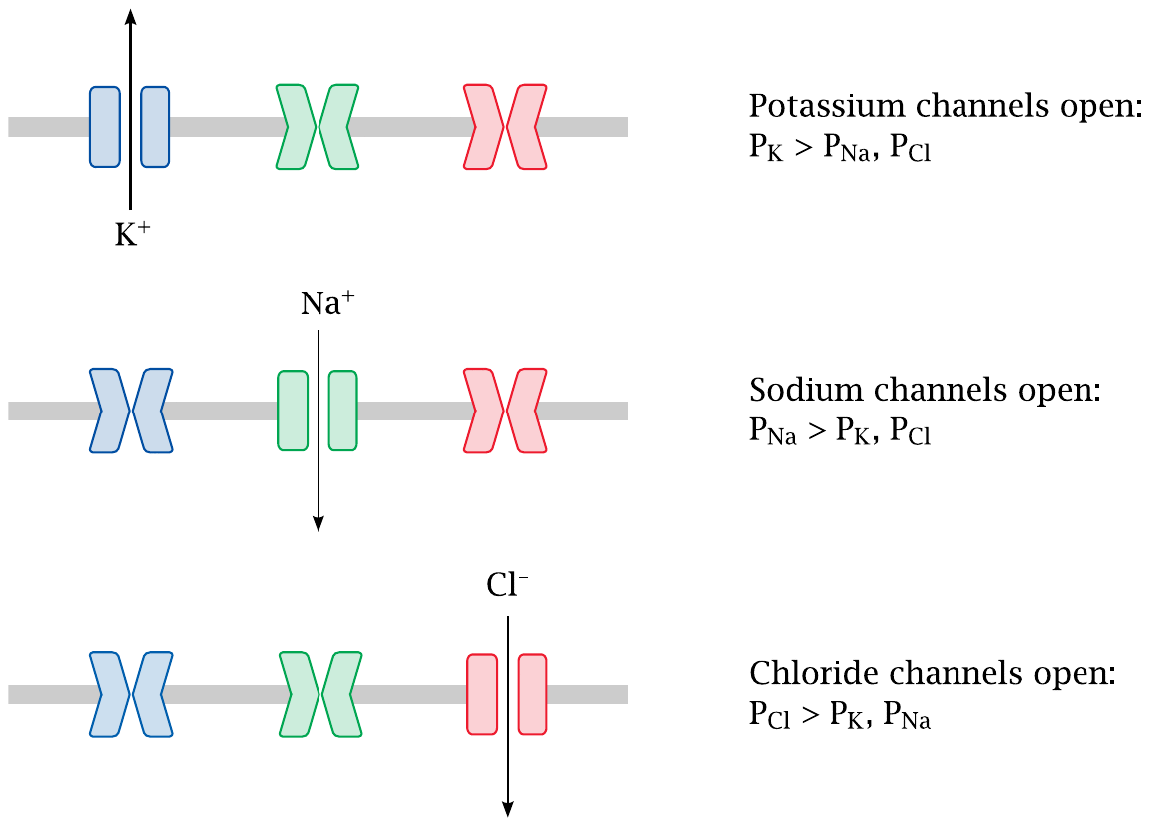
Specific channels control ion permeabilities

Slide 10
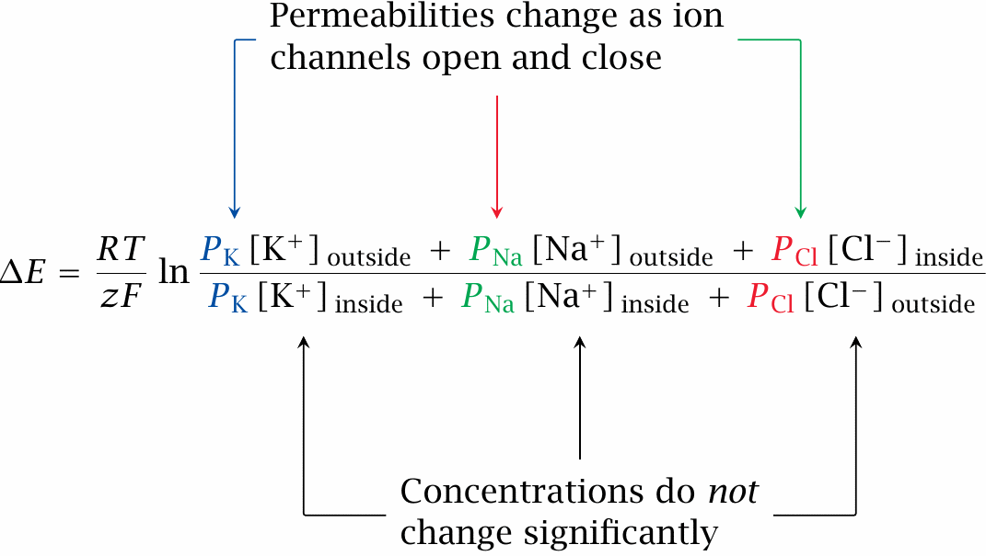
Diffusion potentials with multiple ions: the Goldman equation

Slide 11
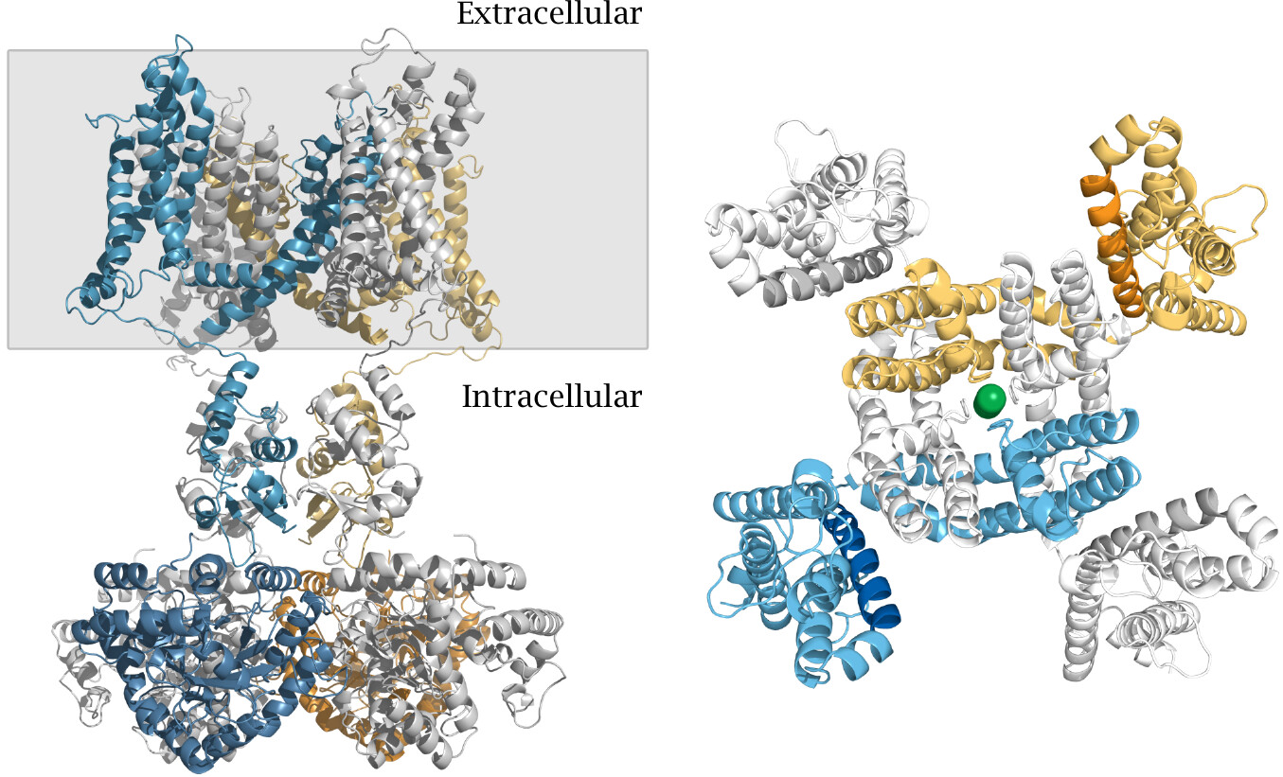
Structure of a voltage-gated K⁺ channel

Slide 12
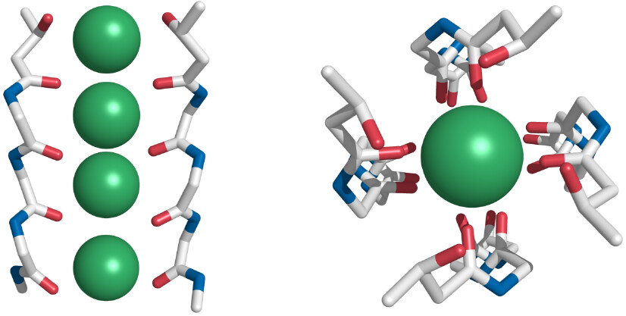
Structure of the K⁺ selectivity filter

Slide 13
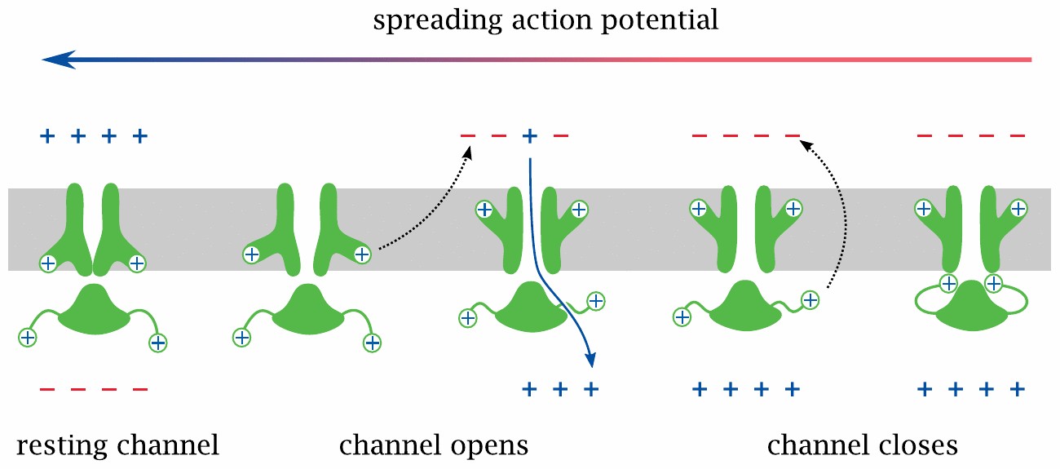
Voltage-gated sodium channels sustain and spread the action potential

Slide 14
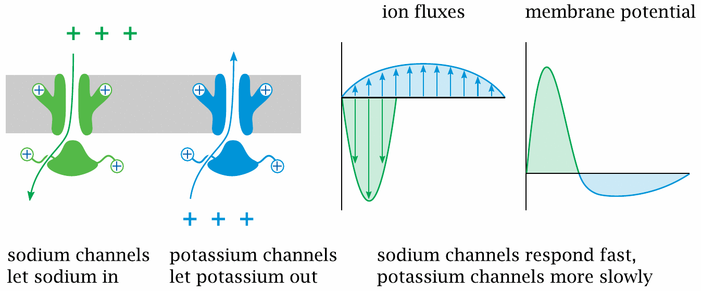
Voltage-gated potassium channels extinguish the action potential

Slide 15
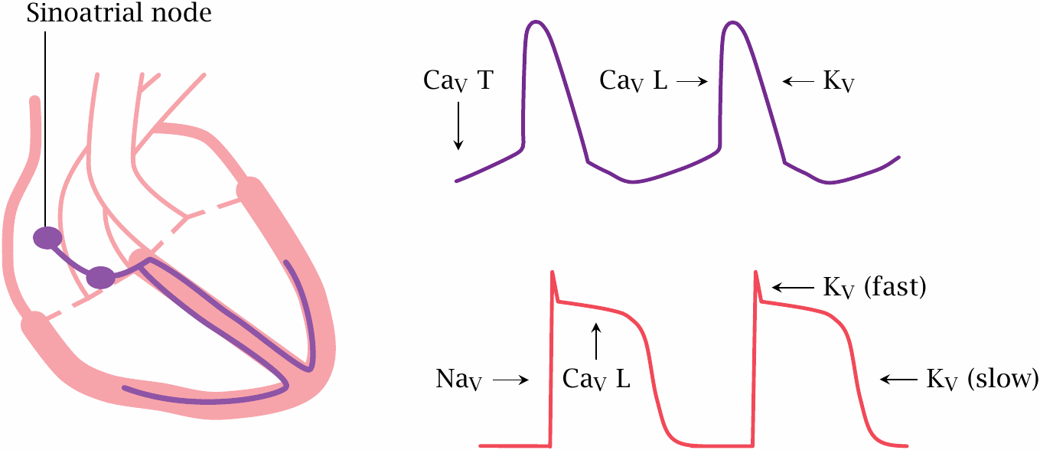
Voltage-gated channels and action potentials in the heart

Slide 16
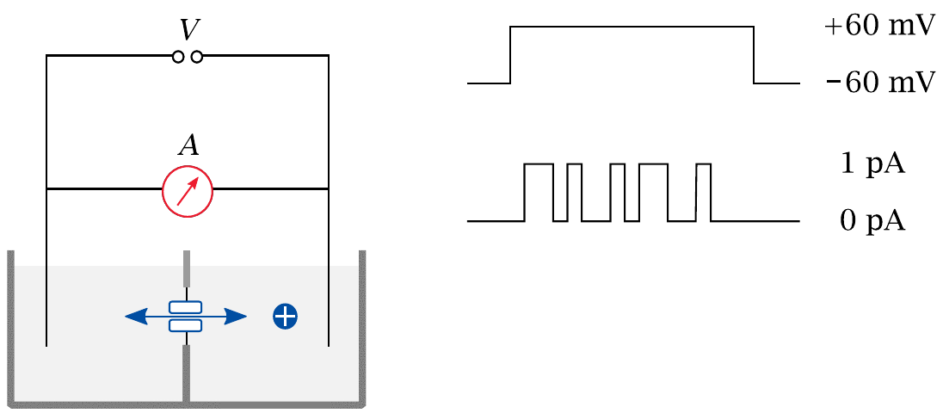
Measuring ion fluxes across single channels using planar lipid bilayers

Slide 17
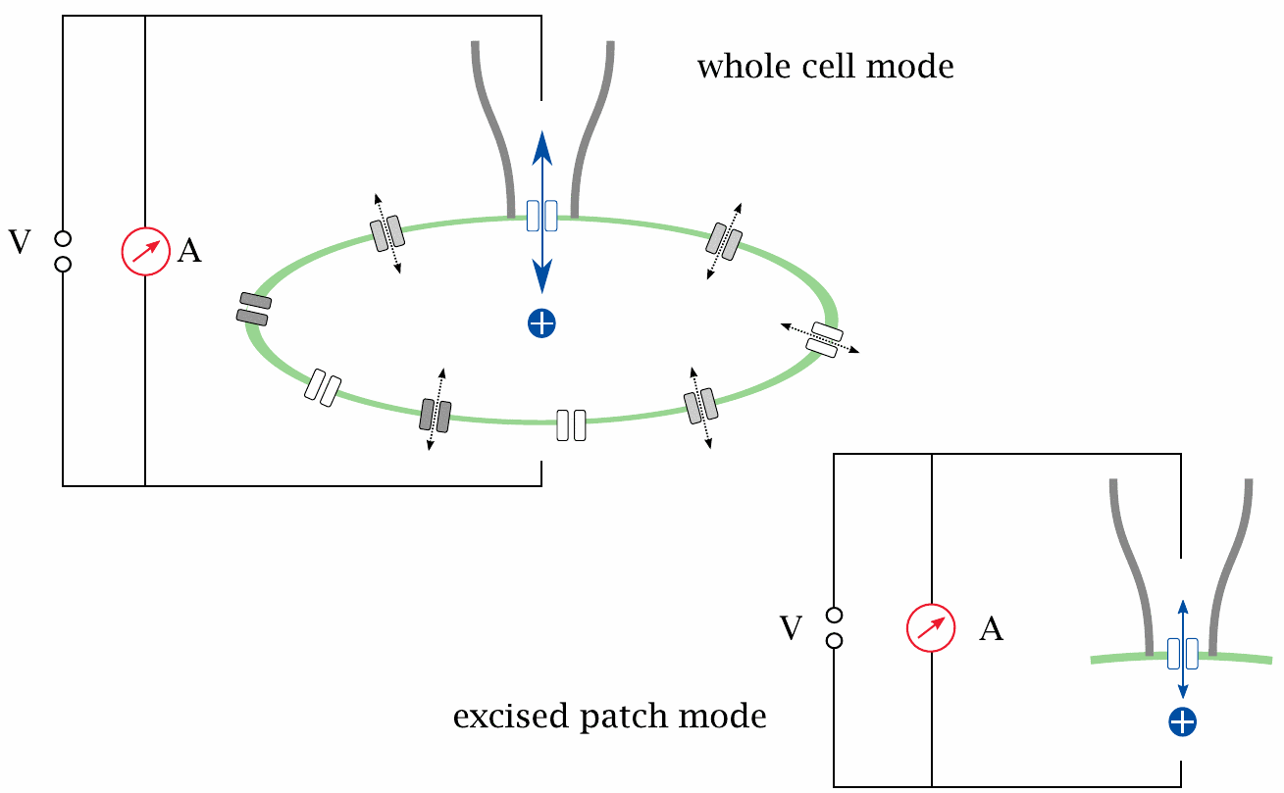
The patch clamp technique

Slide 18
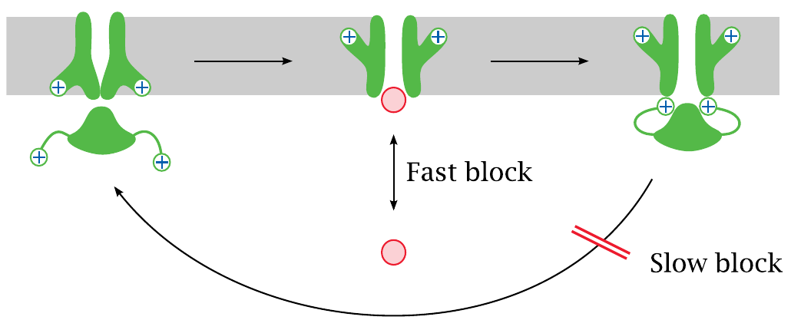
Fast and slow channel block

Slide 19
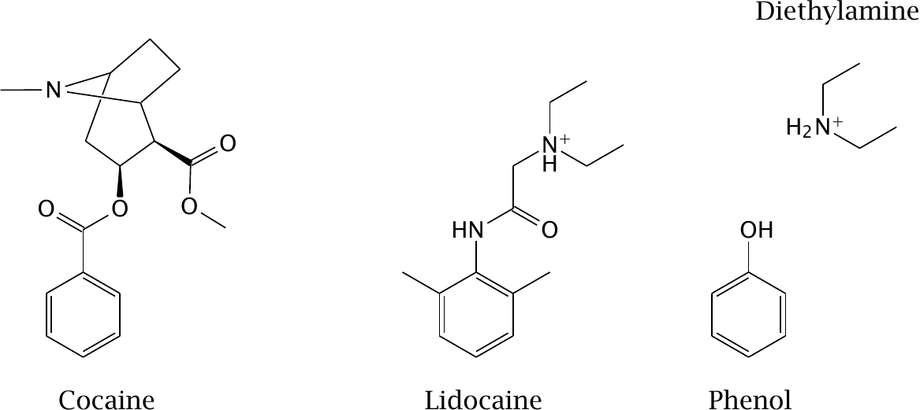
Diethylamine and phenol resemble parts of the lidocaine molecule

Slide 20
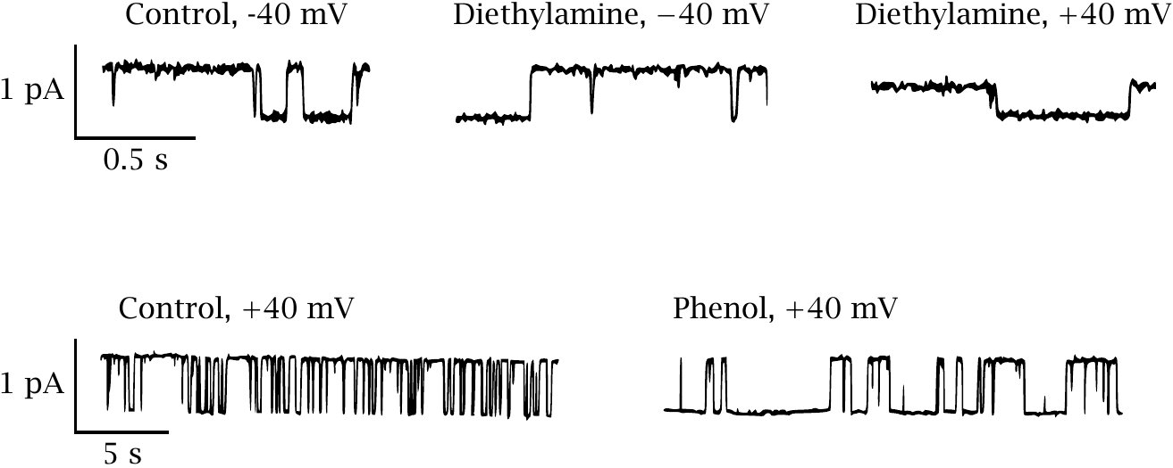
Effects of diethylamine and of phenol on Na_{V} channel conductance

Slide 21
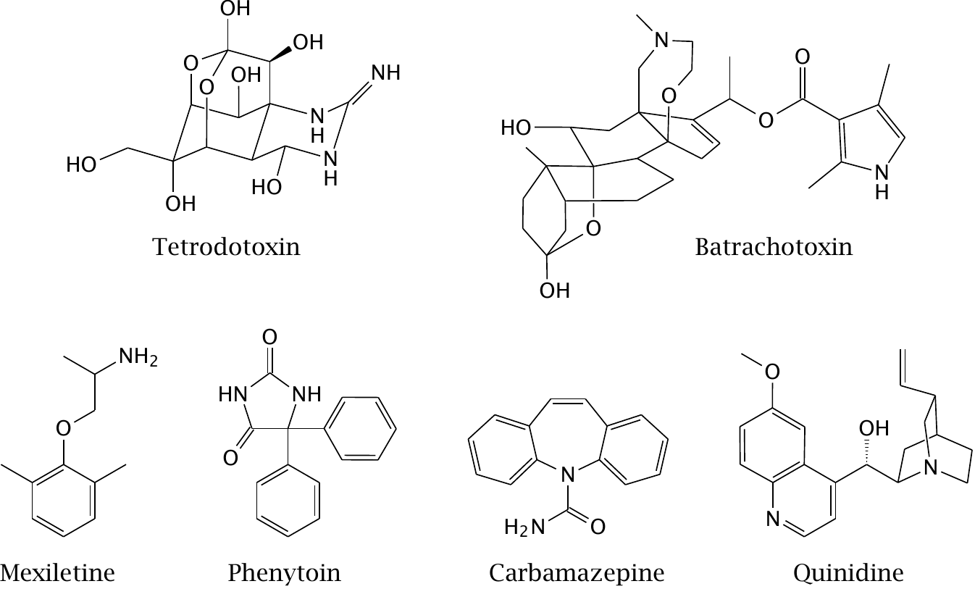
Drugs and poisons that act on Na_{V} channels

Slide 22
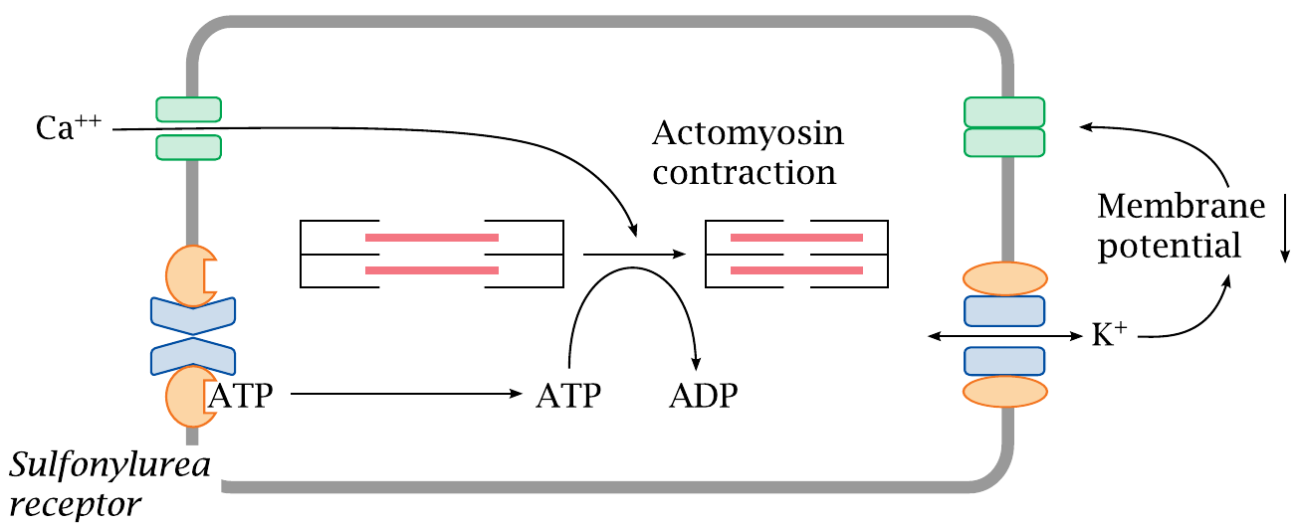
K_{ATP} channels regulate the tone of smooth muscle cells

Slide 23
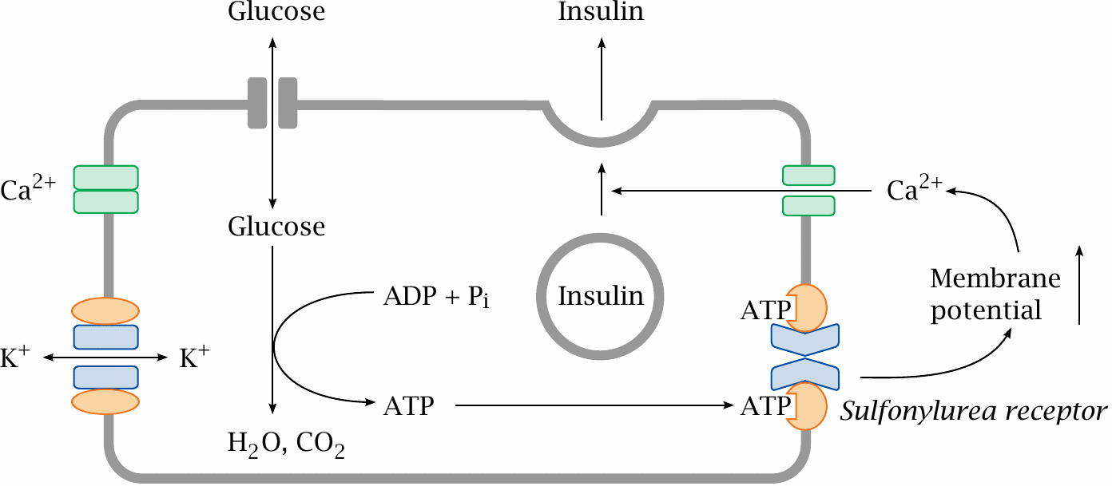
K_{ATP} channels in pancreatic β cells regulate insulin secretion

Slide 24
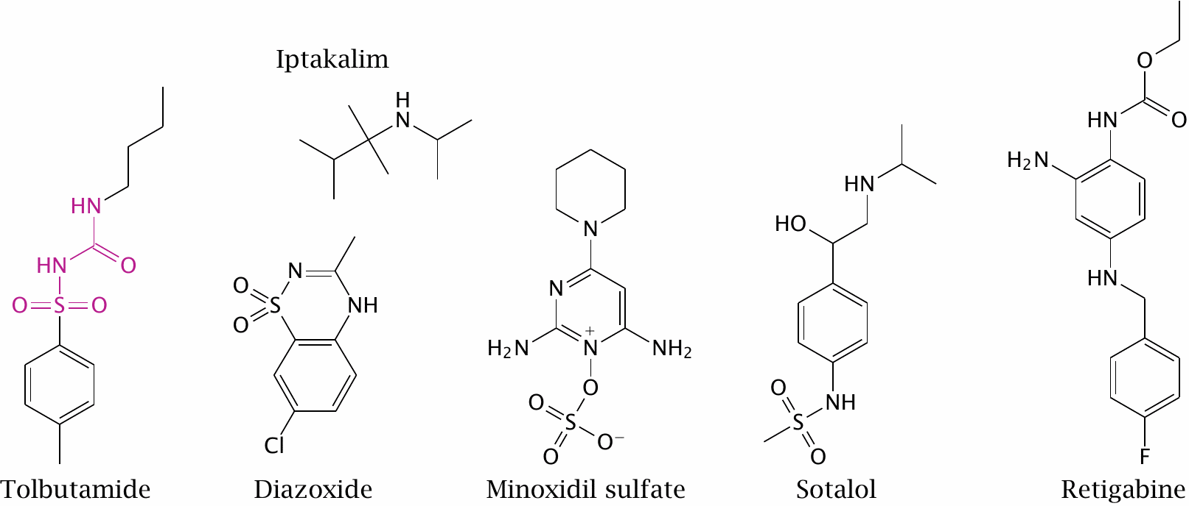
Drugs that act on K⁺ channels

Slide 25
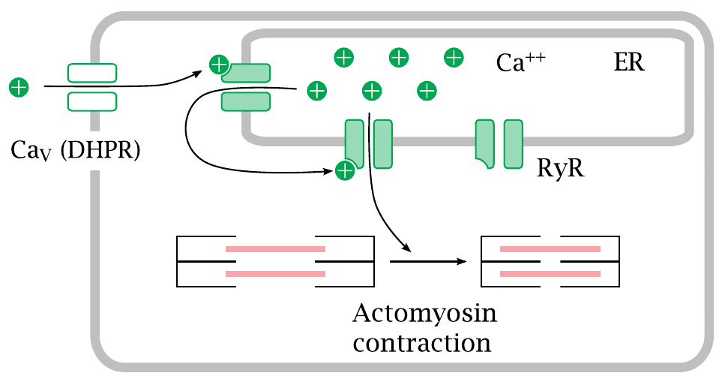
Two calcium channels control the contraction of striated muscle cells

Slide 26
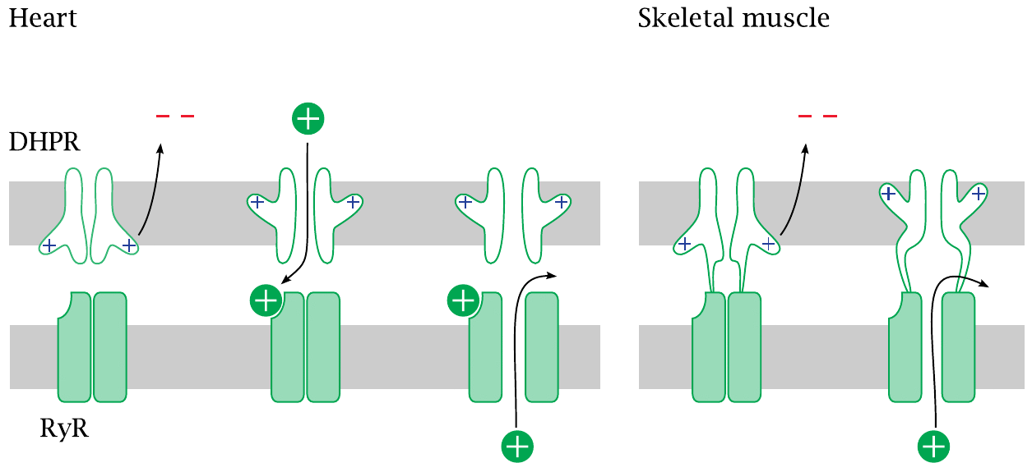
Entry of Ca⁺⁺ through the DHPR is necessary in the heart, but not in skeletal muscle cells

Slide 27
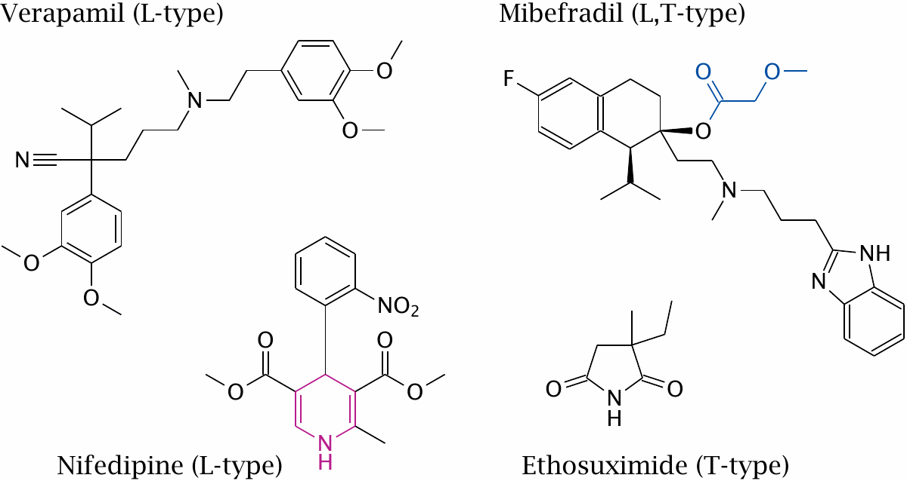
Inhibitors of voltage-gated calcium channels

Slide 28
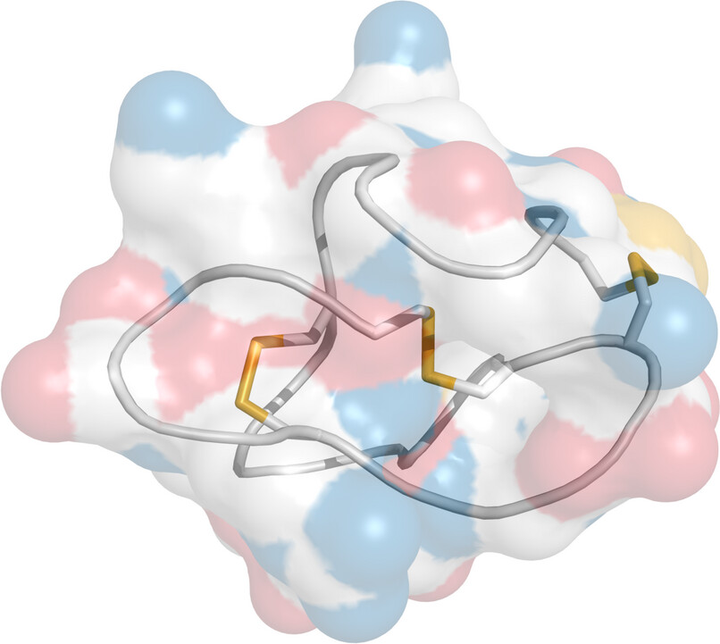
Structure of ω-conotoxin, an inhibitor of N-type Ca_{V} channels

Slide 29
Transient receptor potential channels
activated by physical stimuli such as heat and mechanical tension
conduct multiple cations (in hydrated form)
function in various modes of sensory perception
may be activated by ligands also

Slide 30
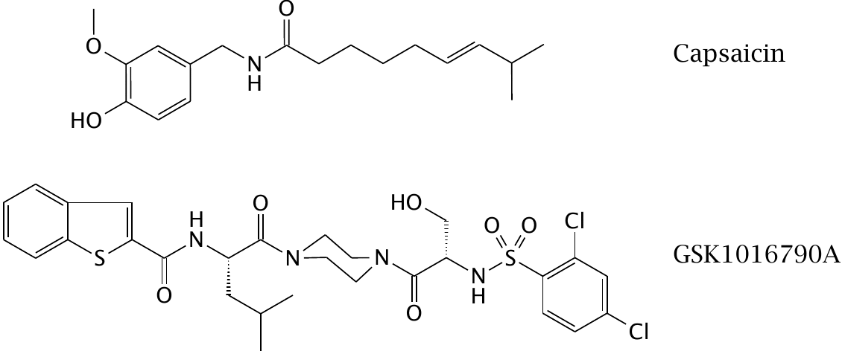
Agonists of transient receptor potential (TRP) channels

Slide 31
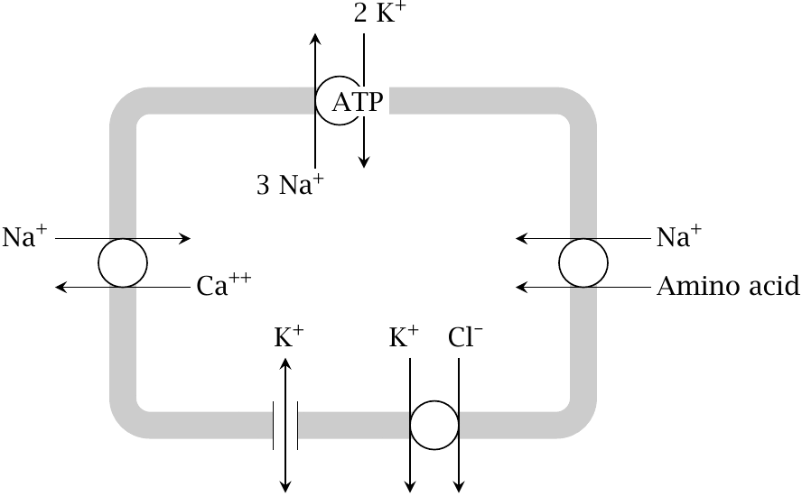
Na⁺/K⁺-ATPase maintains the ion gradients at the plasma membrane

Slide 32
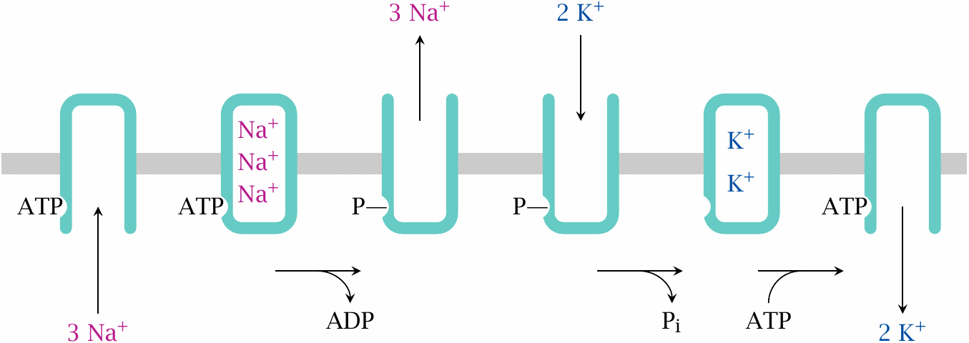
Functional cycle of Na⁺/K⁺-ATPase

Slide 33
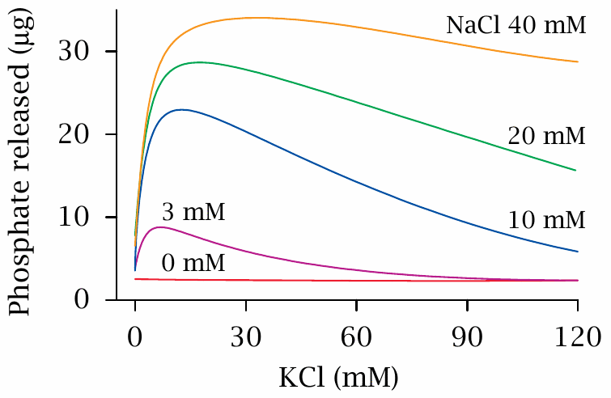
Na⁺/K⁺-ATPase activity as a function of KCl and NaCl concentrations

Slide 34
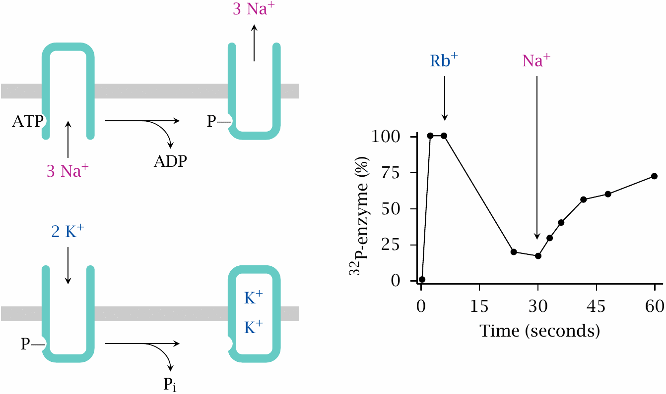
Effects of Rb⁺ and of Na⁺ on the phosphorylation state of Na⁺/K⁺-ATPase

Slide 35
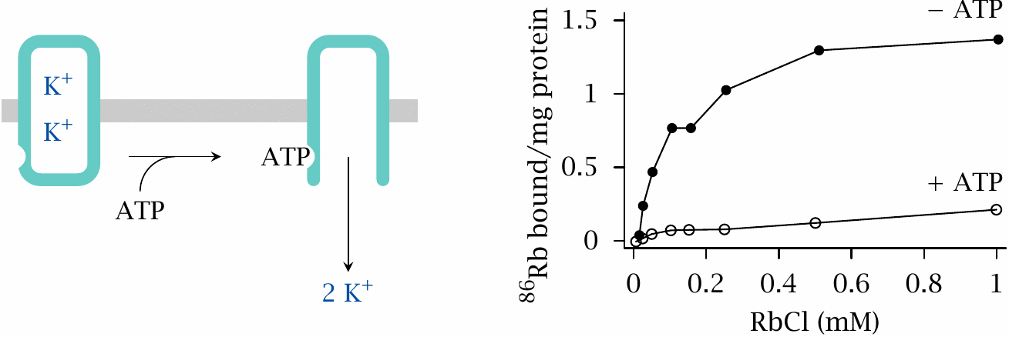
ATP is required to release Rb⁺ from tight binding to Na⁺/K⁺-ATPase

Slide 36
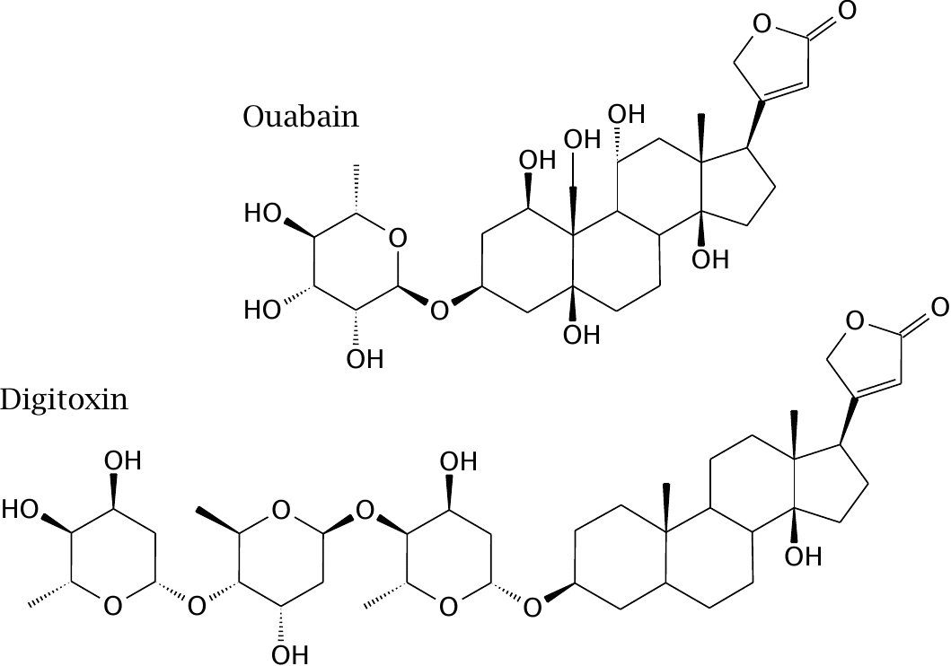
Structures of the Na⁺/K⁺-ATPase inhibitors ouabain and digitoxin

Slide 37
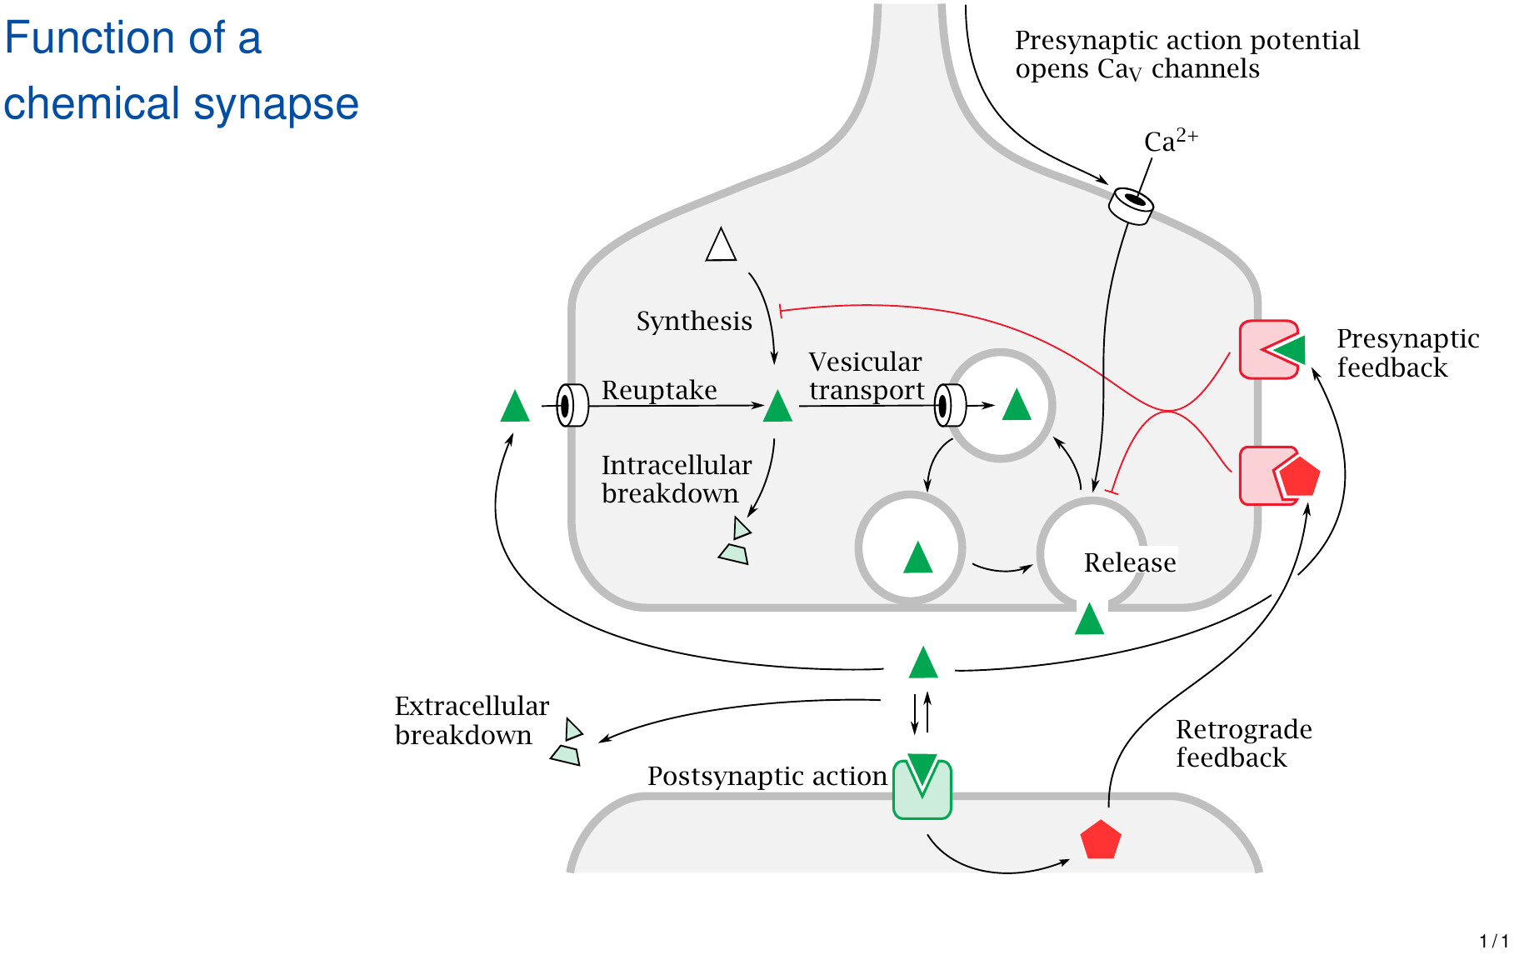

Slide 38
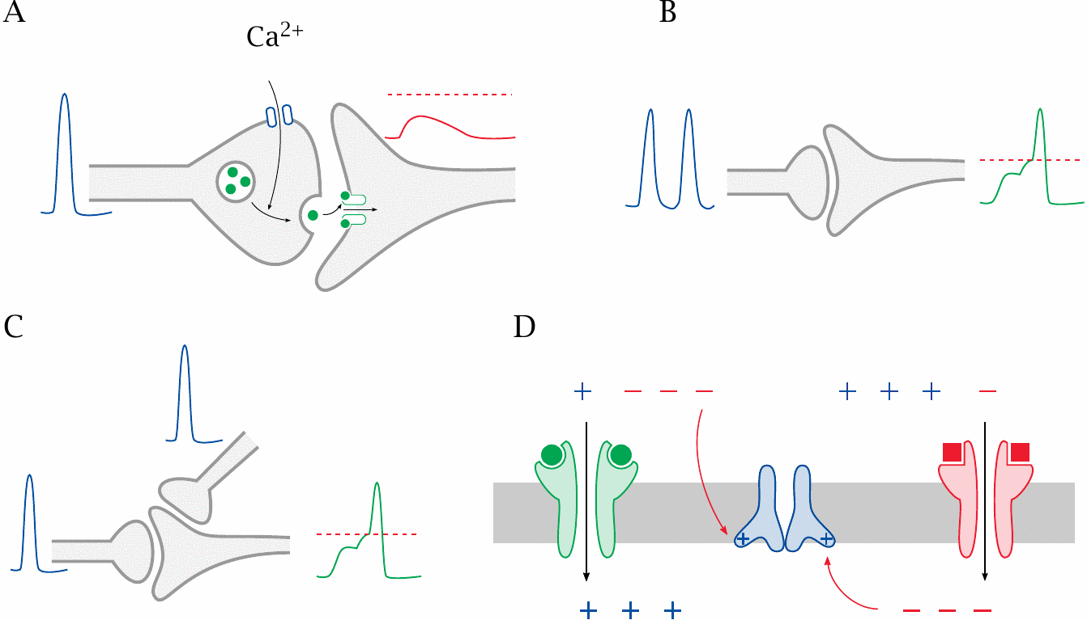
Summation of postsynaptic potentials

Slide 39
Neurotransmitter receptor families
Ligand-gated channels
Cys-loop family
Glutamate receptors
Purine P2X receptors
G protein-coupled receptors

Slide 40
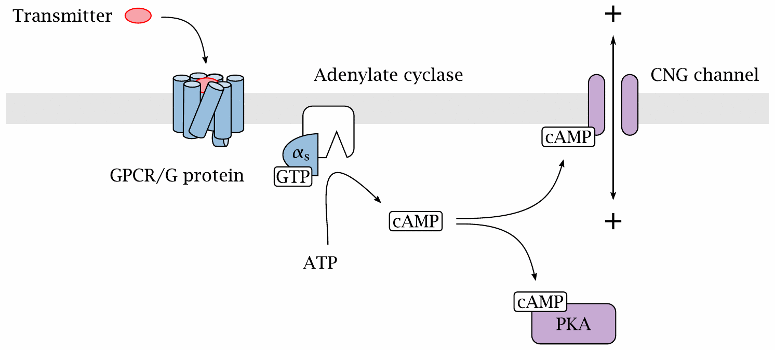
Postsynaptic GPCRs can signal through cyclic nucleotide-gated (CNG) channels

Slide 41
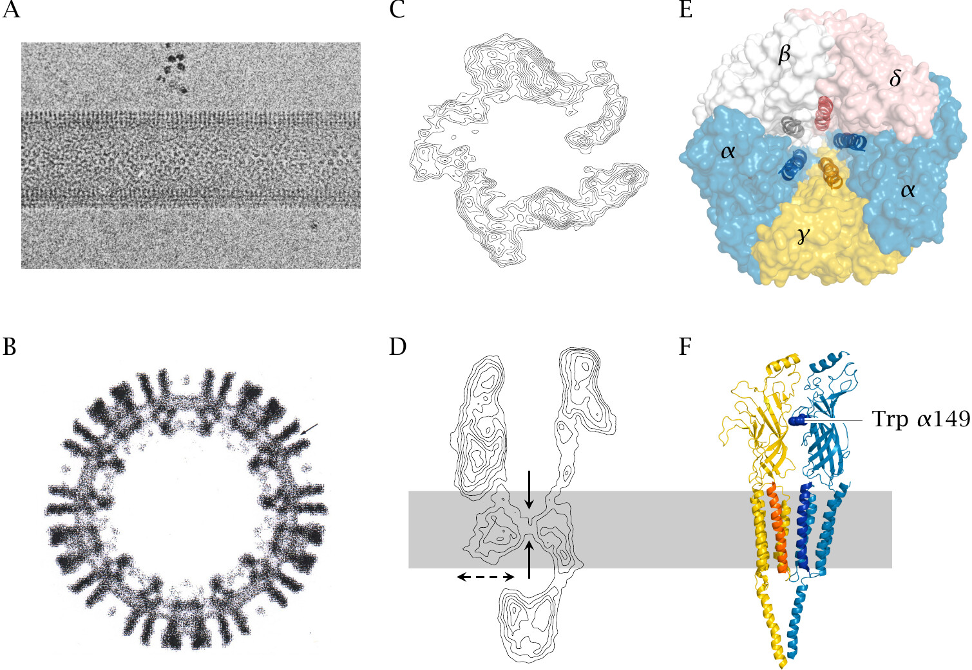
Structure of the nicotinic acetylcholine receptor

Slide 42
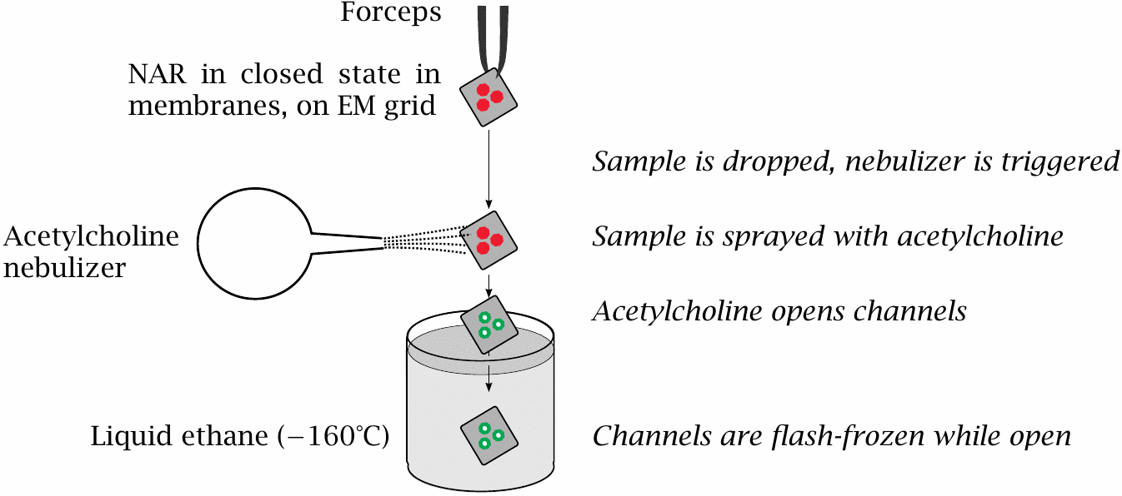
Trapping the nicotinic acetylcholine receptor in the open state

Slide 43
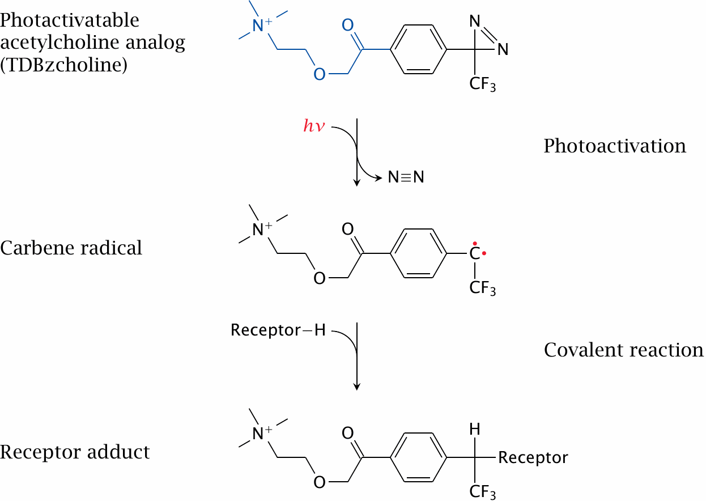
Photoaffinity labeling of the acetylcholine binding site

Slide 44
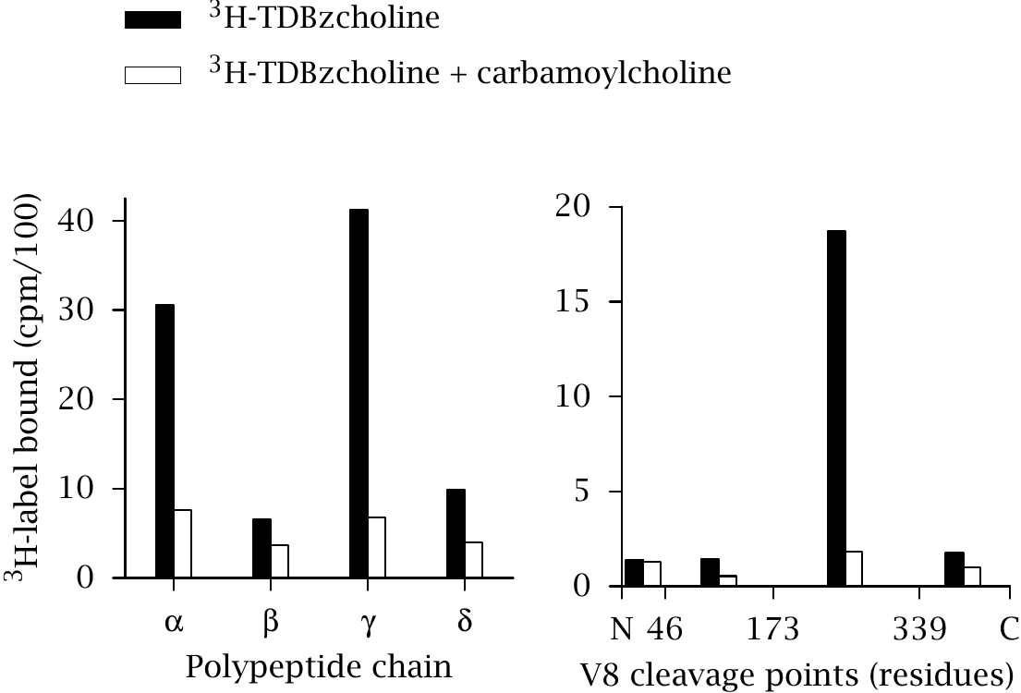
Isolation of affinity-labeled polypeptide chains and fragments

Slide 45
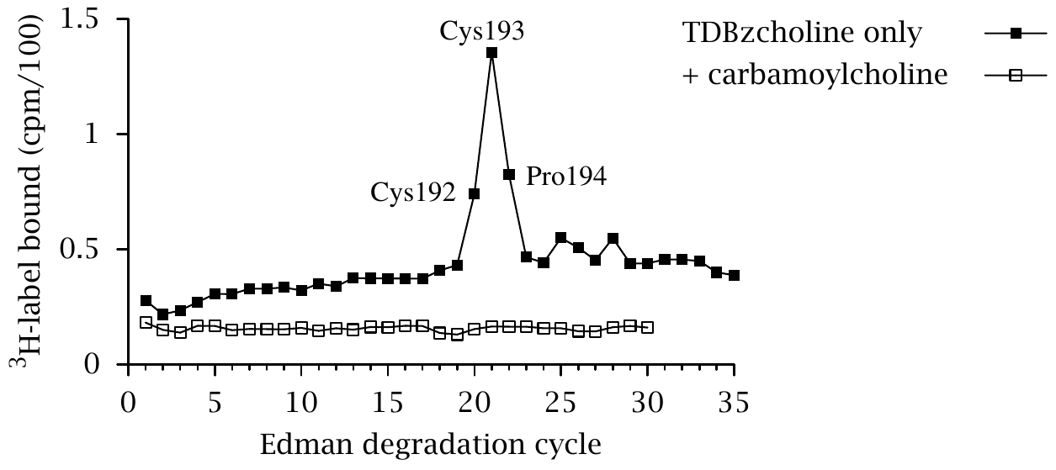
Identification of affinity-labeled amino acid residues

Slide 46
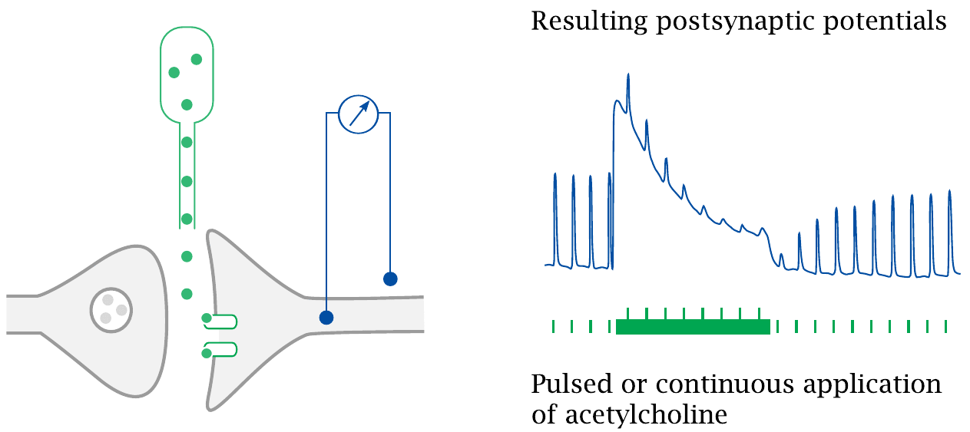
Desensitization of the nicotinic acetylcholine receptor

Slide 47
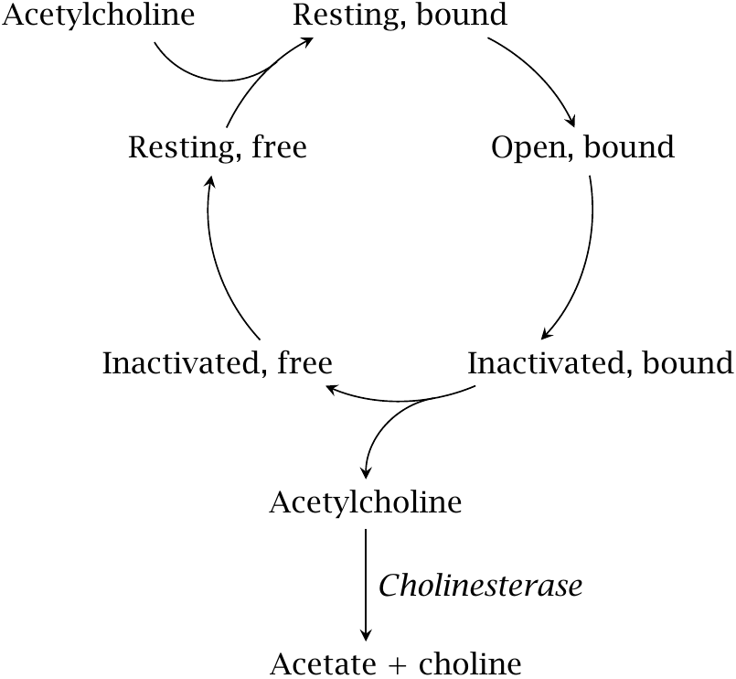
Functional states of the nicotinic acetylcholine receptor

Slide 48
Ionotropic receptors in the cys-loop family
Receptor | Ion selectivity | Effect | Comments
nicotinic acetylcholine | cations | excitatory | pharmacologically distinct subtypes, various applications
5-HT₃ serotonin | cations | excitatory | inhibitors are used to treat emesis
GABA_{A} | chloride | inhibitory | major drug target in narcosis, epilepsy, psychoses
glycine | chloride | inhibitory | regulates motor activity

Slide 49
Drugs that interact with GABA receptors and transporters

Slide 50
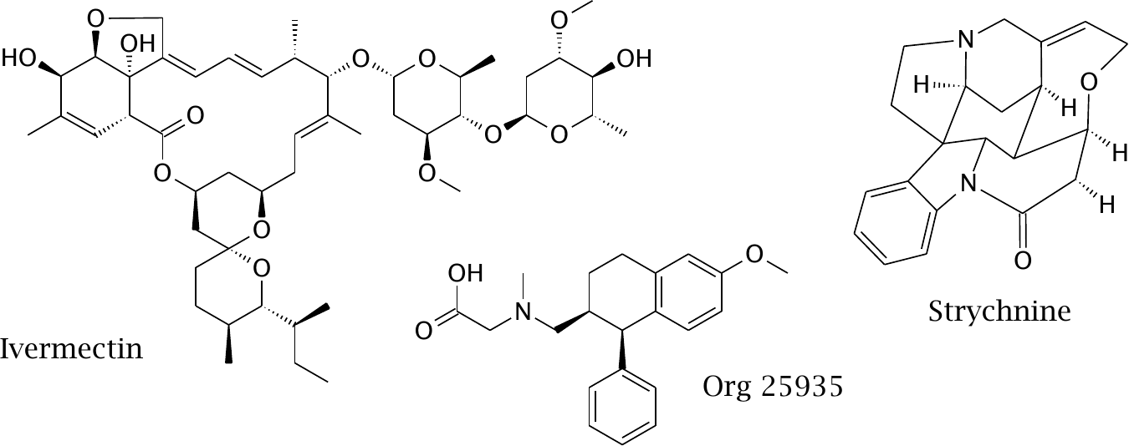
Drugs that interact with glycine receptors and transporters

Slide 51
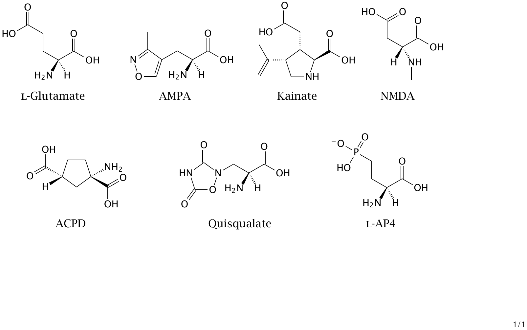
Chemical structures of subtype-selective glutamate receptor ligands

Slide 52
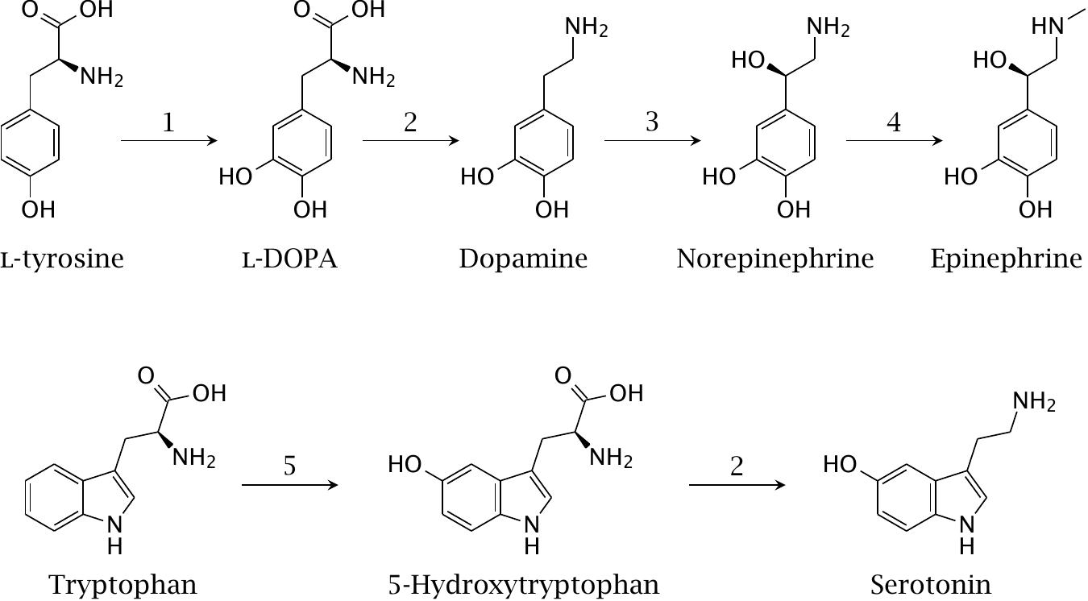
Biosynthesis of the catecholamines and of serotonin

Slide 53
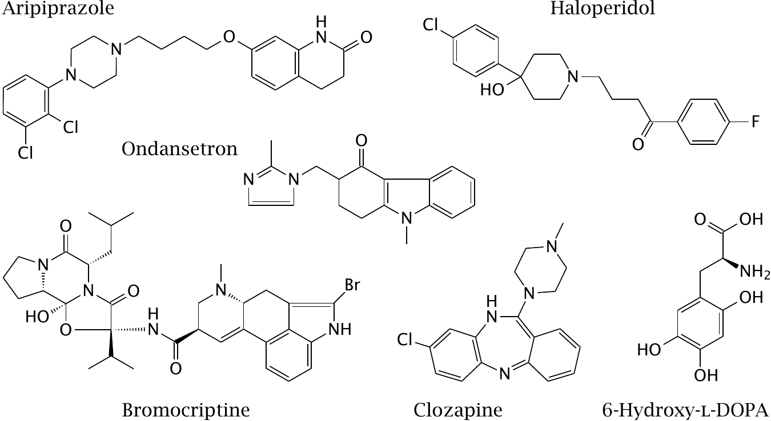
Drugs that interact with dopaminergic and serotoninergic synapses

Slide 54
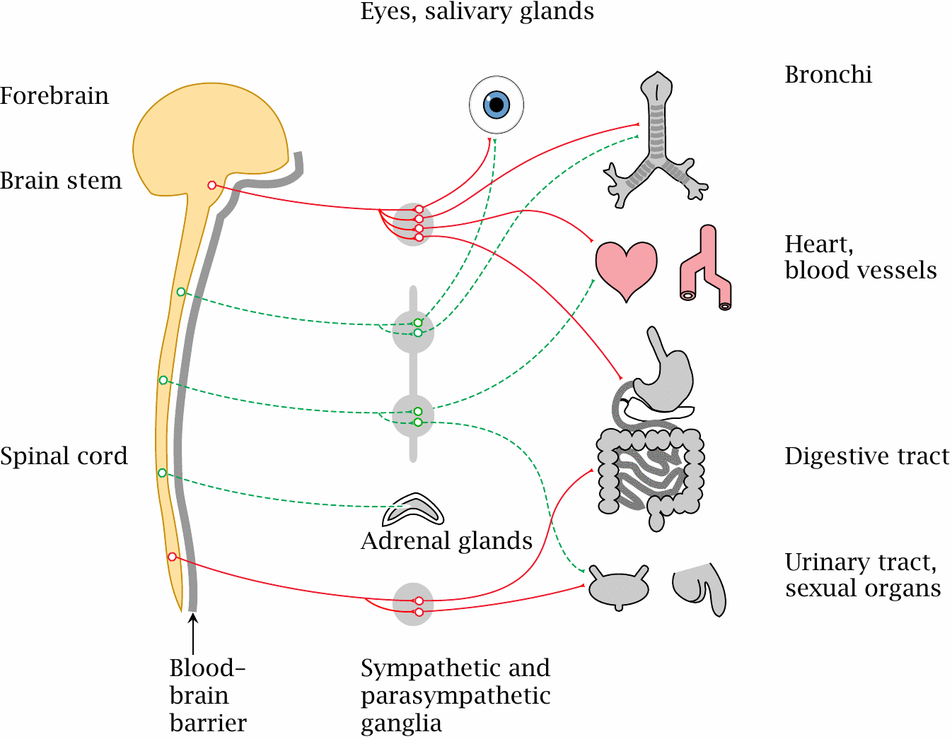
Organization of the autonomic nervous system

Slide 55
Transmitter receptors in the peripheral autonomic nervous system
Subsystem | 1st Synapse | 2nd Synapse
sympathetic | nicotinic | α- or β-adrenergic
parasympathetic | nicotinic | muscarinic

Slide 56
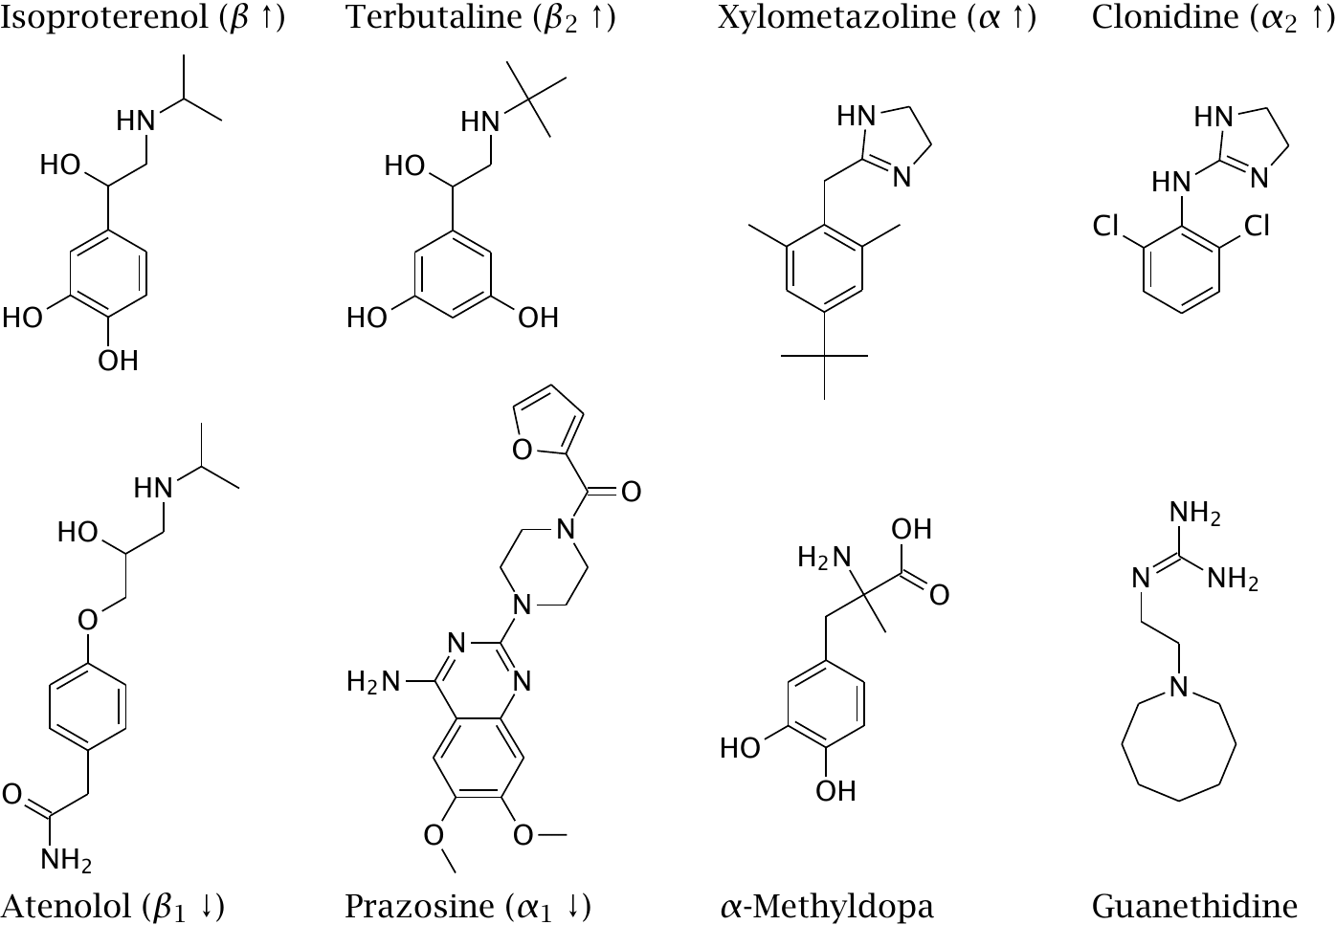
Receptor agonists or antagonists and false transmitters at adrenergic synapses

Slide 57
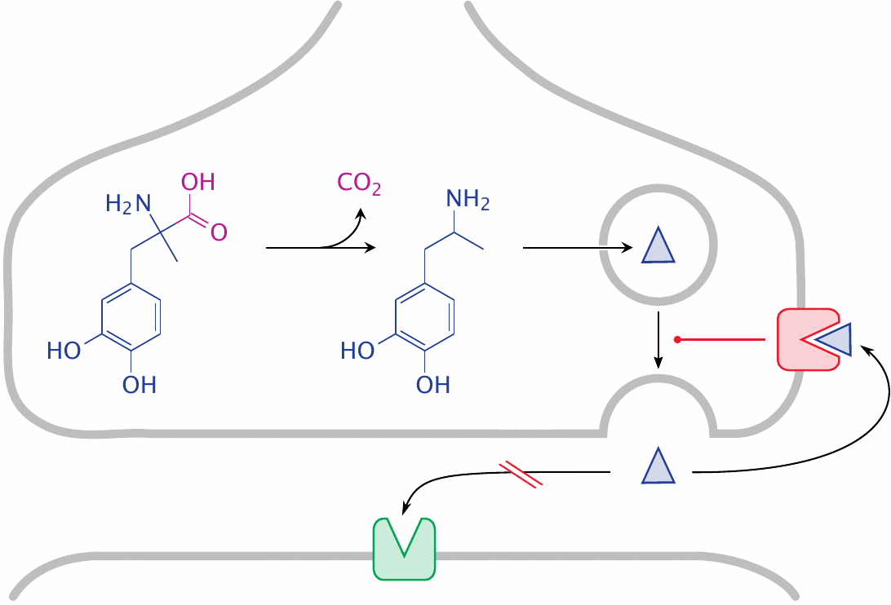
Methyldopa is a false transmitter in noradrenergic synapses

Slide 58
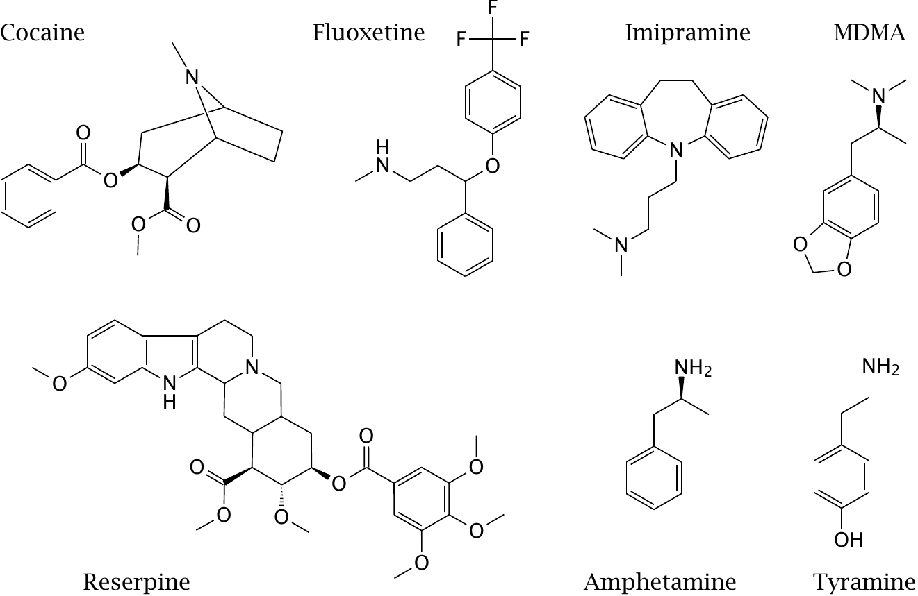
Drugs that act on the membrane transport of monoamine transmitters

Slide 59
Degradation of norepinephrine

Slide 60
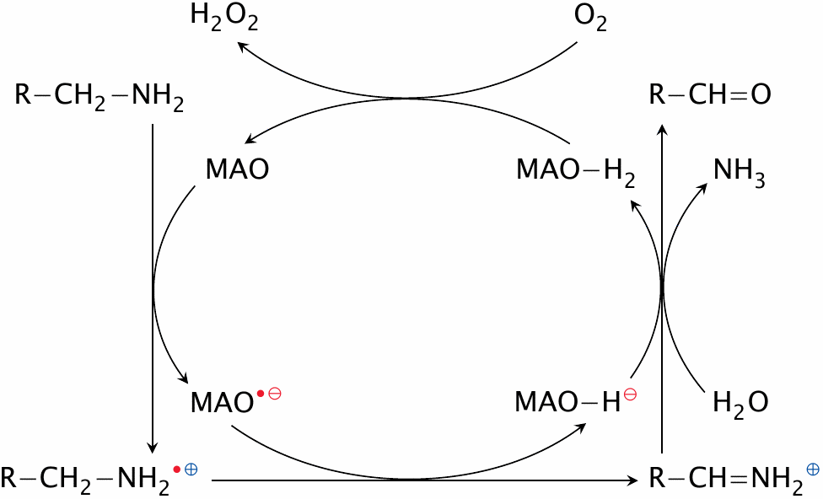
Reaction mechanism of monoamine oxidase (MAO)

Slide 61
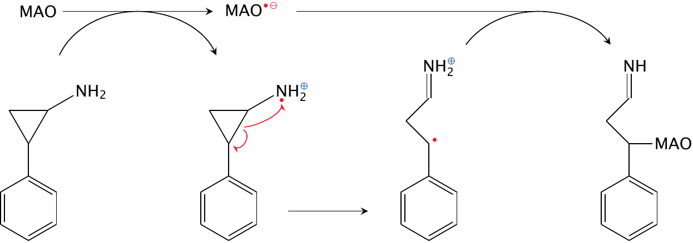
Mechanism-based inhibition of MAO by tranylcypromine

Slide 62
MAO-induced toxicity of MPTP (N-methyl-4-phenyl-tetrahydropyridine)

Slide 63
Structures of cholinergic receptor agonists

Slide 64
Structures of cholinergic receptor antagonists

Slide 65
The catalytic mechanism of cholinesterase

Slide 66
Covalent inactivation of cholinesterase by DFP, and its reactivation by pralidoxime

Slide 67
Structures of cholinesterase inhibitors and of a reactivator

Slide 68
Purine receptor agonists and antagonists

Slide 69
Opioid receptor agonists and antagonists

