Slide 1
G protein-coupled receptors

Slide 2
Drugs that act on G protein-coupled receptors: Some examples
Drug | Major receptor | Drug action | Clinical use
salbutamol | β₂-adrenergic | partial agonist | bronchodilation
fexofenadine | histamine H₁ | inhibitor | antiallergic
atropine | muscarinic | inhibitor | pupil dilation
haloperidol | dopamine | inhibitor | antipsychotic
morphine | opioid | agonist | pain killer
losartan | angiotensin | inhibitor | antihypertensive
clopidogrel | adenosine | inhibitor | anticoagulation

Slide 3
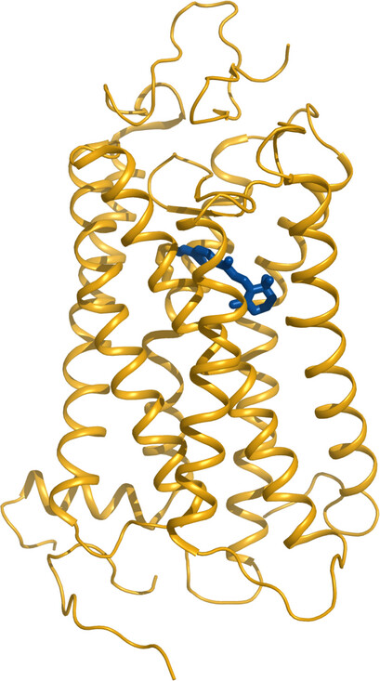
Rhodopsin as a model system of GPCR structure and function

Slide 4
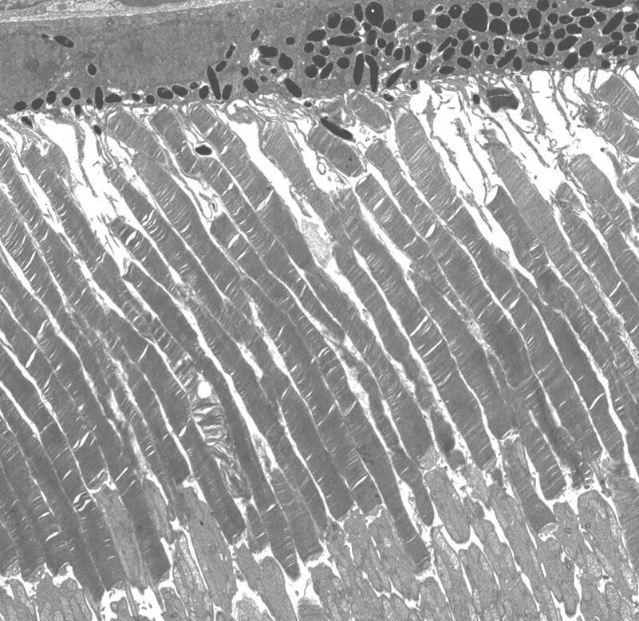
Membrane disks in the outer segments of retinal photoreceptors

Slide 5
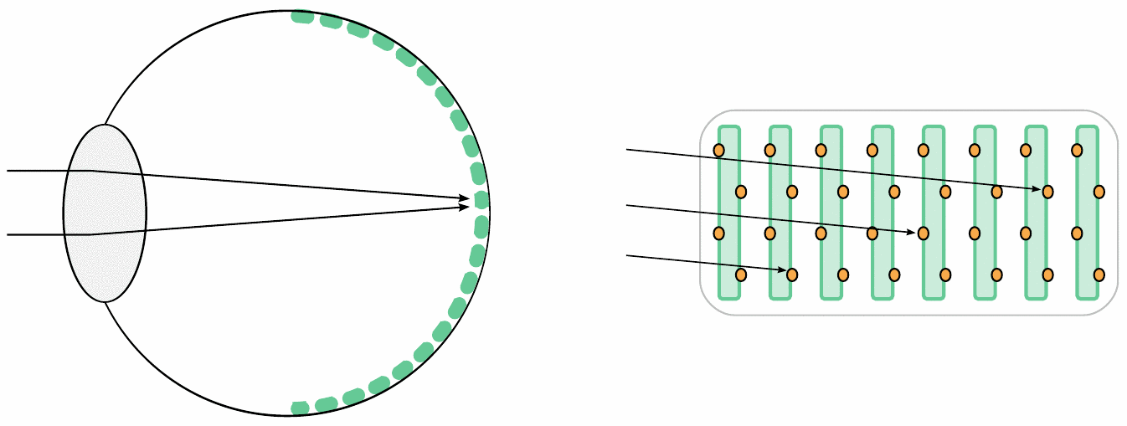
Light harvesting by stacked disks in photoreceptors

Slide 6
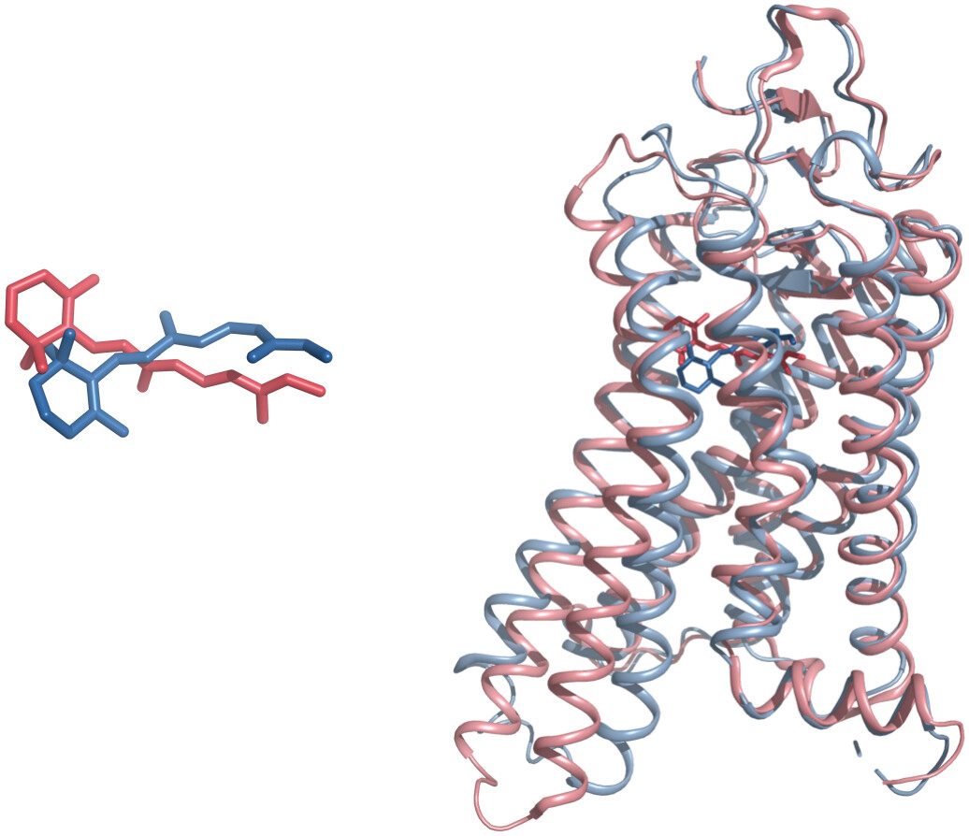
Rhodopsin in the ground state and the activated state

Slide 7
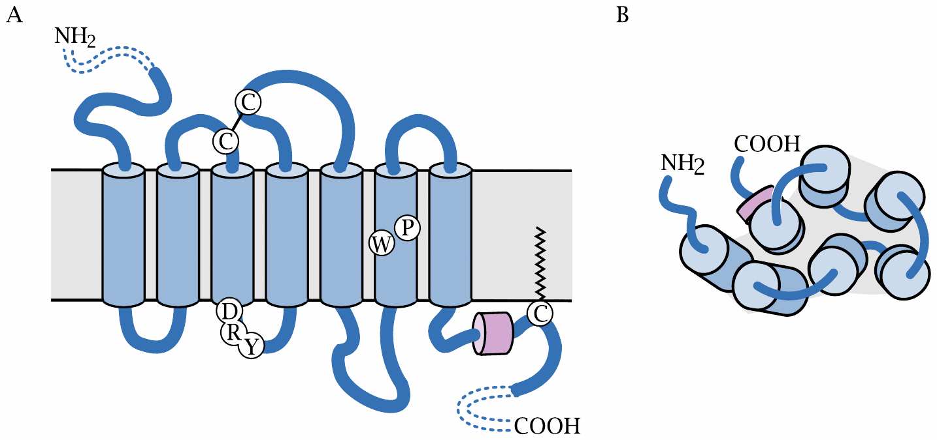
GPCR structure

Slide 8
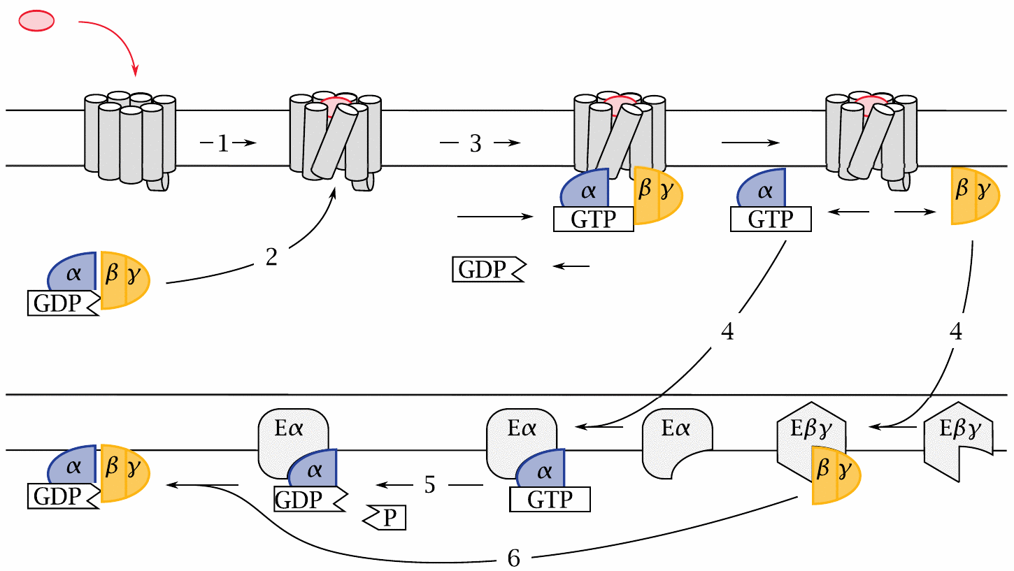
The G protein cycle

Slide 9
The fluorophore in green-fluorescent protein forms autocatalytically

Slide 10
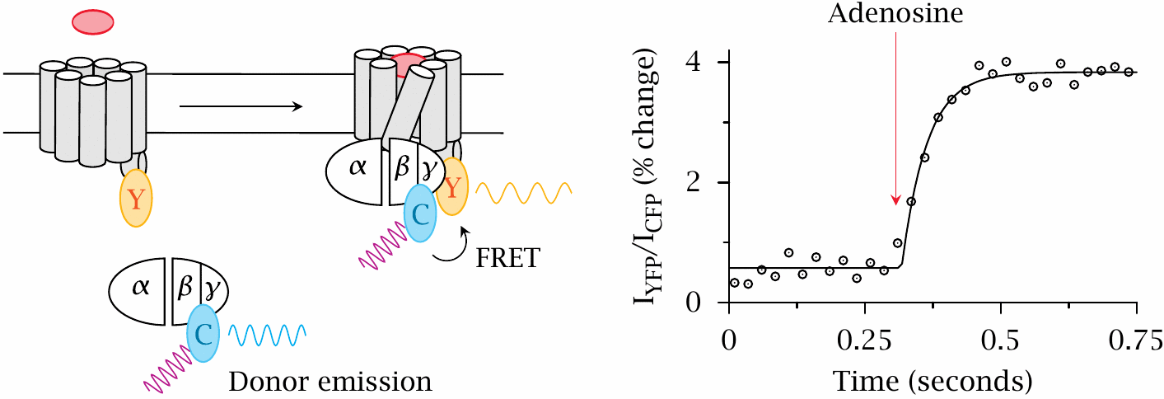
FRET detection of G protein binding to adenosine receptors

Slide 11
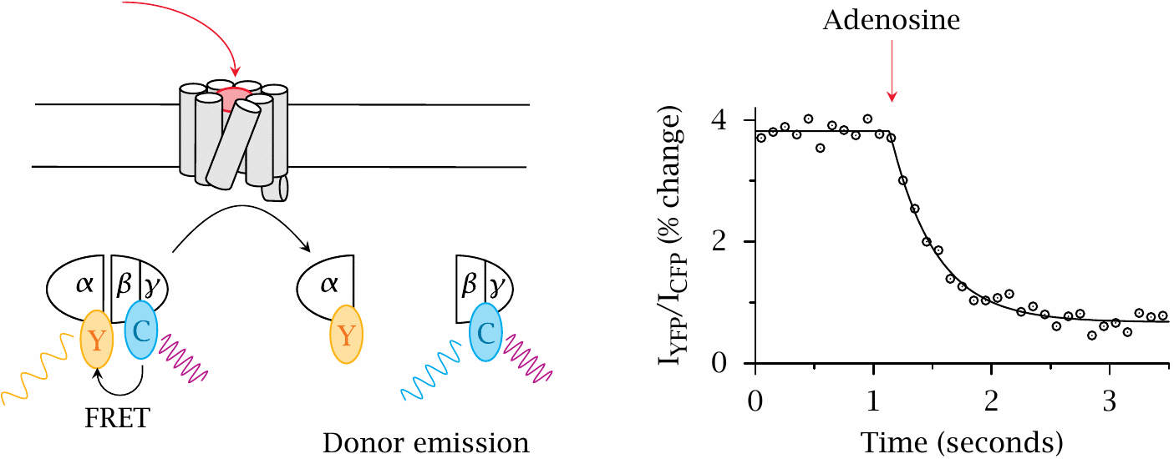
FRET detection of G protein dissociation

Slide 12
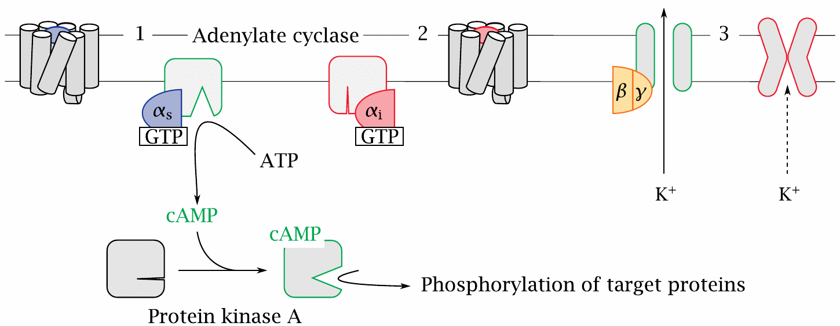
G protein effector mechanisms: adenylate cyclase

Slide 13
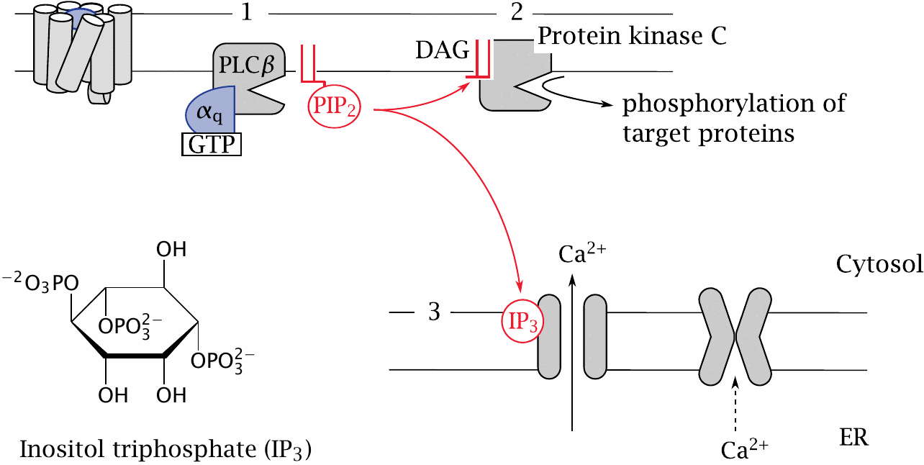
G protein effector mechanisms: the phospholipase C cascade

Slide 14
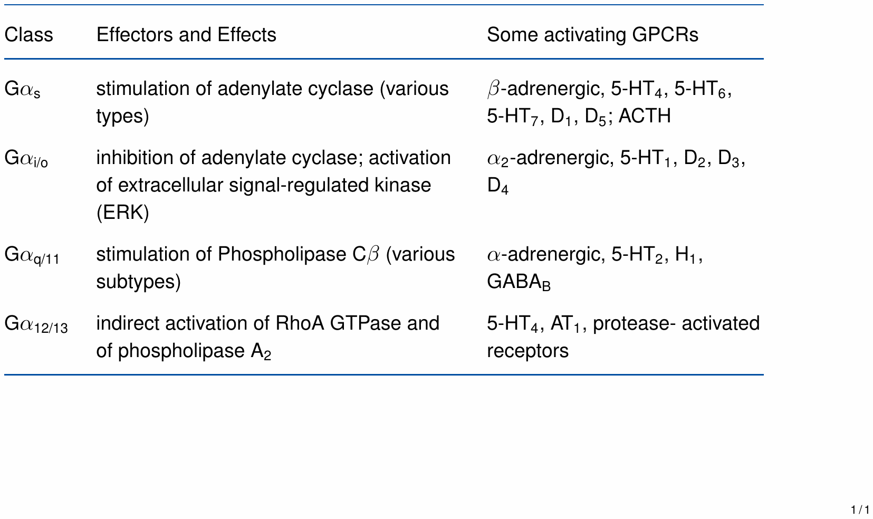
Summary of G protein effector mechanisms

Slide 15
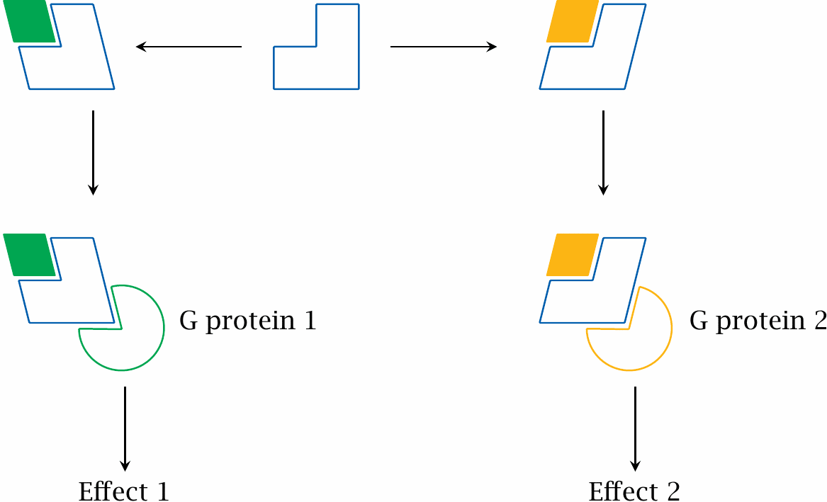
Agonist-specific coupling with GPCRs

Slide 16
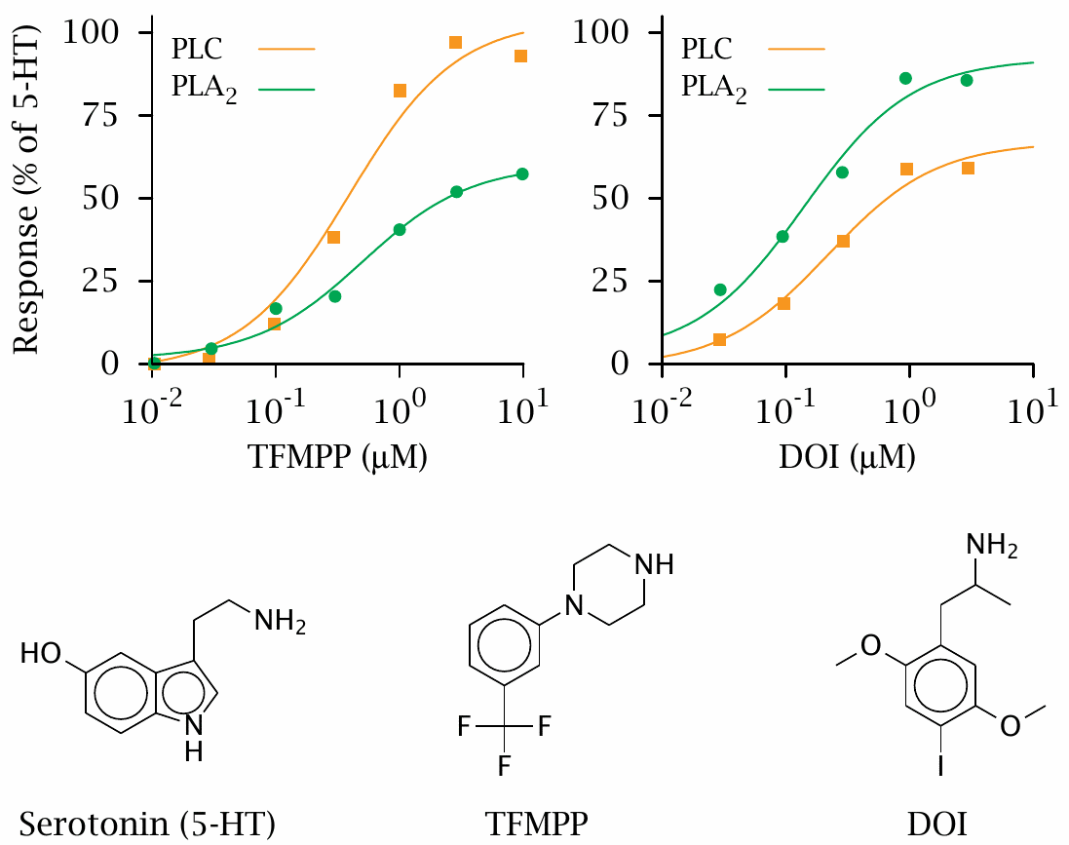
Agonist-specific coupling of 5-HT₂ receptors

Slide 17
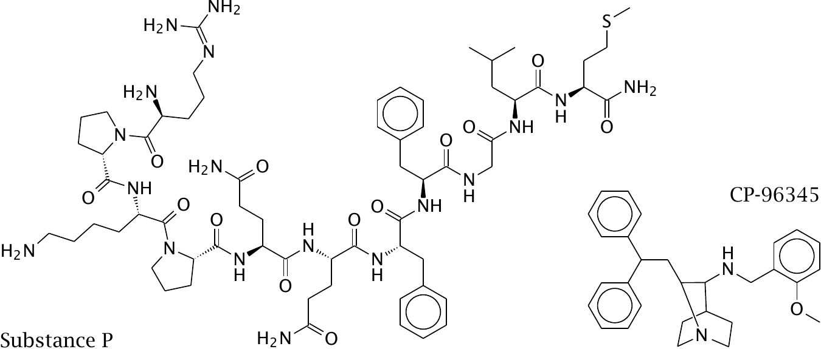
Substance P and its competitive antagonist CP-96345

Slide 18
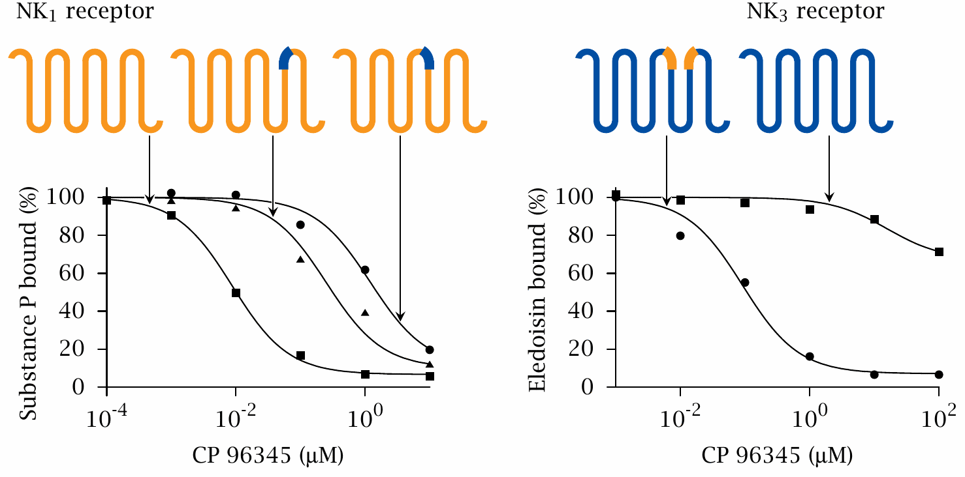
Using receptor chimeras to locate the ligand binding sites of NK receptors

Slide 19
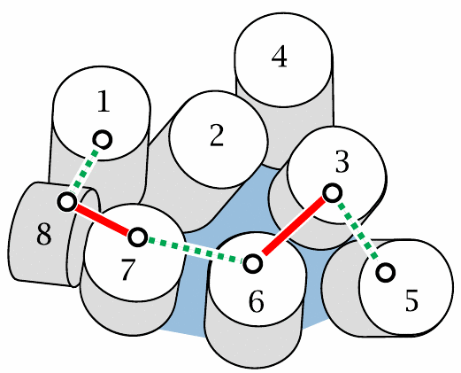
Engineered disulfide bonds pinpoint helix movements involved in GPCR function

Slide 20
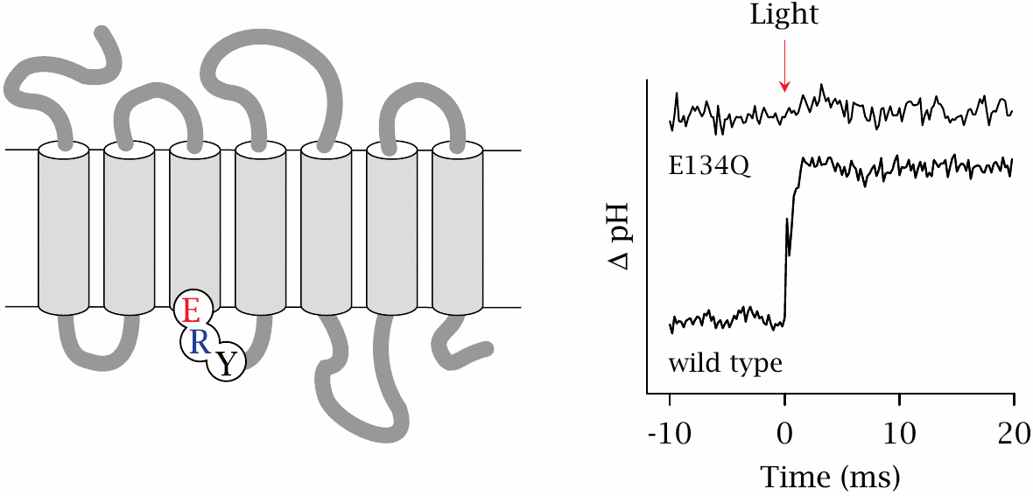
Protonation of residue E134 of rhodopsin in response to light stimulation

Slide 21
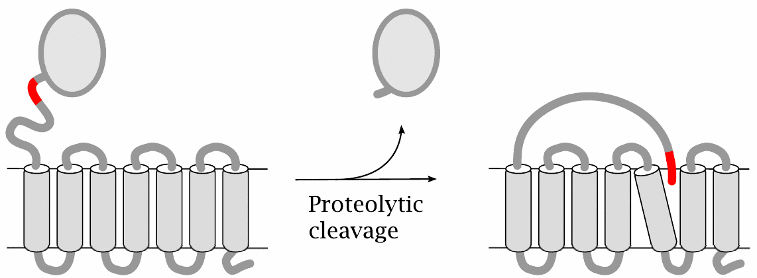
Protease-activated GPCRs

Slide 22
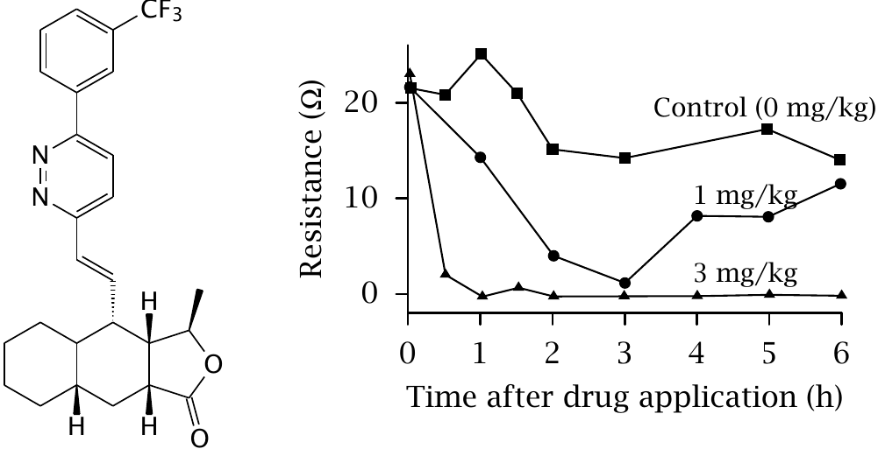
Pharmacological inhibition of protease-activated receptors

Slide 23
GPCR oligomerization
Oligomers can comprise identical or different subunits
Potential for cooperativity
Potential for novel ligand specificity
When receptors for antagonistic mediators form heterodimers, these mediators can “duke it out” already at the cell surface, reducing noise inside the cell

Slide 24
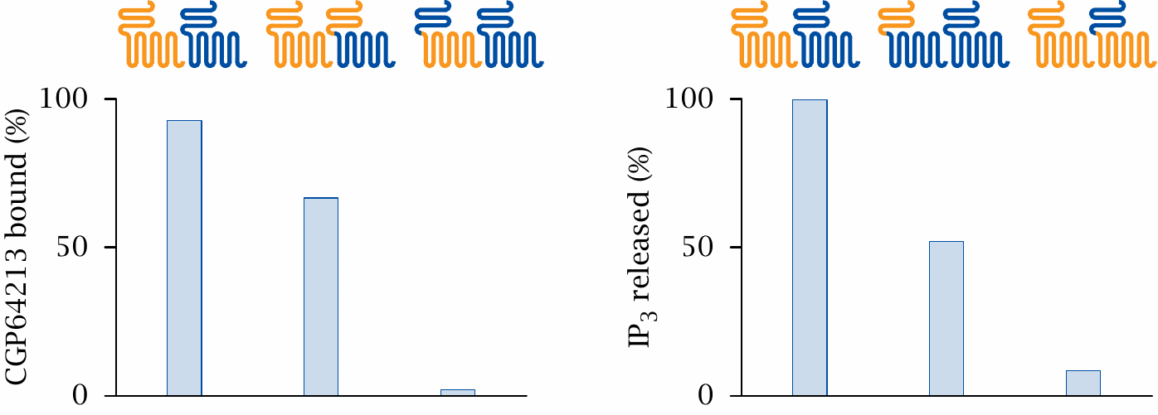
Functional specialization in GABA_{B} receptor heterodimers

Slide 25
Bivalent agonists of muscarinic acetylcholine receptors

Slide 26
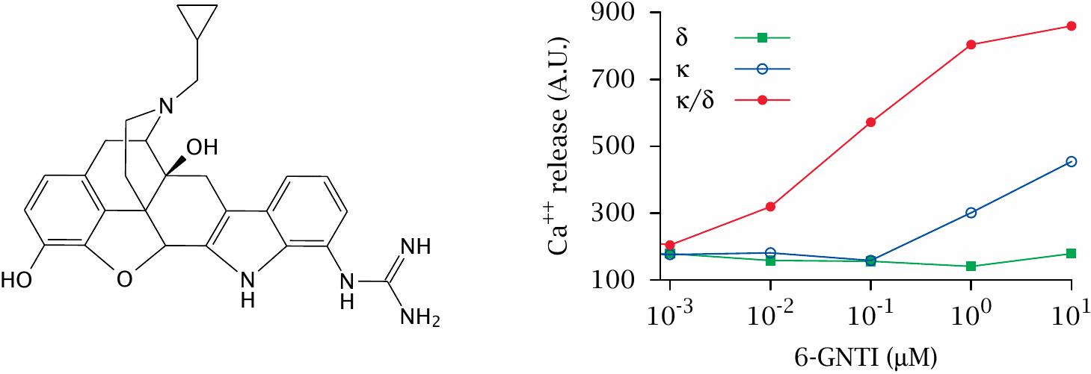
Novel receptor specificity: selective activation of κδ opioid receptor hetero-oligomers by a monovalent ligand

Slide 27
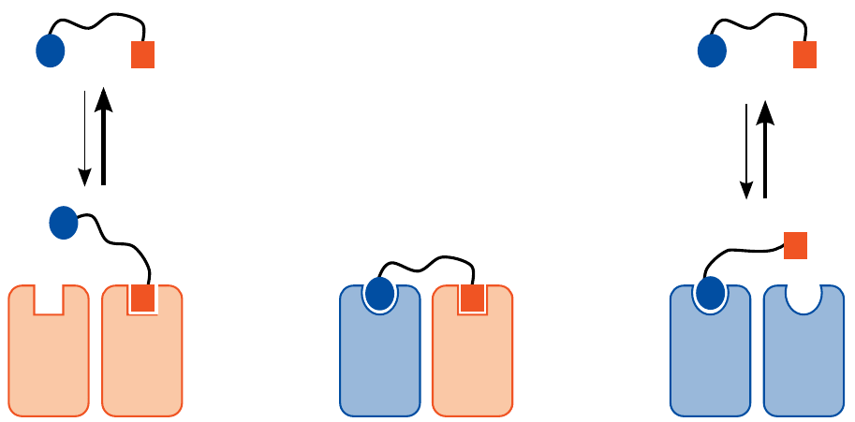
Could receptor heterodimers be targeted with heterodimeric drugs?

Slide 28
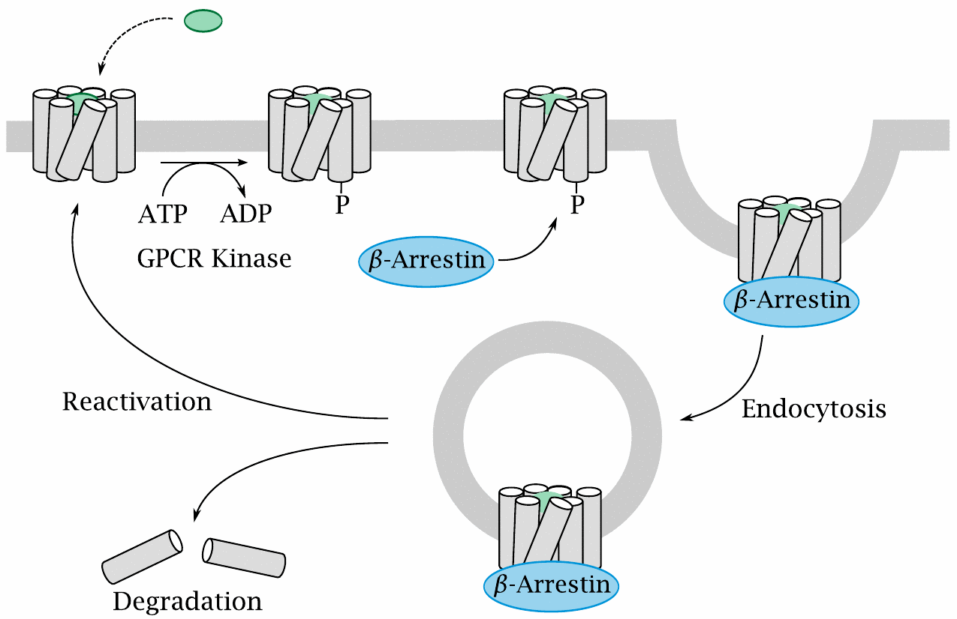
GPCR deactivation by phosphorylation and endocytosis

Slide 29
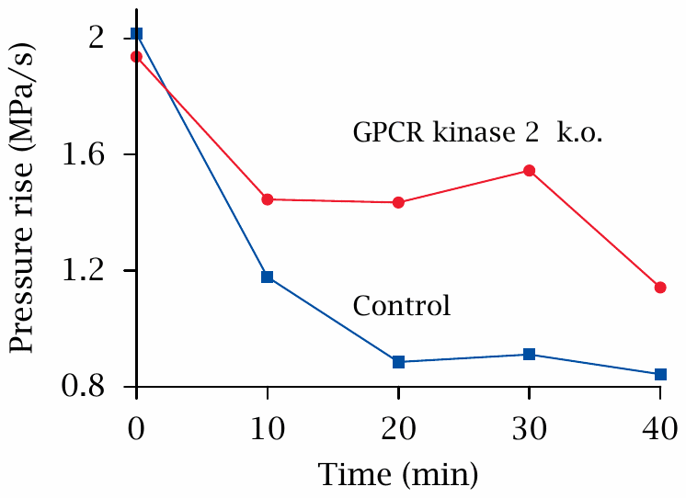
GPCR kinase 2 knockout attenuates tachyphylaxis of cardial β-receptors

Slide 30
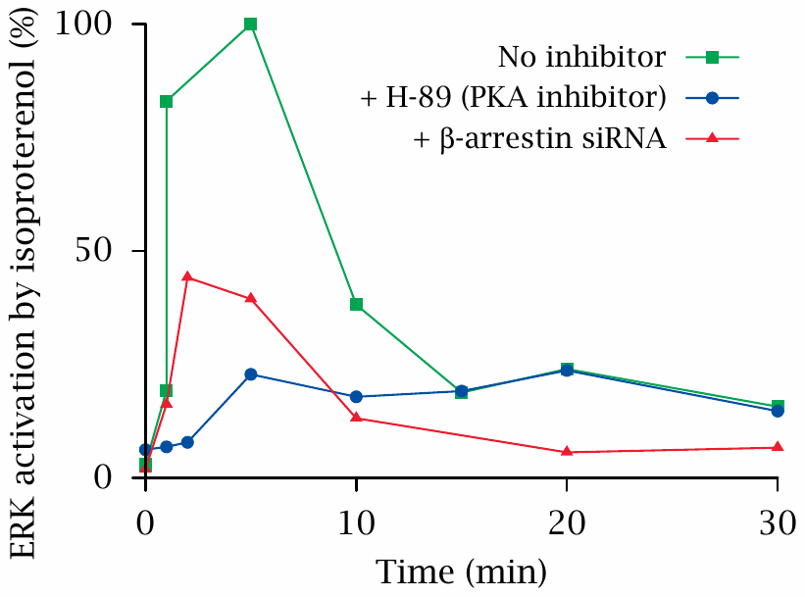
Knock-down of arrestin may reduce GPCR-mediated signals

