Slide 1
Ribonucleic acids as drugs and drug targets

Slide 2
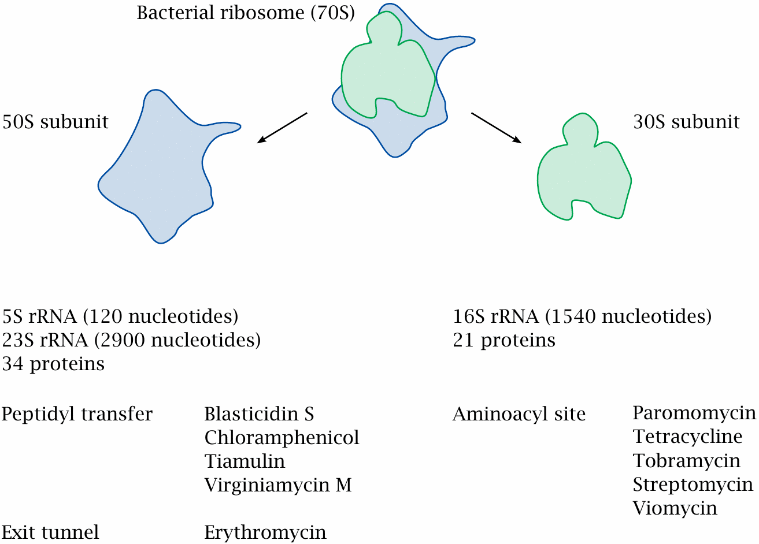
Antibiotics that inhibit the bacterial ribosome

Slide 3
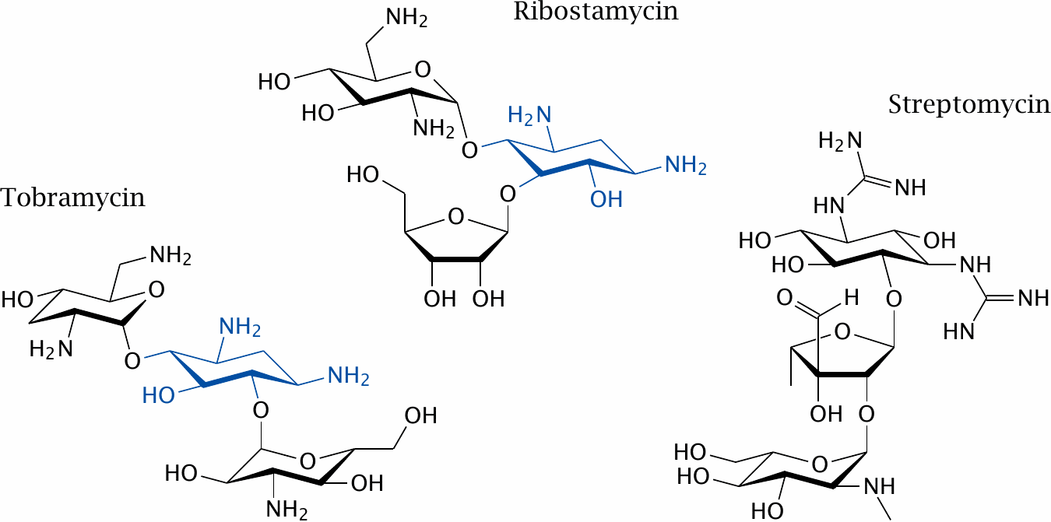
Some aminoglycoside antibiotics

Slide 4
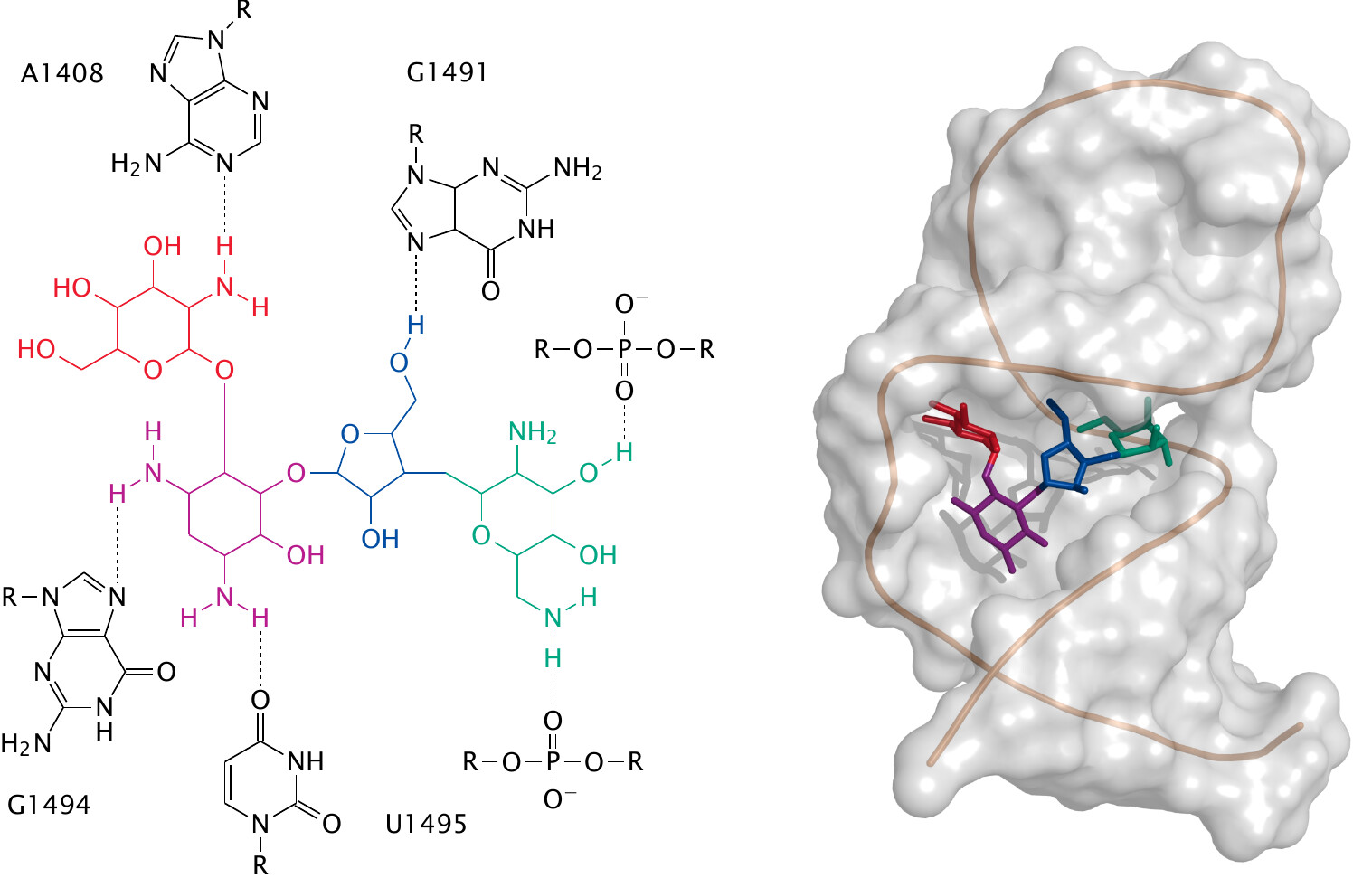
Paromomycin in the ribosomal aminoacyl acceptor site

Slide 5
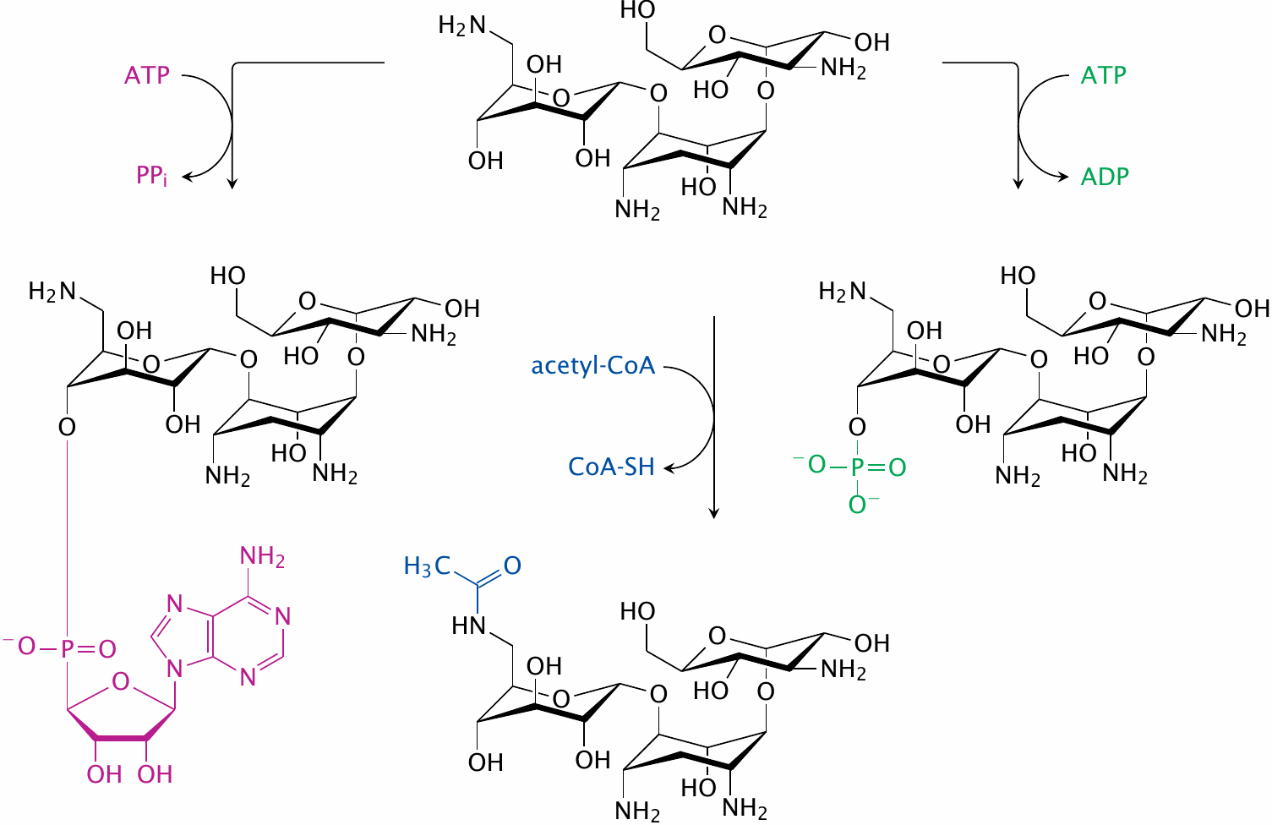
Inactivation of kanamycin by resistance enzymes

Slide 6
Amikacin, a semisynthetic derivative of kanamycin

Slide 7
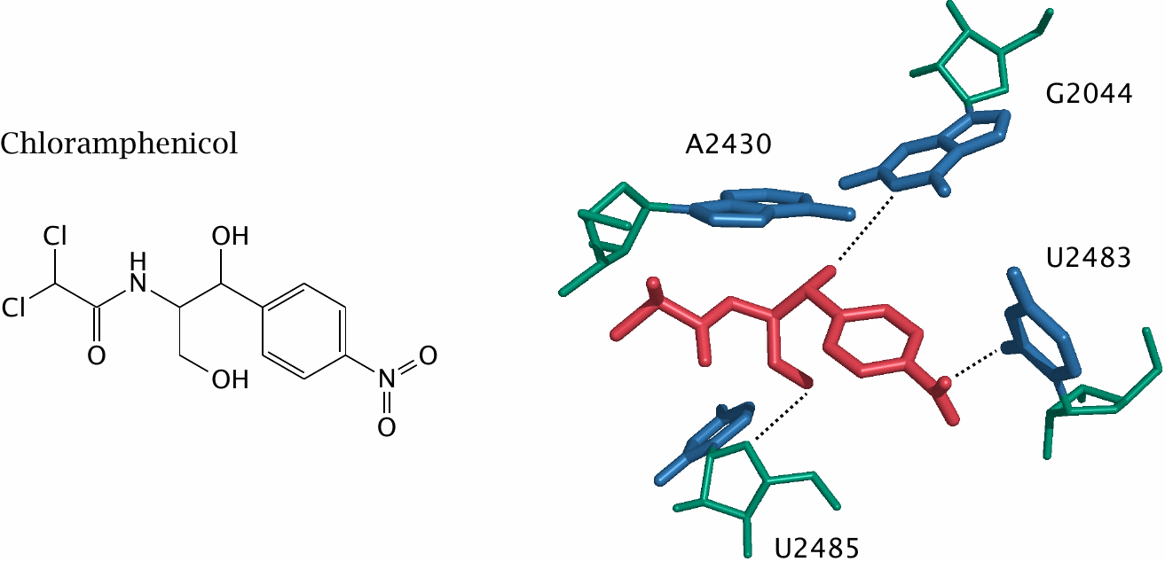
Interactions of chloramphenicol with RNA in the peptidyl transferase site of the ribosome

Slide 8
Telomerase as a target for cancer therapy
in non-cancerous cells, number of successive cell divisions is limited by progressive shortening of the ends (telomeres) of chromosomes
telomerase extends/restores the telomeres
makes DNA from an RNA template (reverse transcriptase)
required in germ line cells
tumour cells ‘immortalize’ themselves by expressing telomerase

Slide 10
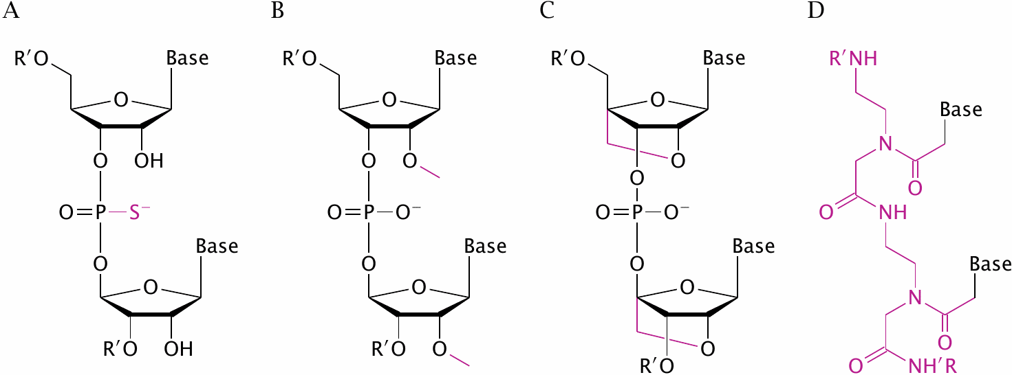
Unusual nucleotide linkages in synthetic oligonucleotides

Slide 11
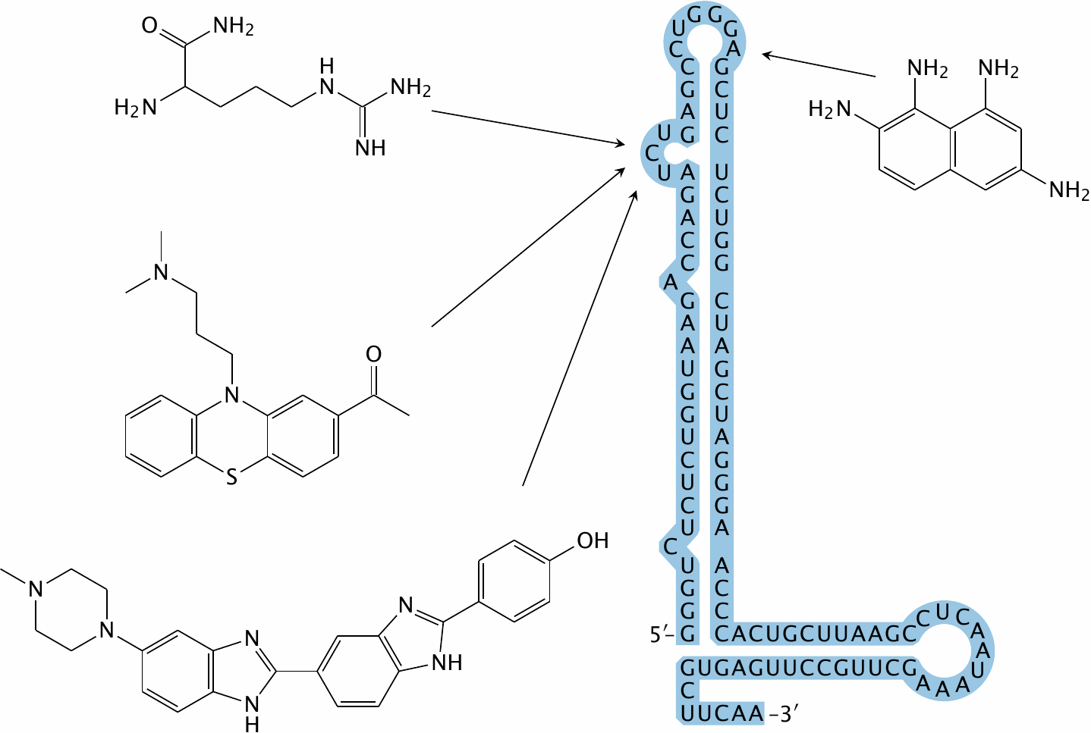
The HIV transactivation-responsive region (TAR)

Slide 12
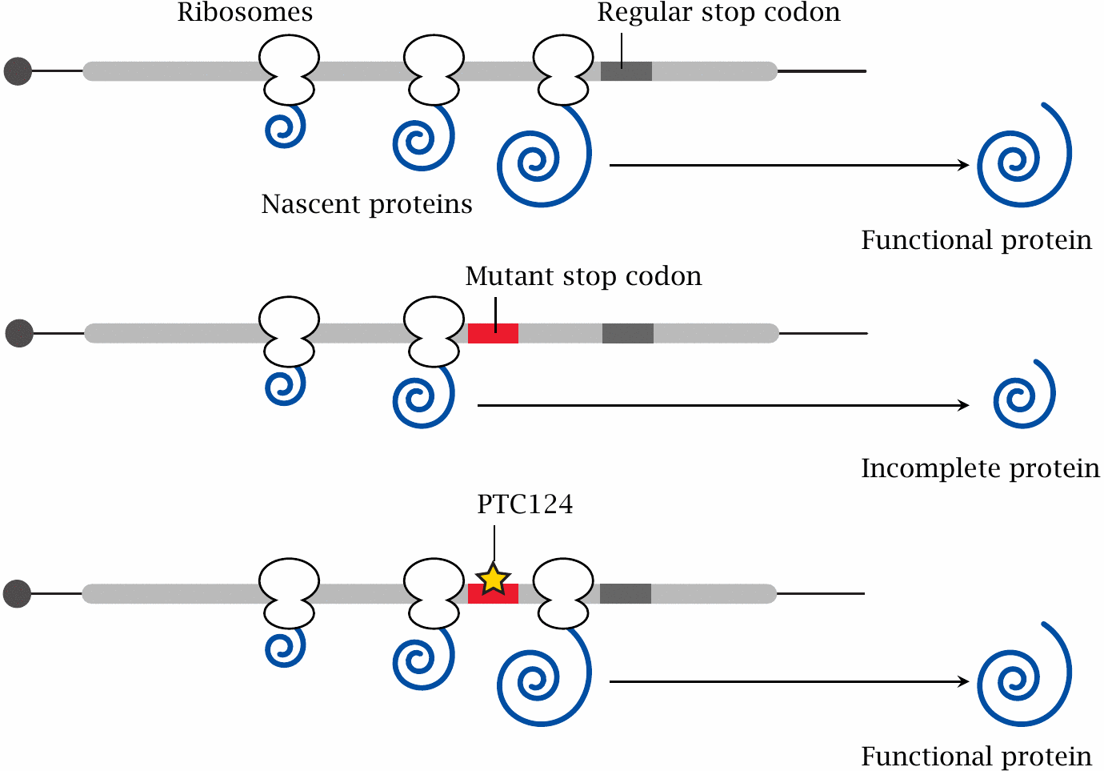
Blocking premature translational termination with PTC124 (ataluren)

Slide 13
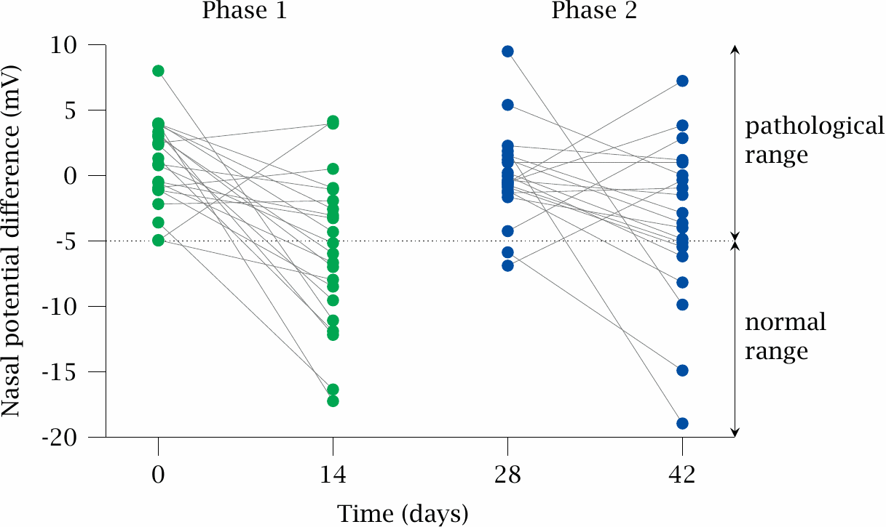
Ataluren in cystic fibrosis

Slide 14
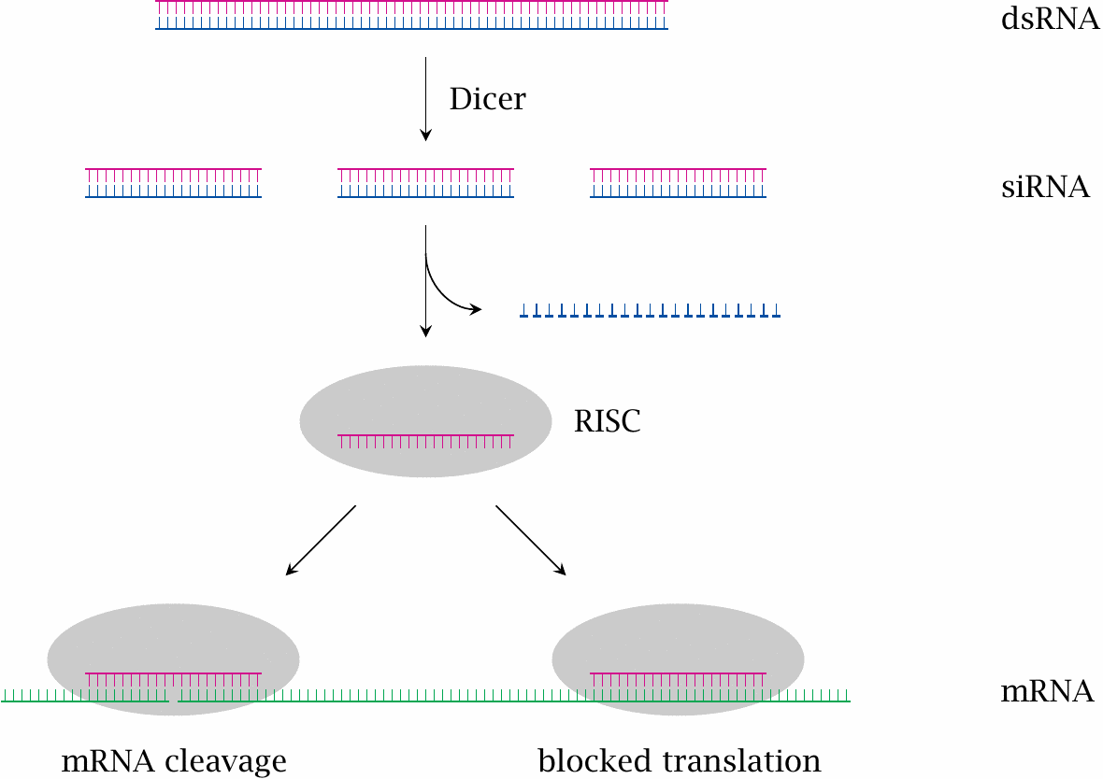
RNA interference

Slide 15
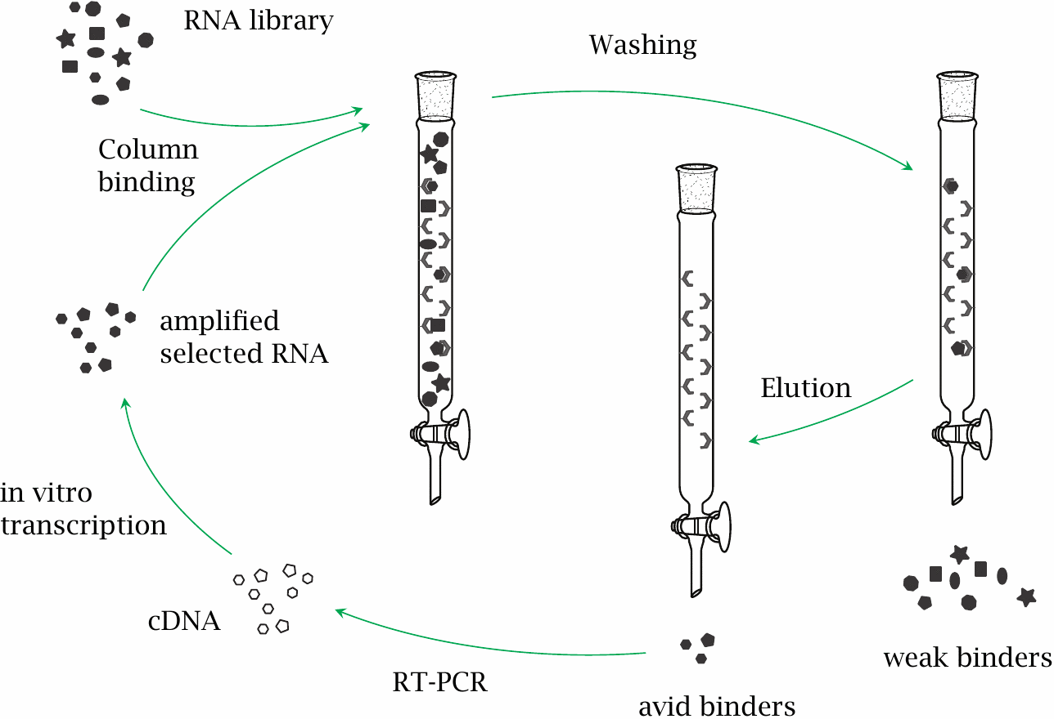
The SELEX process for generating RNA aptamers

