Slide 1
Chemotherapy of infectious diseases

Slide 2
Diversity of infectious pathogens
Bacteria
Fungi
Parasites—eukaryotes other than fungi
Protozoa—unicellular
Metazoa—multicellular
Viruses

Slide 3
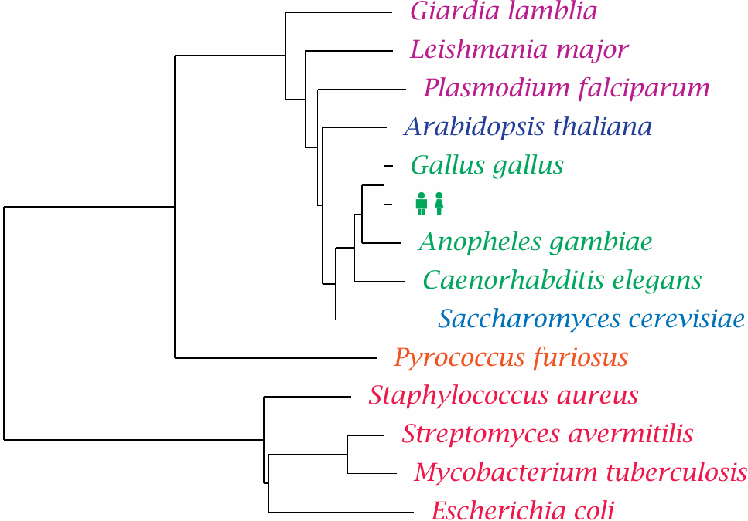
The tree of life, slightly pruned

Slide 4
Drug targets for antimicrobial therapy
Macromolecules that occur in the cells of the pathogen but not within the human host. Examples:
the bacterial cell wall (penicillin)
de novo synthesis of folic acid (sulfonamides)
Macromolecules that occur in both humans and the pathogen but are structurally divergent. Examples:
ribosomes (chloramphenicol)
dihydrofolate reductase (trimethoprim)
DNA topoisomerase (ciprofloxacin)

Slide 5
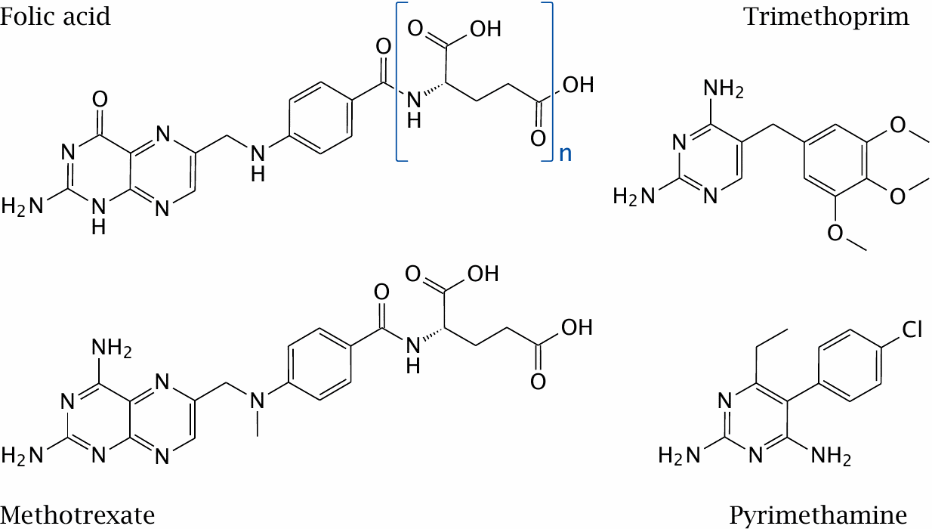
Structures of folic acid and of three inhibitors of dihydrofolate reductase

Slide 6
Microbial resistance mechanisms
Mechanisms affecting the target:
Structural alteration / mutation
Compensatory overexpression
Mechanisms affecting the drug:
Reduced uptake
Active extrusion
Enzymatic inactivation

Slide 7
Overview of antibacterial chemotherapy
Targets
Cell wall
Ribosomes
Enzymes related to cell division
Intermediate metabolism
Antibiotic resistance
Bacteria have short generation times—fast de novo evolution of resistance
Resistance genes exist in producers of antibiotics—can spread to pathogenic bacteria by gene transfer

Slide 8
Gene transfer mechanisms in bacteria
Transformation: cellular uptake of naked DNA
Conjugation: plasmid-encoded active transfer between bacterial cells
Transduction: gene transfer mediated by bacteriophages
Transposons: transfer of genes between carrier DNA molecules (chromosomes, plasmids)

Slide 9
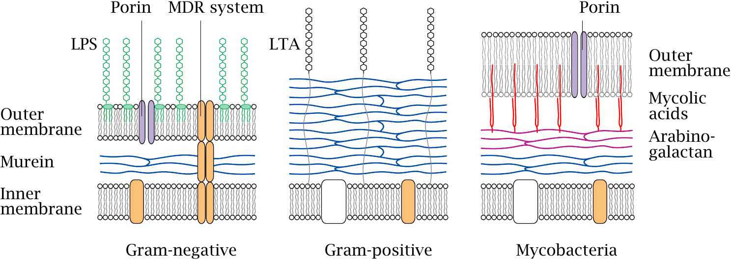
Bacterial cell wall structure

Slide 10
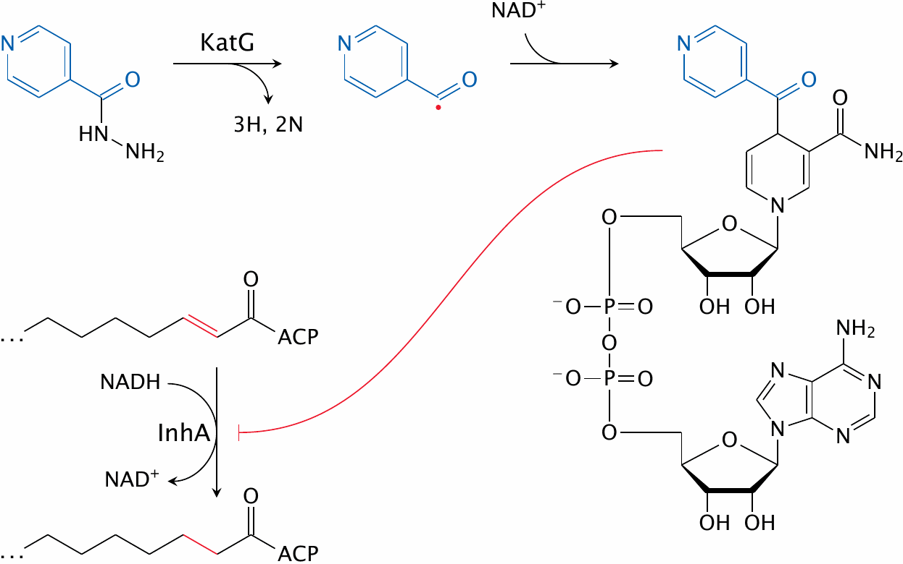
Action mechanism of isoniazid (INH)

Slide 11
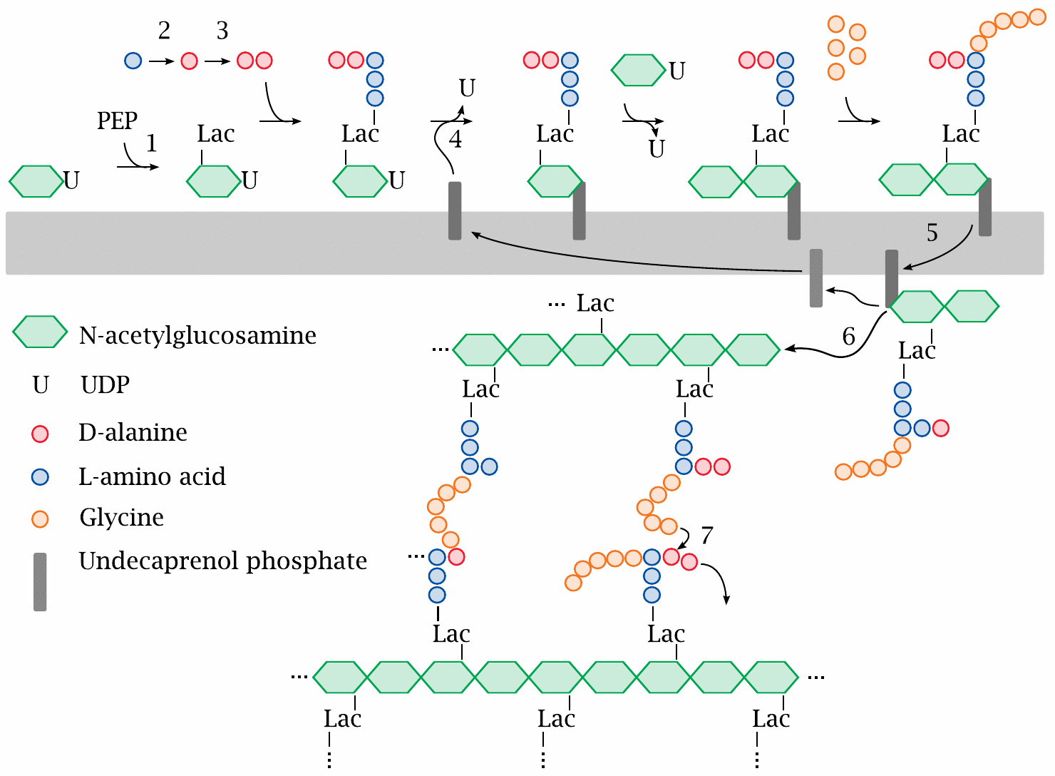
Outline of bacterial murein synthesis

Slide 12
Fosfomycin mimics both phosphoenolpyruvate and glycerophosphate

Slide 13
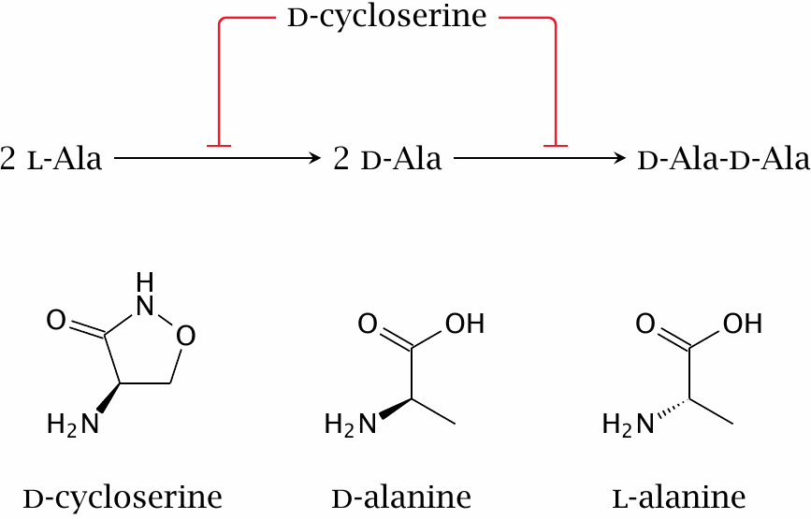
Cycloserine inhibits alanine racemase and D-alanine ligase

Slide 14
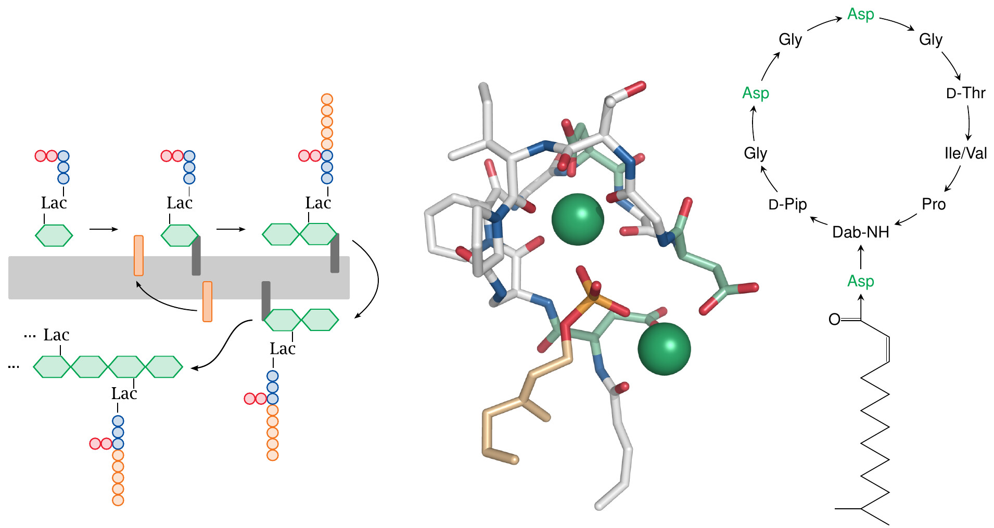
The lipopeptide laspartomycin sequesters undecaprenol phosphate

Slide 15
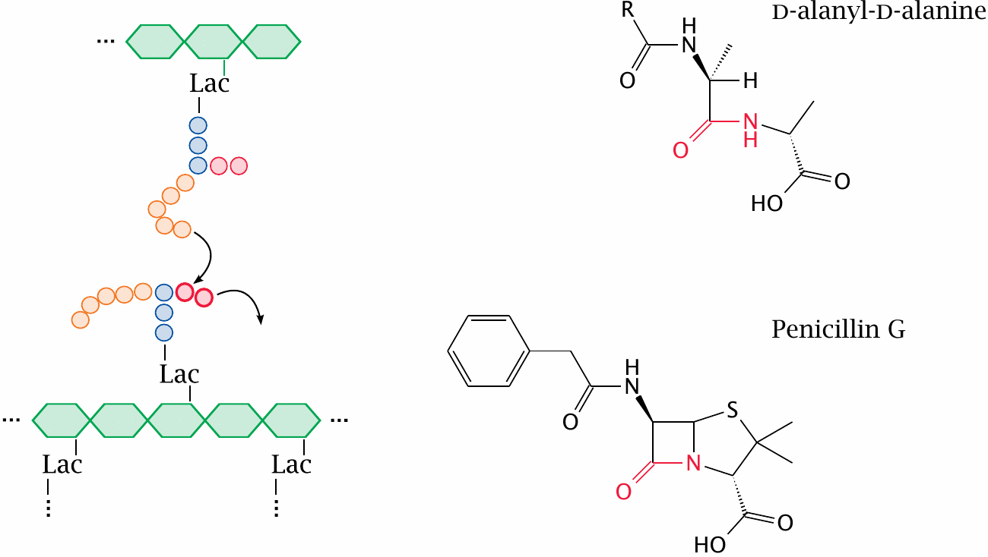
β-Lactam antibiotics resemble the substrate of the transpeptidase reaction

Slide 16
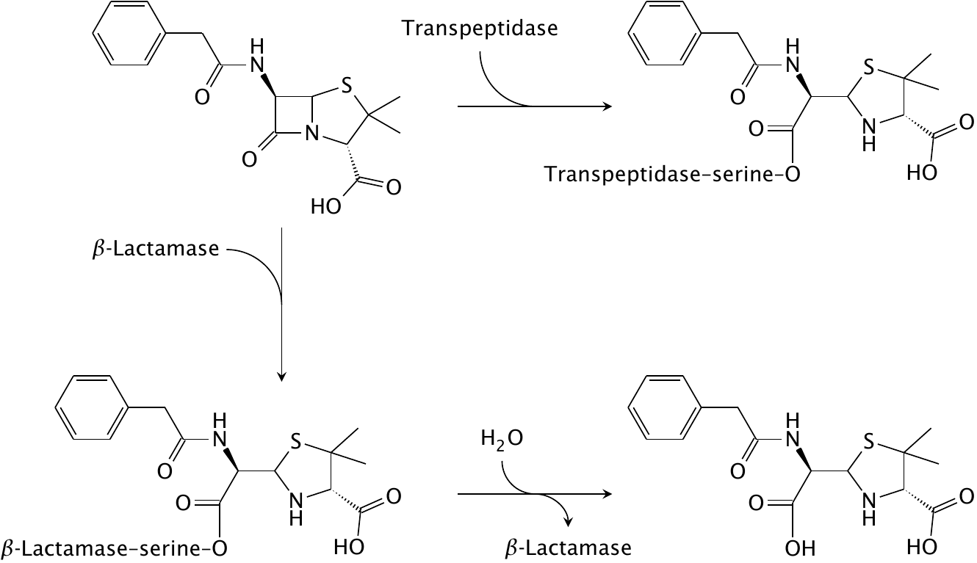
Reactions of penicillin G with transpeptidase and β-lactamase

Slide 17
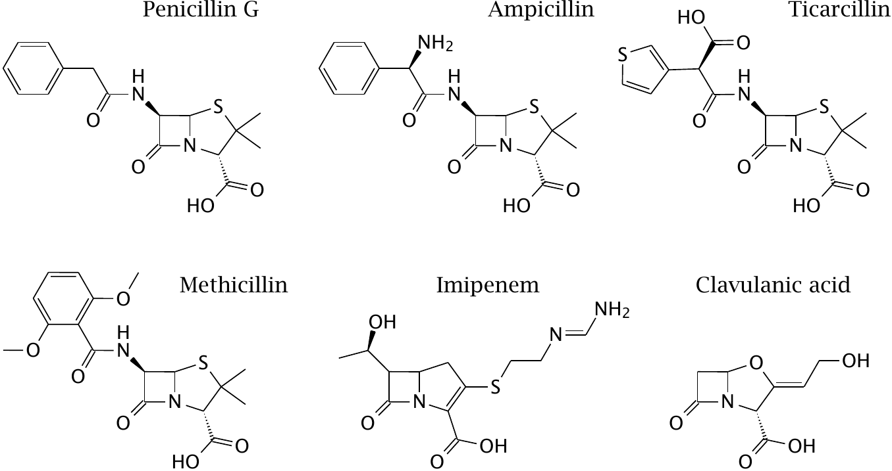
Structures of β-lactam antibiotics (1)

Slide 18
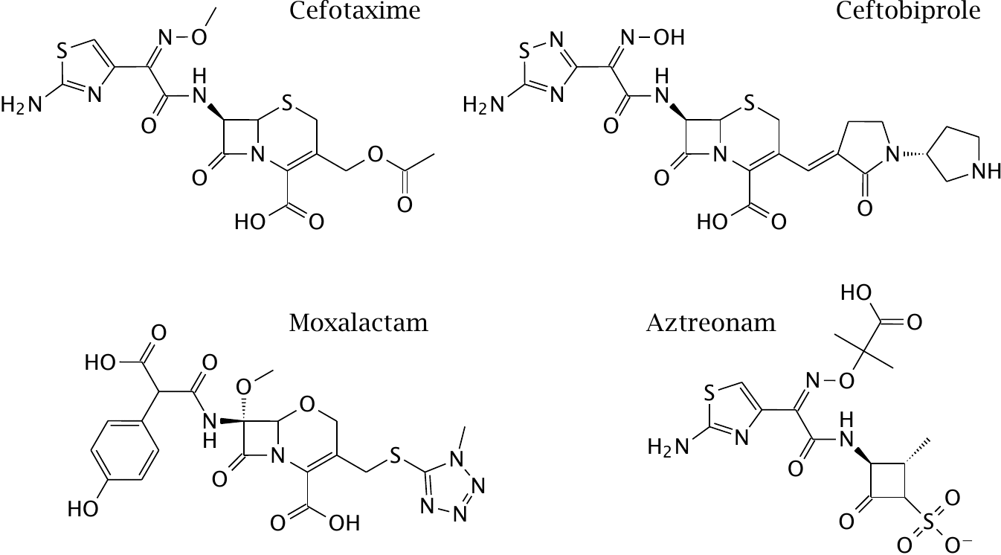
Structures of β-lactam antibiotics (2)

Slide 19
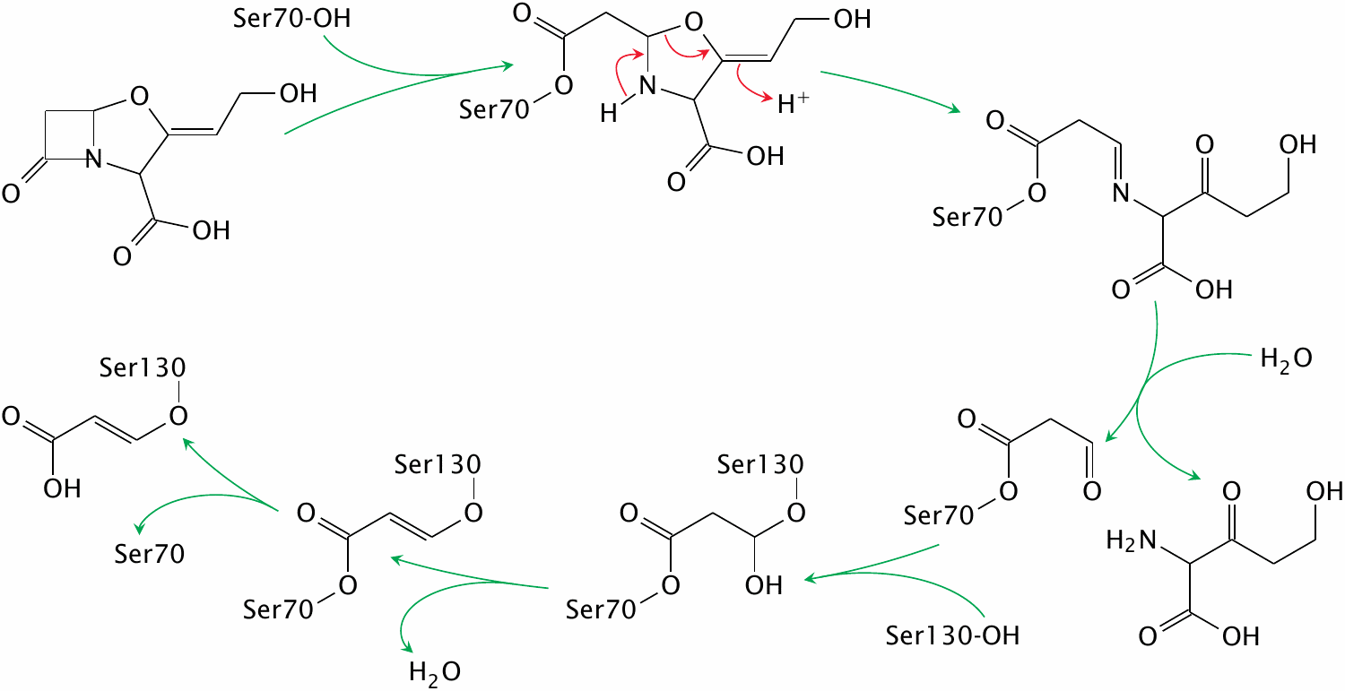
Inactivation of SHV-1 β-lactamase by clavulanic acid

Slide 20
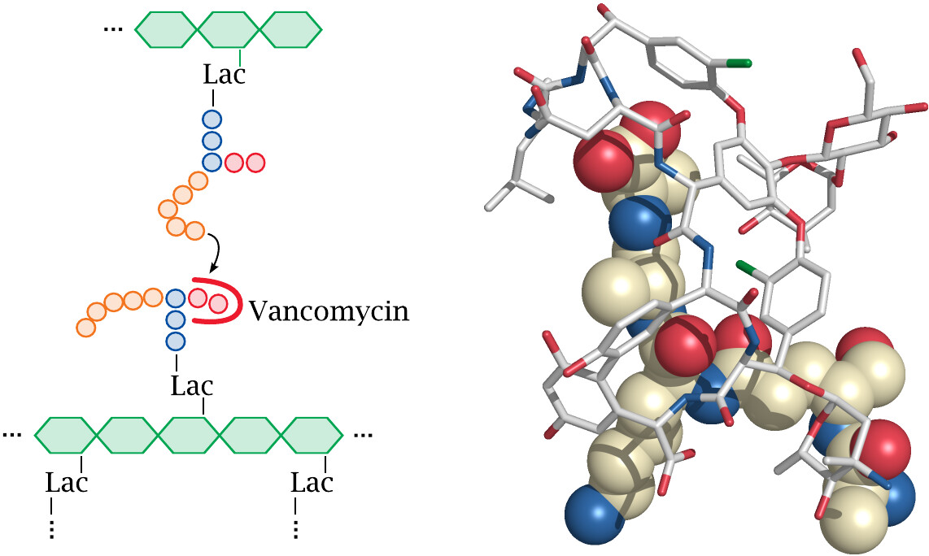
Vancomycin sequesters the substrate of the transpeptidase reaction

Slide 21
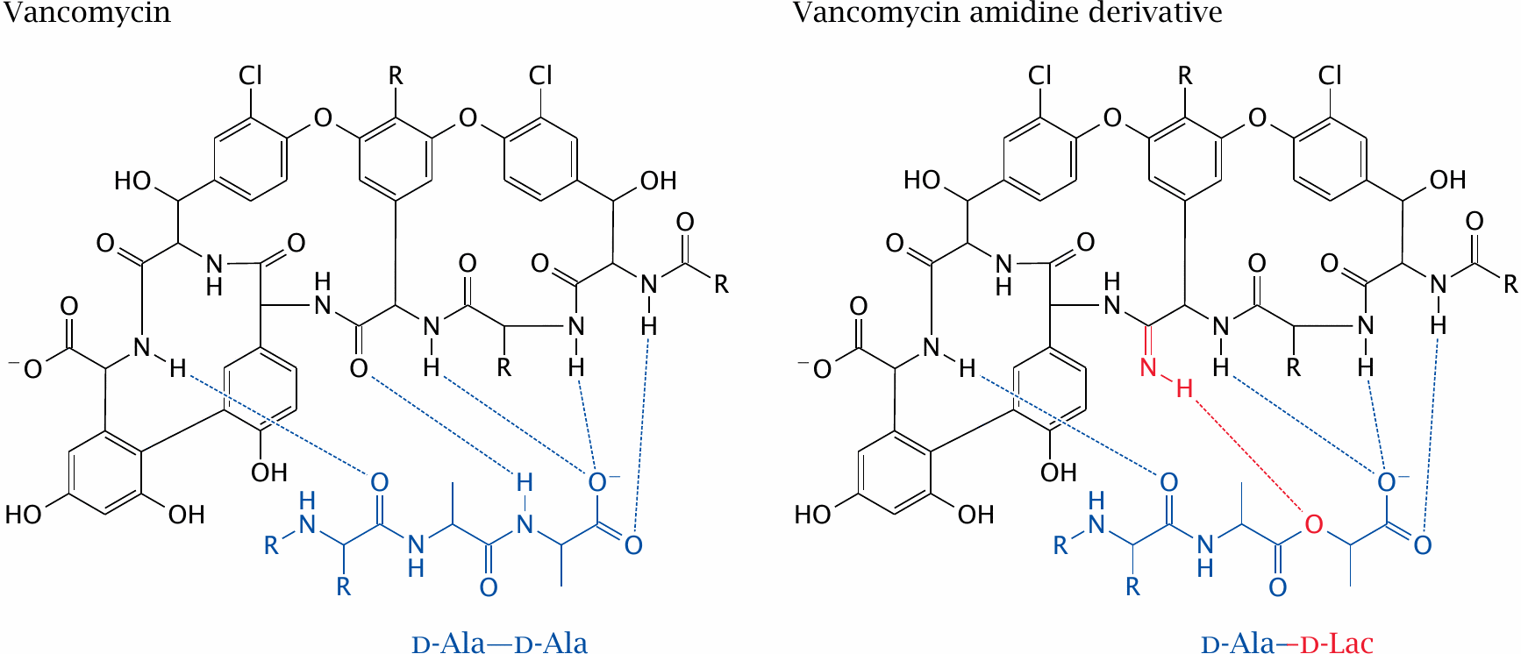
Vancomycin can be modified to overcome bacterial resistance

Slide 22
Antibiotics that inhibit ribosomal protein synthesis
Aminoglycosides
Tetracyclines
Macrolides
Chloramphenicol
Puromycin
…

Slide 23
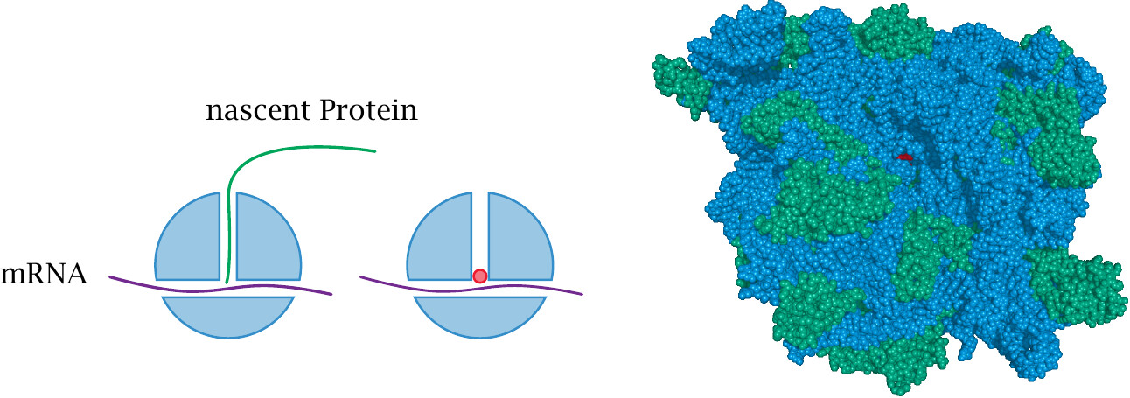
Chloramphenicol lodges into the peptidyl-transfer site of the ribosome

Slide 24
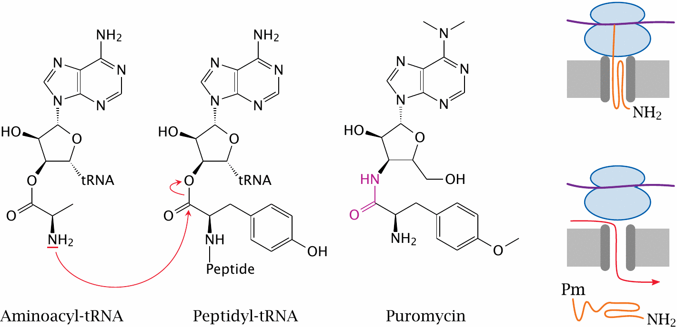
Structure and action mechanism of puromycin

Slide 25
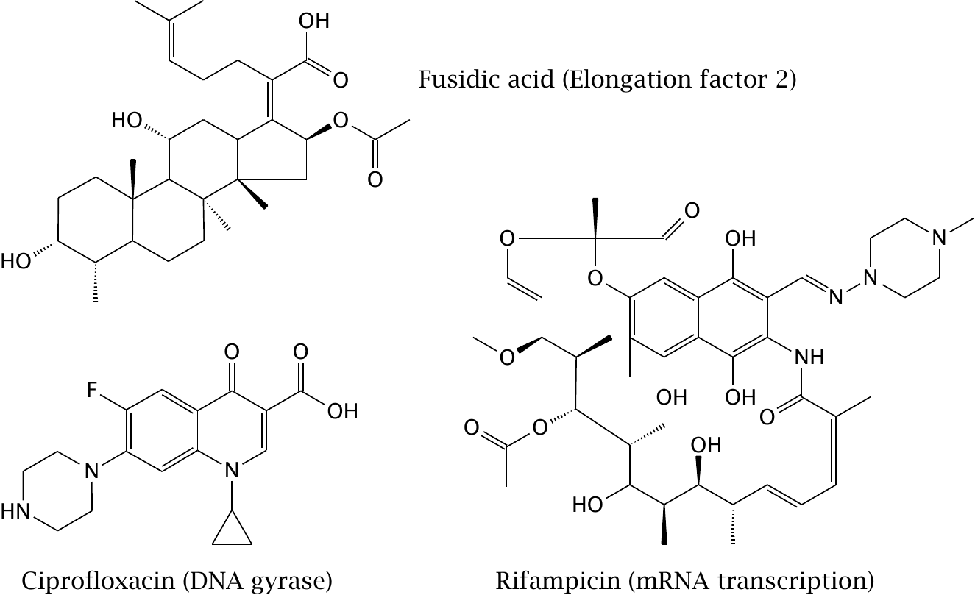
Diverse inhibitors of bacterial macromolecular synthesis

Slide 26
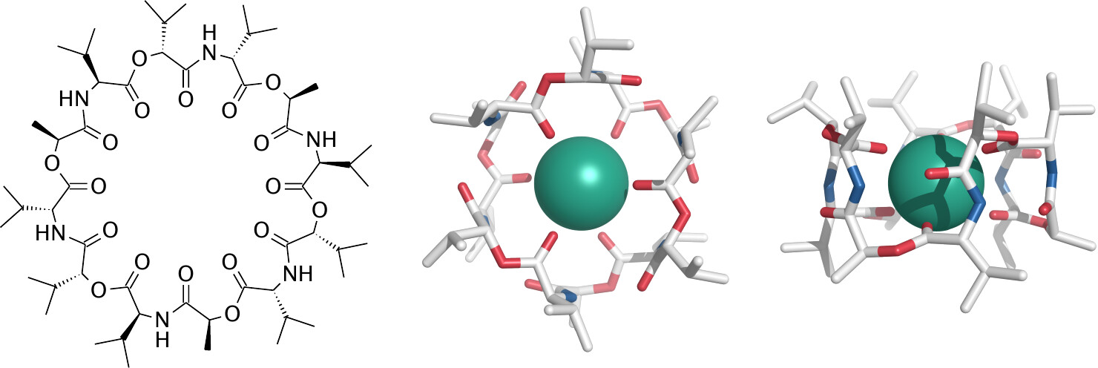
Structure of the potassium ionophore valinomycin

Slide 27
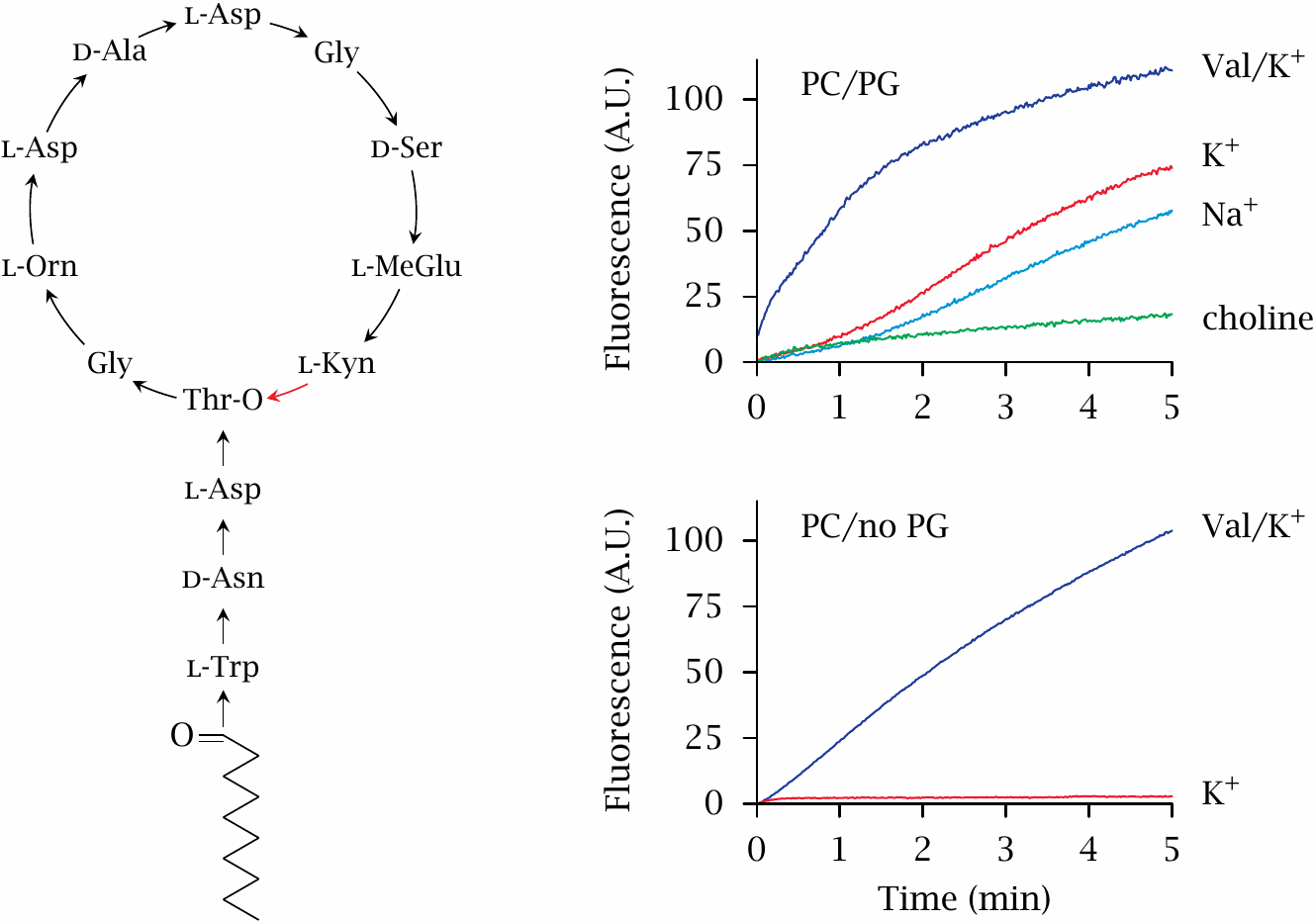
Daptomycin permeabilizes membranes containing phosphatidylglycerol

Slide 28
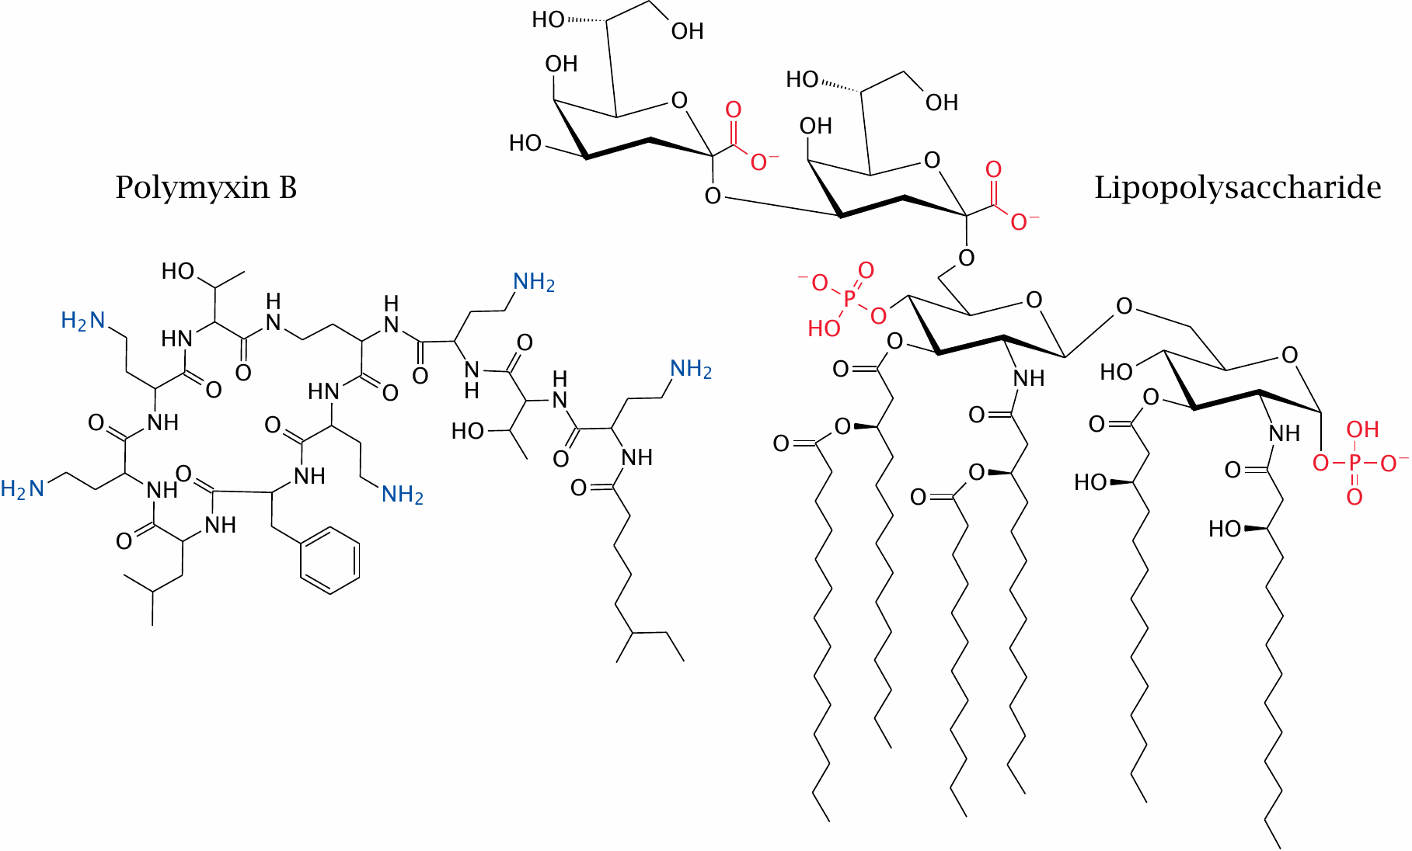
Structures of polymyxin B and lipopolysaccharide

Slide 29
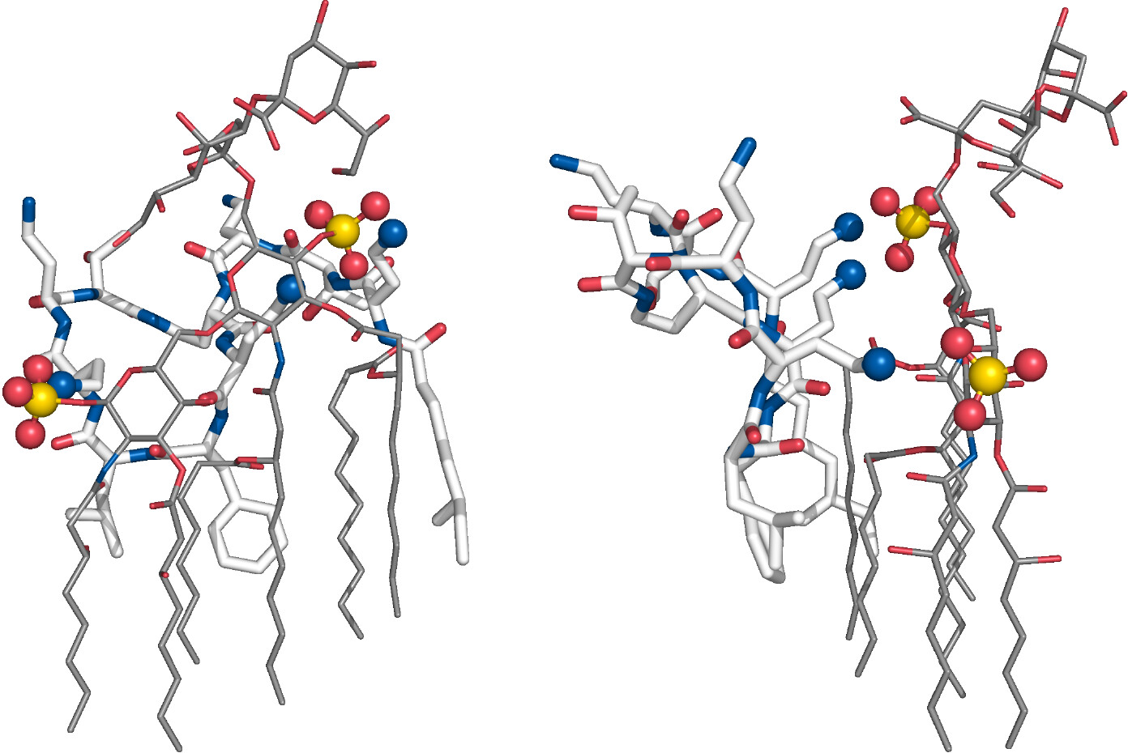
A model of the polymyxin B–LPS complex

Slide 30
Drug targets in antifungal chemotherapy
ergosterol in cell membranes (amphotericin B)
ergosterol synthesis (ketoconazole; terbinafine)
thymidylate synthase (5-fluorocytosine)
1,3-β-glucan synthesis (echinocandins)

Slide 31
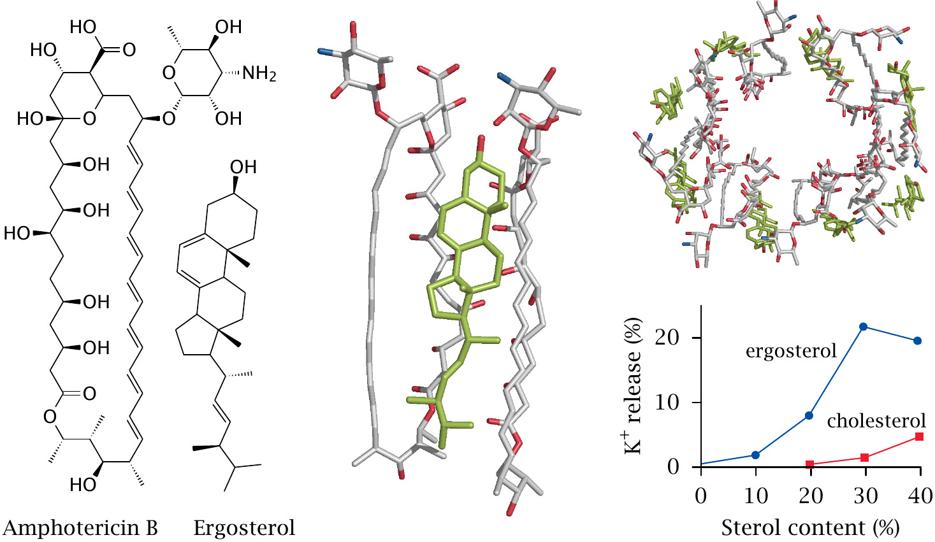
Structure and action mode of amphotericin B

Slide 32
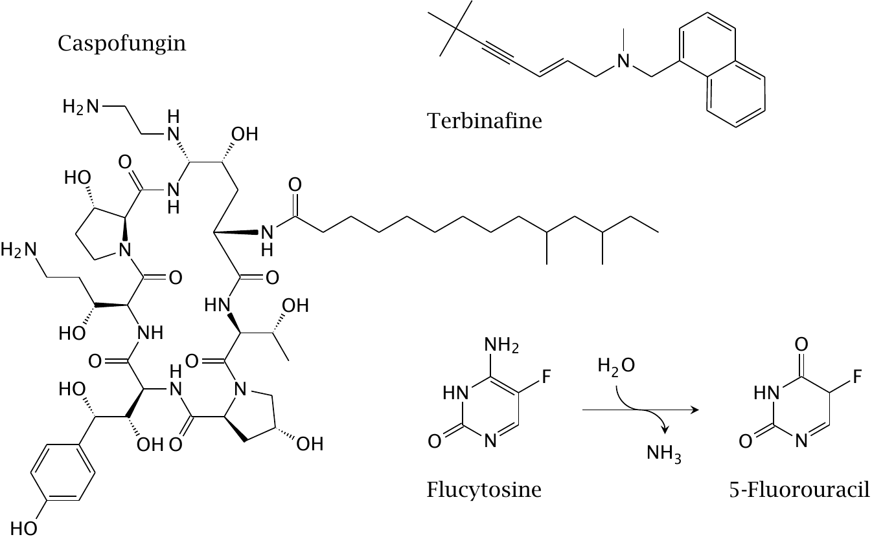
Other antifungal drugs

Slide 33
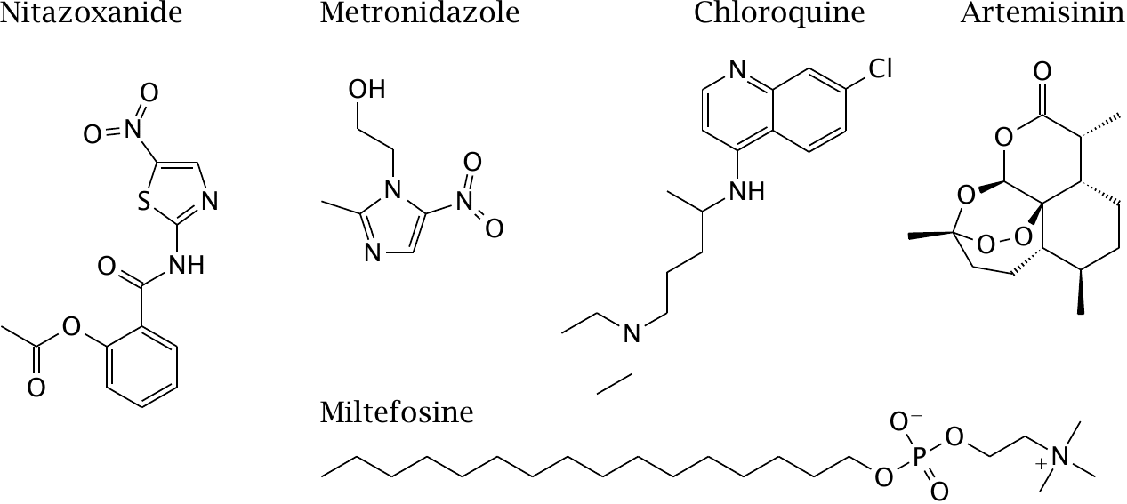
Antiprotozoal drugs

Slide 34
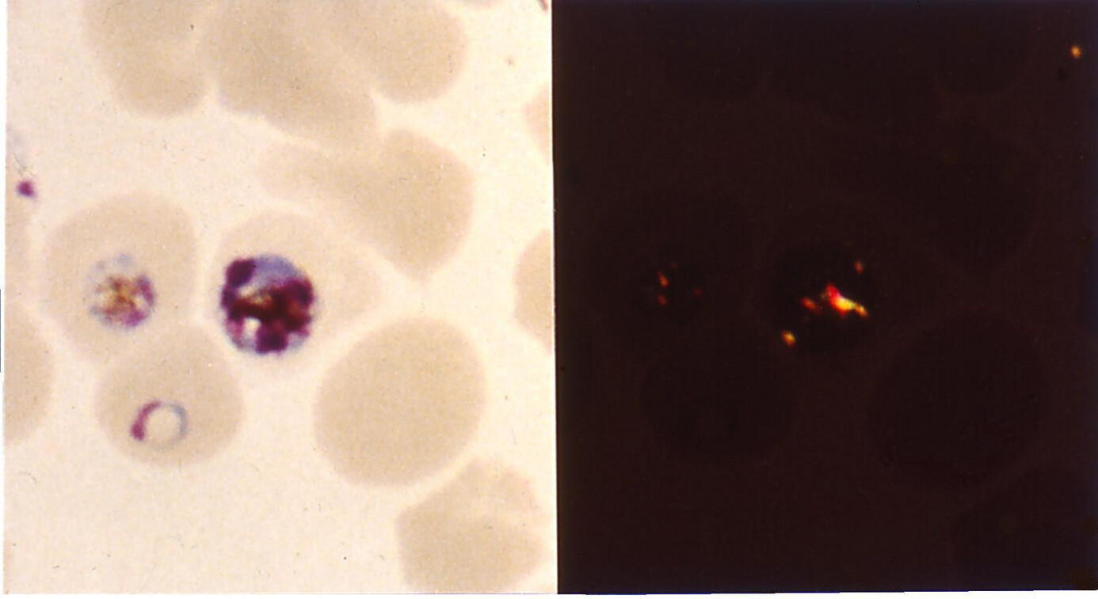
Hemozoin inside malaria parasites inside red blood cells

Slide 35
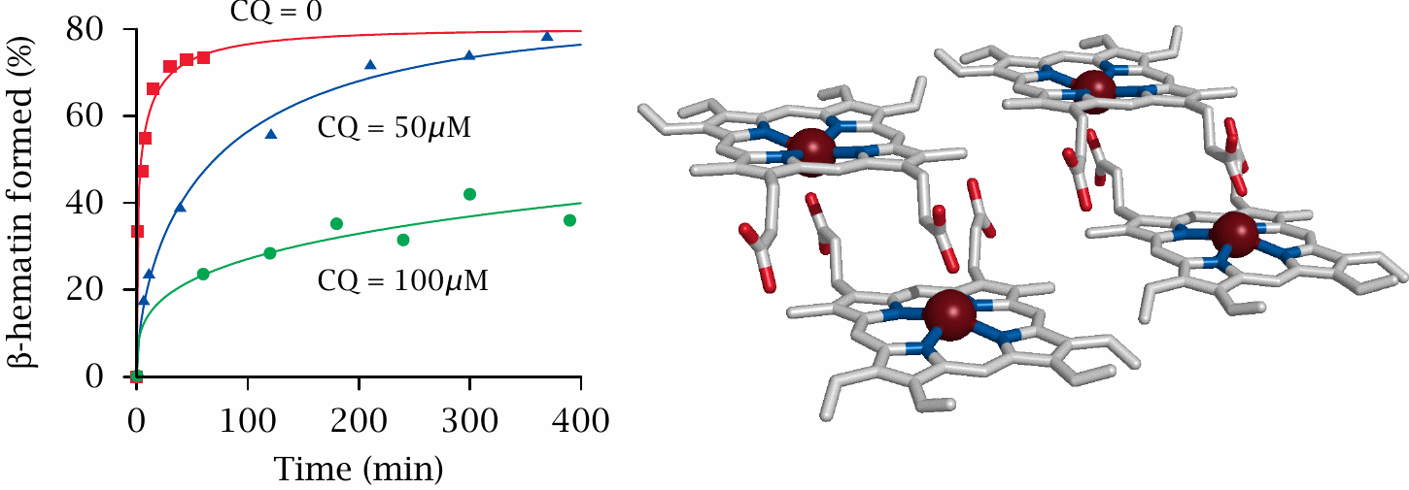
Chloroquine inhibits formation of β-hematin

Slide 36
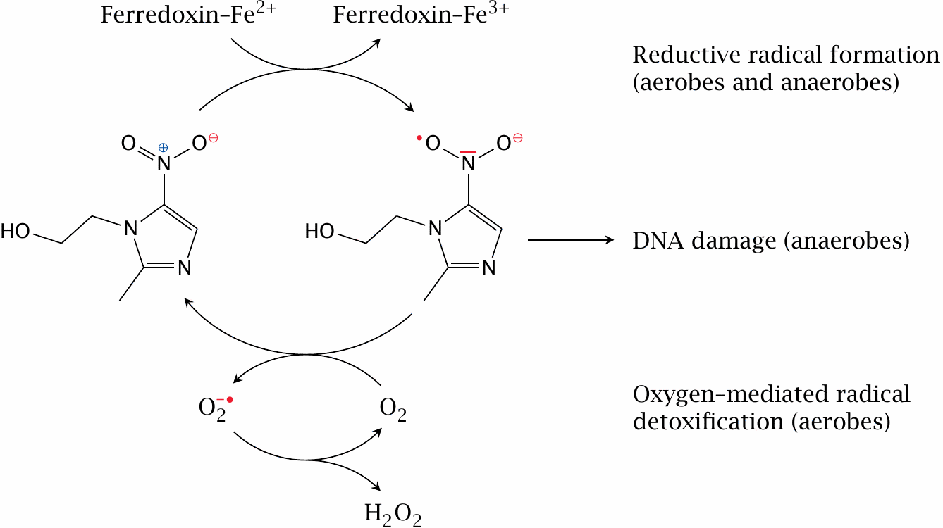
Action mechanism and selective toxicity of nitroimidazoles

Slide 37
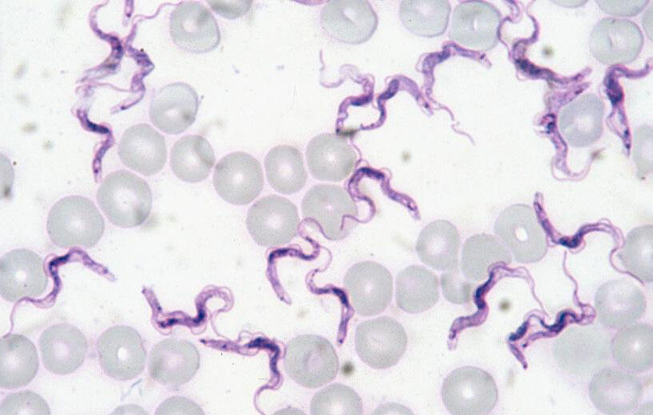
Trypanosomes in a blood smear

Slide 38
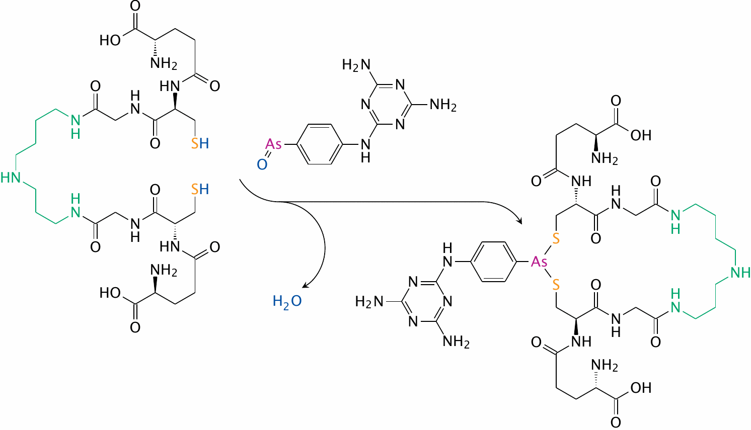
Melarsene oxide binds trypanothione

Slide 39
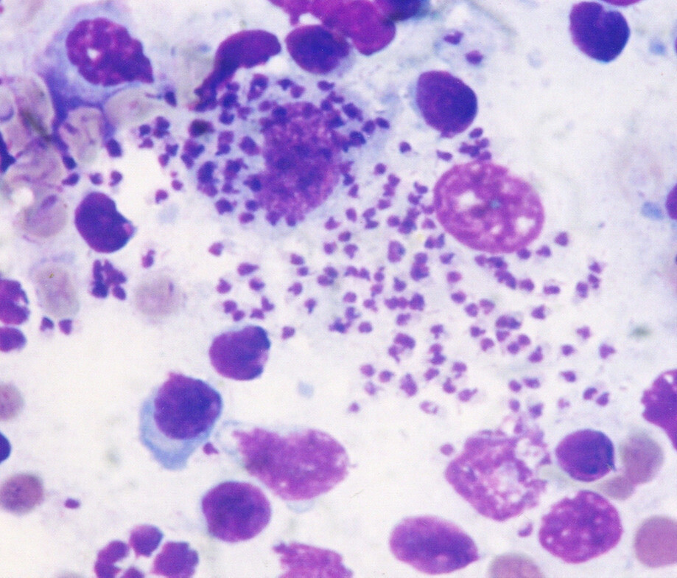
Leishmania in bone marrow

Slide 40
Antiviral chemotherapy
The genome may be
small (5 kbp) or large (>300 kbp)
RNA or DNA
segmented or a single molecule
single-or double-stranded
if single-stranded, plus-or minus stranded
inserting itself into the host cell genome (retroviruses) or replicating independently (others)
Proteins may be expressed separately or as a single polyprotein
Propagation may be transient (hepatitis A) or persistent (hepatitis B)
The virion may be naked or enveloped

Slide 41
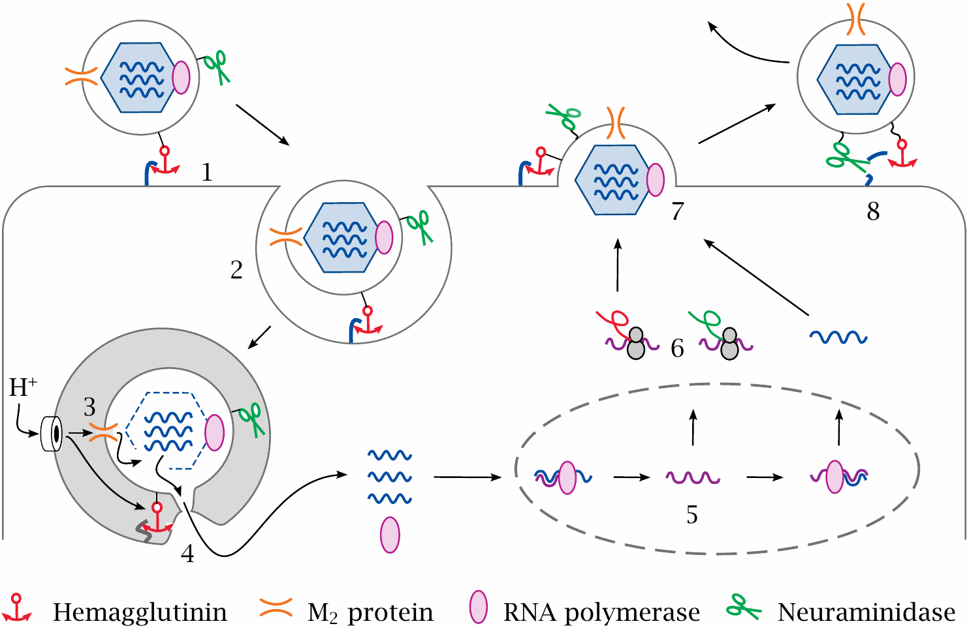
The life cycle of influenza virus

Slide 42
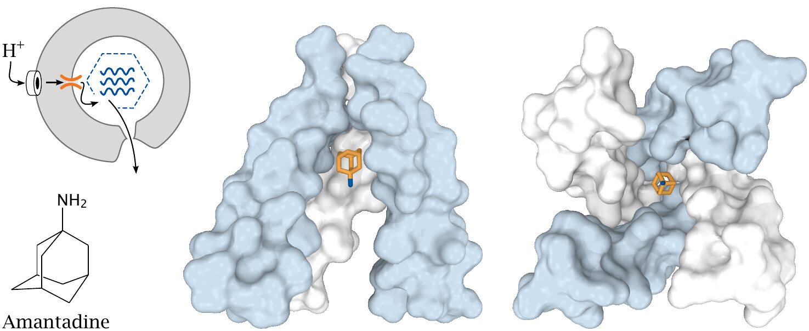
Amantadine blocks the M₂ proton channel

Slide 43
Oseltamivir inhibits influenzavirus neuraminidase

Slide 44
Inhibition of HIV fusion with target cells by the peptide enfuvirtide

Slide 45
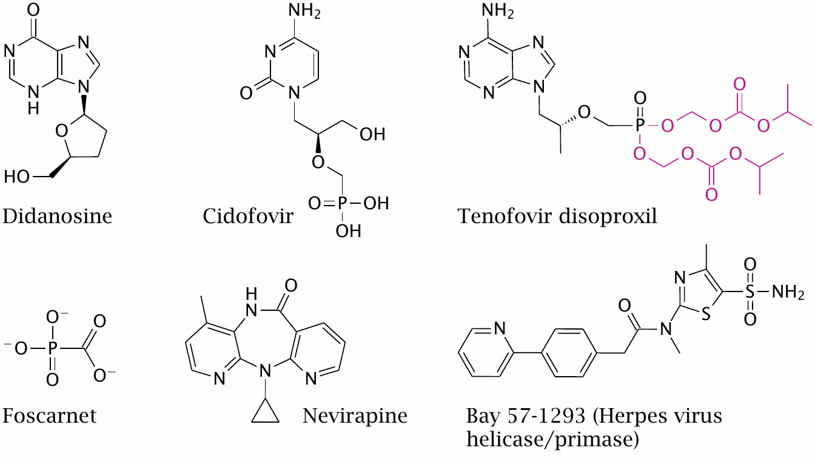
Inhibitors of virus genome replication

Slide 46
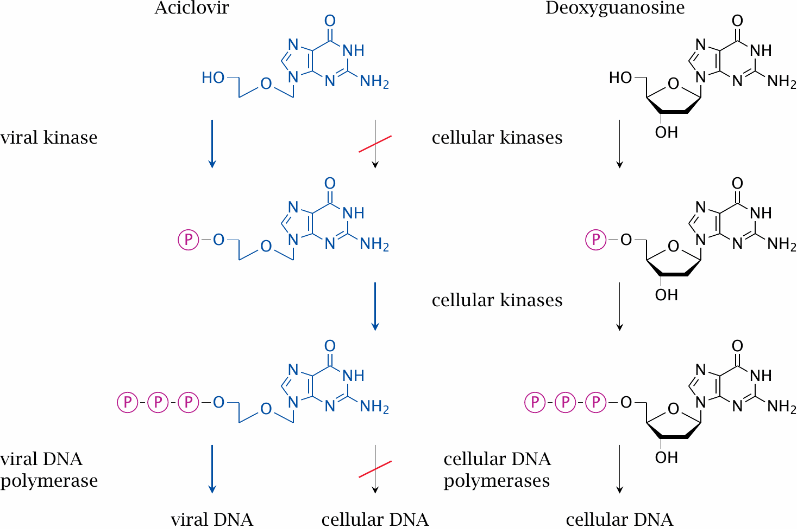
Activation of acyclovir

Slide 47
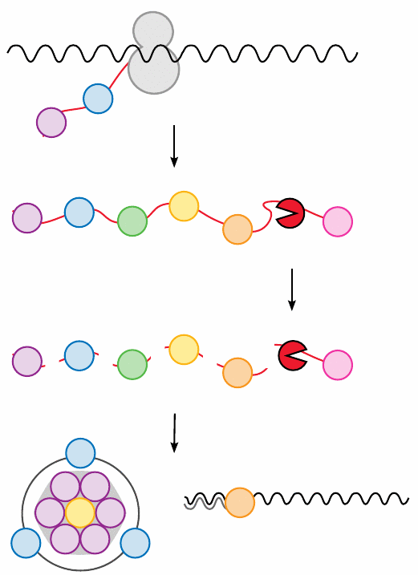
Function of virus proteases

