Slide 1
The hexose monophosphate shunt

Slide 2
The hexose monophosphate shunt: Overview

Slide 3
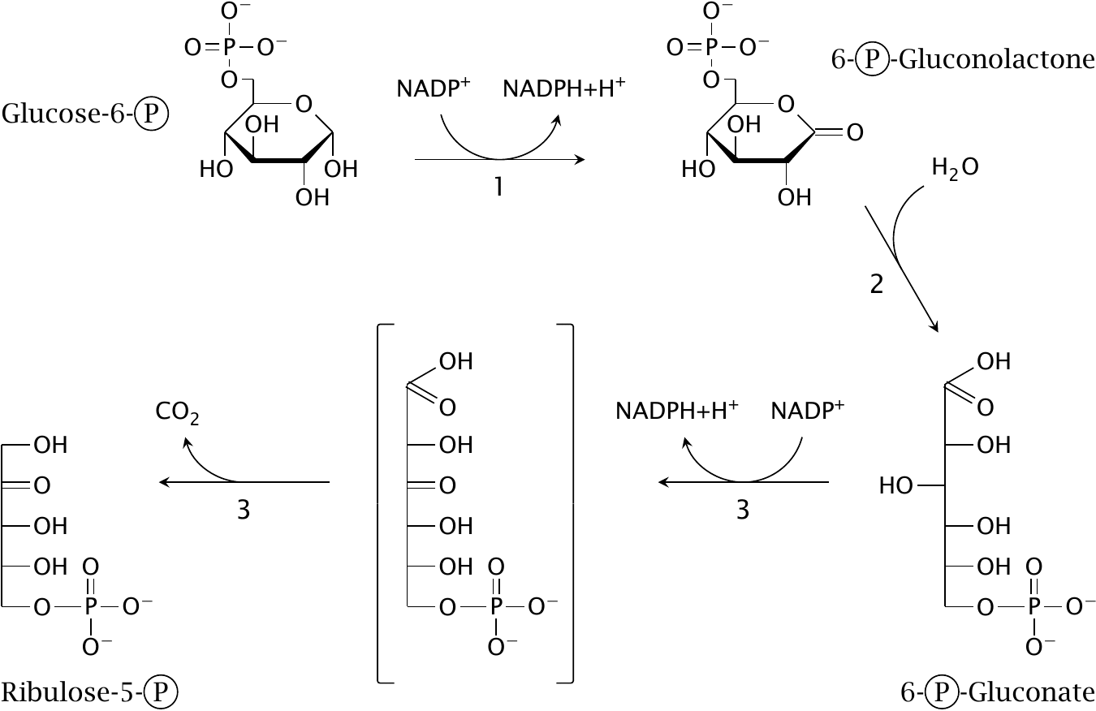
Reactions in the oxidative stage

Slide 4
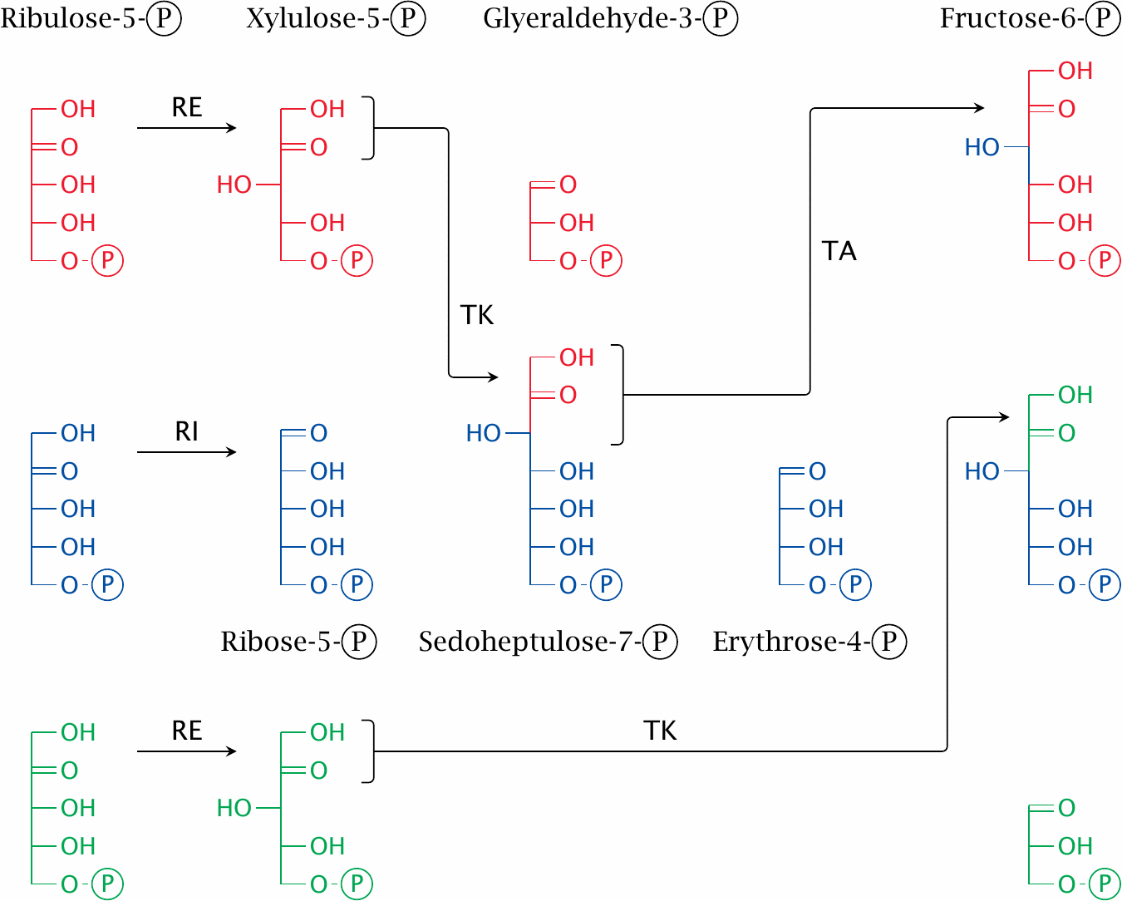
Reactions in the sugar shuffle stage

Slide 5
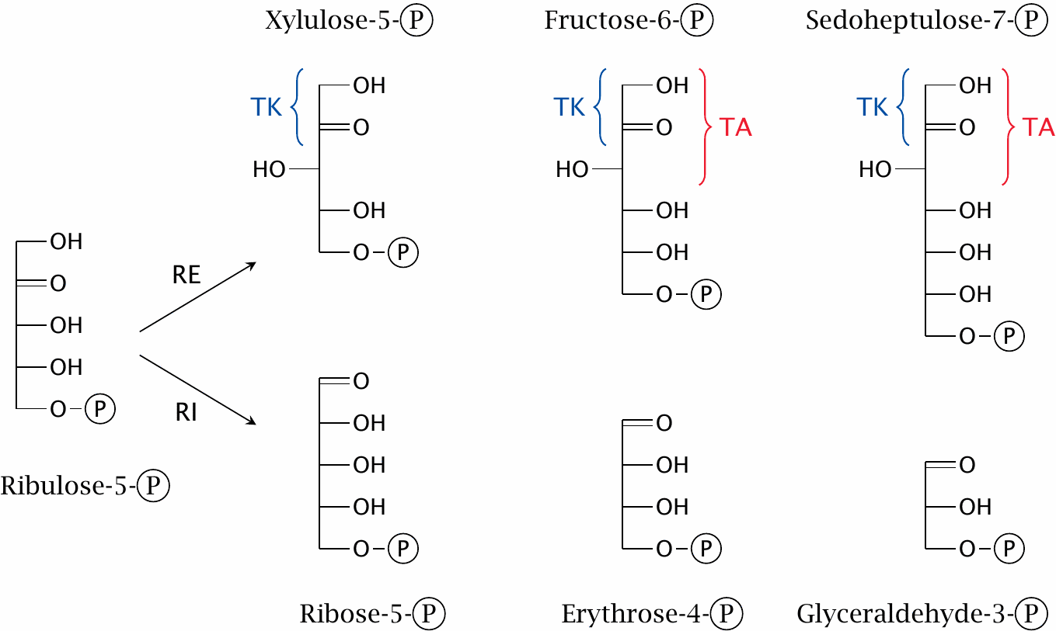
Ketoses and aldoses in the HMS

Slide 6
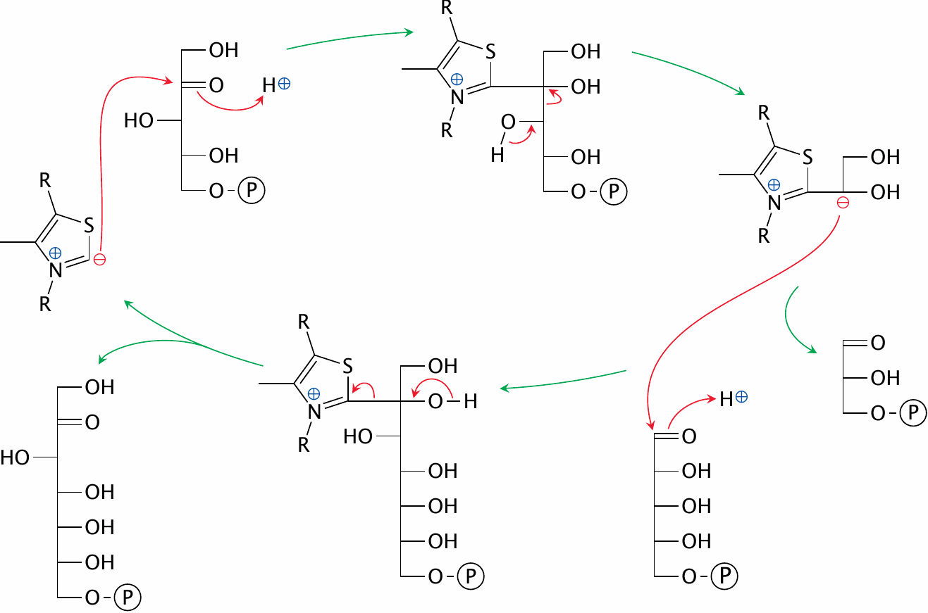
The mechanism of transketolase

Slide 7
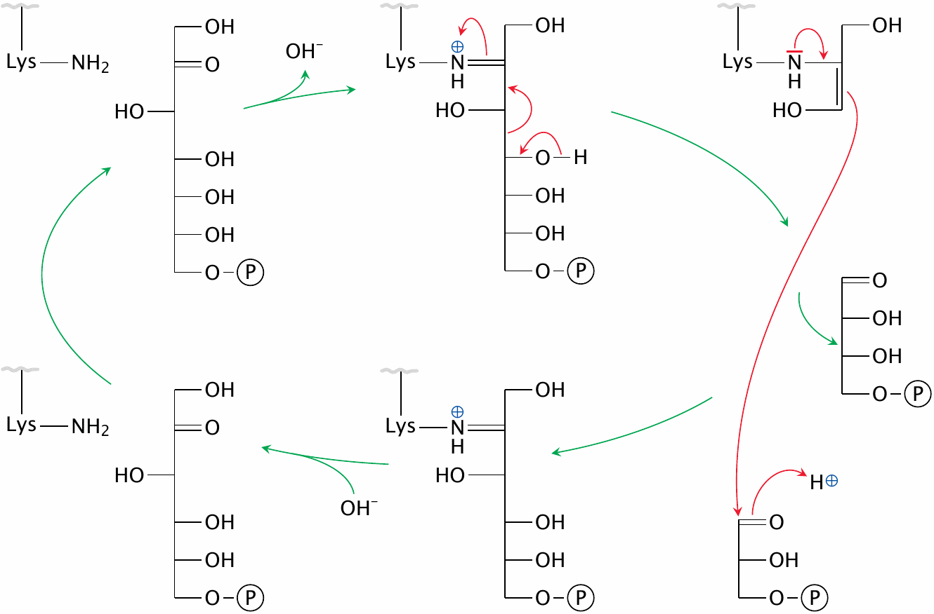
The mechanism of transaldolase

Slide 8
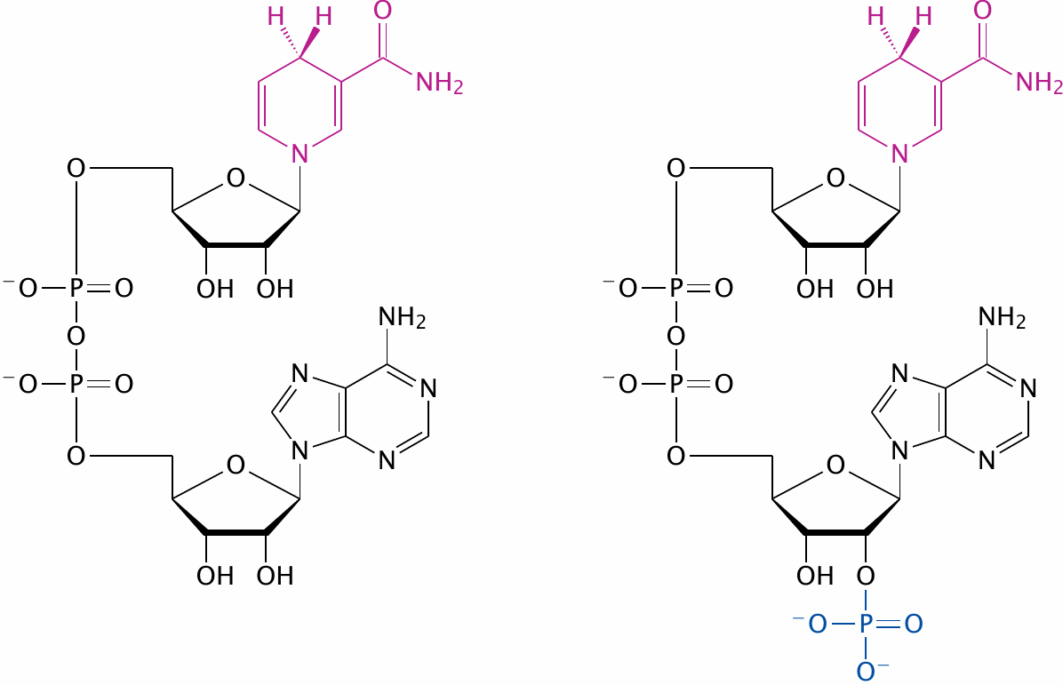
Why do we need both NADH and NADPH?

Slide 9
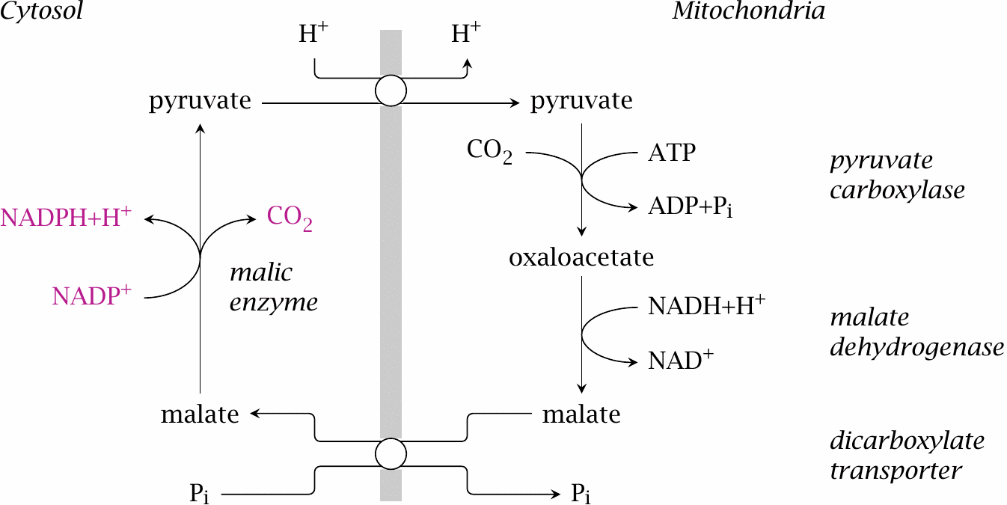
NADPH generation by malic enzyme

Slide 10
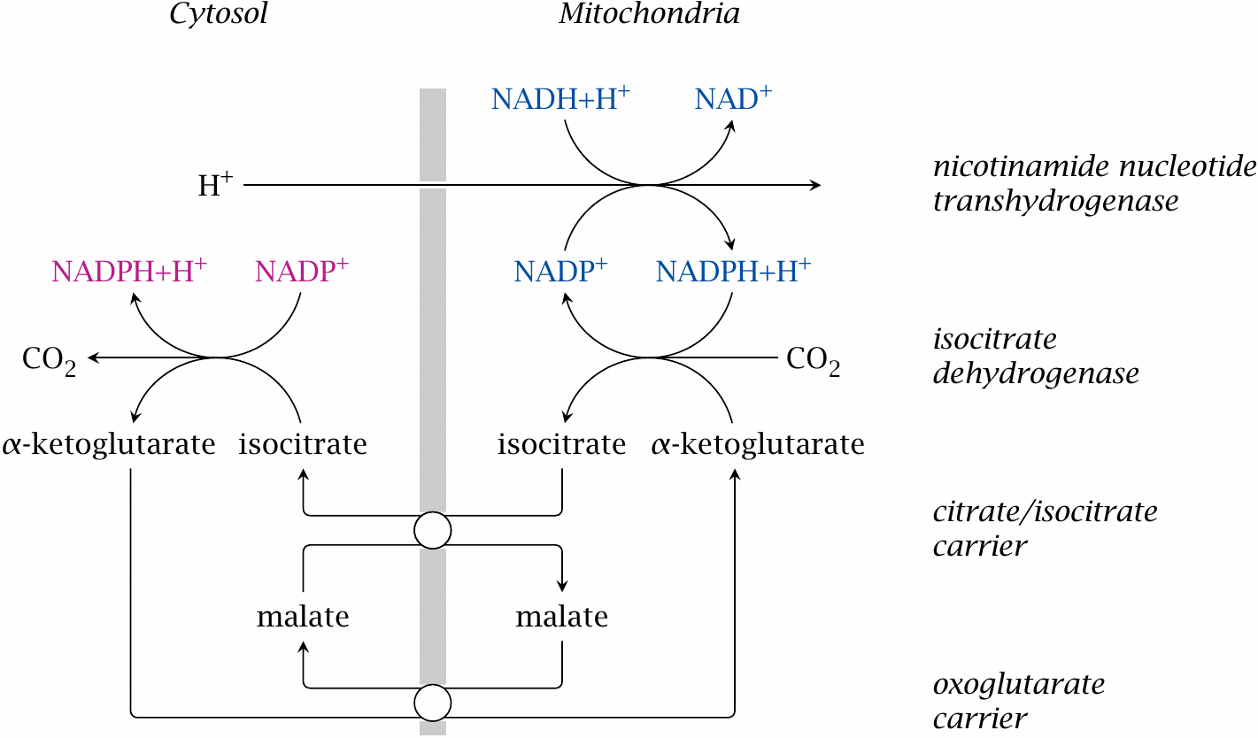
NADPH generation by transhydrogenase and NADP-linked isocitrate dehydrogenase

Slide 11
Uses of NADPH
synthesis of fatty acids and cholesterol
fixation of ammonia by glutamate dehydrogenase
oxidative metabolism of drugs and poisons by cytochrome P450 enzymes
generation of nitric oxide and of reactive oxygen species by phagocytes
scavenging of reactive oxygen species that form as byproducts of oxygen transport and of the respiratory chain

Slide 12
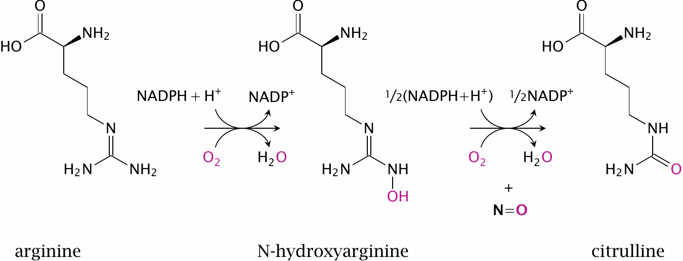
The nitric oxide synthase reaction

Slide 13
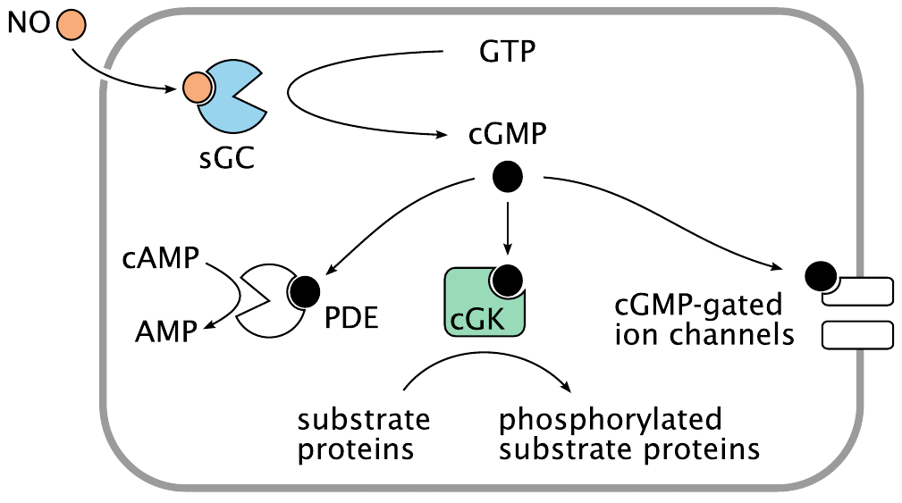
Signaling effects of nitric oxide

Slide 14
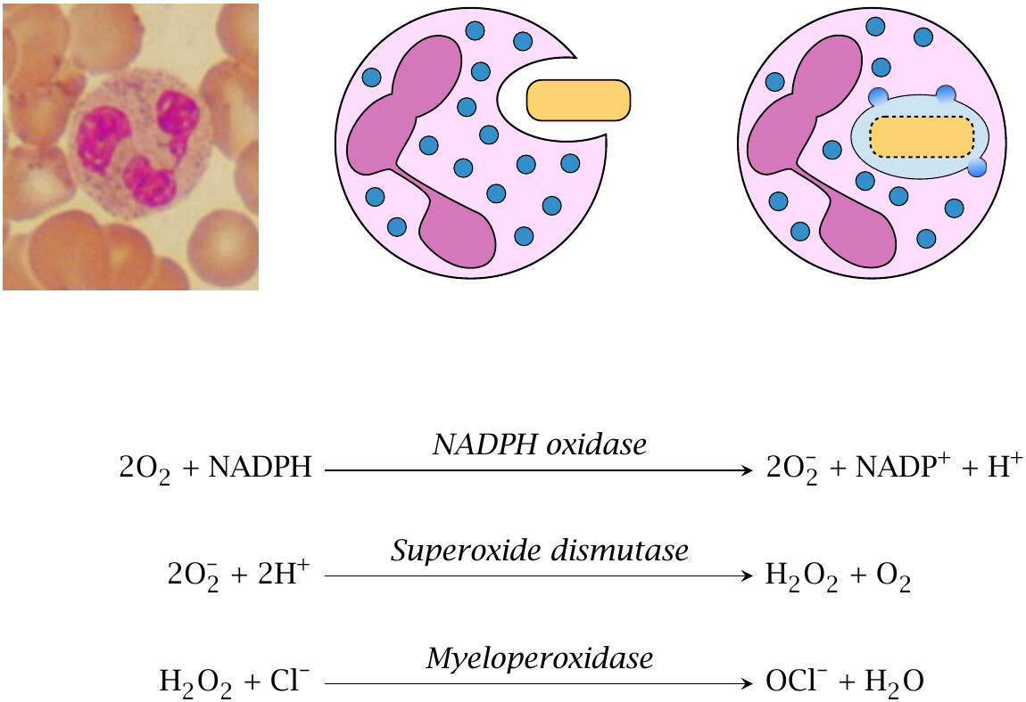
Phagocytes use NADPH to generate reactive oxygen species

Slide 15
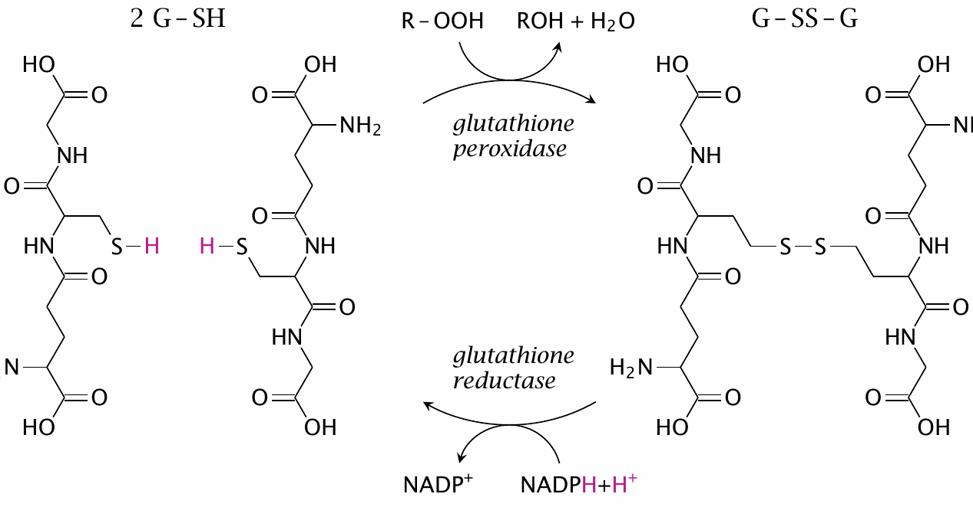
Scavenging of reactive oxygen species requires NADPH, too

Slide 16
Glucose-6-phosphate dehydrogenase deficiency
most patients are healthy most of the time—hemolytic crises occur upon exposure to drugs or diet components that cause enhanced formation of ROS
manifest in red blood cells because these cells lack protein synthesis—no replacement of deficient protein molecules
affords partial protection against malaria—similar to sickle cell anemia and other hemoglobinopathias
X-chromosomally encoded—males more severely affected

Slide 17
Vicia faba and favism

Slide 18
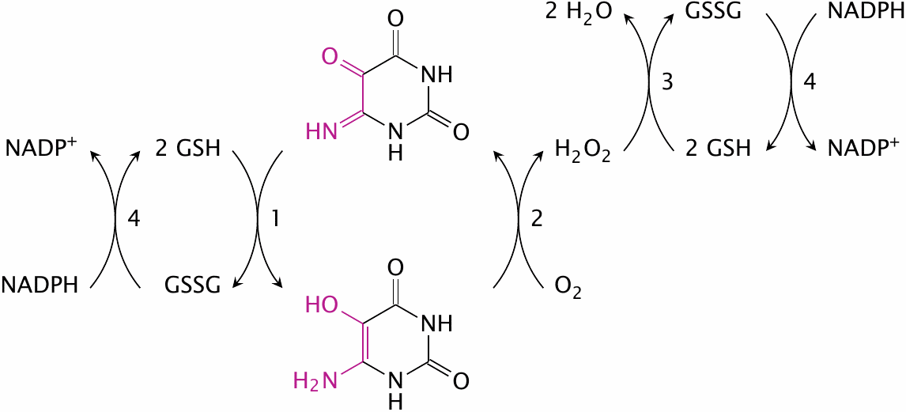
Redox cycling of isouramil

Slide 19
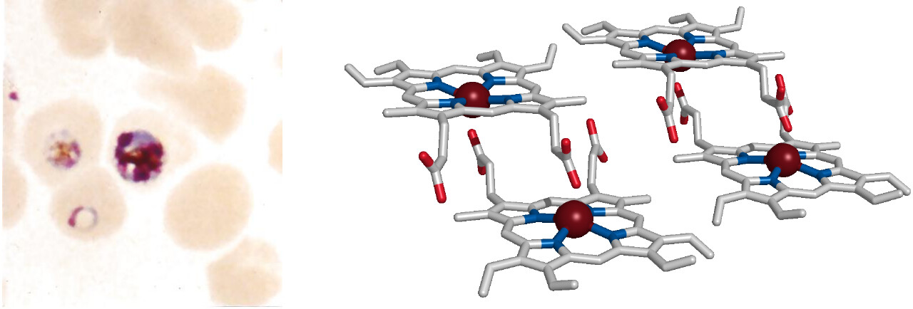
Malaria parasites detoxify heme by crystallization

Slide 20
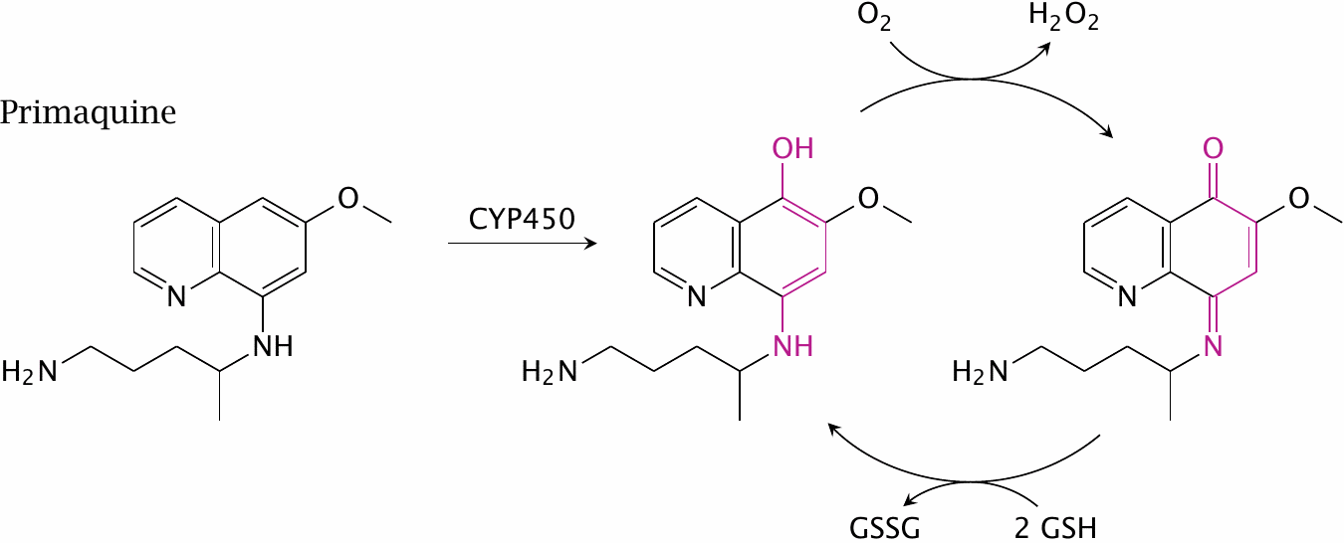
Primaquine and glucose-6-phosphate dehydrogenase deficiency

