Slide 1
Gluconeogenesis

Slide 2
Glucose is an indispensable metabolite
The brain requires at least ~50% of its calories in the form of glucose
Red blood cells exclusively subsist on glucose
Glucose is a precursor of other sugars needed in the biosynthesis of nucleotides, glycoproteins, and glycolipids
Glucose is needed to replenish NADPH, which supplies reducing power for biosynthesis and detoxification

Slide 3
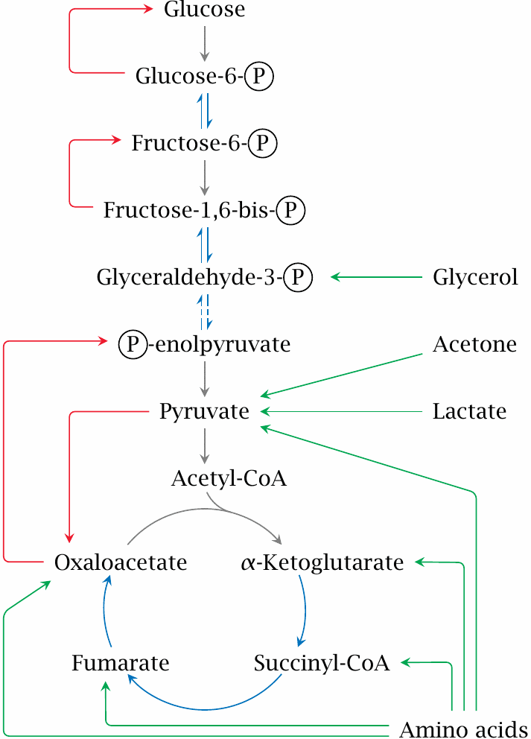
Overview of gluconeogenesis

Slide 4
The pyruvate carboxylase reaction

Slide 5
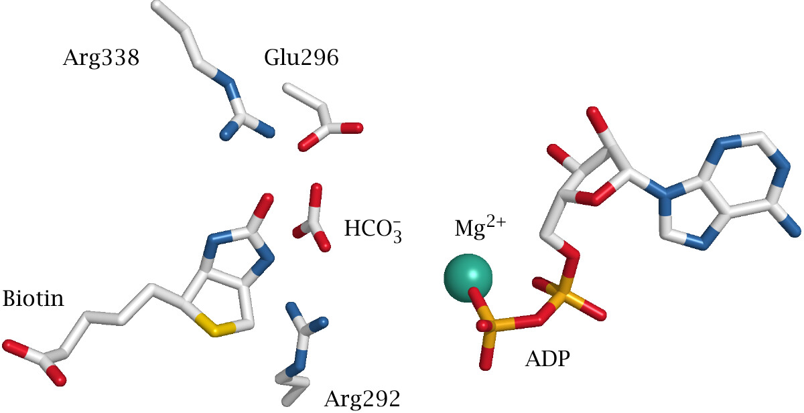
The active site of E. coli biotin carboxylase

Slide 6
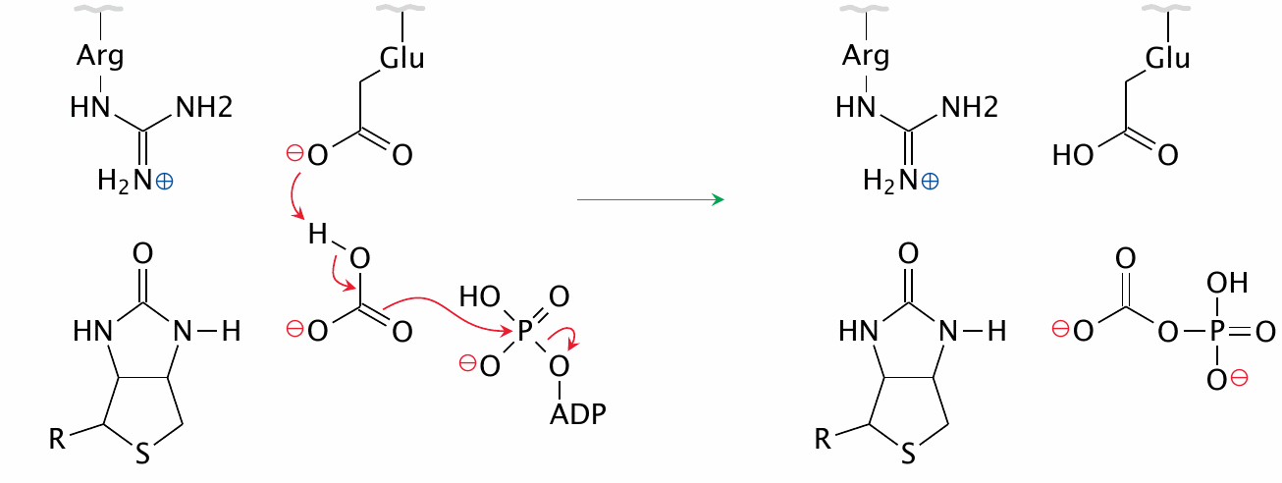
Activation of bicarbonate

Slide 7
The carboxylation of biotin

Slide 8
The carboxylation of pyruvate

Slide 9
The phosphoenolpyruvate carboxykinase reaction

Slide 10
Fructose-1,6-bisphosphatase and glucose-6-phosphatase

Slide 11
Energy balance of gluconeogenesis

Slide 12
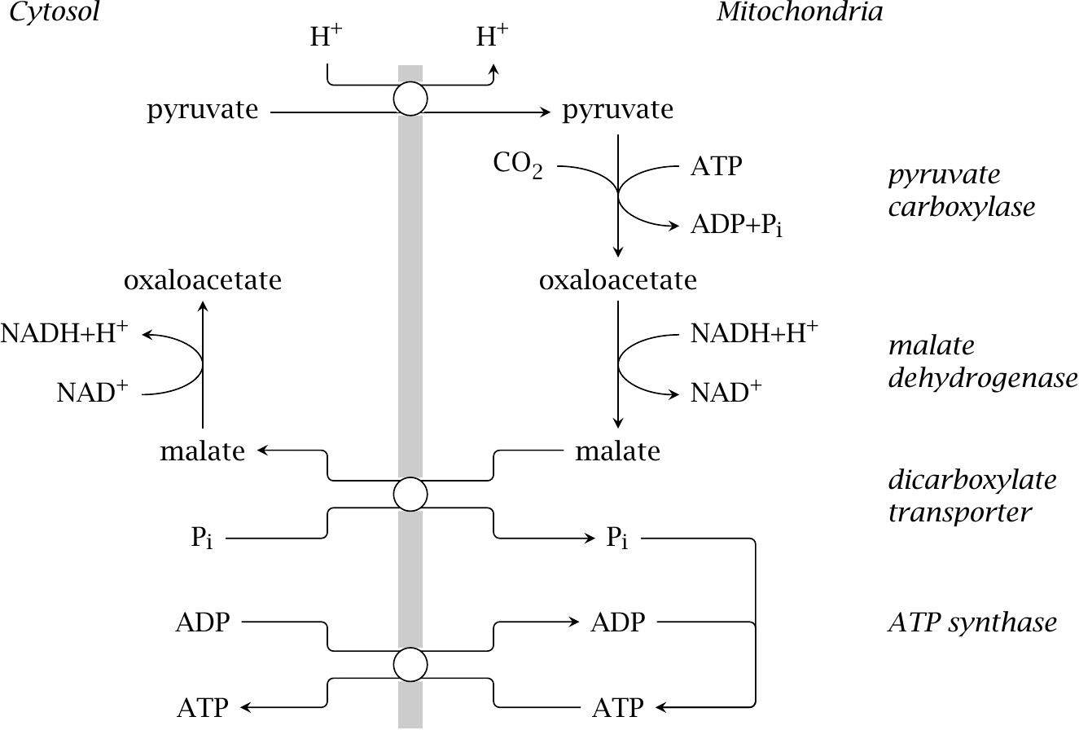
Mitochondrial substrate transport in gluconeogenesis

Slide 13
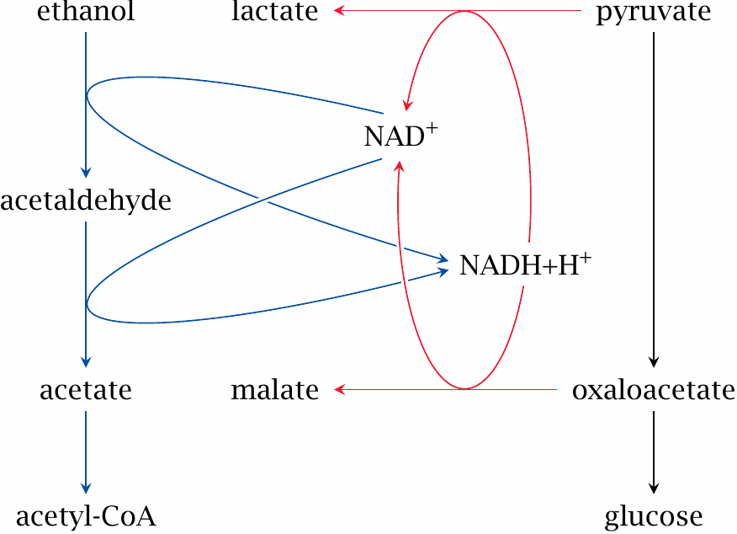
Ethanol degradation inhibits gluconeogenesis

Slide 14
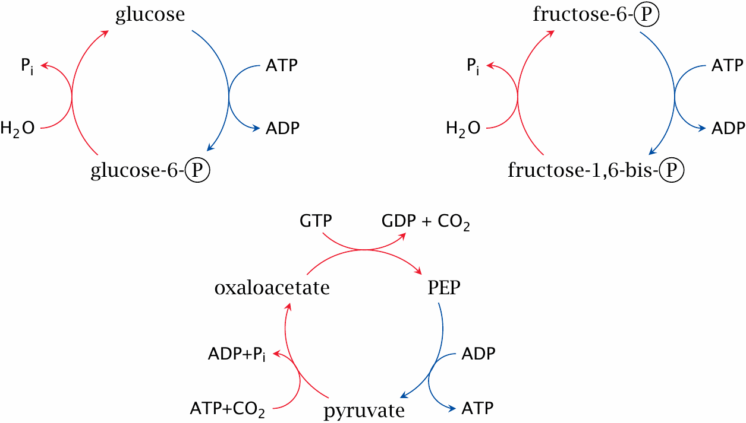
Simultaneous activity of glycolysis and gluconeogenesis creates futile cycles

Slide 15
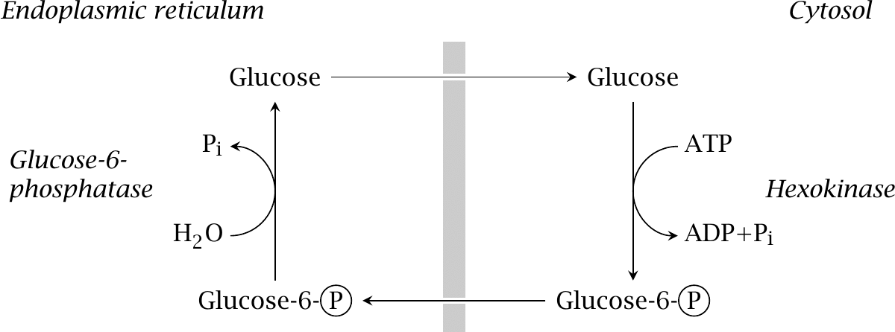
Glucose phosphorylation cycling involves two separate compartments

Slide 16
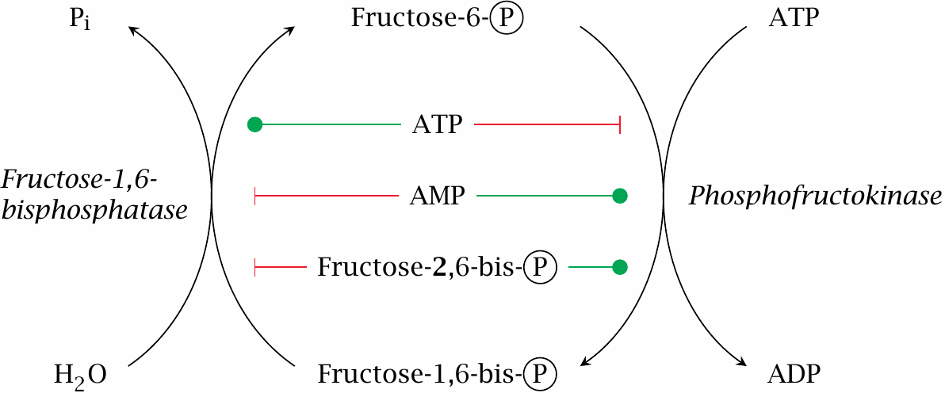
Allosteric regulation limits fructose-6-phosphate phosphorylation cycling

Slide 17
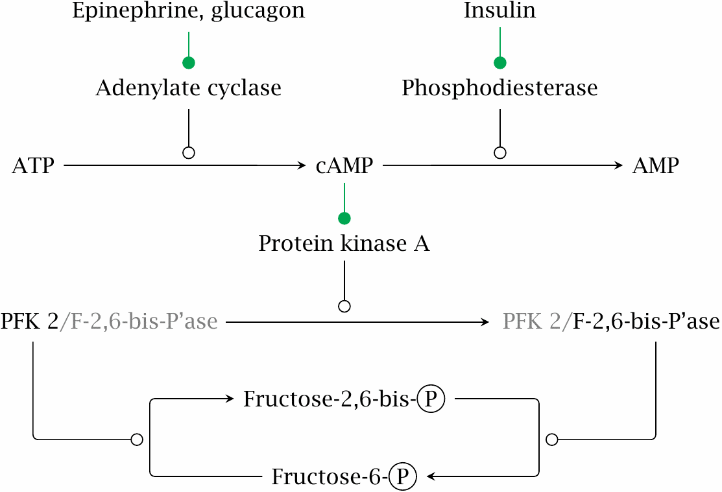
The level of fructose-2,6-bisphosphate is controlled by hormones

Slide 18
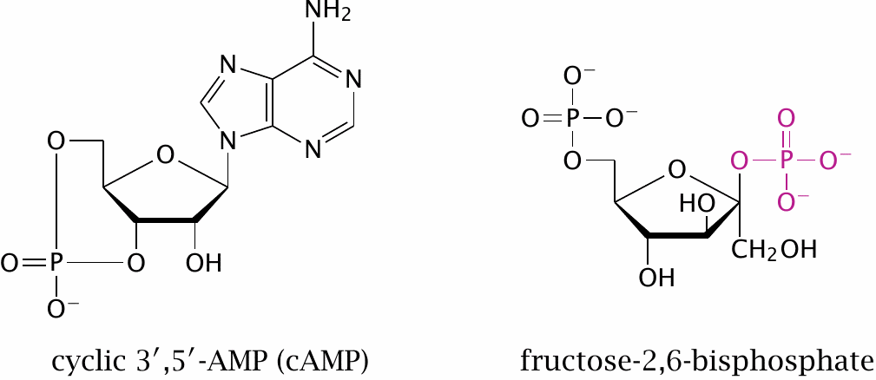
The secondary messengers cAMP and fructose-2,6-bisphosphate

Slide 19
Regulation of pyruvate kinase
allosteric activation by fructose-1,6-bisphosphate
allosteric inhibition by ATP and alanine
inhibition by PKA-mediated phosphorylation

