Slide 1
Catabolism of sugars other than glucose

Slide 2
Dietary sugars other than glucose
Trivial name | Composition | Source
lactose (milk sugar) | disaccharide of glucose and galactose | milk
sucrose | disaccharide of glucose and fructose | sugar cane, sugar beet, other fruits
fructose | monosaccharide | various fruits
sorbitol | sugar alcohol | fruits; semisynthetic
ribose, deoxyribose | monosaccharides | nucleic acids

Slide 3
Degradation of fructose and sucrose

Slide 4
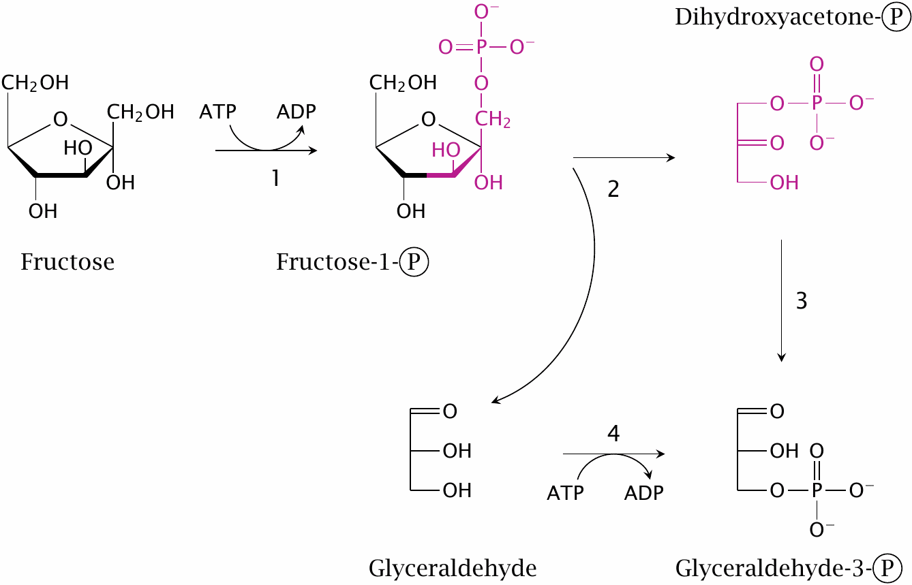
The fructolysis pathway

Slide 5
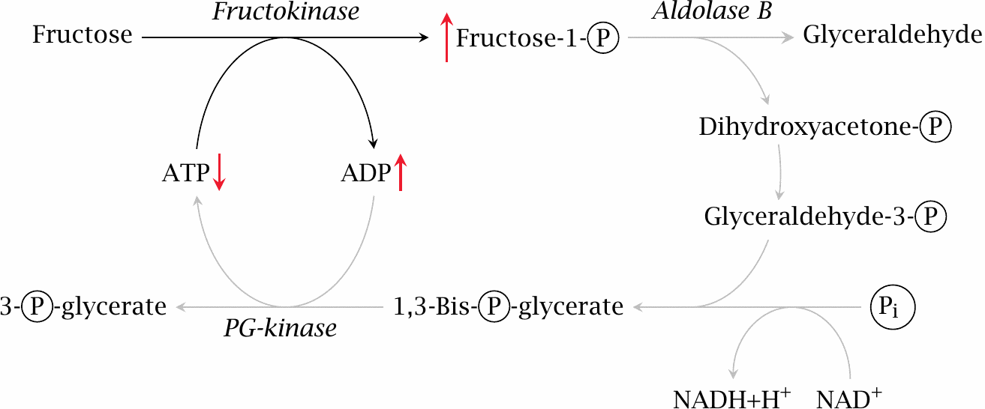
Fructose intolerance

Slide 6
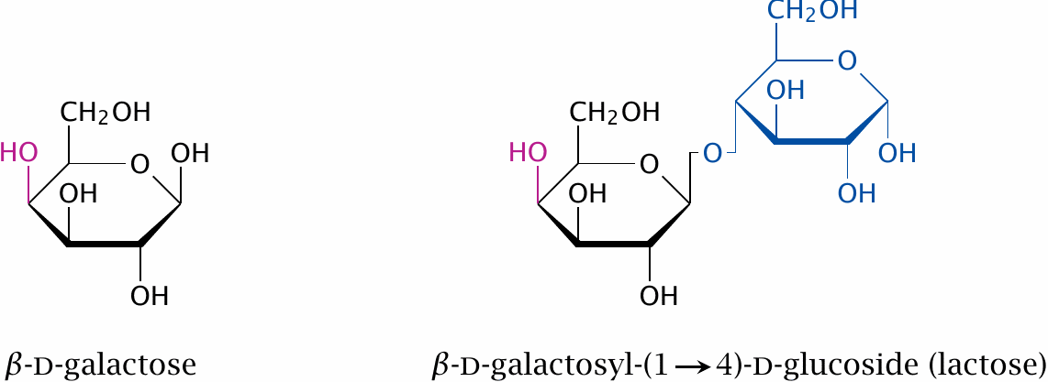
Lactose and galactose

Slide 7
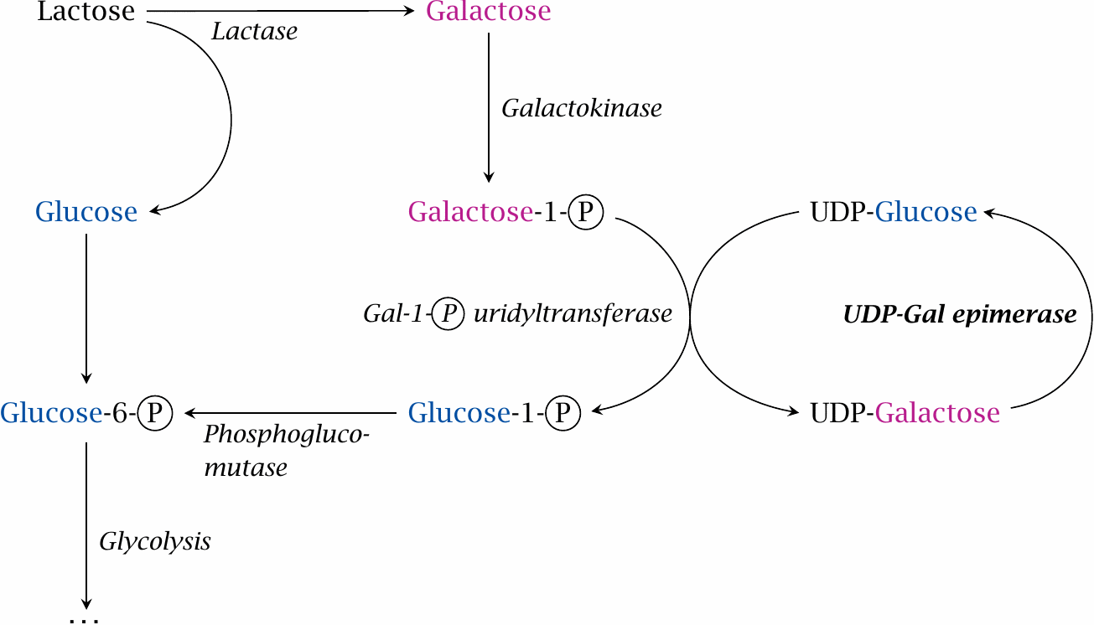
The Leloir pathway for galactose utilization

Slide 8
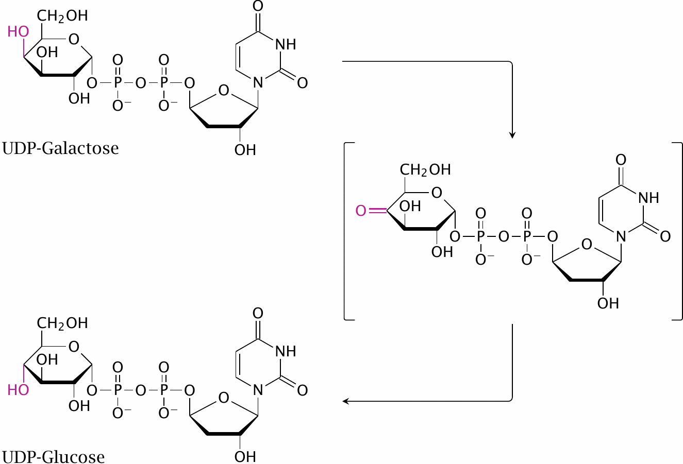
Mechanism of UDP-galactose epimerase

Slide 9
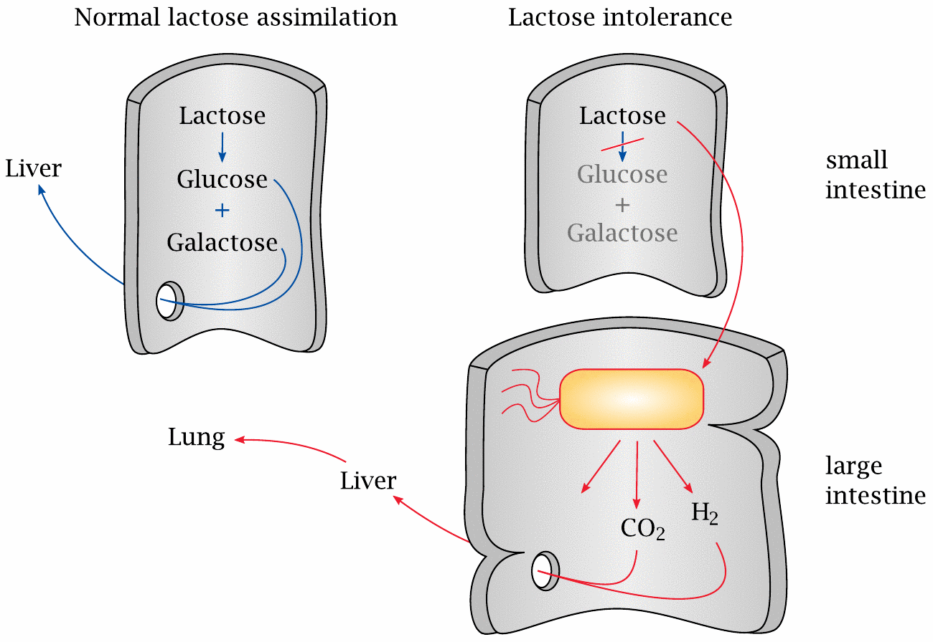
Lactose intolerance

Slide 10
Galactosemia
Type | Enzyme deficiency | Accumulating metabolites
I | galactose-1-phosphate-uridyltransferase | galactose, galactose-1-phosphate, galactitol, galactonate
II | galactokinase | galactose, galactitol
III | UDP-galactose epimerase | galactose-1 phosphate, UDP-galactose

Slide 11
Sorbitol is an intermediate of the polyol pathway

