Slide 1
Iron and heme metabolism

Slide 2
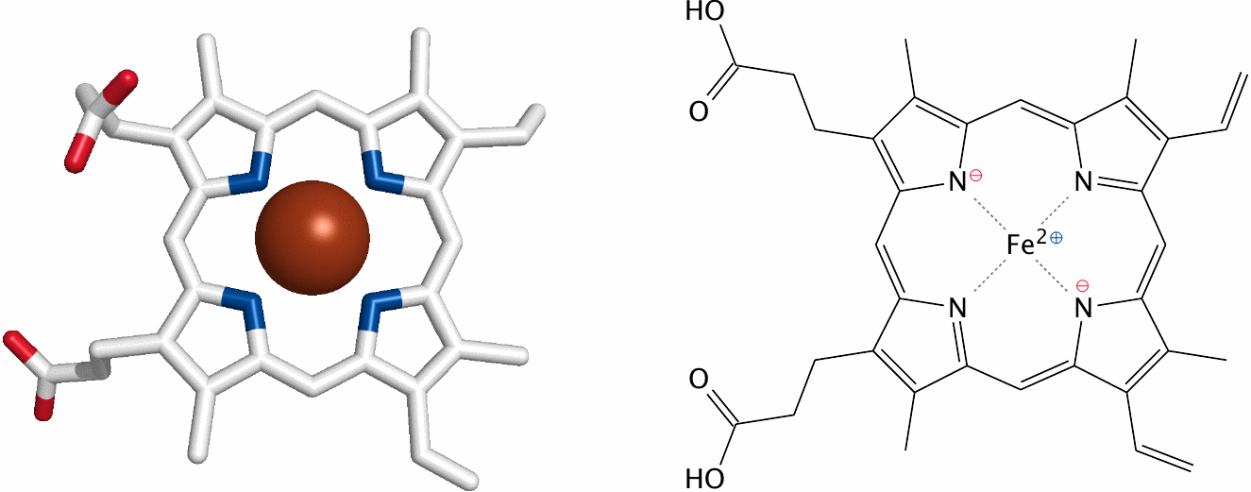
Iron and heme metabolism

Slide 3
Functions of heme
Redox chemistry
electron transport: cytochromes in the respiratory chain
enzyme catalysis: cytochrome P450, cyclooxygenase, others
Reversible binding of gases
O₂: hemoglobin and myoglobin (80–90% of all heme)
NO: guanylate cyclase

Slide 4
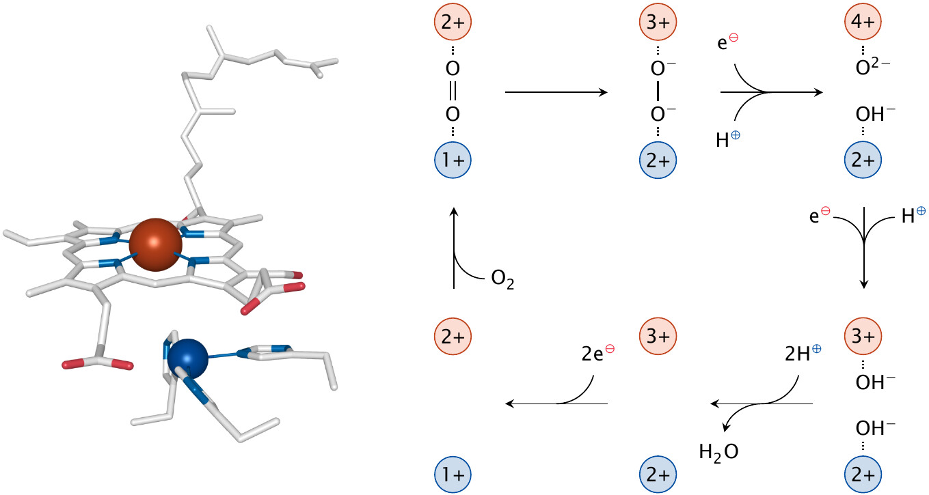
Heme in cytochrome C oxidase

Slide 5
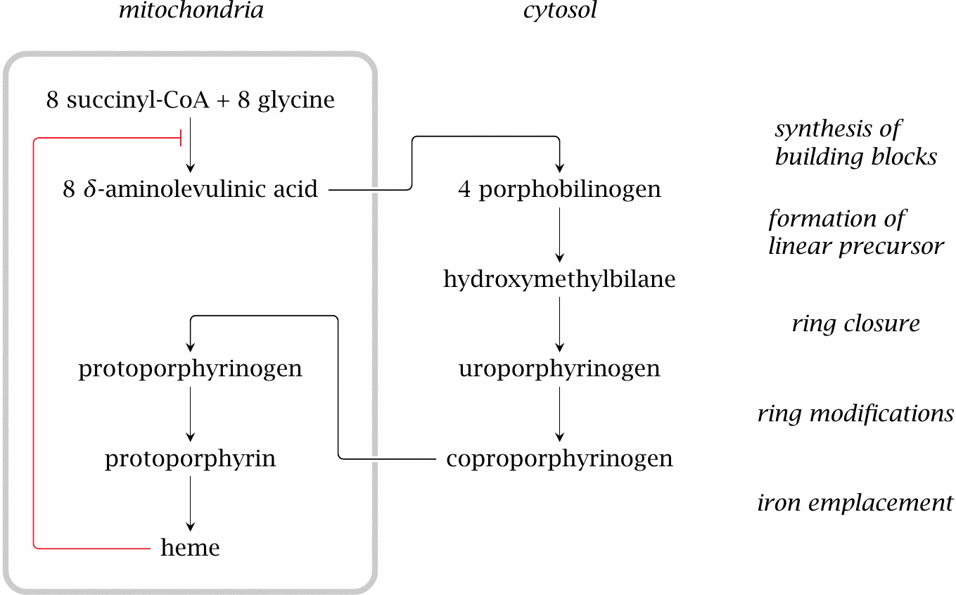
Heme synthesis (overview)

Slide 6
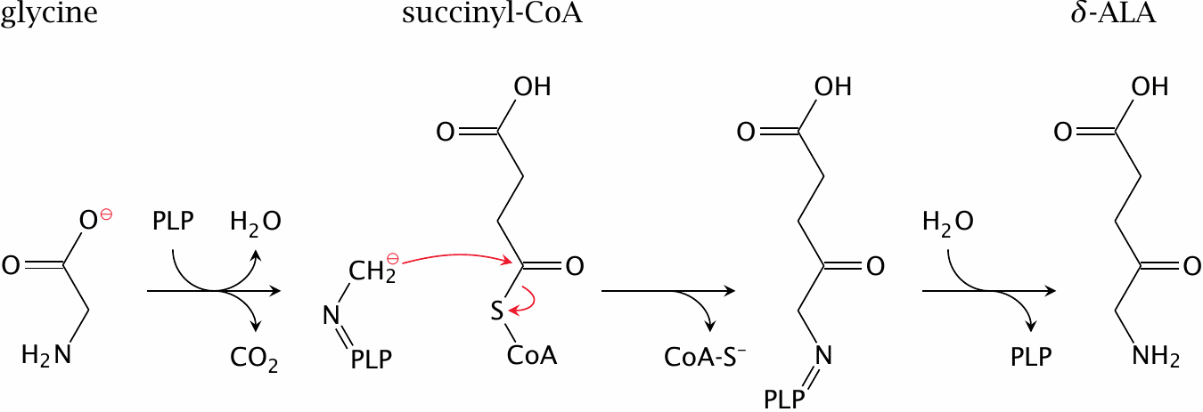
The δ-aminolevulinate synthase reaction

Slide 7
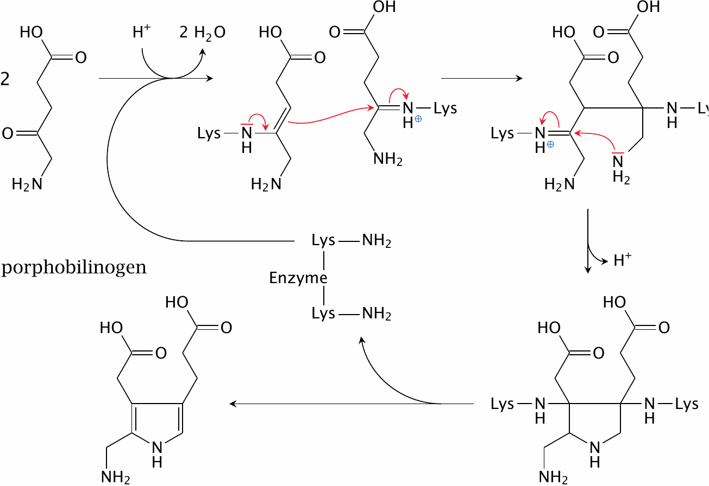
The porphobilinogen synthase reaction

Slide 8
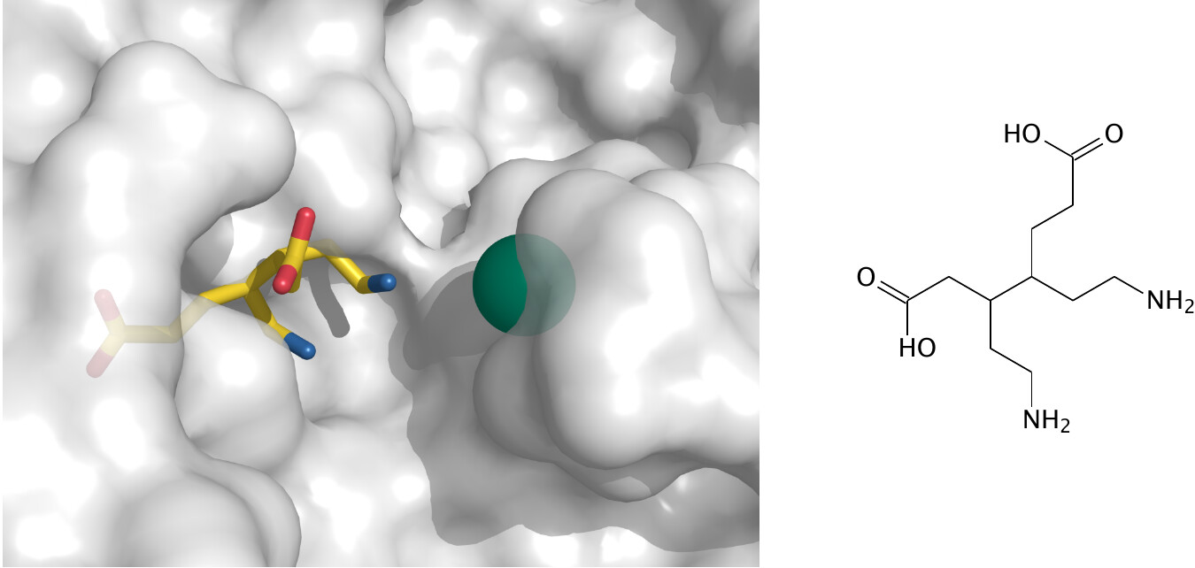
A substrate analogue next to zinc inside the active site of porphobilinogen synthase

Slide 9
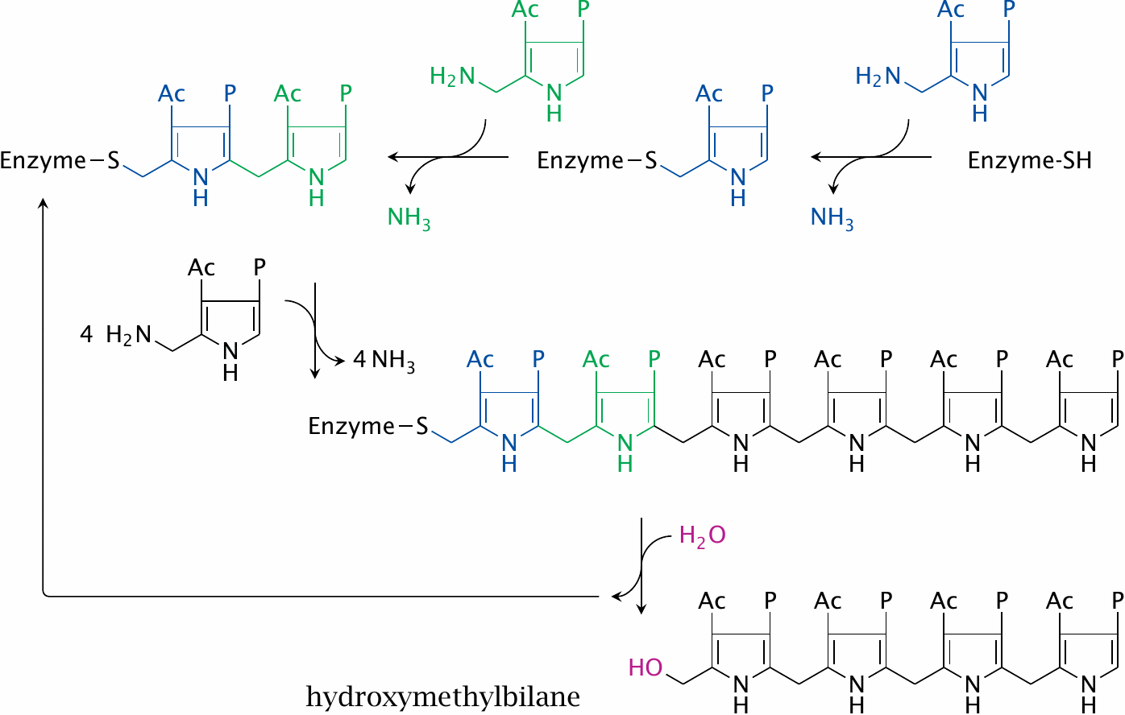
Porphobilinogen deaminase synthesizes hydroxymethylbilane

Slide 10
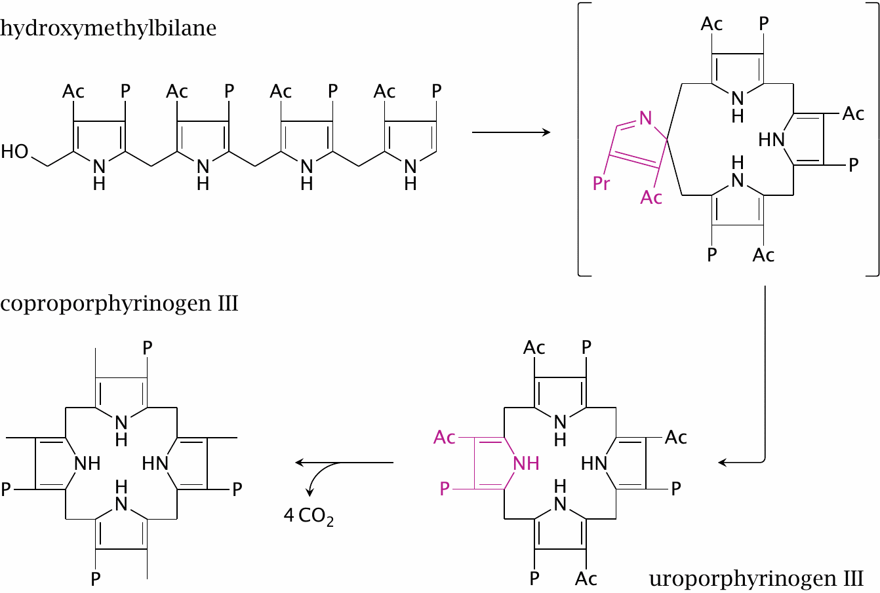
Synthesis of uro- and coproporphyrinogen III

Slide 11
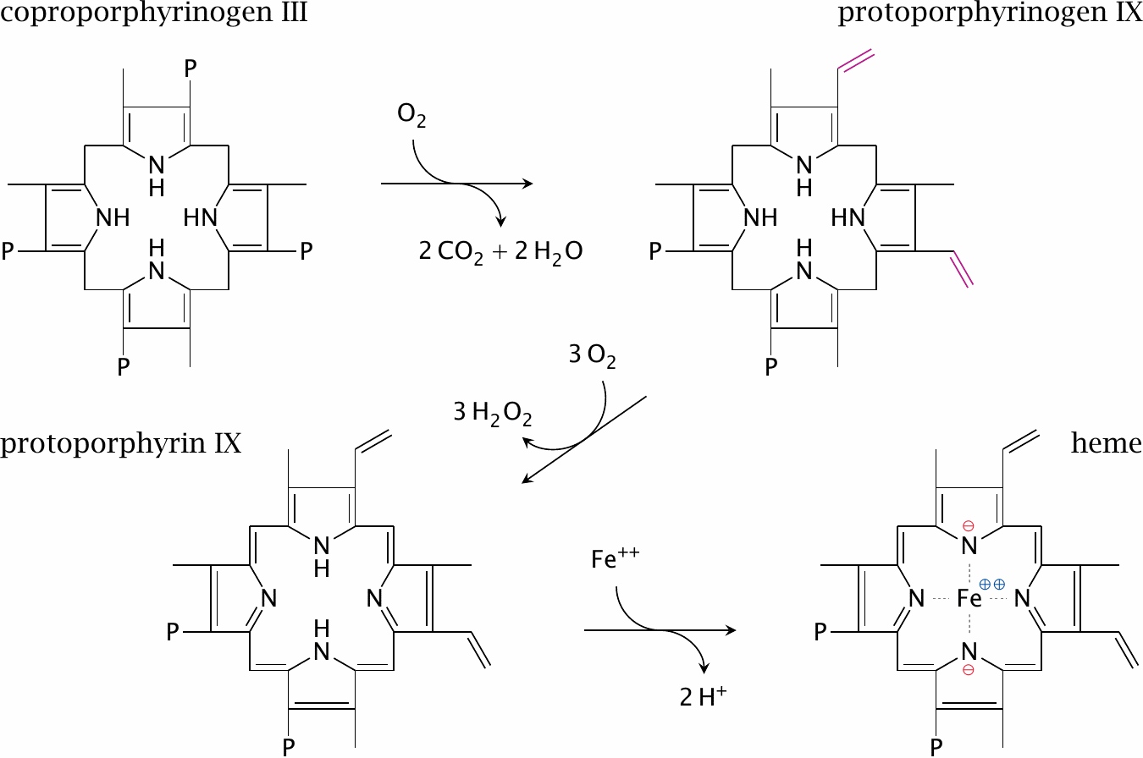
Final steps in heme synthesis

Slide 12
Disruptions of heme synthesis
iron depletion
hereditary enzyme defects (porphyrias)
vitamin B₆ deficiency—inhibition of aminolevulinate synthase
lead poisoning—inhibition of porphobilinogen synthase

Slide 13
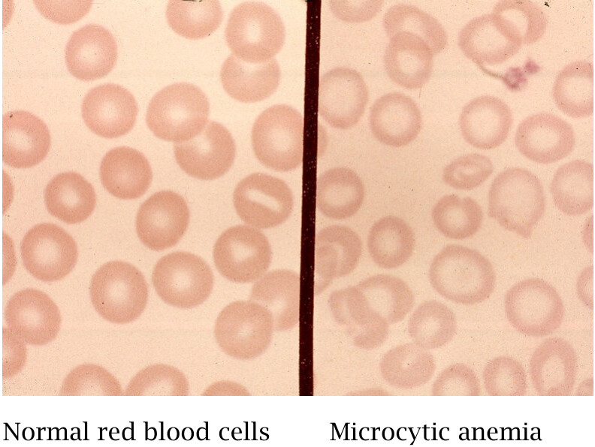
Disruption of heme synthesis causes microcytic, hypochromic anemia

Slide 14
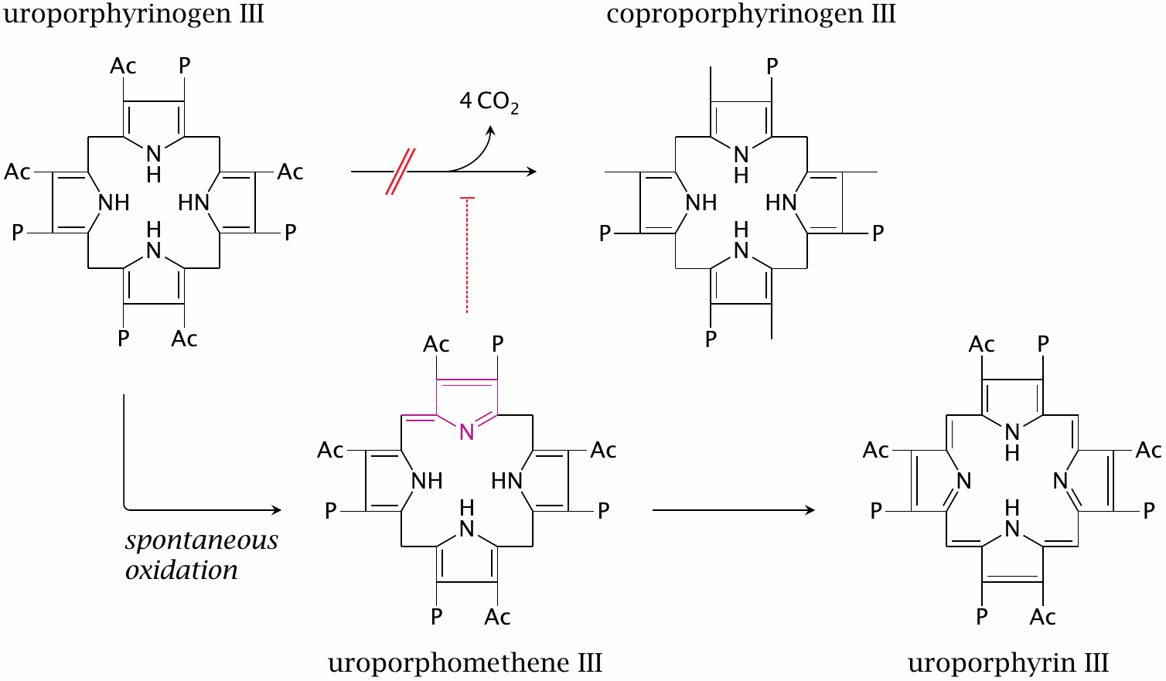
Porphyria cutanea tarda (PCT) is caused by uroporphyrinogen decarboxylase deficiency

Slide 15
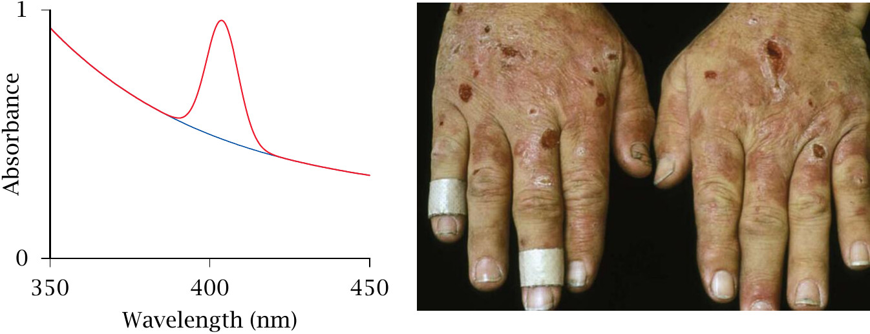
Laboratory and clinical findings in PCT

Slide 16
Causation of porphyria cutanea tarda
hereditary—rare, autosomal dominant; enzyme defect is manifest in all tissues
sporadic—exogenous, or related to a genetic defect in iron uptake regulation
caused by alcohol, halogenated hydrocarbons, other toxic substances
enzyme activity lacking in the liver but not erythrocytes and other tissues—enzyme is functional but inhibited by interfering metabolites
iron overload seems important in both hereditary and sporadic forms

Slide 17
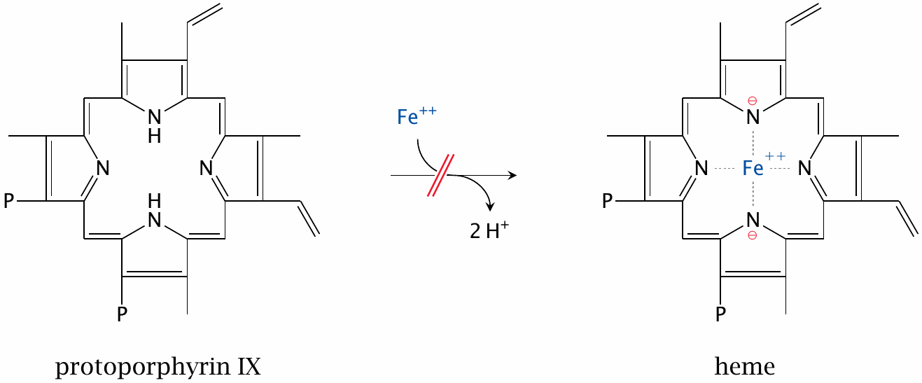
A defect of ferrochelatase causes erythropoietic protoporphyria

Slide 18
Acute intermittent porphyria (AIP)
deficiency of porphobilinogen deaminase, autosomal dominant
excessive synthesis of δ-ALA in liver
surplus porphobilinogen in urine—urine is colored red
δ-ALA inhibits the GABA_{A} receptor, causing
psychiatric symptoms (‘organic psychosis’)—too often misdiagnosed and mistreated
abdominal pain (neuropathic)
episodes can be induced by drugs

Slide 19
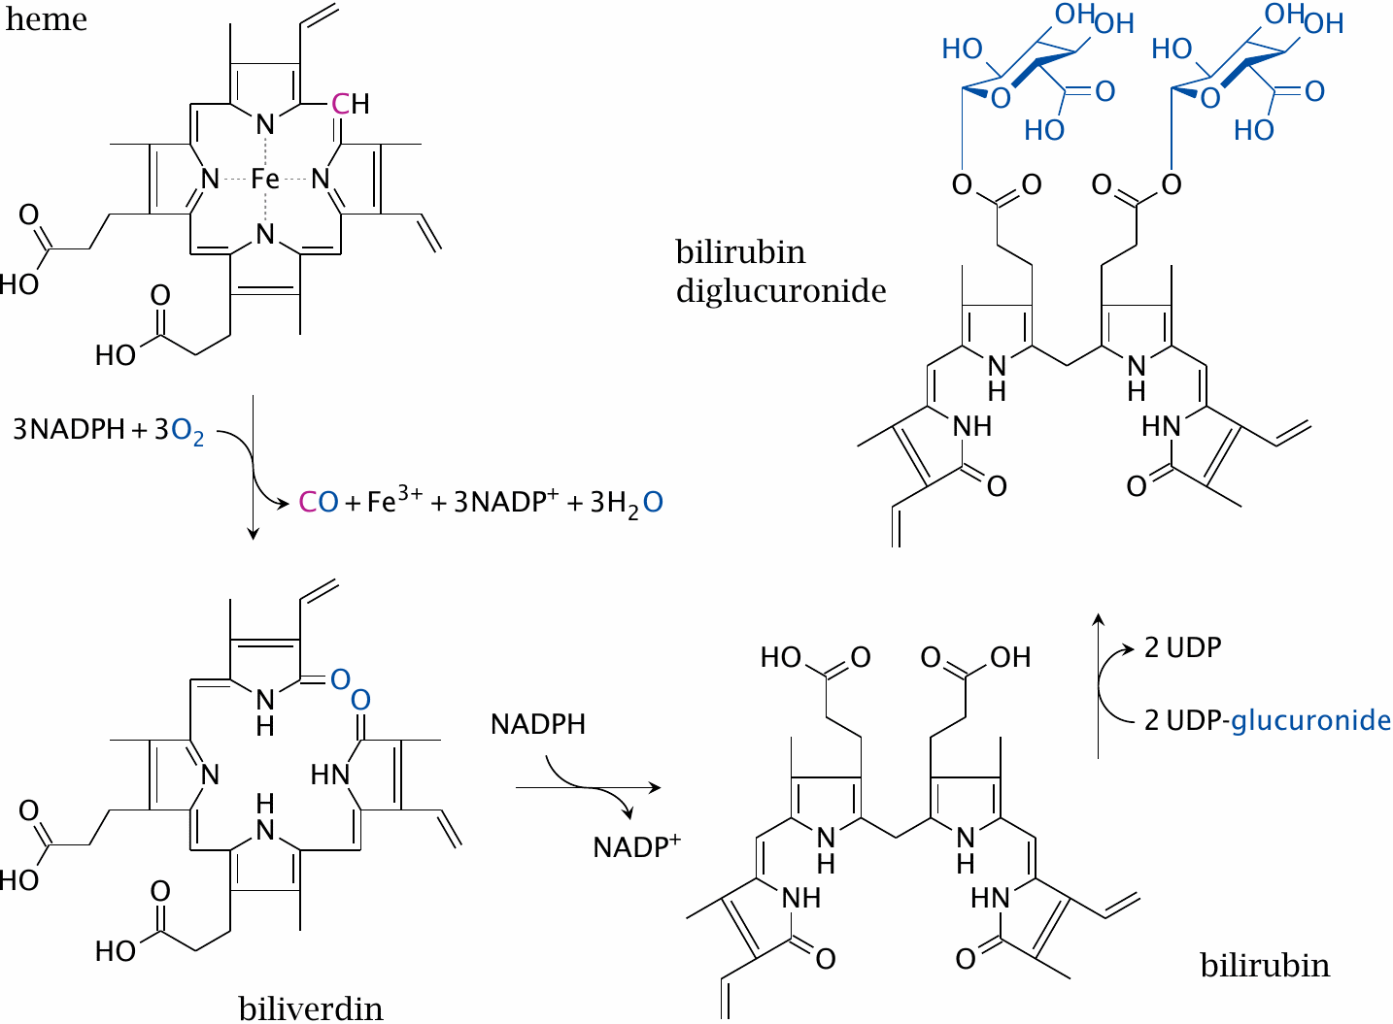
Heme degradation

Slide 20
Jaundice
Accumulation of bilirubin in the body. Causes:
increased production: hemolytic anemia (premature decay of red blood cells)
decreased conjugation: enzyme defect, liver disease
decreased excretion of conjugated heme: deficiency of ABCC2 transporter (Dubin-Johnson syndrome)
mechanically blocked excretion: bile duct blocked by bile stone or tumor

Slide 21
Enzyme defects in bilirubin conjugation by UDP-glucuronosyltransferase
transient, usually mild: neonatal jaundice
genetic, mild: Gilbert syndrome—asymptomatic jaundice
genetic, severe, rare: Crigler-Najjar syndrome

Slide 22
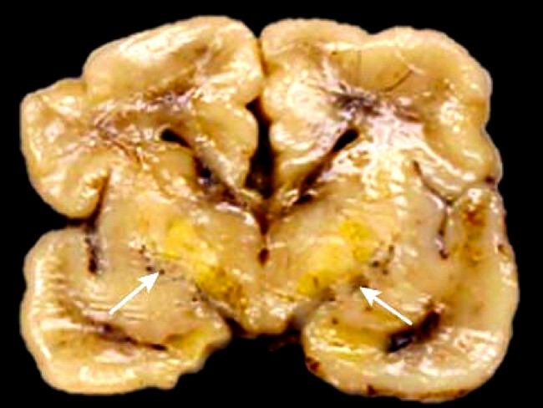
Bilirubin encephalopathy (“kernicterus”)

Slide 23
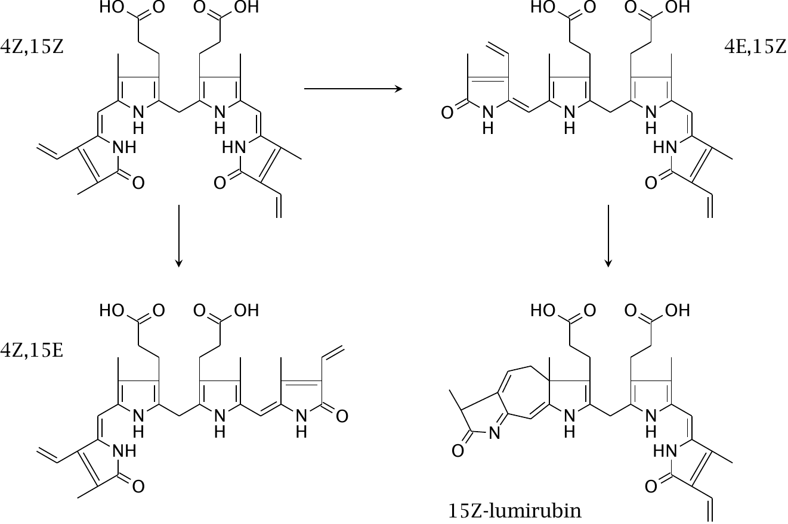
Photoisomerization products of bilirubin

Slide 24
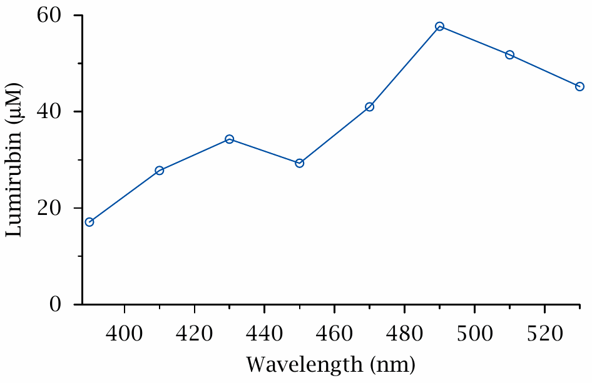
Wavelength dependence of lumirubin formation

Slide 25
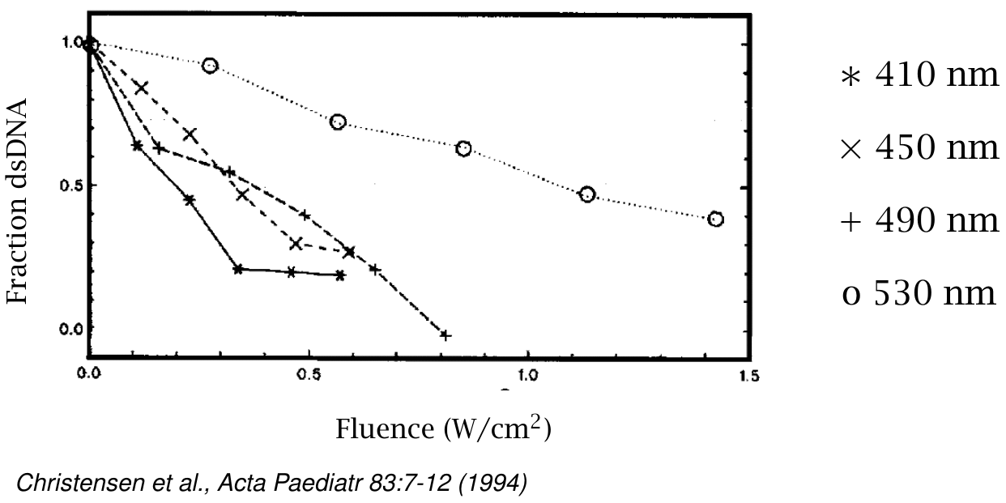
DNA strand breaks induced by bilirubin photo-activation (determined with Hoechst 32258)

Slide 26
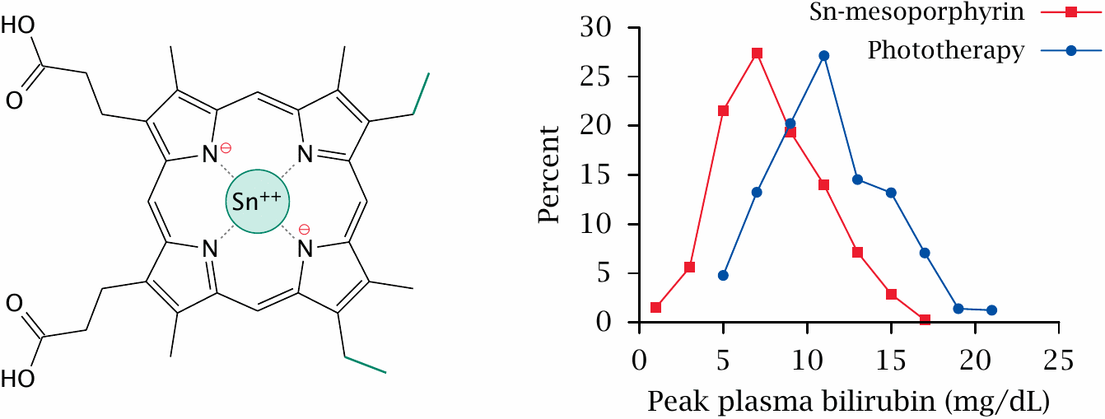
Sn-mesoporphyrin, an inhibitor of heme oxygenase
68from Pediatrics 108:25–30

Slide 27
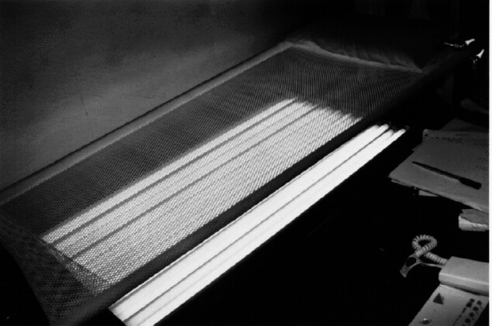
Long-term phototherapy of Crigler-Najjar syndrome

Slide 28
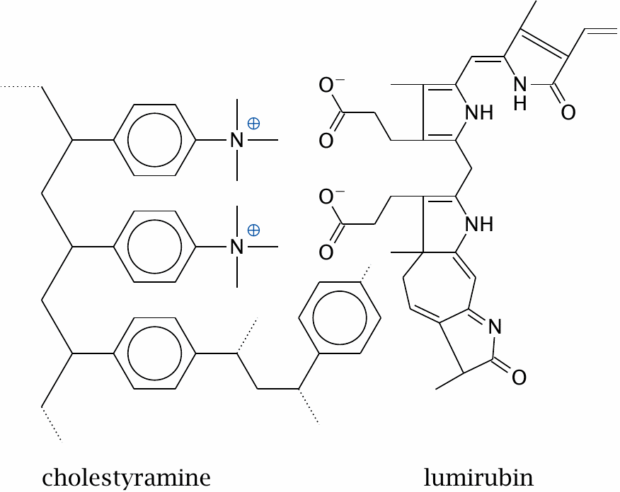
Cholestyramine particles absorb lumirubin

Slide 29
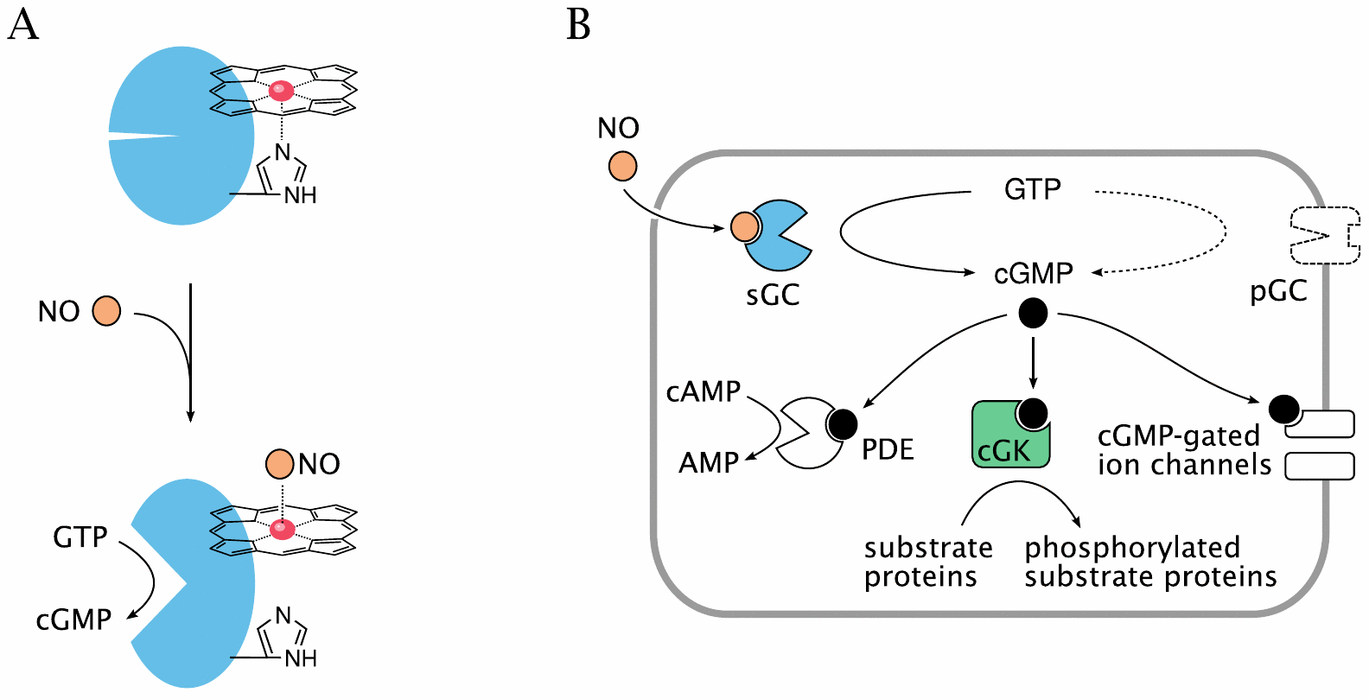
Is CO a signaling molecule, like NO?

Slide 30
Iron uptake, transport and storage
uptake in the small intestine: Fe²⁺—free or bound to heme
transient storage as ferritin inside the intestinal epithelia
transport in the blood: Fe³⁺—bound to transferrin with very high affinity
cellular uptake: endocytosis of transferrin, release of iron in acidic endosome
storage: intracellular ferritin particles
depletion: scaled-off cells, blood loss, breast milk

Slide 31
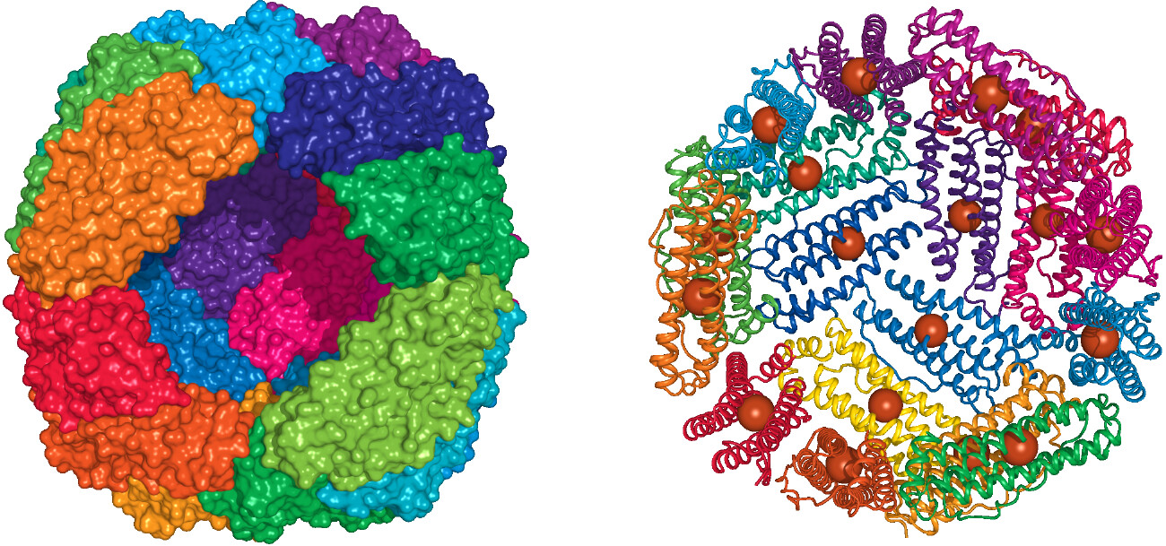
Structure of ferritin

Slide 32
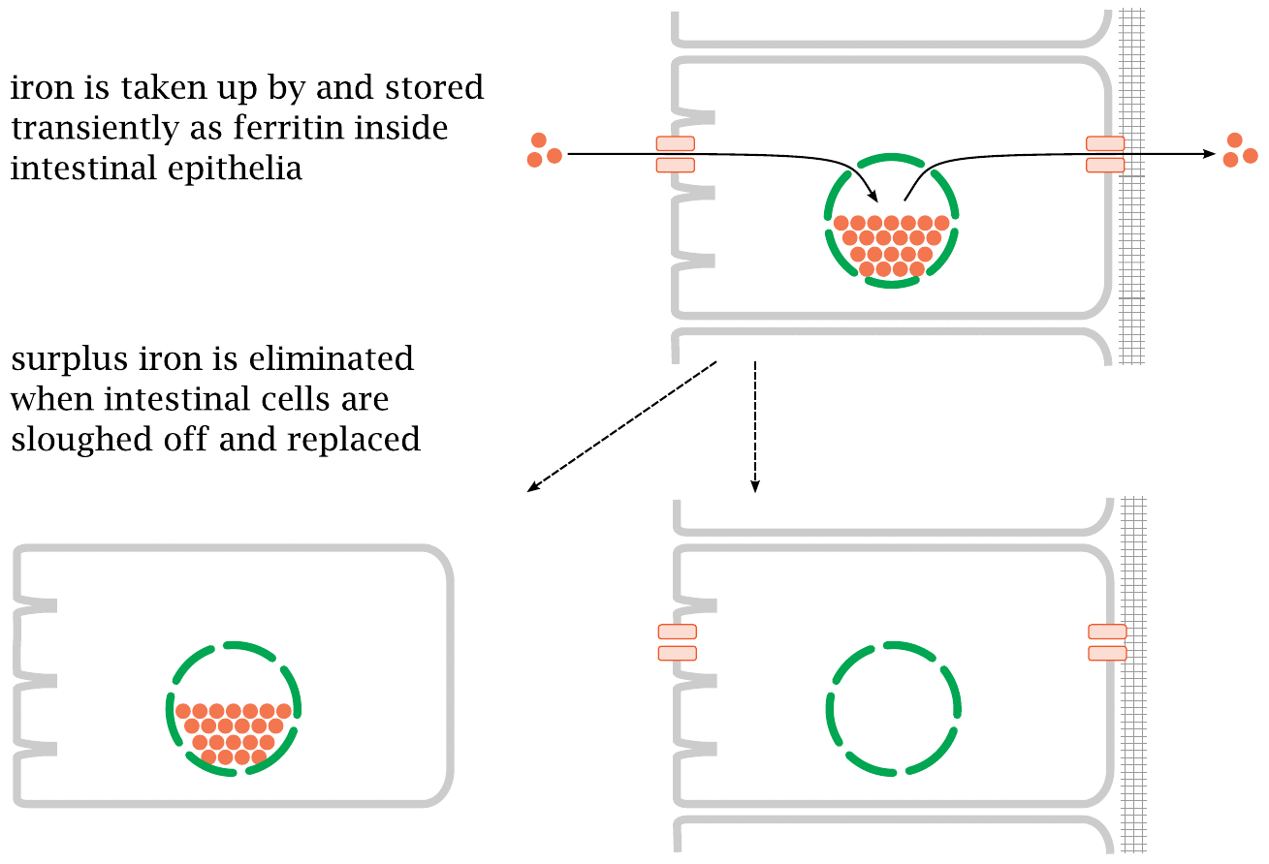
Ferritin in the small intestine regulates iron uptake

Slide 33
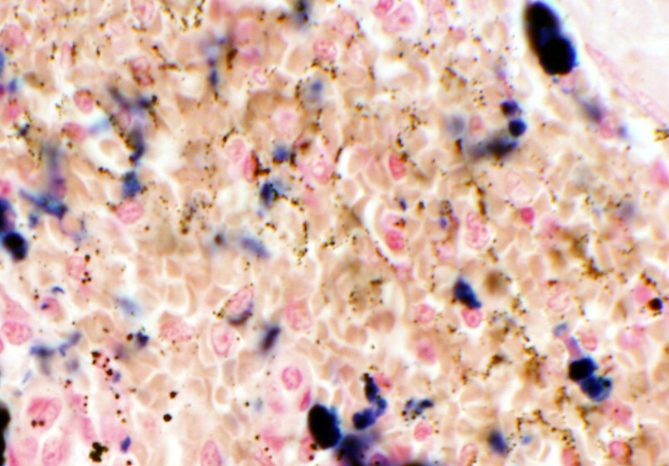
Hemosiderin in liver tissue

