Slide 1
Diabetes mellitus

Slide 2
Diabetes mellitus
What’s in a name?
diabetes: “marching through”—urine is produced incessantly
mellitus: honey-sweet—as opposed to diabetes insipidus (insipid—without flavor)
What does the adjective tell us about a traditional method of diagnosis?

Slide 3
Forms and causes of diabetes mellitus
Form | Cause
type 1 | lack of insulin due to destruction of β-cells in pancreas islets
type 2 | lack of functional response to insulin
secondary | excess activity of hormones antagonistic to insulin

Slide 4
Overview of kidney function
Urine is “distilled” from blood plasma in several stages:
ultrafiltration: 10-20% of the blood plasma volume that passes through the kidneys is squeezed across a molecular sieve; small solutes are filtrated, macromolecules are retained
solute reuptake: glucose, amino acids, salts etc. are recovered from the ultrafiltrate through active transport
water reuptake: driven by osmotic gradient
solute secretion: some substrates are actively secreted into the nascent urine

Slide 5
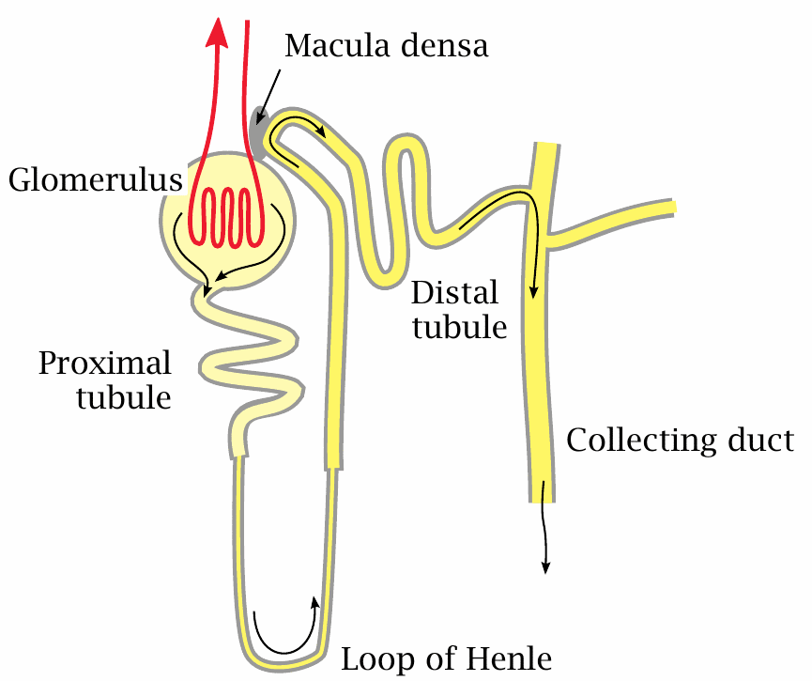
The nephron

Slide 6
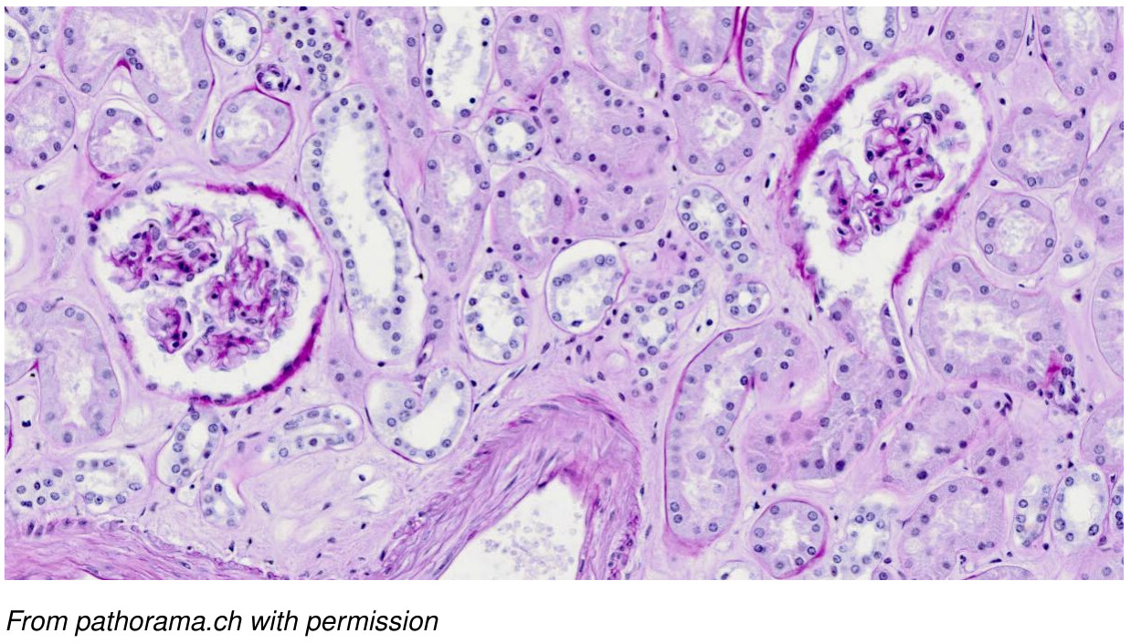
Kidney tissue structure and function: Glomeruli and tubules

Slide 7
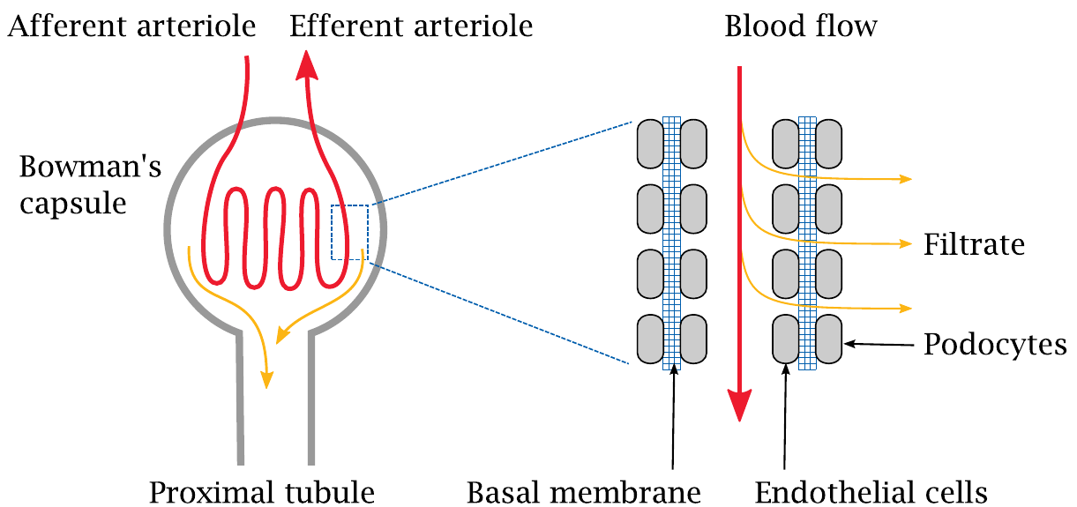
Primary filtration occurs in the glomerulus

Slide 8
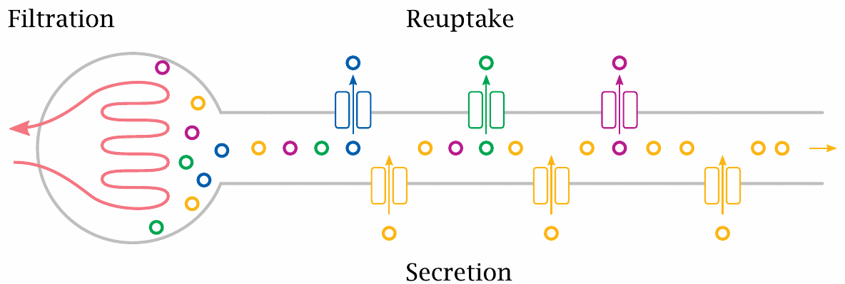
Reuptake and secretion occur in the tubular segments

Slide 9
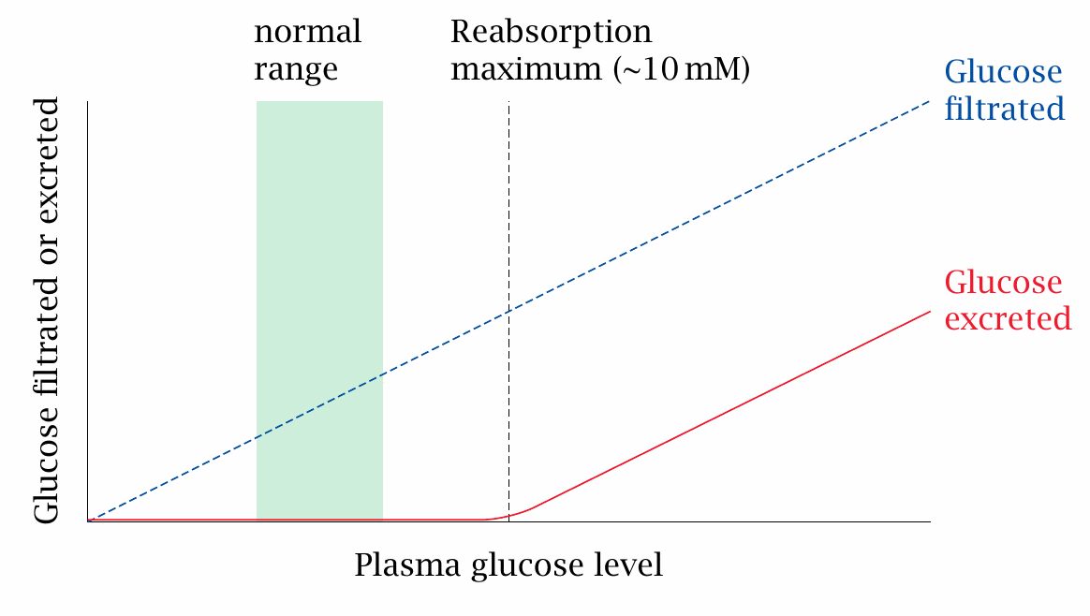
The capacity for glucose reuptake is saturated slightly above the physiological plasma concentration range

Slide 10
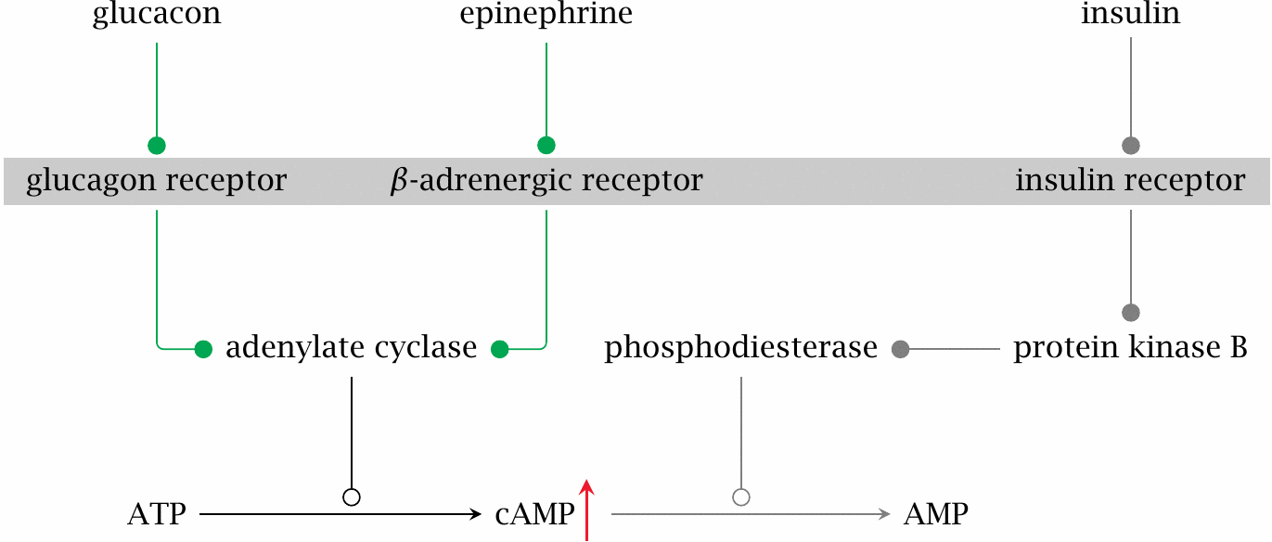
Lack of insulin drives up cAMP

Slide 11
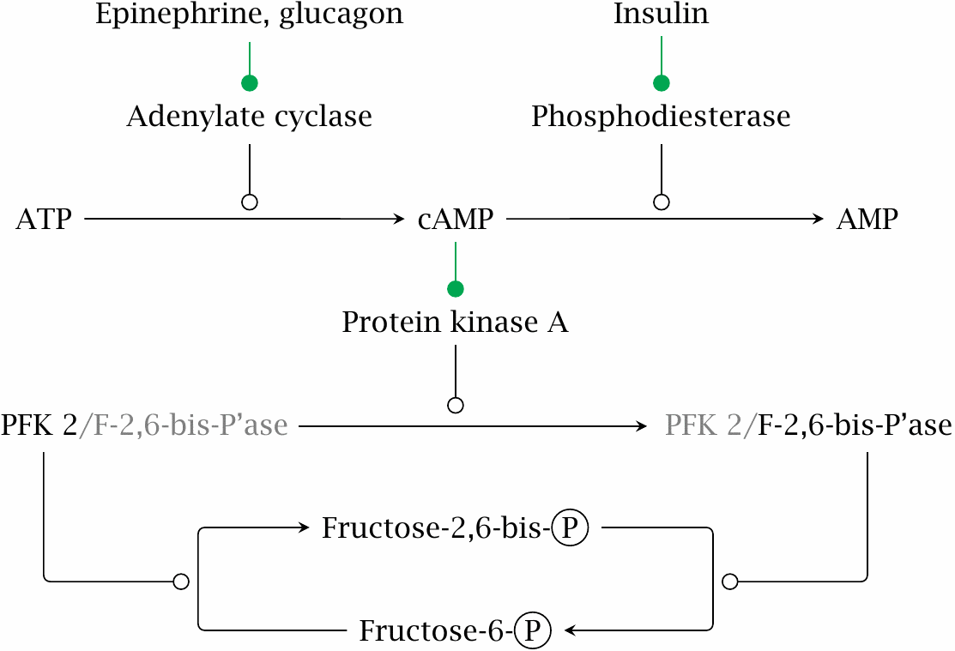
Lack of insulin promotes gluconeogenesis

Slide 12
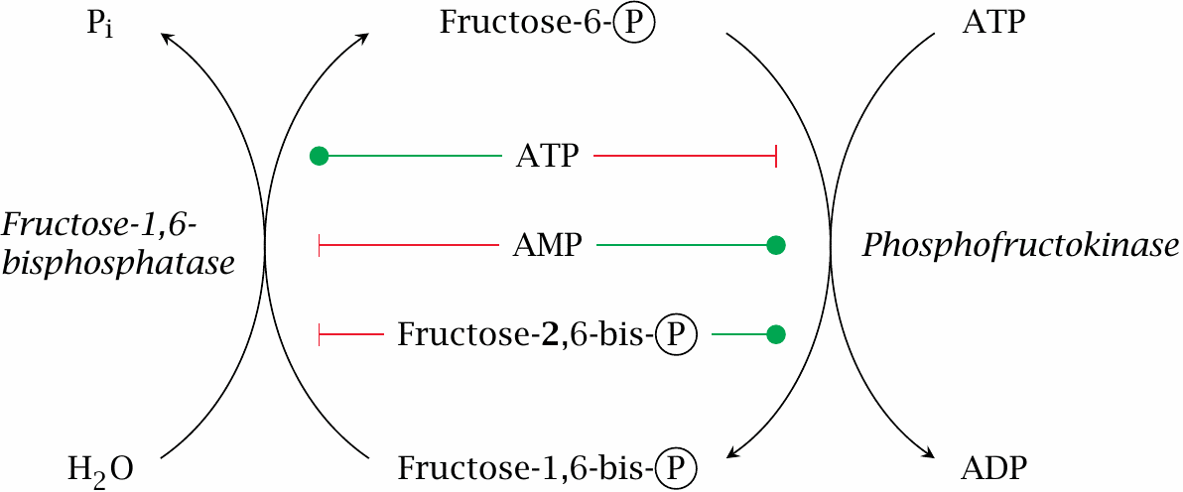
Lack of insulin promotes gluconeogenesis (2)

Slide 13
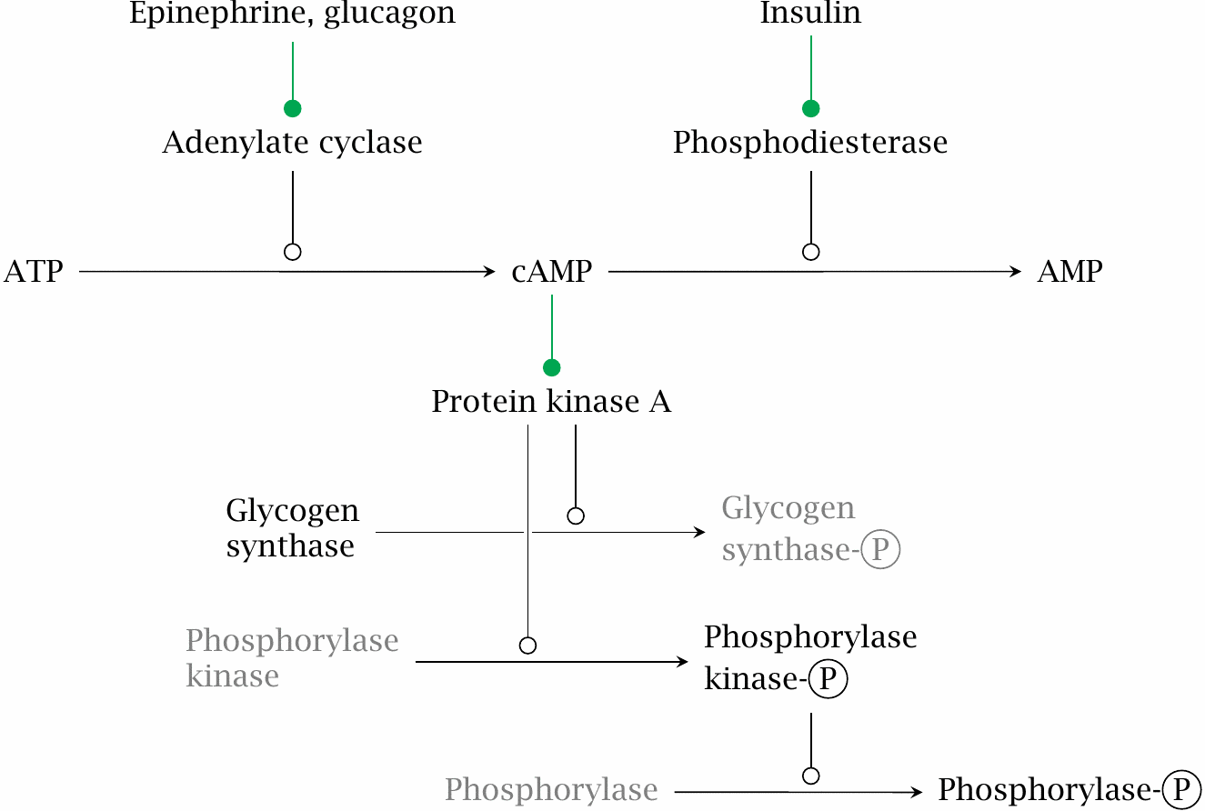
Lack of insulin induces breakdown and inhibits synthesis of glycogen

Slide 14
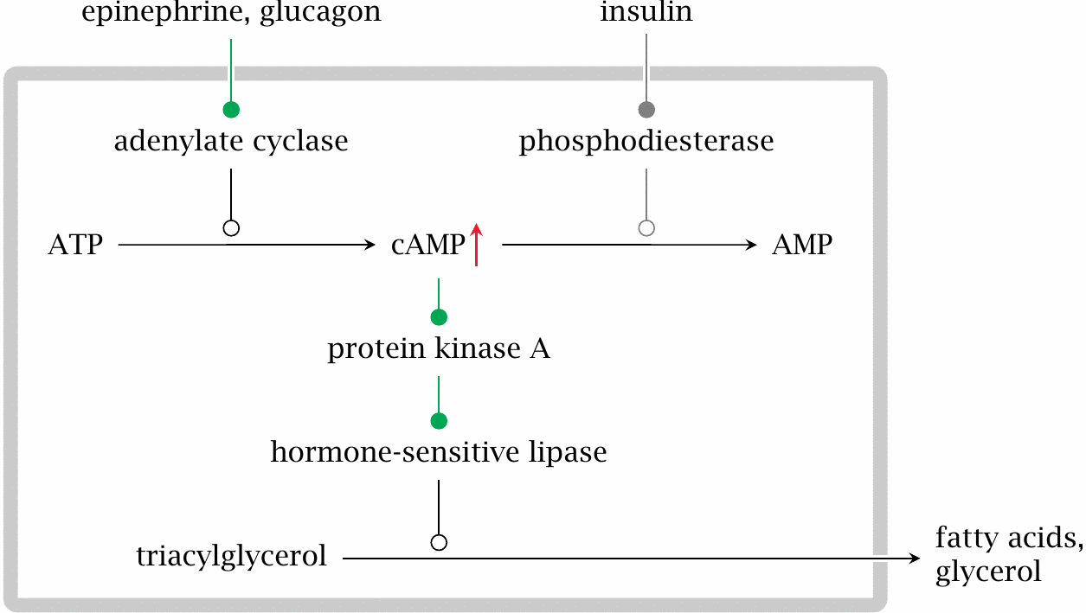
Lack of insulin induces triacylglycerol breakdown in fat tissue

Slide 15
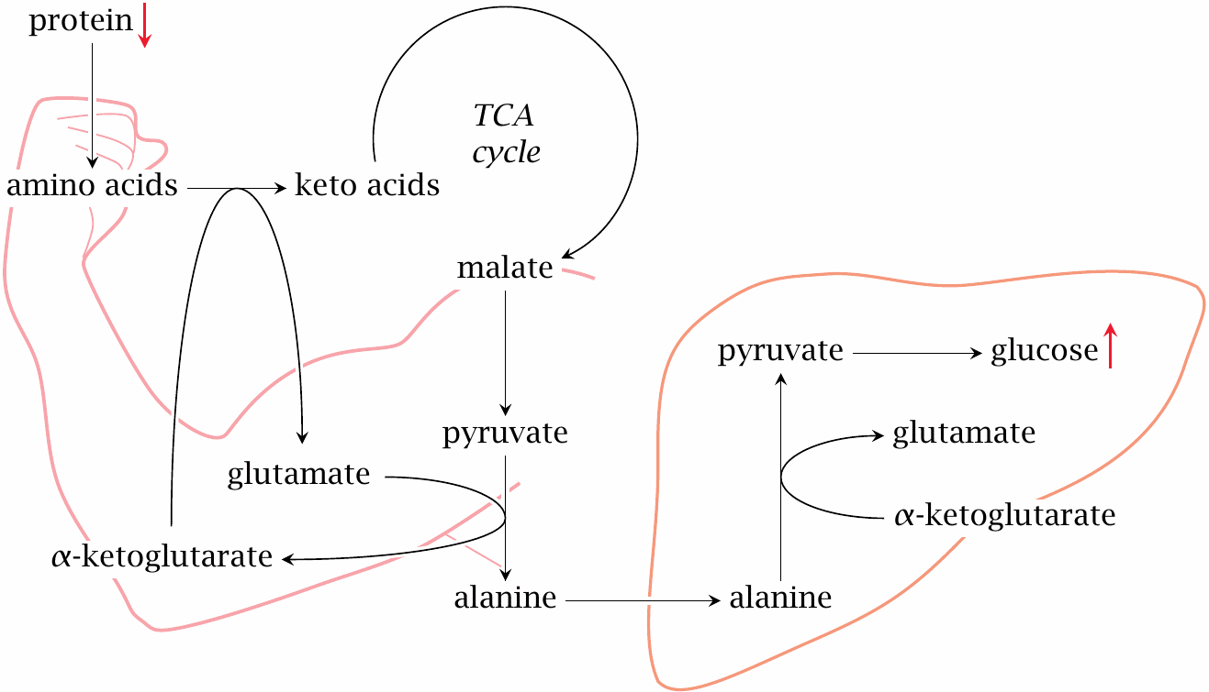
Lack of insulin induces protein breakdown in muscle tissue

Slide 16
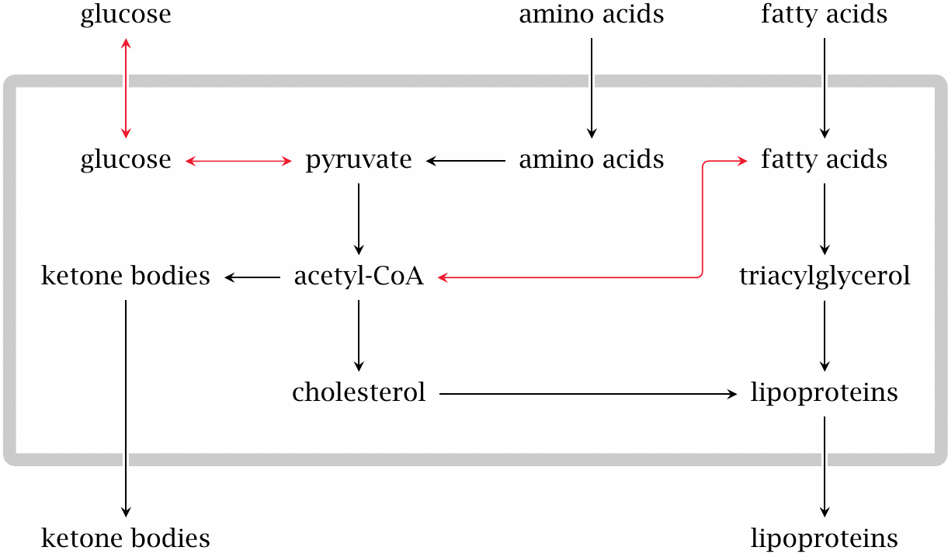
Substrate overload in the liver leads to ketogenesis and lipoprotein synthesis

Slide 17
Laboratory findings in untreated or under-treated diabetes
Observation | Cause
increased blood glucose | excessive gluconeogenesis, lack of utilization
glucose excreted in urine | capacity for renal reuptake exceeded
acidosis (low blood pH) | high plasma levels of ketone bodies
increased urea levels | accelerated muscle protein breakdown
increased blood lipoproteins | increased synthesis and packaging of cholesterol and triacylglycerol in the liver

Slide 18
Typical symptoms and history in a new case of type 1 diabetes
Symptom | Cause
dehydration | osmotic diuresis due to glucose excretion
acetone smell | acetone forms from acetoacetate, is exhaled
coma | both acidosis and blood hyperosmolarity impair brain function
loss of body weight | dehydration, breakdown of proteins and fat
recent flu-like disease, possibly myocarditis | coxsackievirus infection

Slide 19
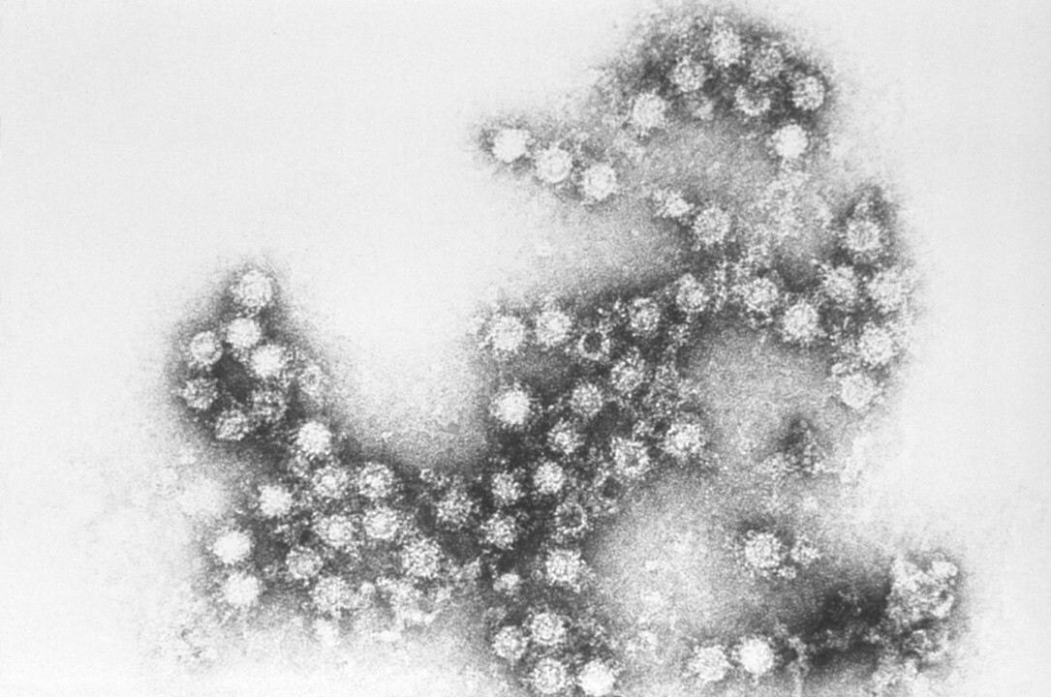
The role of coxsackieviruses in the pathogenesis of type 1 diabetes

Slide 20
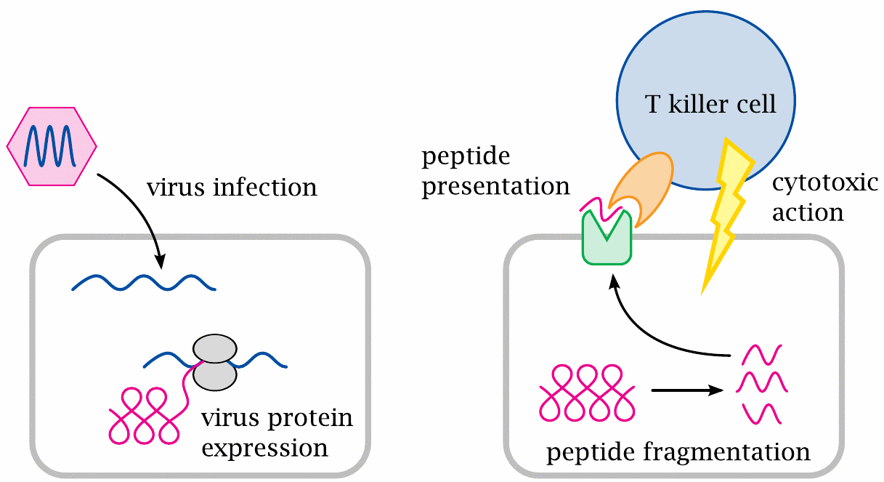
Outline of T lymphocyte function in antiviral immune responses

Slide 21
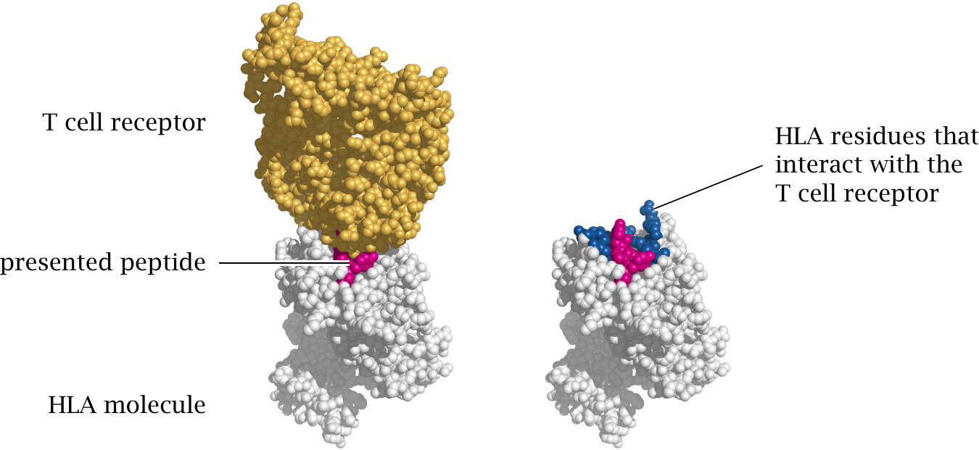
Structure of a T cell receptor bound to its cognate peptide presented by an HLA molecule

Slide 22
HLA alleles influence the risk of developing type 1 diabetes
HLA-DQ Haplotype | Relative risk | Absolute risk
A1: 0301-0302 / B1: 0501-0201 | 21 | 6%
B1: 0602 | 0.03 | 0.01%

Slide 23
How to treat a fresh case of acute diabetes
Severely sick, possibly comatose patient
infusion therapy for fluid replacement, pH and electrolyte adjustment
parenteral nutrition with proportional insulin substitution
frequent monitoring of lab parameters (glucose, salts, pH) to adjust therapy
Upon stabilization
reversal to oral nutrition
train patient to adhere to a stable, regular diet and inject themselves with insulin
teach patient to monitor blood glucose and to recognize symptoms of hyper- and hypoglycemia

Slide 24
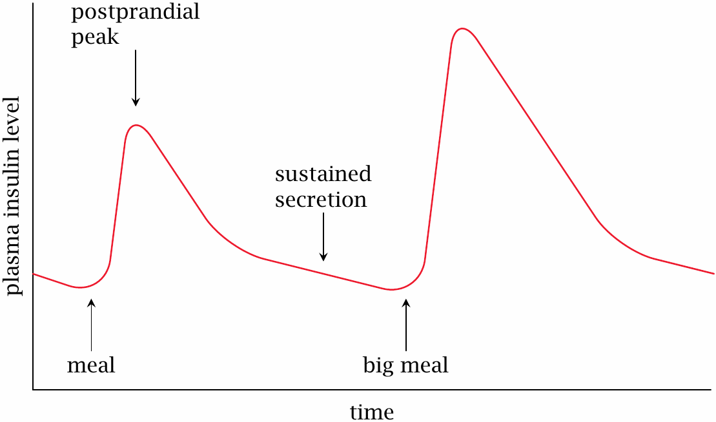
Kinetics of physiological insulin secretion

Slide 25
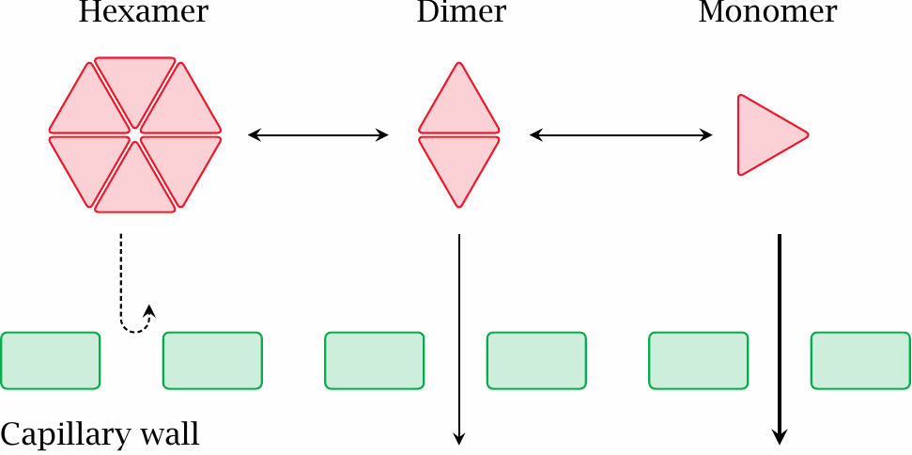
The reversible aggregation of insulin delays its diffusion from tissue into the circulation

Slide 26
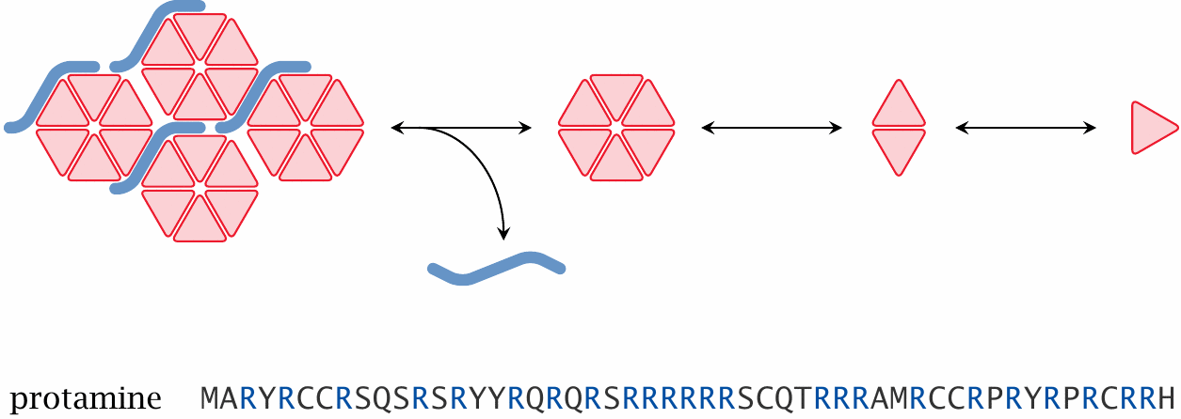
Delayed release of insulin from protamine complexes

Slide 27
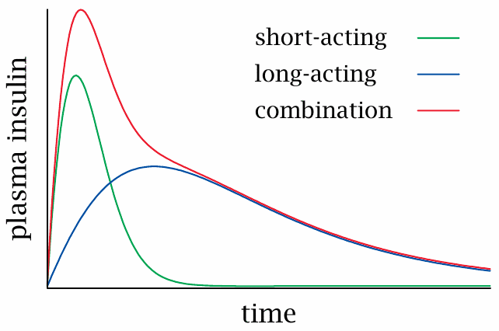
Biphasic insulin preparations

Slide 28
Short-term complications of insulin-requiring diabetes
Deviation | Symptoms
insulin too low | hyperglycemia, acidosis, …, coma
insulin too high | hypoglycemia, coma

Slide 29
Long-term complications of insulin-requiring diabetes
Biochemical deviation | Clinical manifestation
accumulation of sorbitol in the lens of the eye | cataract
increased conversion of glucose to lipids | increased blood fats, atherosclerosis
glucosylation of proteins? sorbitol accumulation? | damage to nerve fibres, kidneys, other organs

Slide 30
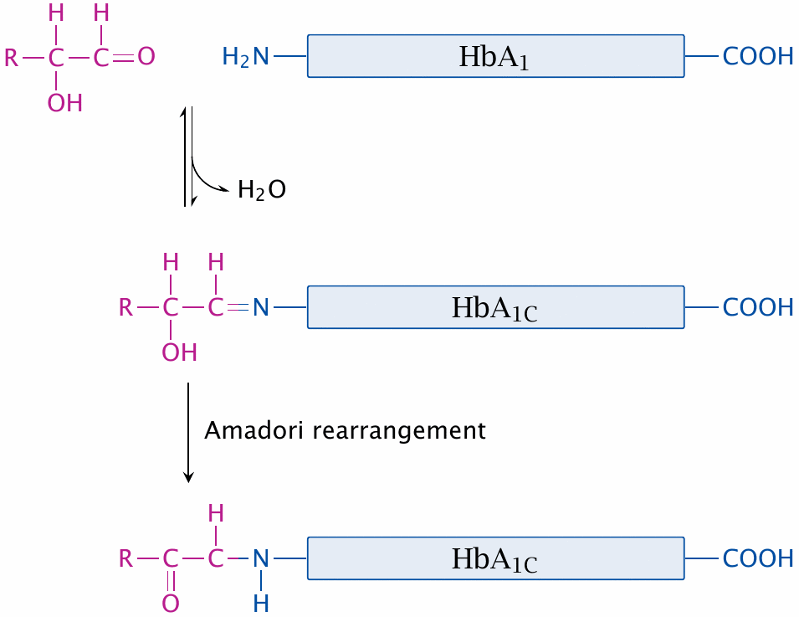
HbA_{1C} as a parameter of long-term glucose control

Slide 31
Intensive insulin therapy
rationale: prevent long term complications through tight control of blood glucose
means: frequent glucose sampling and injections, or continuous insulin application with pump, such that the rate of insulin infusion is controlled by the current glucose level
challenge: avoid hypoglycemia through insulin overdose—we need to minimize the delay between insulin application and effect

Slide 32
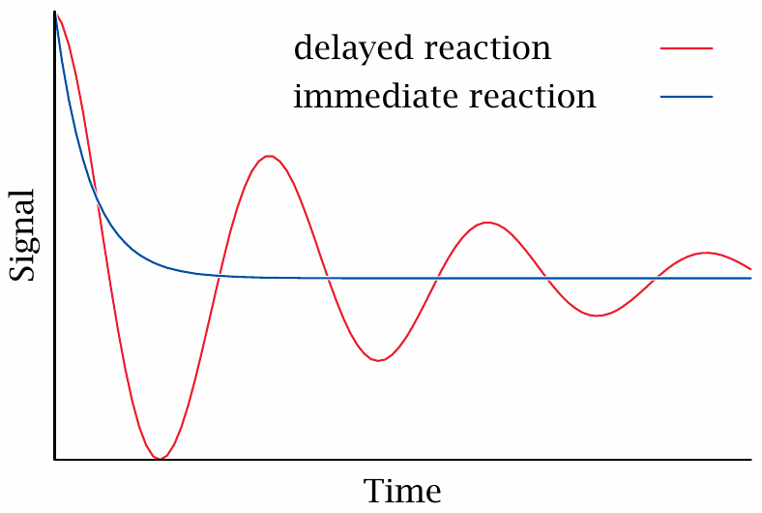
Nerdy intermission: delayed feedback causes signal oscillation

Slide 33
Mutant insulins optimized for rapid dissociation and uptake
Insulin lispro: Proline B28 switched with lysine B29
Insulin aspart: Proline B28 replaced with aspartate

Slide 34
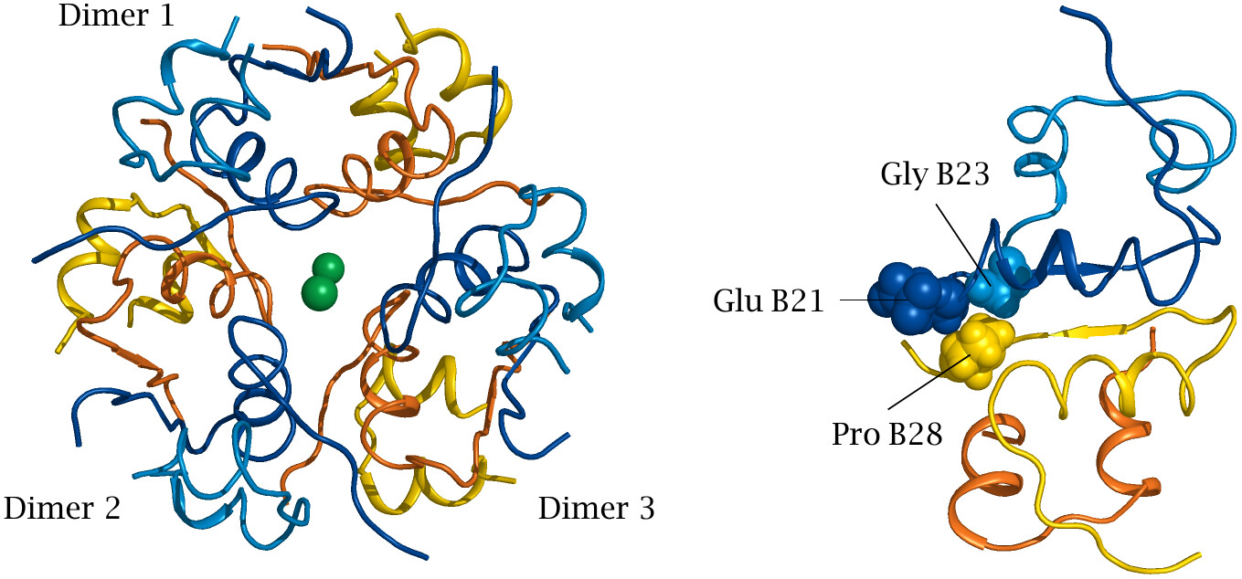
Structural basis for proline B28 mutations

Slide 35
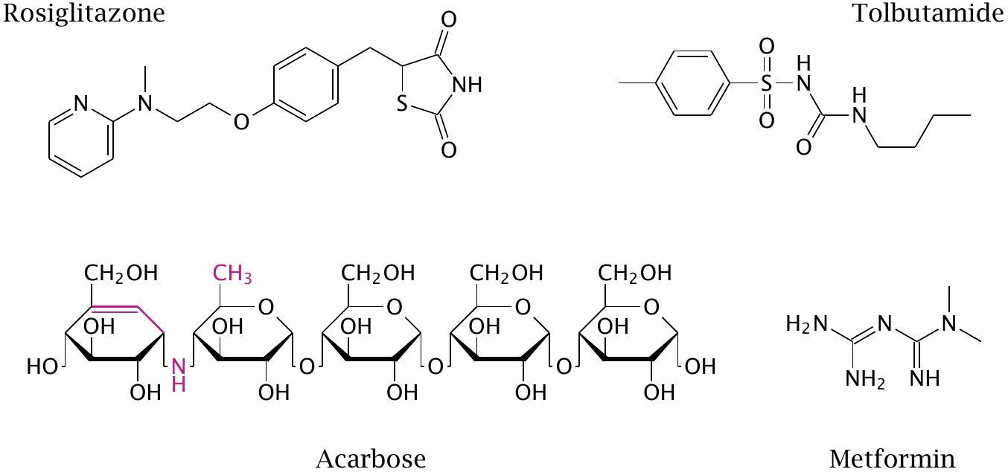
Oral antidiabetic drugs

Slide 36
Action modes of oral antidiabetics
Drug | Action mechanism
tolbutamide | sulfonylurea receptor agonist
rosiglitazone | peroxisome proliferator-activated receptor γ agonist; inhibition of mitochondrial pyruvate transport
acarbose | inhibition of the brush border enzymes sucrase and maltase—reduced or delayed glucose uptake
tolrestat | aldose reductase inhibitor (withdrawn)
metformin | NADH dehydrogenase inhibition ?

Slide 37
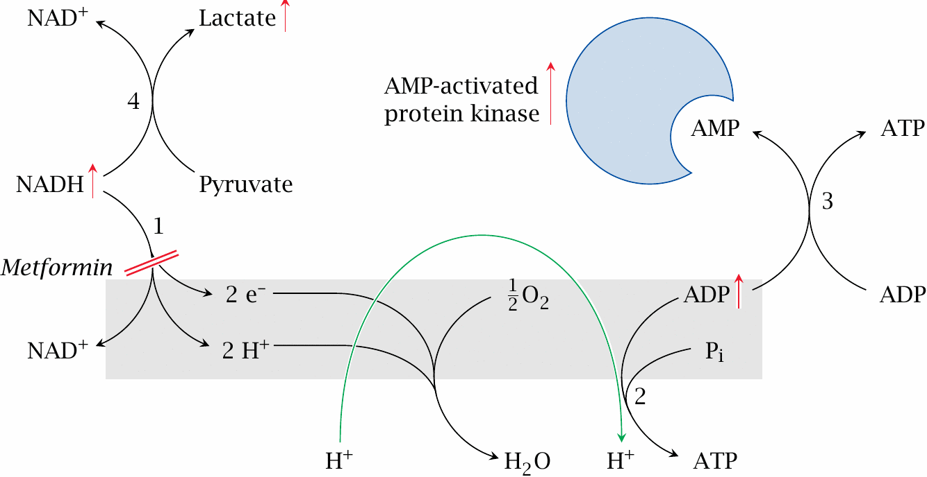
Hypothetical mode of action of metformin

Slide 38
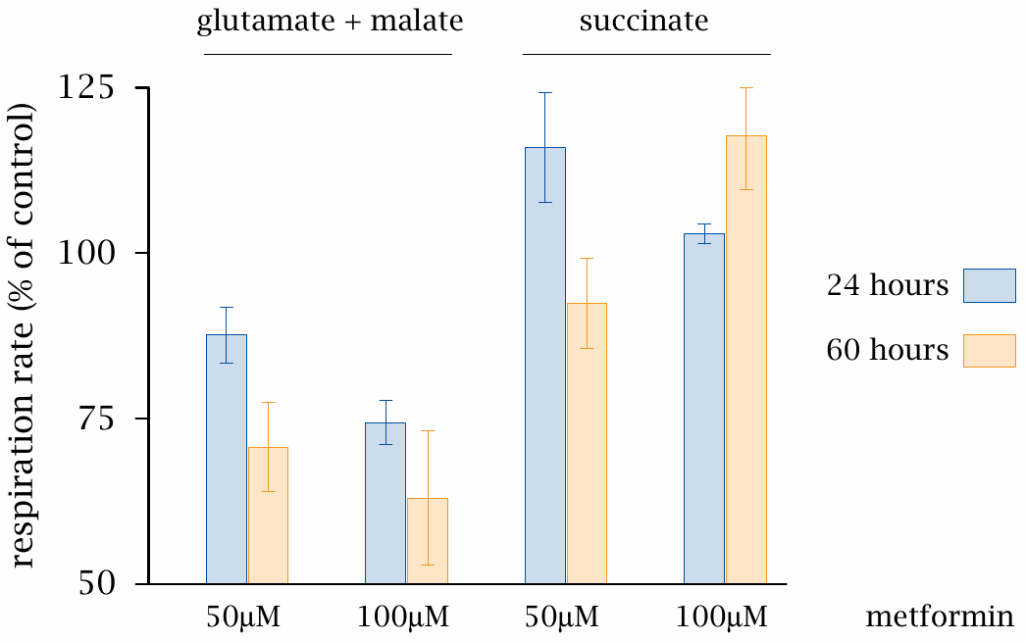
Inhibition of complex I of the respiratory chain by metformin

