Slide 1
Cholesterol metabolism

Slide 2
Biological significance of cholesterol
Cholesterol is an essential lipid constituent of cell membranes
Cholesterol is a precursor of steroid hormones and of bile acids
Intermediates of cholesterol biosynthesis are required to make vitamin D and for posttranslational modification of membrane proteins
High plasma cholesterol promotes atherosclerosis

Slide 3
Processes that determine the cholesterol balance
intestinal uptake of dietary cholesterol
de novo cholesterol synthesis
synthesis of steroid hormones from cholesterol
synthesis of bile acids from cholesterol, and their biliary secretion
biliary secretion of surplus cholesterol in unmodified form

Slide 4
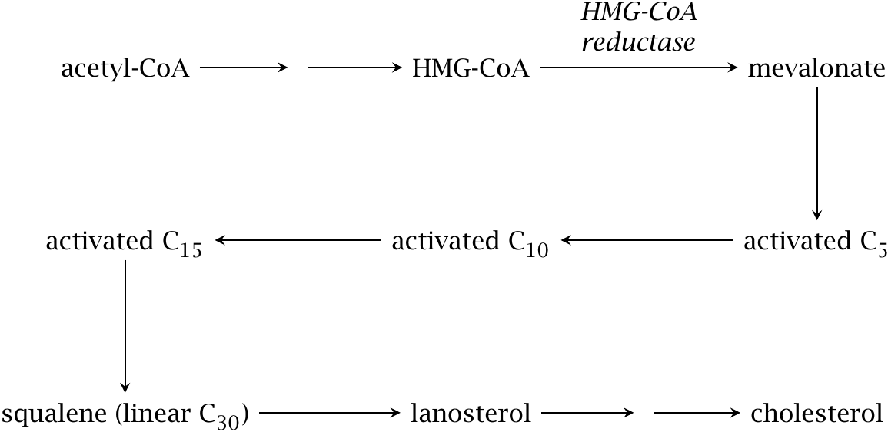
Overview of cholesterol synthesis

Slide 5
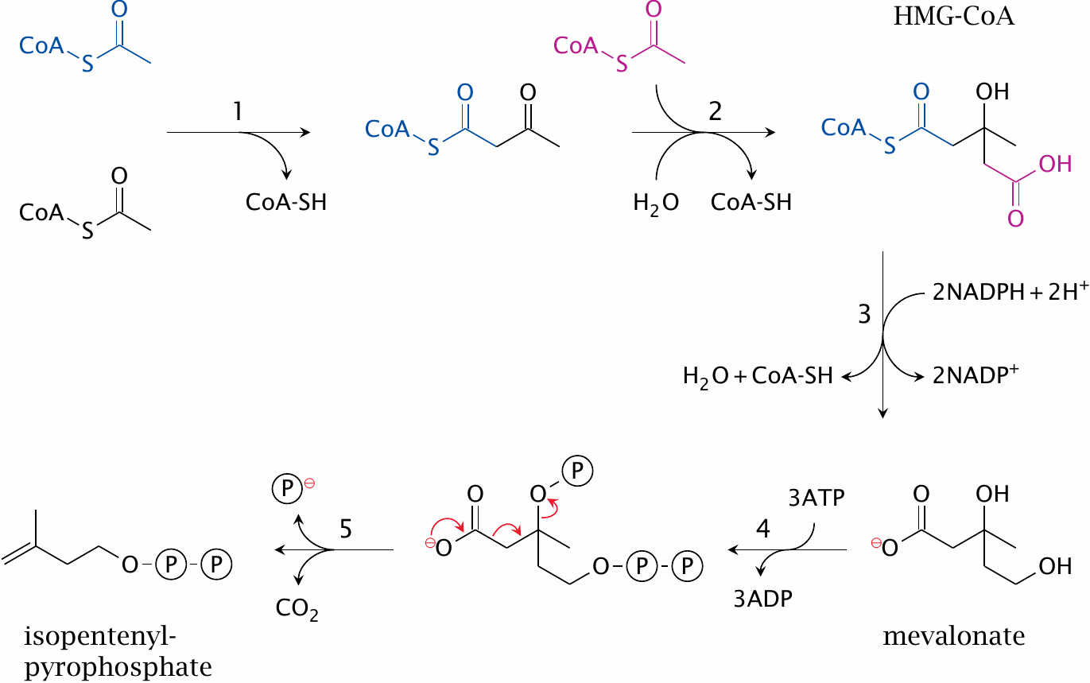
Initial activation steps in cholesterol synthesis

Slide 6
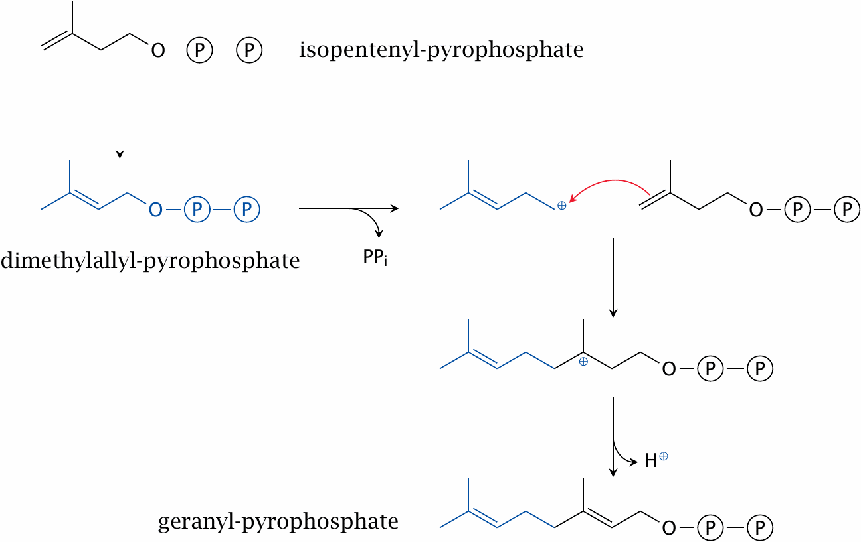
Formation of a C₁₀ intermediate

Slide 7
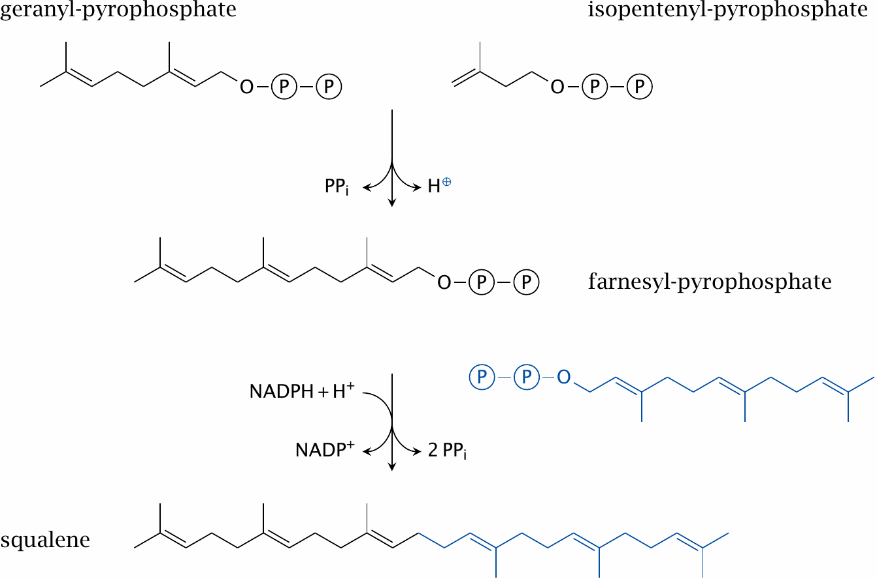
Formation of C₁₅ and C₃₀ intermediates

Slide 8
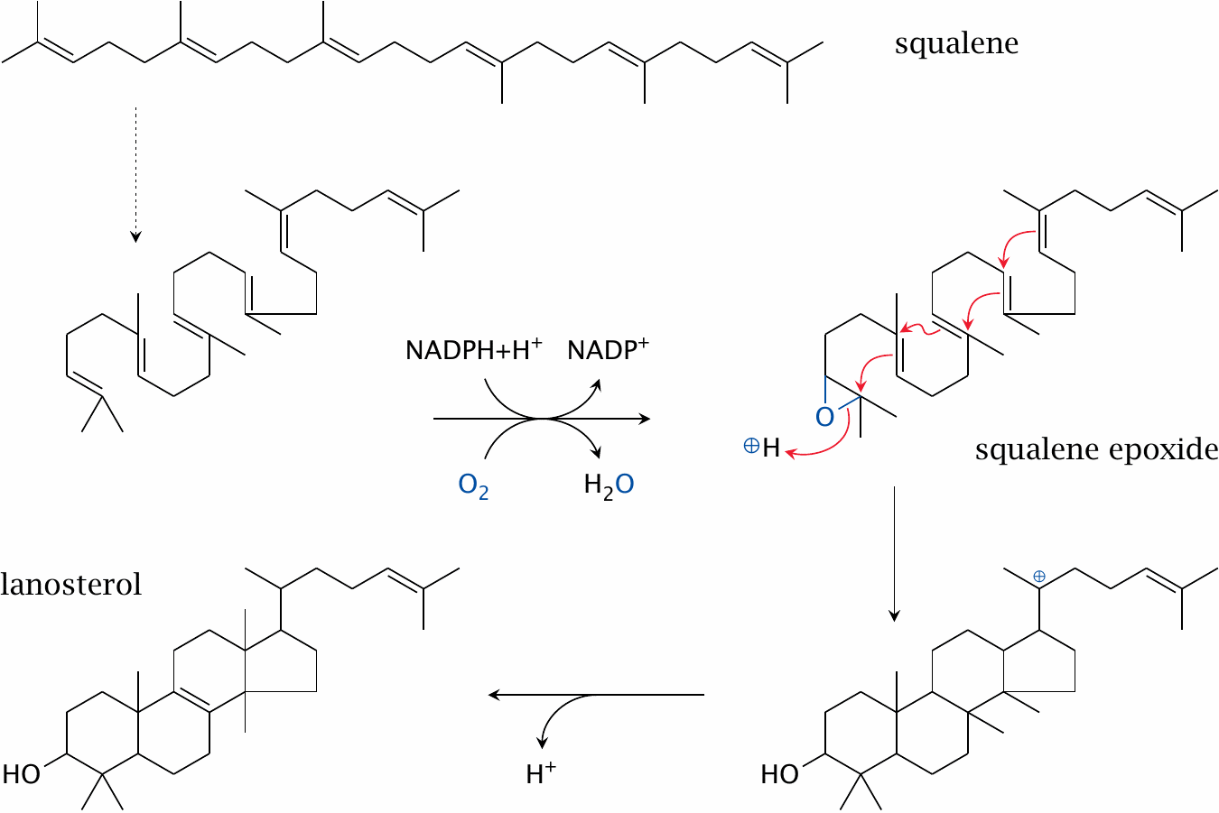
Squalene cyclization yields the first sterol intermediate

Slide 9
Demethylation, desaturation and saturation steps convert lanosterol to cholesterol

Slide 10
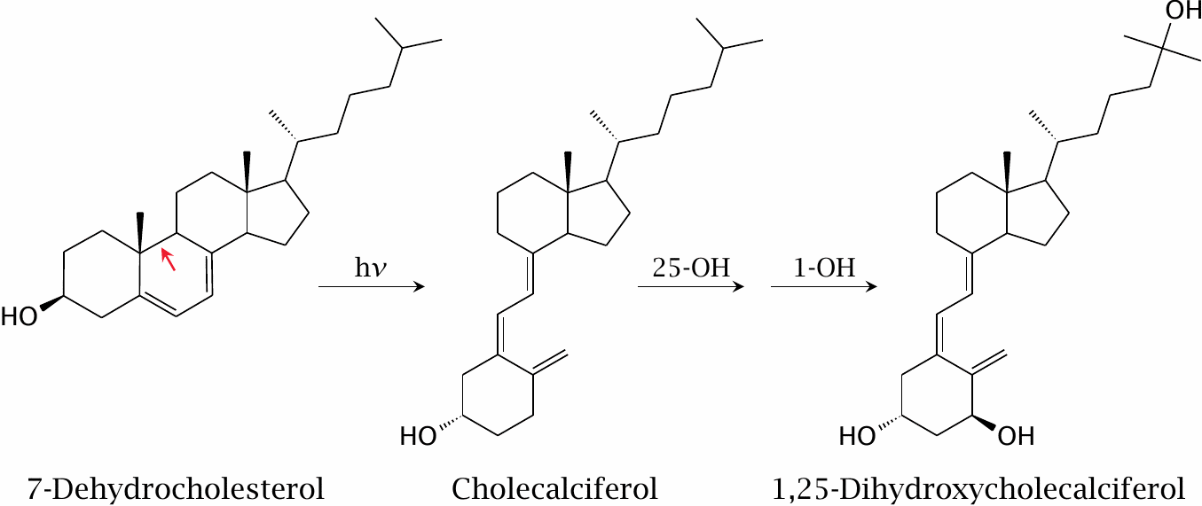
UV-dependent synthesis of cholecalciferol

Slide 11
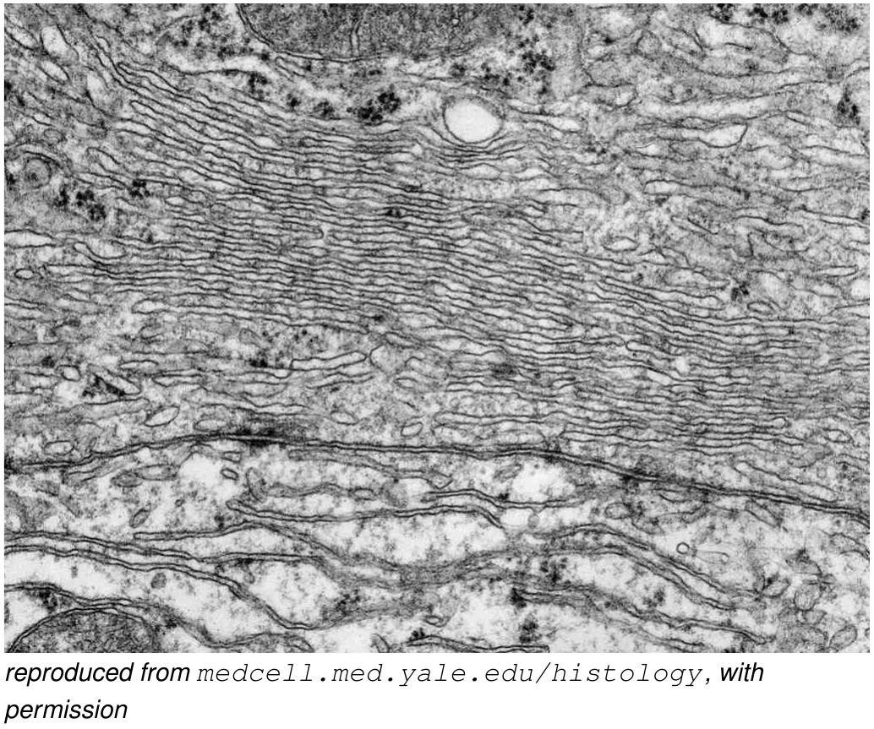
Sterol metabolism occurs in the smooth endoplasmic reticulum

Slide 12
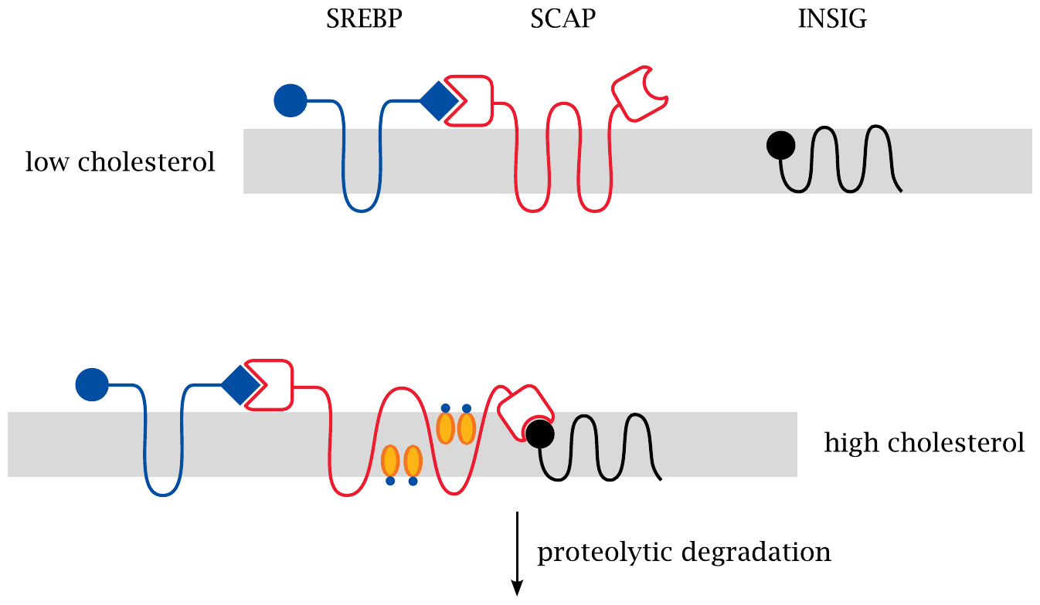
Transcriptional regulation of cholesterol synthesis starts in the endoplasmic reticulum

Slide 13
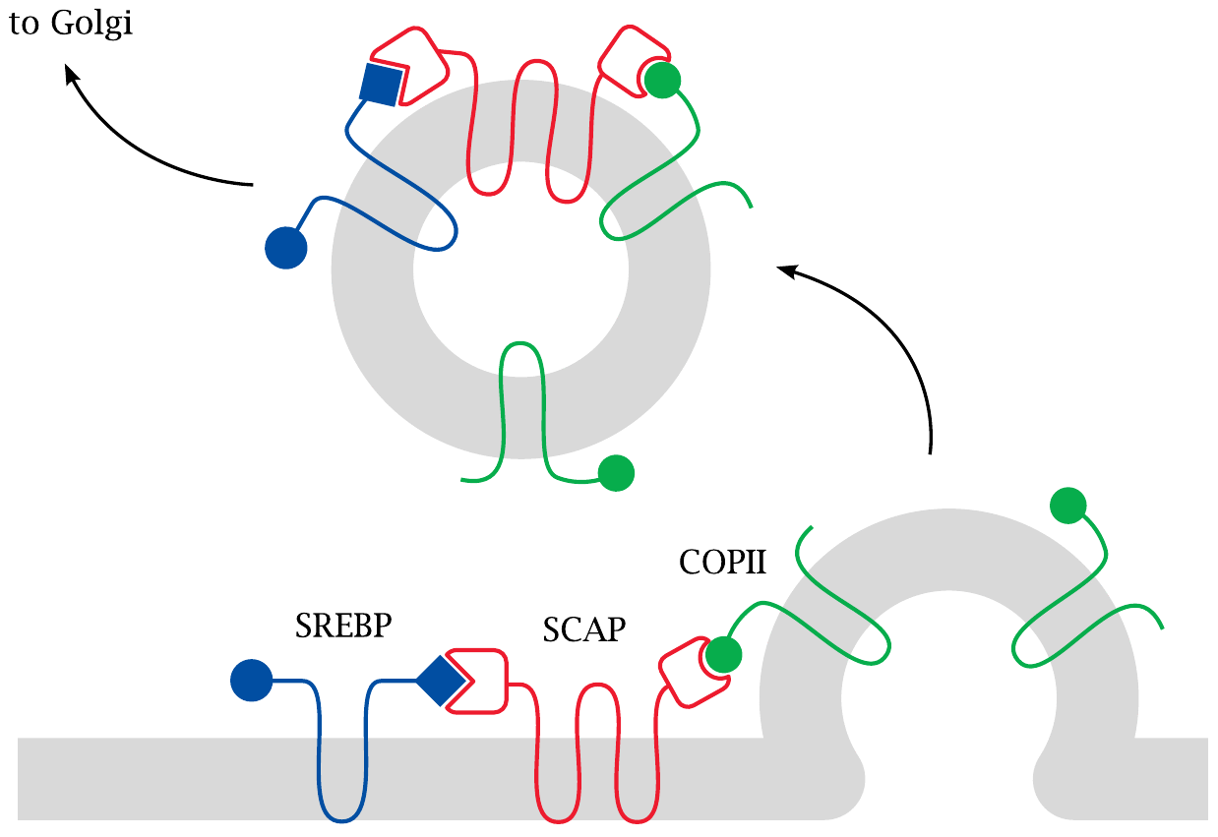
When cholesterol is low, SREBP is sorted to the Golgi apparatus

Slide 14
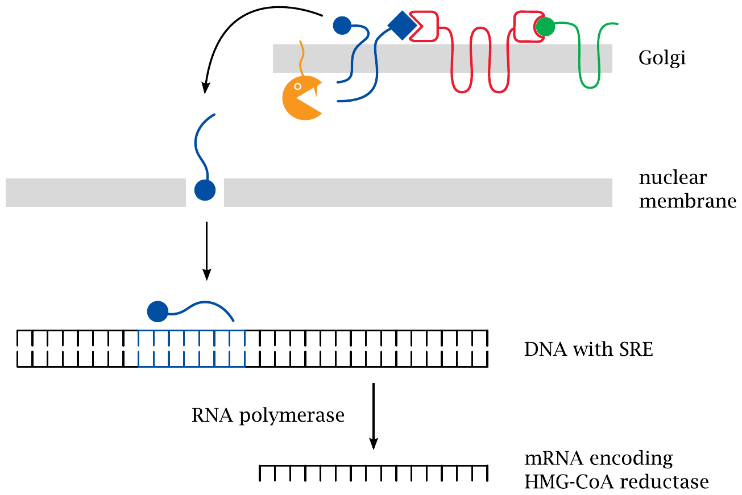
Proteolytic cleavage in the Golgi releases SREBP

Slide 15
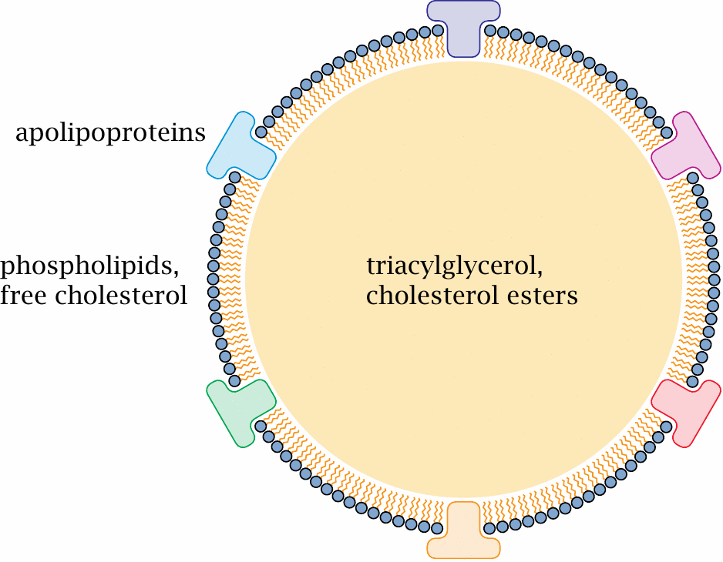
Lipoprotein structure

Slide 16
Classification of plasma lipoproteins
 | Chylomicrons | VLDL | LDL | HDL
Density (g/ml) | 0.95 | 0.95–1.0 | 1.02–1.06 | 1.06–1.12
Origin | small intestine | liver | liver | liver
Function | distribute dietary TAG and cholesterol | distribute TAG from liver | distribute cholesterol from liver | return excess cholesterol to liver
Predominant lipid species | TAG | TAG | cholesterol | phospholipids, cholesterol

Slide 17
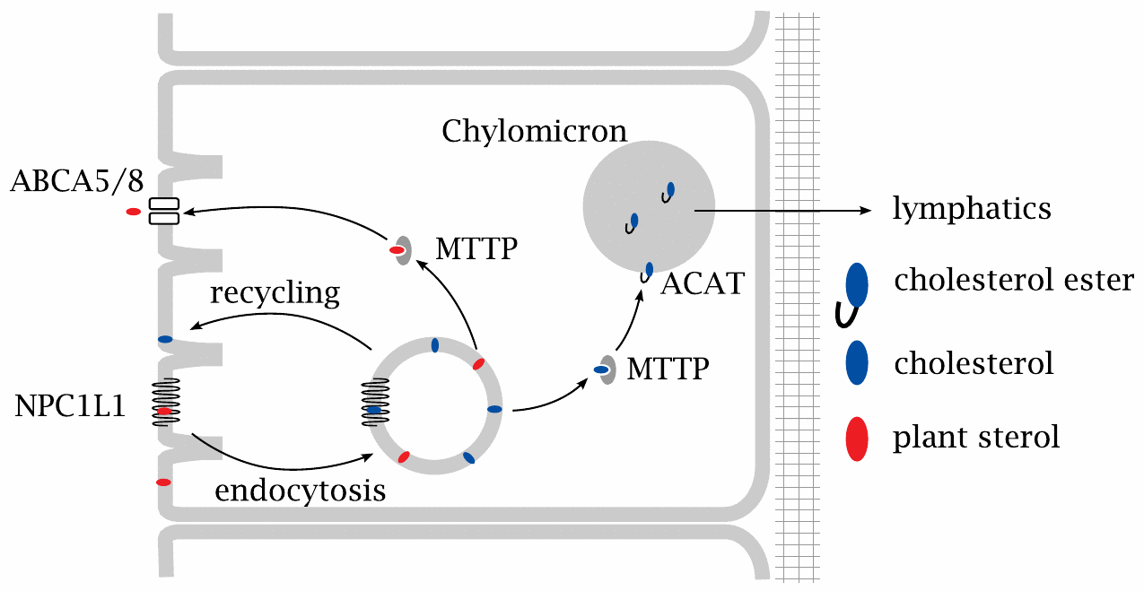
Two membrane proteins control the uptake of sterols from the intestine

Slide 18
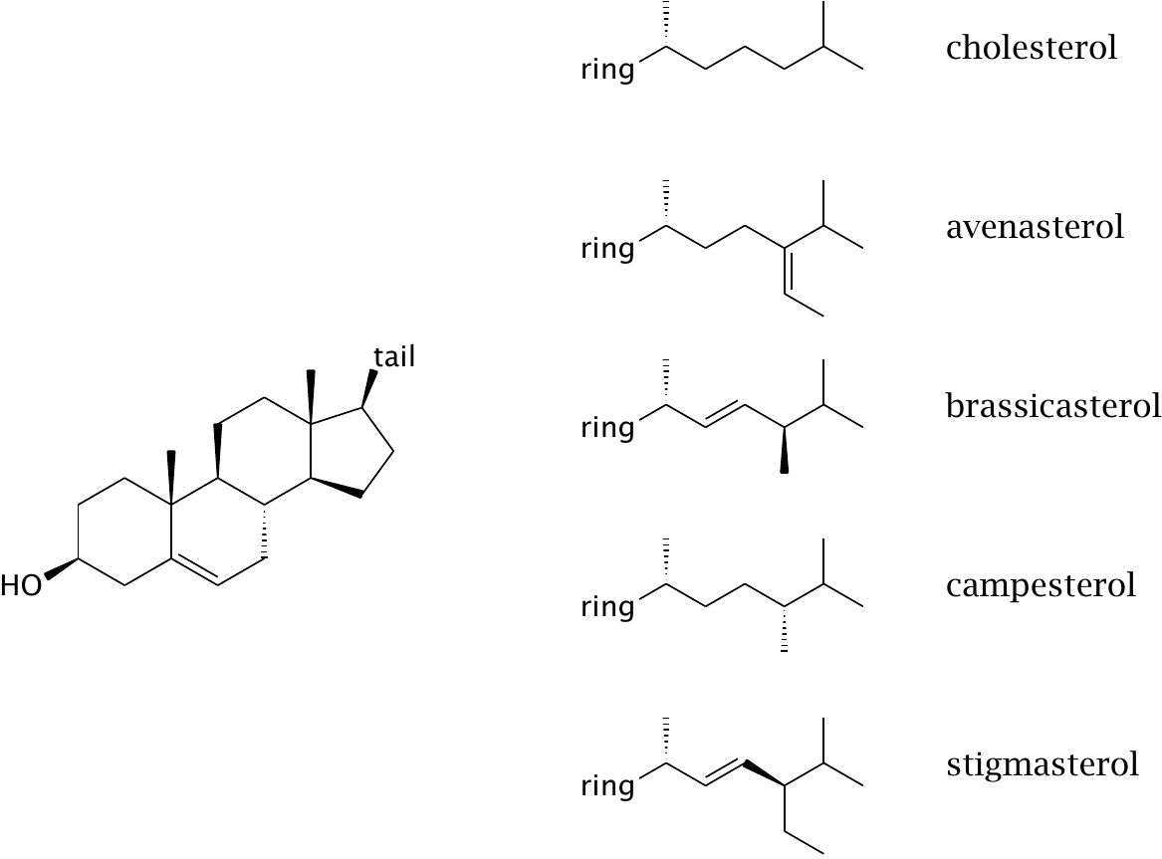
Plant sterol structures

Slide 19
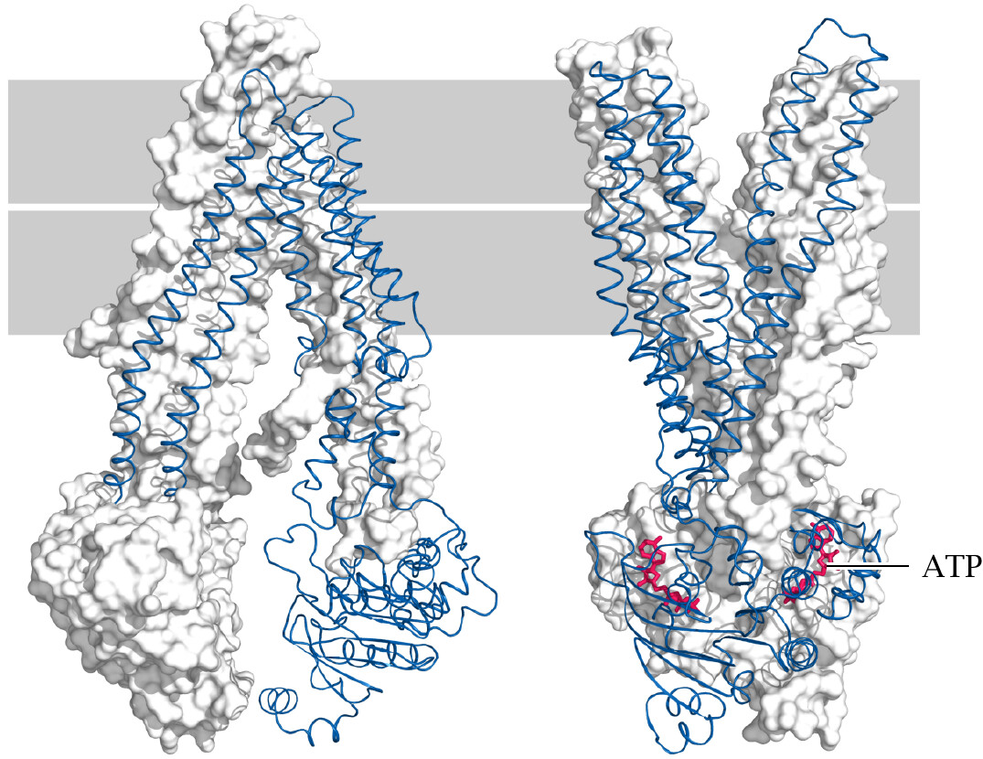
Structures of ABC transporters in the inward-open and outward-open conformations

Slide 20
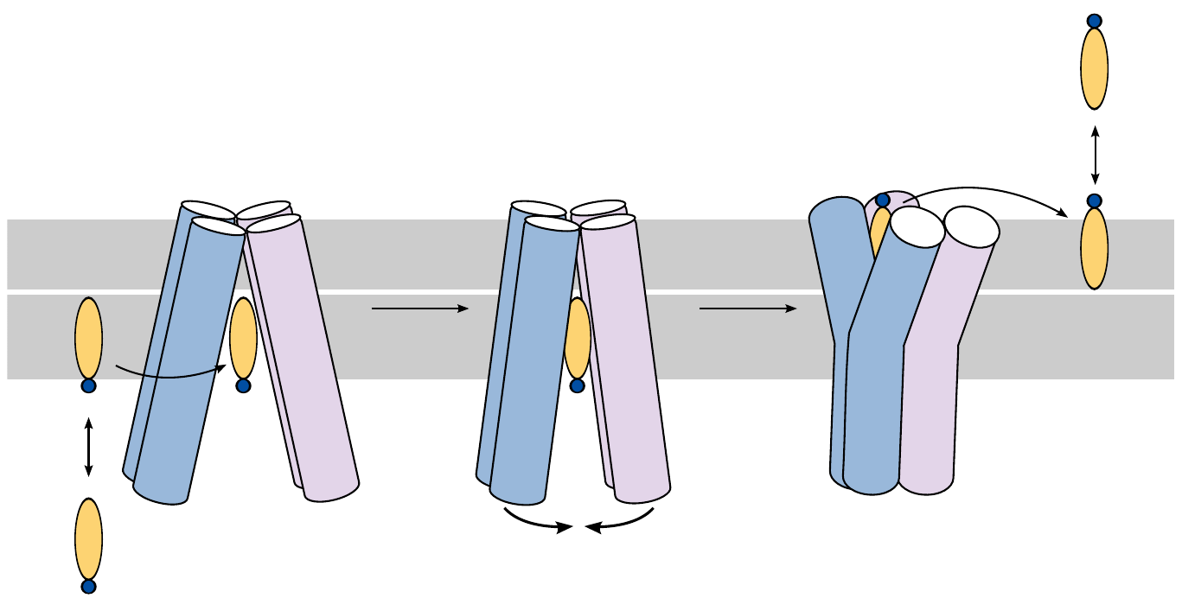
ABC transporters induce substrate “flip-flop” across the membrane

Slide 21
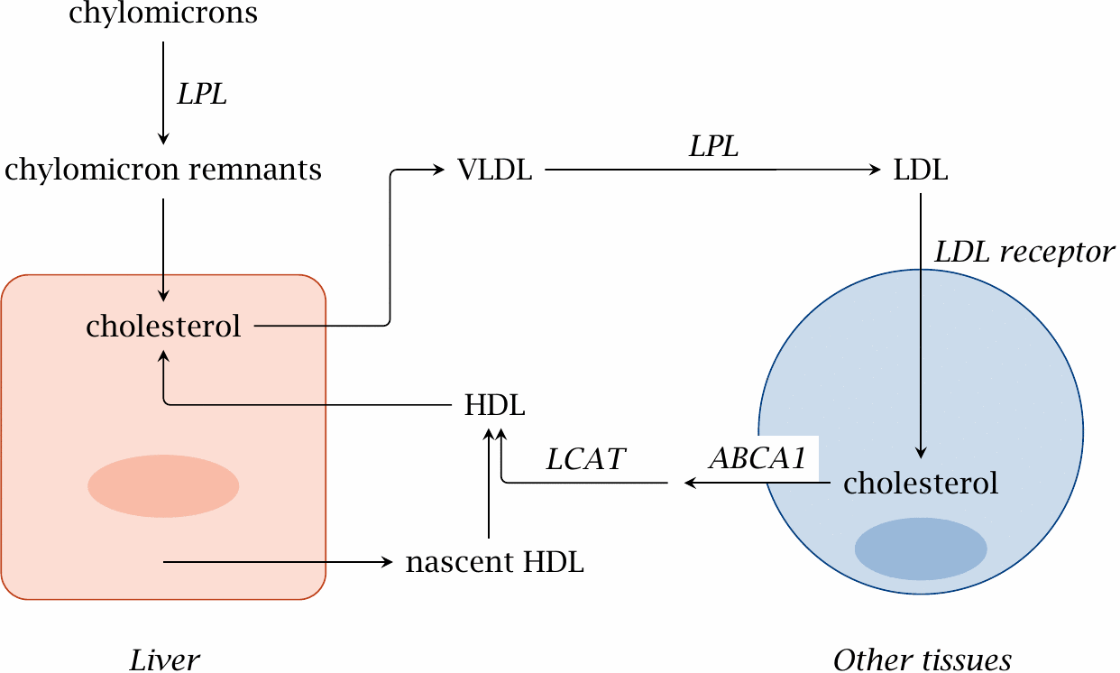
Transport of cholesterol between the liver and peripheral tissues

Slide 22
Stages of cholesterol transport
Dietary cholesterol
Packaged into chylomicrons, which turn into chylomicron remnants through triacylglycerol extraction by lipoprotein lipase
Chylomicron remnants are taken up by the liver
Liver cholesterol (from diet, or endogenously synthesized)
Packaged into VLDL
Lipoprotein lipase turns VLDL into IDL and then LDL
LDL is taken up through receptor-mediated endocytosis in peripheral tissues

Slide 23
Cholesterol transport (ctd.)
Cholesterol in peripheral tissues
HDL is produced in liver and intestines as an empty carrier for cholesterol (containing mainly phospholipid and apo A-1)
HDL binds to cells in periphery (including in vascular lesions) and takes up surplus cholesterol
Cholesterol-laden HDL is taken up into the liver by endocytosis, cholesterol is recycled

Slide 24
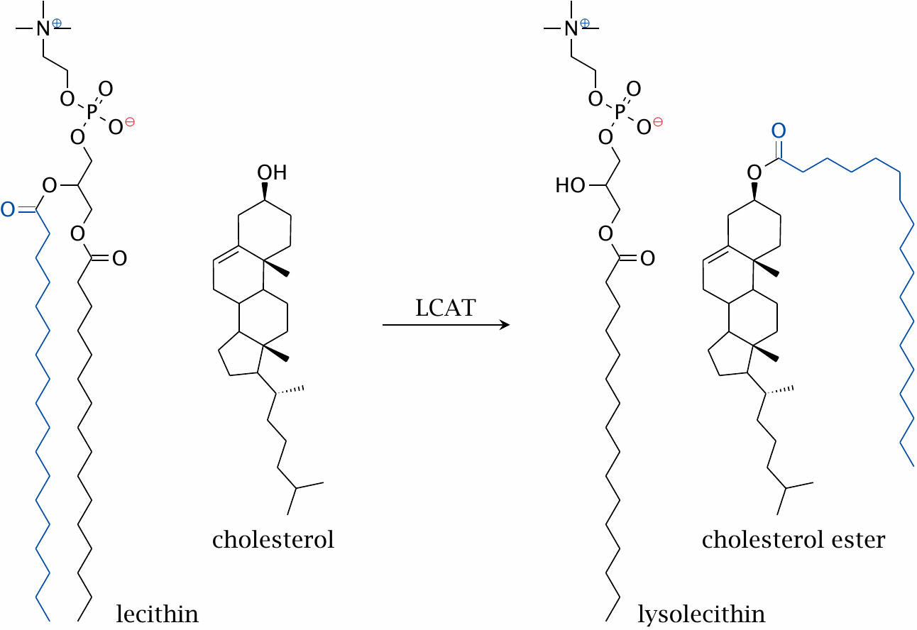
The lecithin-cholesterol acyltransferase (LCAT) reaction

Slide 25
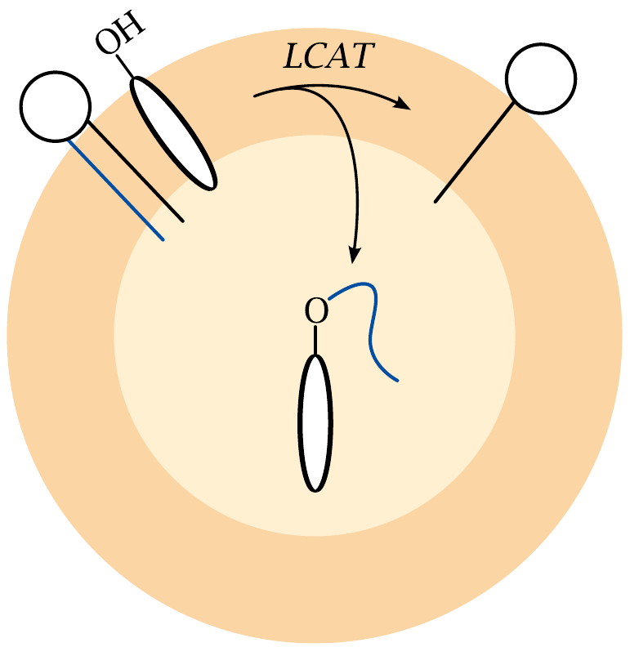
Cholesterol esters can be stored inside lipoprotein particles

Slide 26
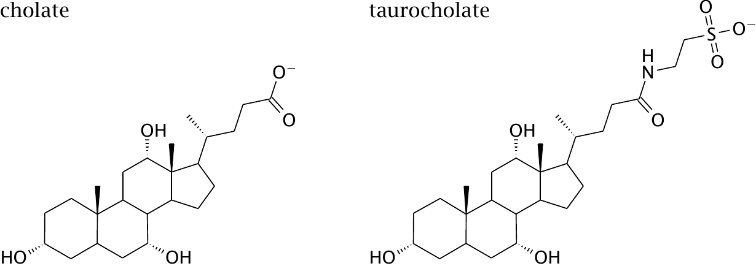
Bile acids are derived from cholesterol

Slide 27
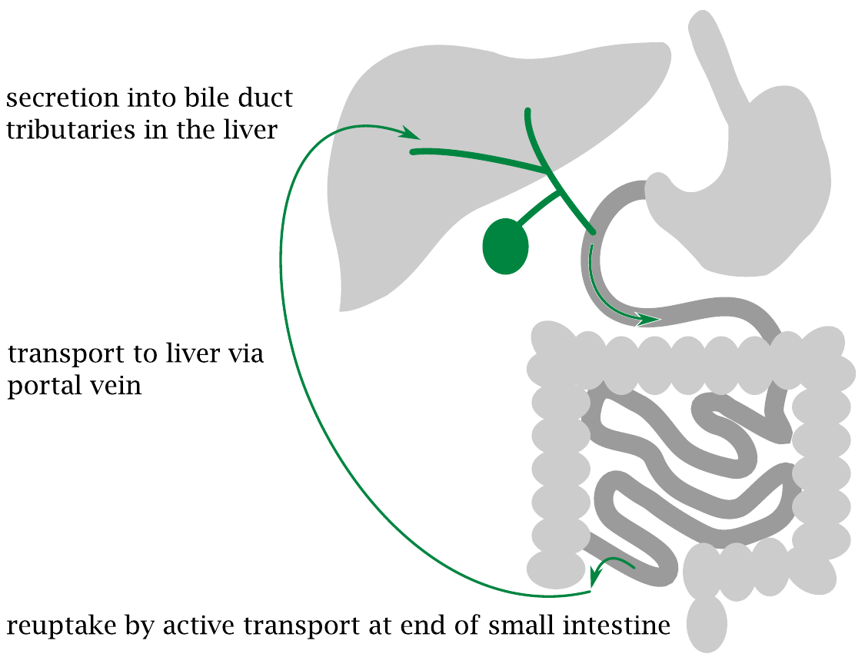
Bile acids undergo enterohepatic cycling

Slide 28
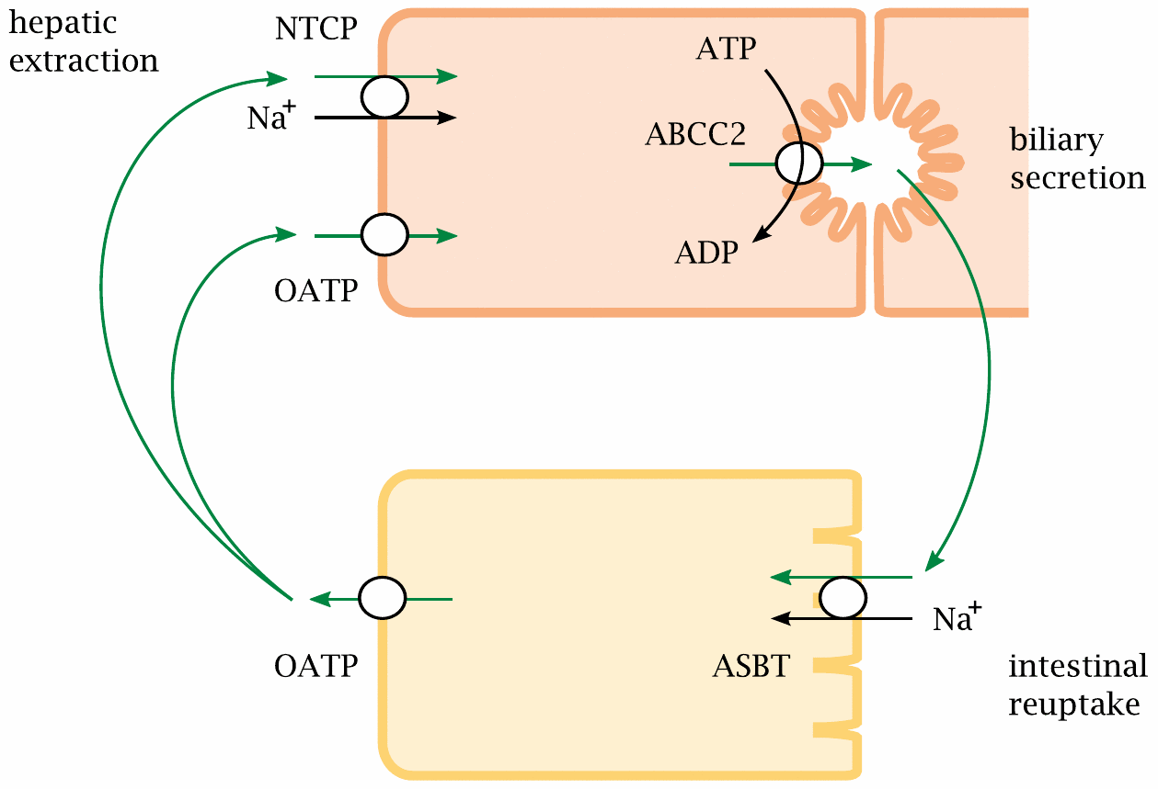
Bile acid cycling involves multiple transport proteins

Slide 29
A deficient ABCC2 transporter causes Dubin-Johnson syndrome
impaired excretion of bile acids → cholesterol precipitates in the bile → bile stones
impaired excretion of bilirubin → jaundice
impaired excretion of many drugs → potential drug toxicity

Slide 30
Is atherosclerosis a metabolic disease?
… it is important to remember that the best documented initiating factor is still hypercholesterolemia … additional factors should be considered in the context of how they relate to the processes initiated by hypercholesterolemia.
Daniel Steinberg, “Atherogenesis in perspective: Hypercholesterolemia and inflammation as partners in crime”, Nature Medicine 8:1211 (2002).

Slide 31
Macroscopic appearance of atherosclerotic lesions

Slide 32
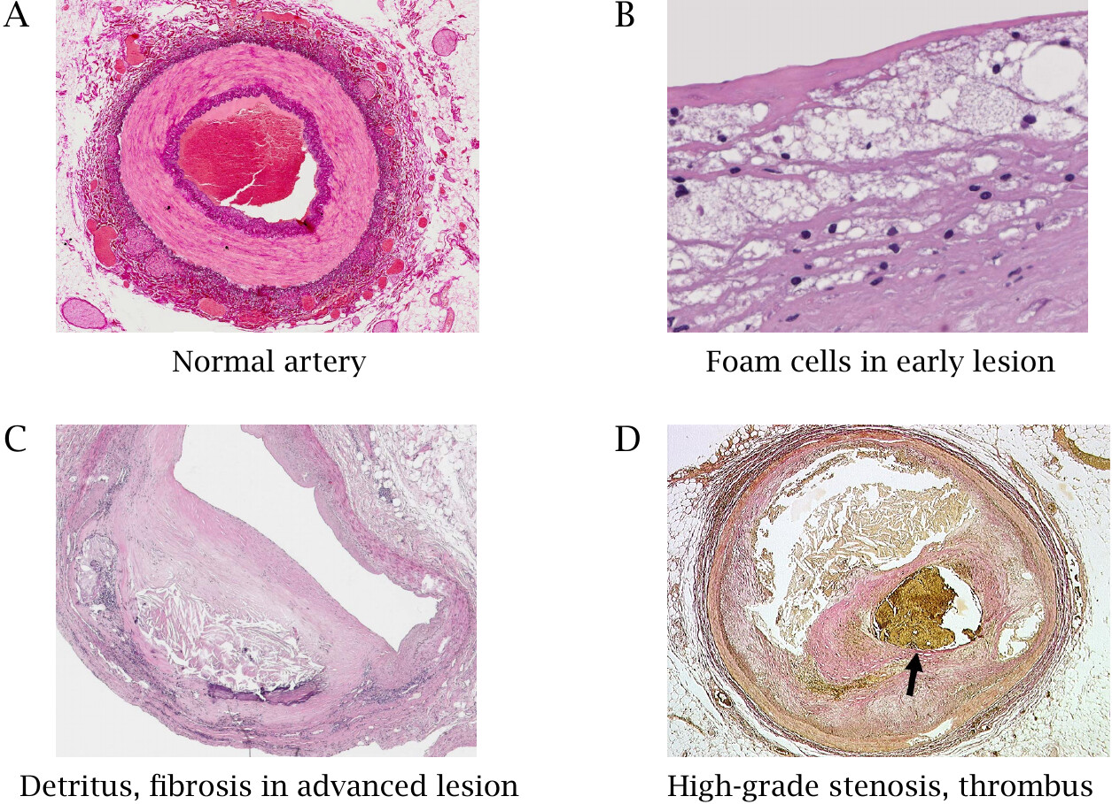
Microscopic appearance of atherosclerotic lesions

Slide 33
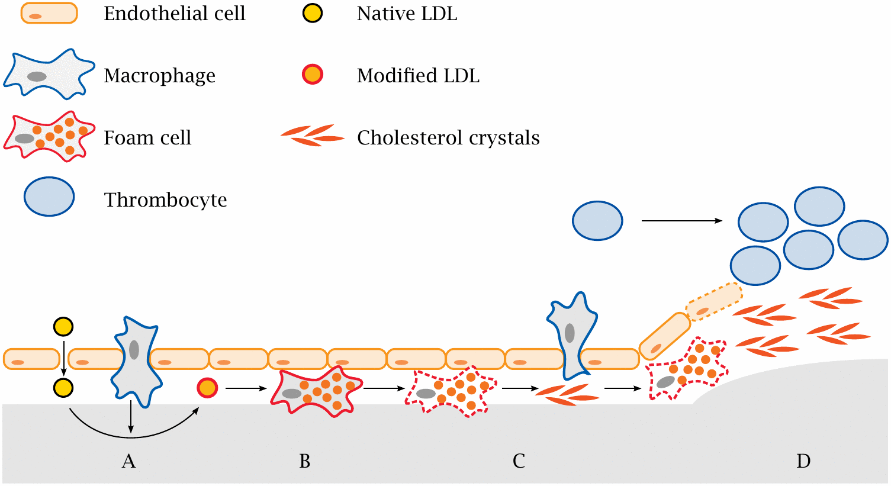
Development of an atherosclerotic lesion

Slide 34
Metabolic aspects of atherosclerosis
cholesterol uptake, synthesis and degradation
cholesterol transport in the circulation: LDL (low density lipoprotein) and HDL (high density lipoprotein)
biochemical changes that turn physiological, benign LDL into an atherogenic agent

Slide 35
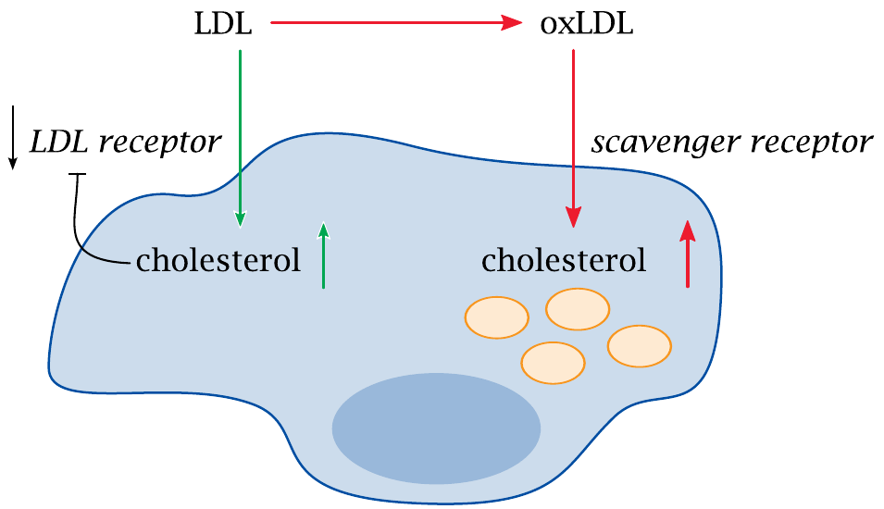
Two modes of uptake of cholesterol into macrophages

Slide 36
Modification of LDL is essential for excessive uptake by macrophages via the scavenger receptor
LDL receptor is down-regulated once the cell is full up with cholesterol—no further LDL will be taken up
Covalently modified LDL will be taken up by macrophages via scavenger receptors
Various modifications have similar effects
Modifications can affect both lipid and apolipoprotein components of LDL

Slide 37
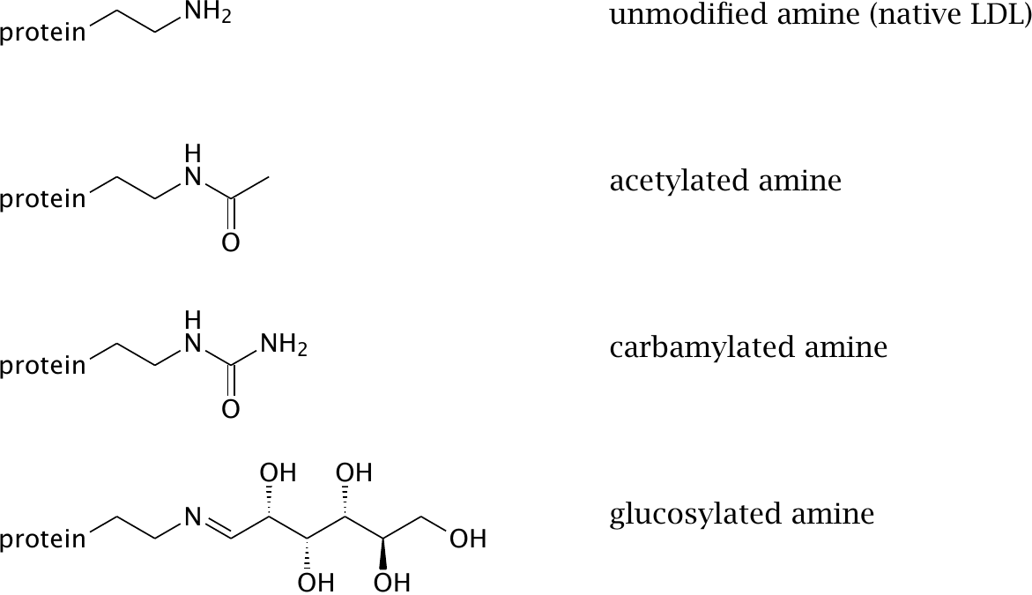
Experimental protein modifications that turn LDL into a ligand for the scavenger receptor

Slide 38
Which modifications of LDL are significant in vivo?
Modification | Possible causes
acetylation | easily achieved in vitro, but not plausible in vivo
carbamylation | promoted by urea, which is enhanced in kidney disease; also promoted by smoking
glucosylation | promoted by high blood glucose (diabetes)
partial proteolysis | proteases released from macrophages
oxidation of lipids and apolipoproteins | reactive oxygen species released from macrophages

Slide 39
How does LDL become oxidized?
Phagocytes produce reactive oxygen species
Transition metals (Fe, Cu) exacerbate ROS activity
Lipoxygenases convert fatty acids to radicals that can bind to LDL and induce lipid peroxidation

Slide 40
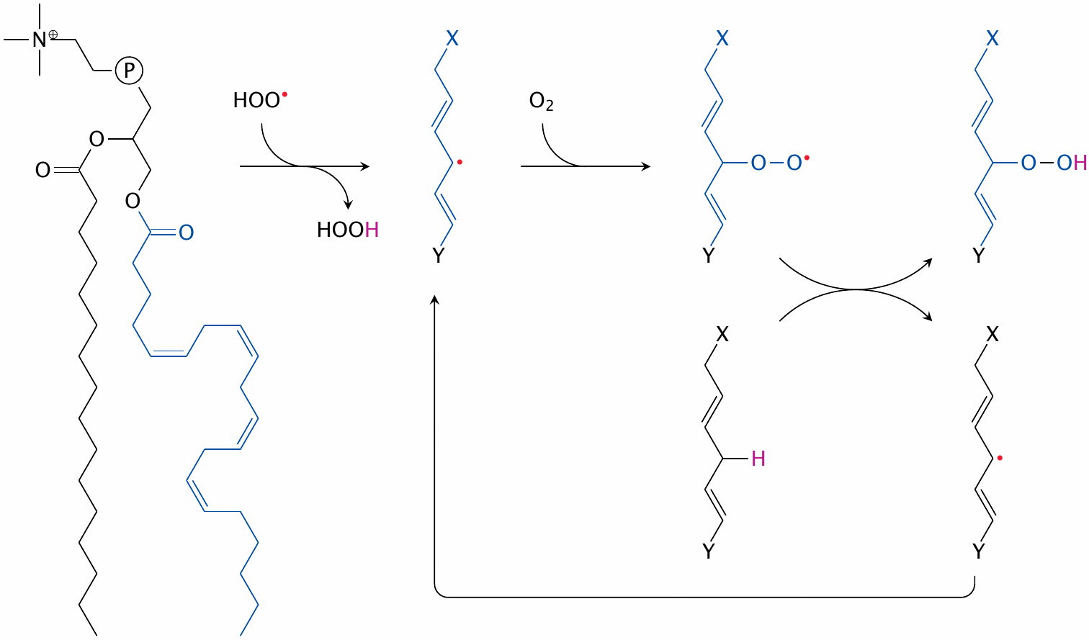
Self-sustained lipid peroxidation induced by peroxy radicals

Slide 41
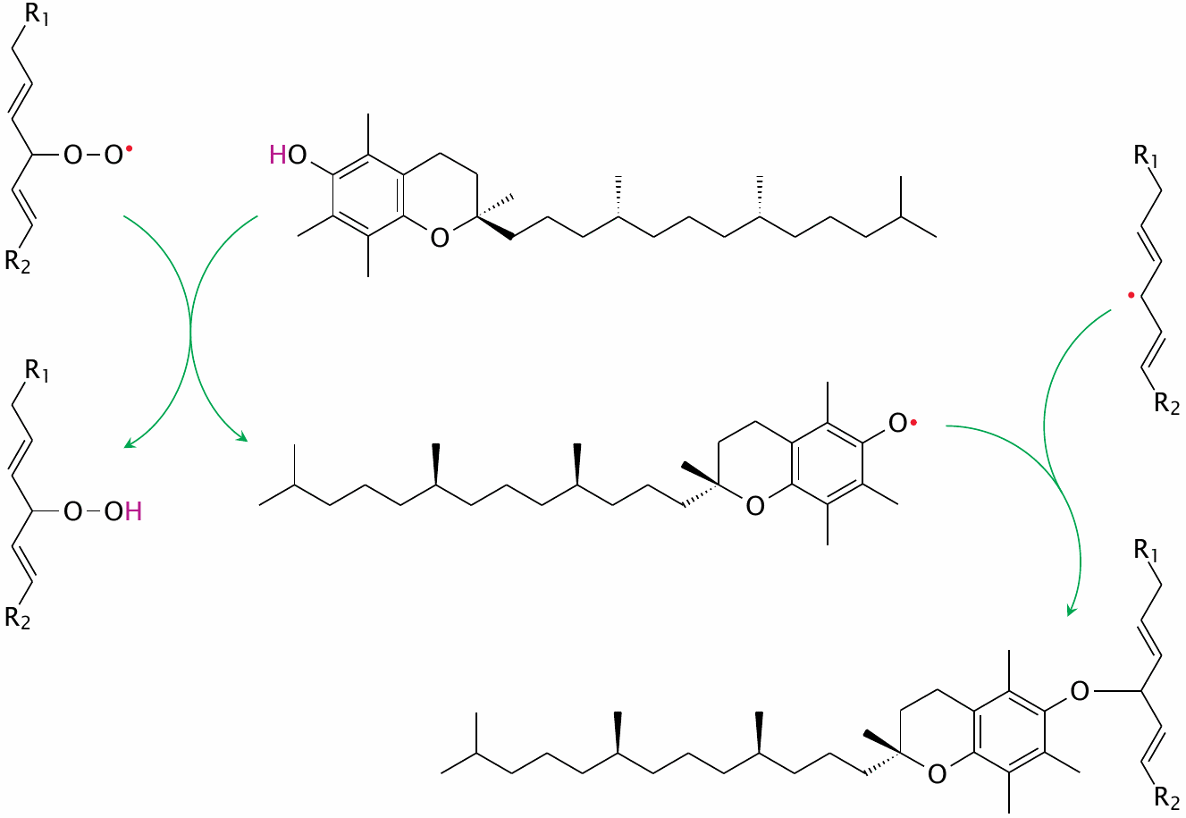
α-Tocopherol intercepts lipid peroxidation

Slide 42
Experimental evidence implicating LDL oxidation in the pathogenesis of atherosclerosis
Vitamin E reduces the severity of atherosclerosis in animal models—but not in clinical studies on humans
Antibodies against oxidized LDL are found in blood; among these, IgG promotes atherosclerosis, whereas IgM inhibits it
Haptoglobin alleles differ in the efficiency of hemoglobin clearance, which correlates inversely with susceptibility to atherosclerosis
Production of HOCl by myeloperoxidase: chlorotyrosine residues detectable in oxLDL ex vivo—but myeloperoxidase k.o. mice have increased susceptibility to atherosclerosis

Slide 43
Lowering LDL cholesterol: therapeutic principles
inhibition of cholesterol synthesis
inhibition of cholesterol uptake
inhibition of cholesterol ester transfer protein
inhibition of bile acid reuptake
LDL apheresis

Slide 44
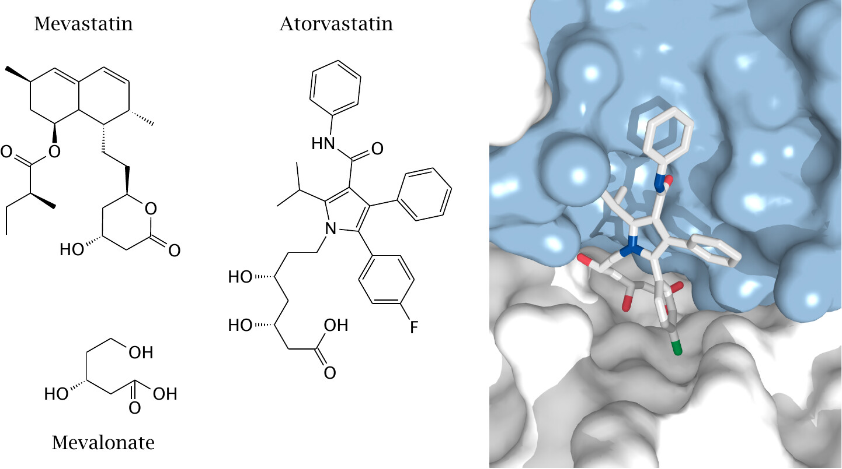
“Statins” inhibit HMG-CoA reductase

Slide 45
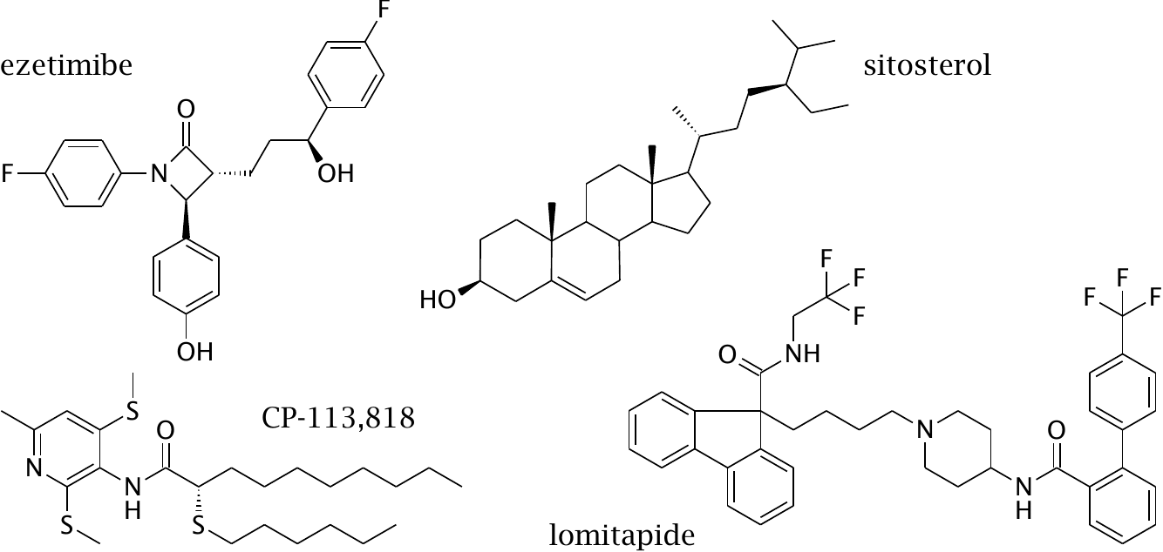
Inhibitors of intestinal cholesterol uptake

Slide 46
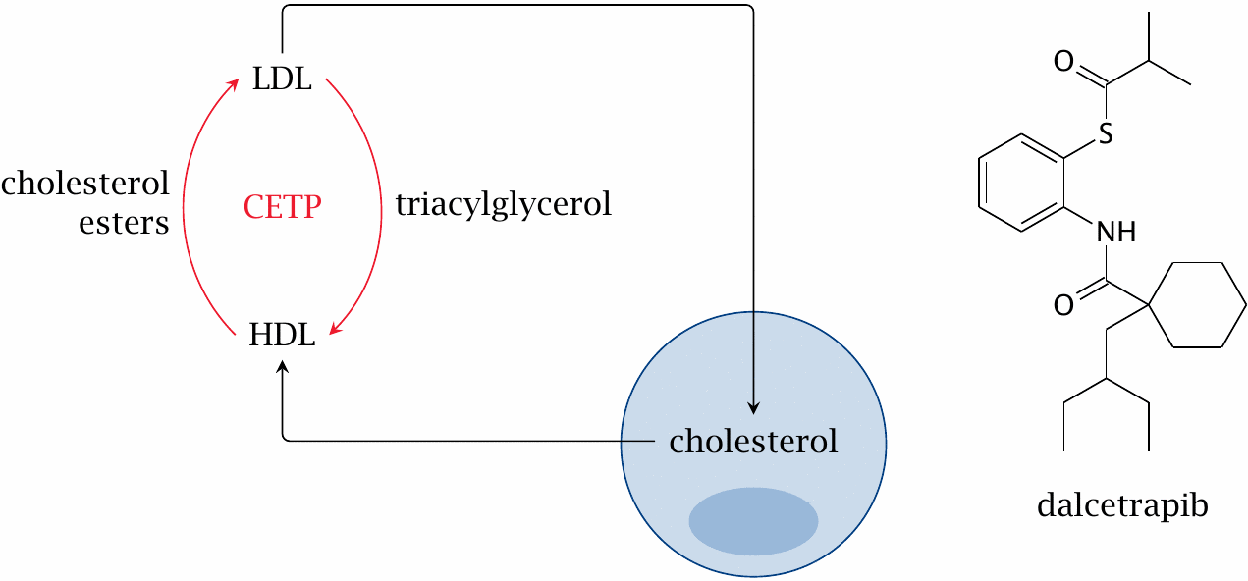
Cholesterol ester transfer protein (CETP) short-circuits cholesterol transport by lipoproteins

Slide 47
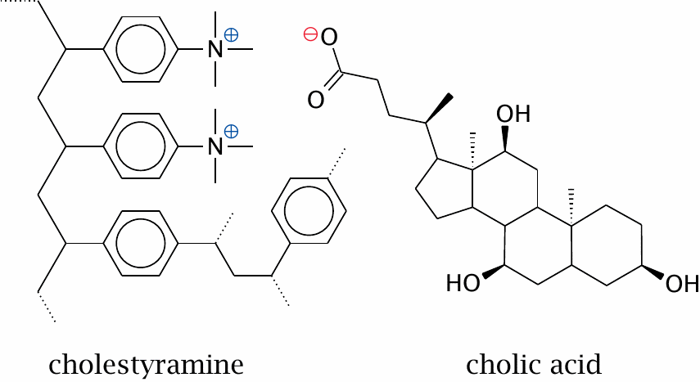
Cholestyramine particles absorb bile acids

Slide 48
LDL apheresis
Blood is diverted through an extra-corporeal filtration device
cells are separated from plasma
LDL is removed from plasma by affinity methods or size-based filtration
The remaining plasma and cells are returned to the circulation
The procedure is repeated in weekly or biweekly intervals

Slide 49
More …
triparanol—an old drug, inhibits some CYP450 enzymes in the conversion from lanosterol to cholesterol; withdrawn due to toxicity
bezafibrate—a PPARγ agonist
nicotinic acid—activates hormone-sensitive lipase through a G protein coupled receptor named HM74A; 5 likely additional mechanisms
probucol and succinobucol—supposedly antioxidants that prevent LDL oxidation, but also cause unrelated changes in other laboratory parameters
guar gum and other carbohydrate fibers —absorb and prevent intestinal uptake of cholesterol and bile acids with variable efficiency
thyroid hormone analogs—promote LDL utilization

Slide 50
Familial hypercholesterolemia is due to a gene defect in the LDL receptor

Slide 51
Tangier disease: Disruption of cholesterol transfer to HDL

Slide 52
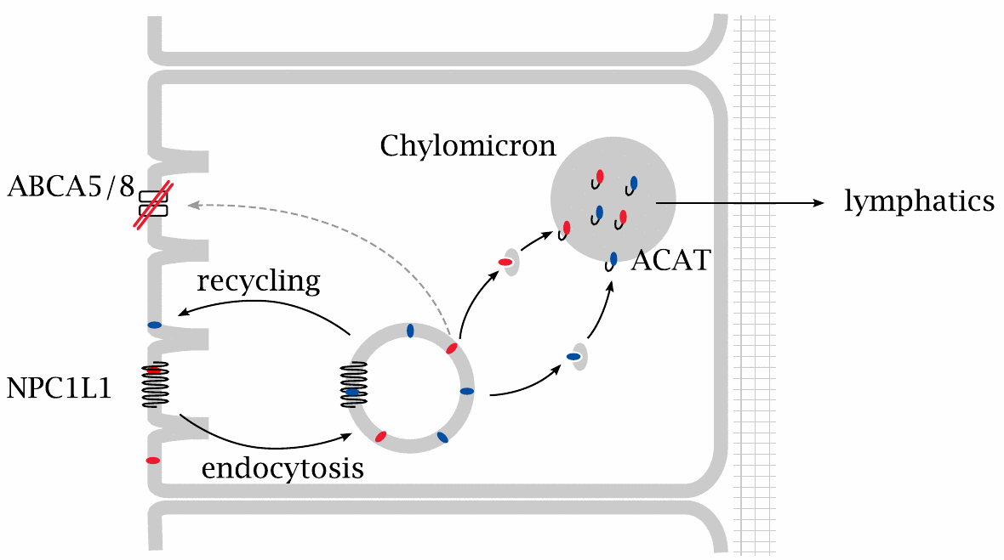
A defective plant sterol exporter causes sitosterolemia

