Slide 1
Introduction

Slide 2
Significance of metabolism in medicine
hereditary enzyme defects
diabetes, atherosclerosis, gout
antimetabolites in the chemotherapy of cancers and infections
inactivation and elimination of xenobiotics and drugs

Slide 3
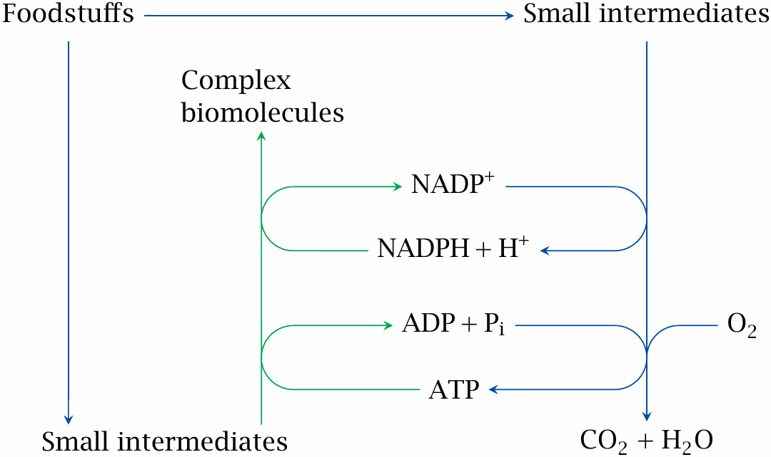
Catabolic and anabolic reactions

Slide 4
Diversity of metabolism: pathways in plants and bacteria
Pathway | Organisms
photosynthesis | plants and cyanobacteria
nitrogen fixation | specialized soil bacteria
oxidation or reduction of inorganic minerals | archaebacteria
acid- and gas-producing fermentations | anaerobic bacteria

Slide 5
Types of foodstuffs
carbohydrates
protein
fat
nucleic acids

Slide 6
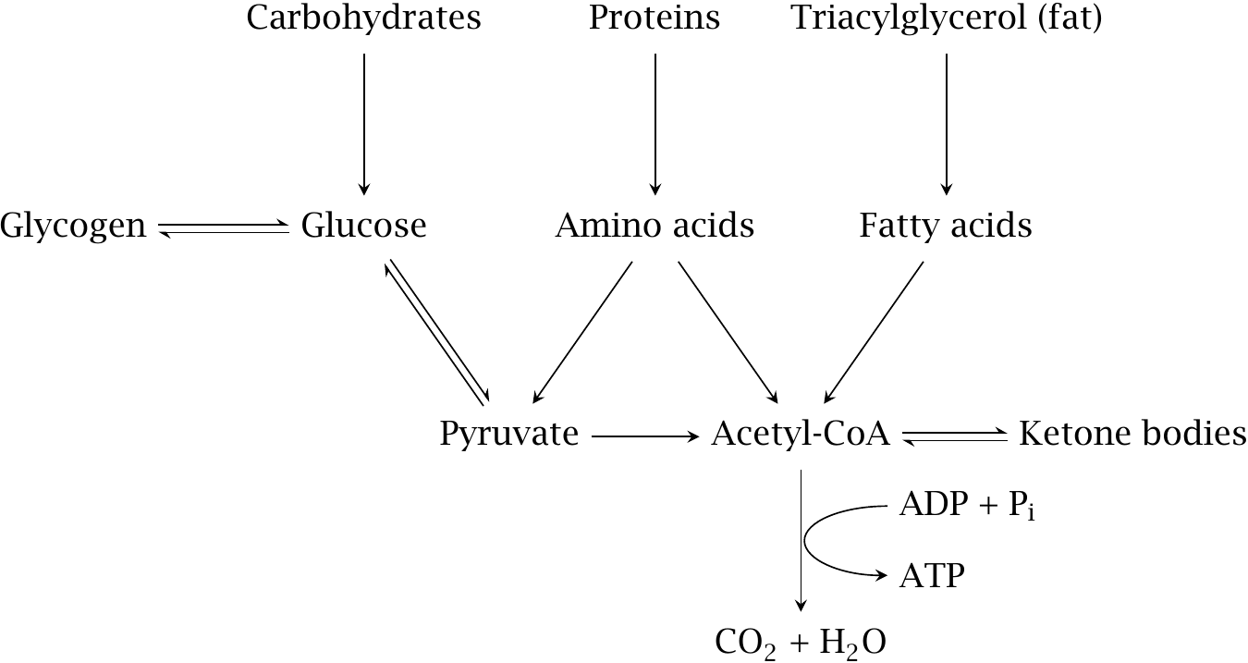
Breakdown of foodstuffs: Overview

Slide 7
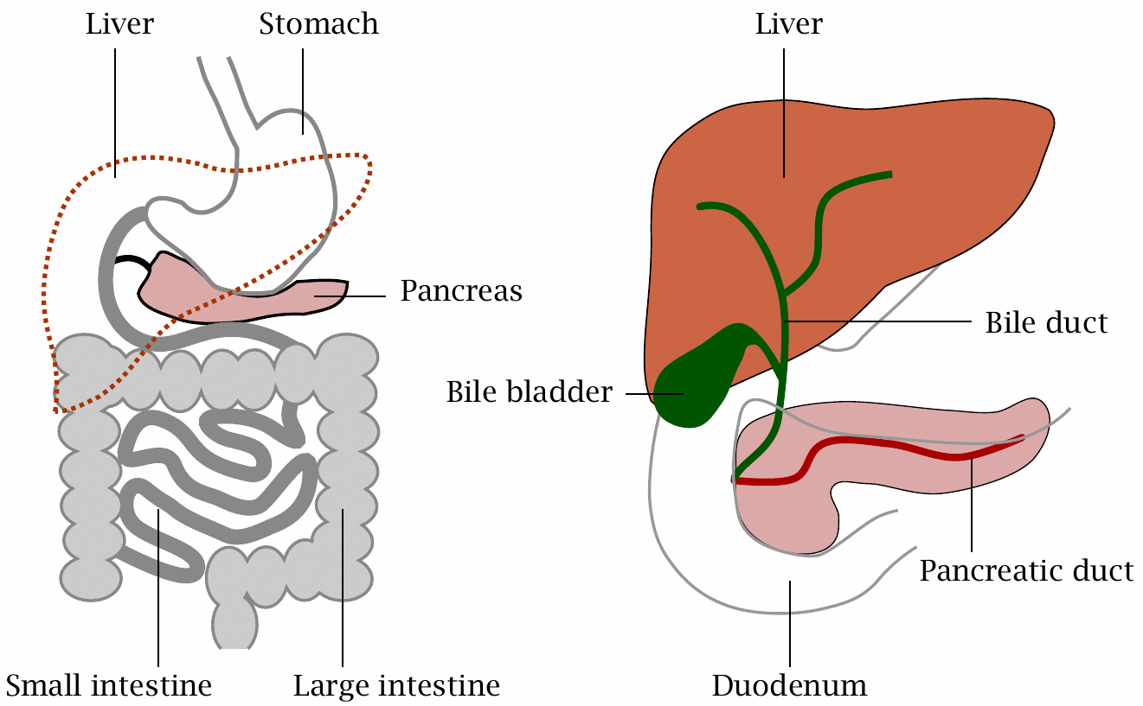
Functional anatomy of the digestive system

Slide 8
Intestinal organs: functional overview
Organ | Function
stomach | killing of microbes contained in the food; protein denaturation
small intestine | breakdown of macromolecules to small molecules, uptake of the latter
large intestine | fluid and ion reuptake
pancreas | production of digestive enzymes and of hormones
liver | production of bile; metabolic homeostasis

Slide 9
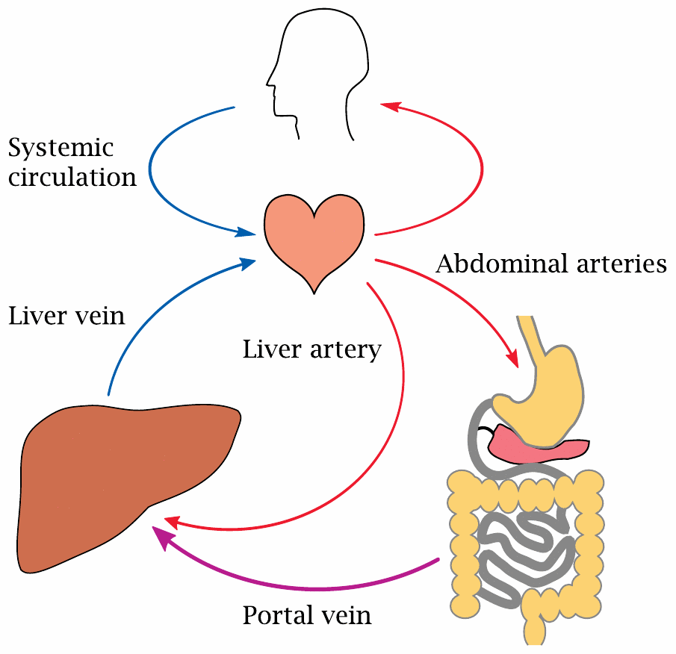
The portal circulation

Slide 10
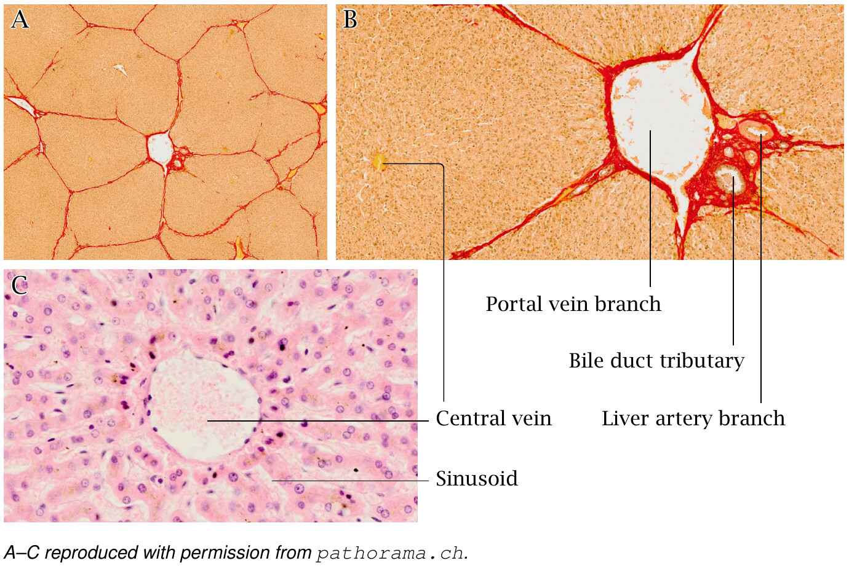
Liver tissue structure

Slide 11
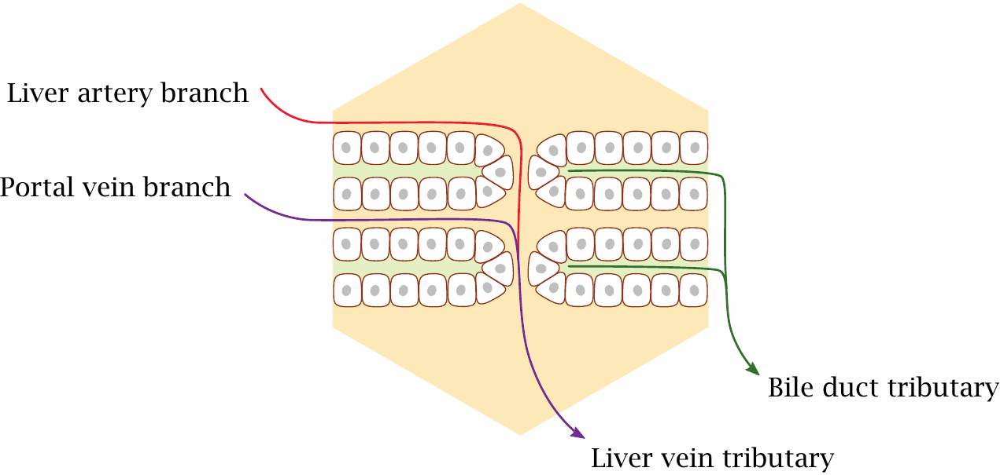
Blood flow and bile flow within the liver lobule

Slide 12
The stomach: functions of gastric acid
HCl, pH 1–2
secreted by specialized cells in the mucous membrane (parietal cells)
kills germs contained in food; patients with lack of gastric acid are at increased risk of intestinal infection
denatures food proteins and makes them accessible to cleavage by proteases

Slide 13
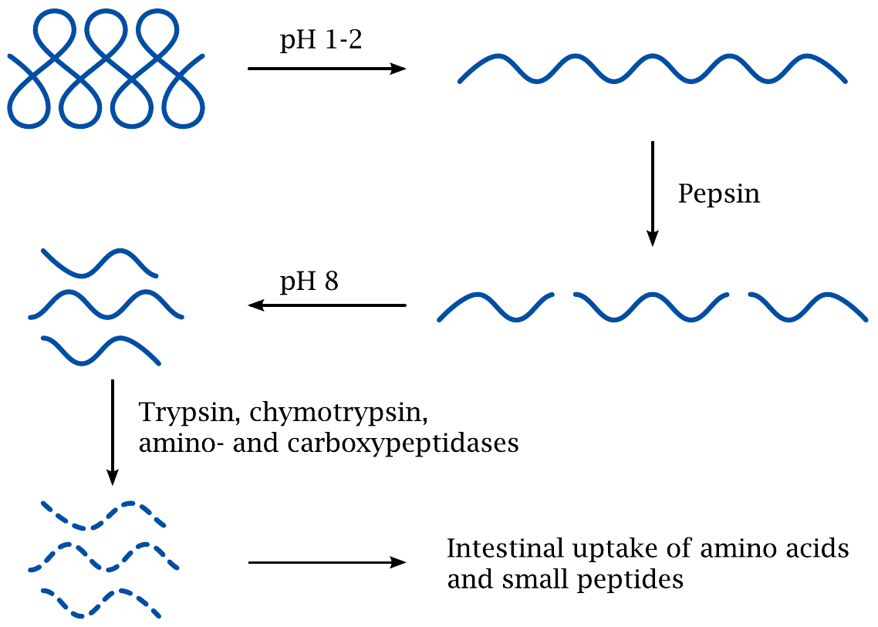
Gastric acid and pepsin in protein digestion

Slide 14
Function of the exocrine pancreas
secretion of digestive enzymes
amylase
proteases, peptidases
lipases
DNAse, RNAse
secretion of sodium bicarbonate to neutralize gastric acid

Slide 15
Roles of bile in digestion
Bile acids solubilize triacylglycerol and make it accessible to pancreatic lipase
Bicarbonate contributes to the neutralization of gastric acid

Slide 16
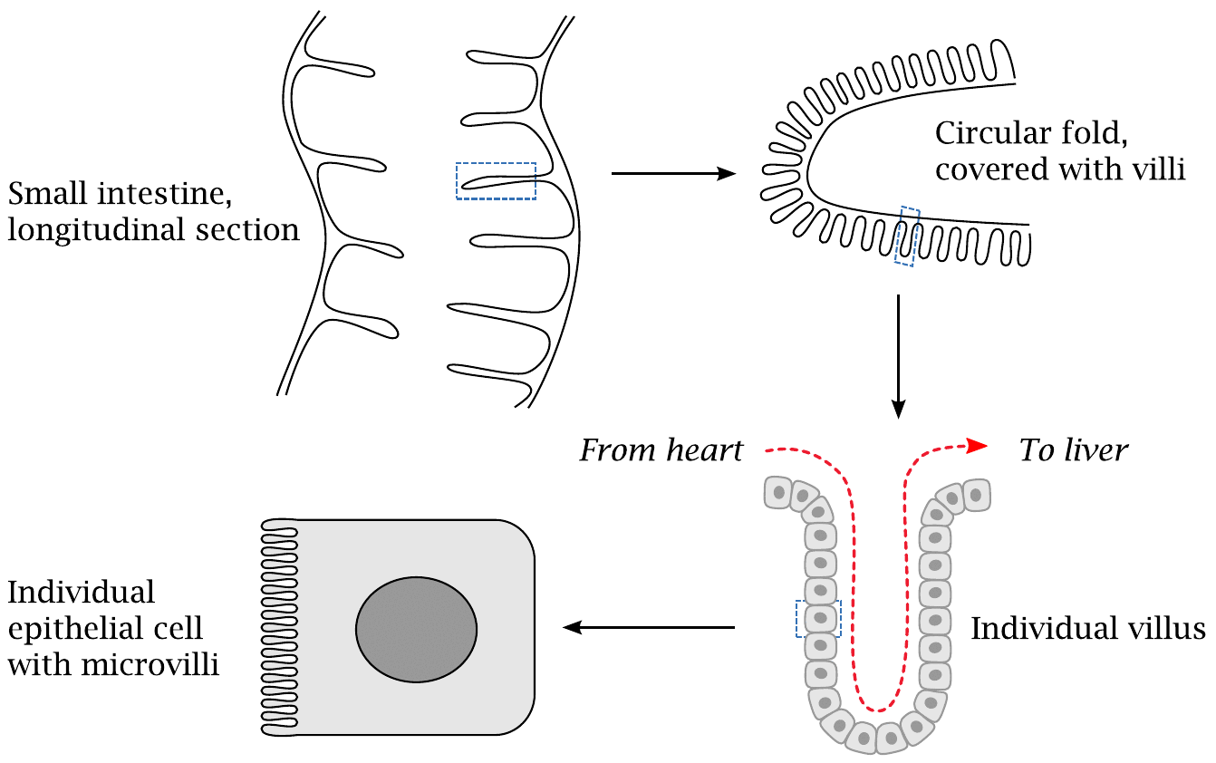
The small intestine

Slide 17
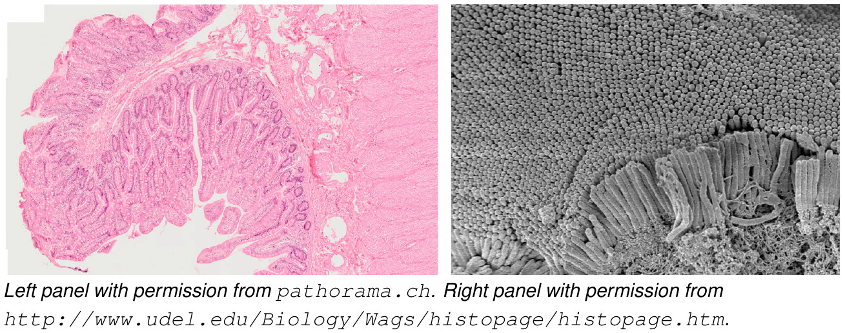
Microscopic structure of the small intestine

Slide 18
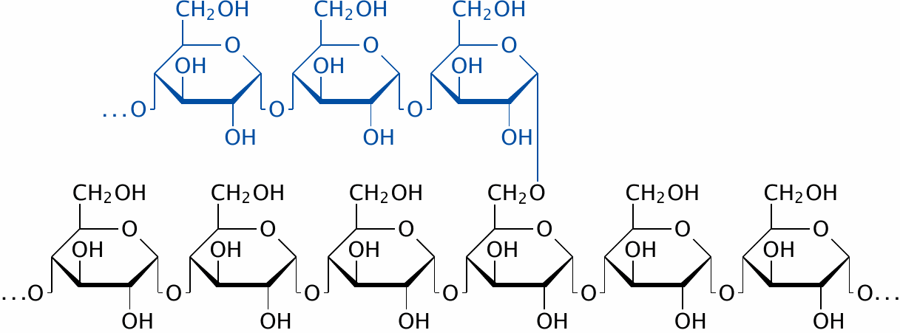
Amylose and amylopectin are polymers of α-D-glucose

Slide 19
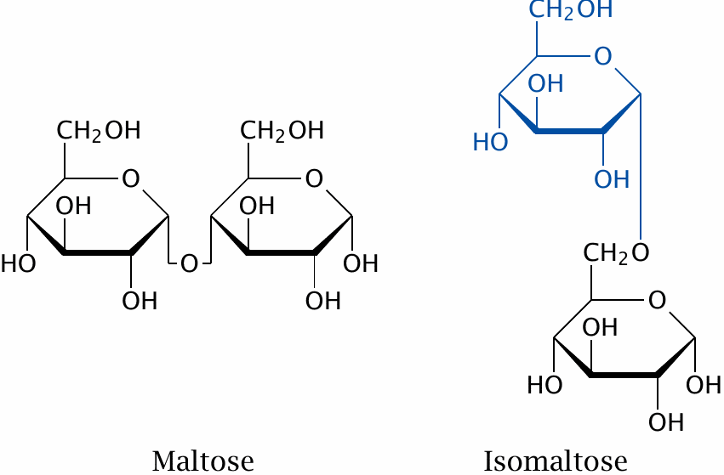
Amylase breaks down starch to maltose and isomaltose

Slide 20
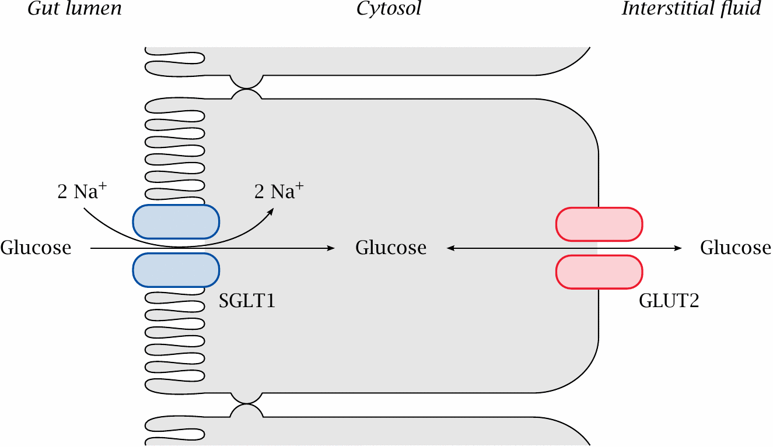
Mechanism of glucose uptake from the gut

Slide 21
The large intestine
Anaerobic milieu—99% of all bacteria in the large intestine are strict anaerobes
Bacteria degrade non-utilized foodstuffs, reducing osmotic activity of gut content
Mucous membrane recovers water and electrolytes
Bacterial metabolism releases potentially toxic products (e.g. ammonia), which are taken up and inactivated by the liver

Slide 22
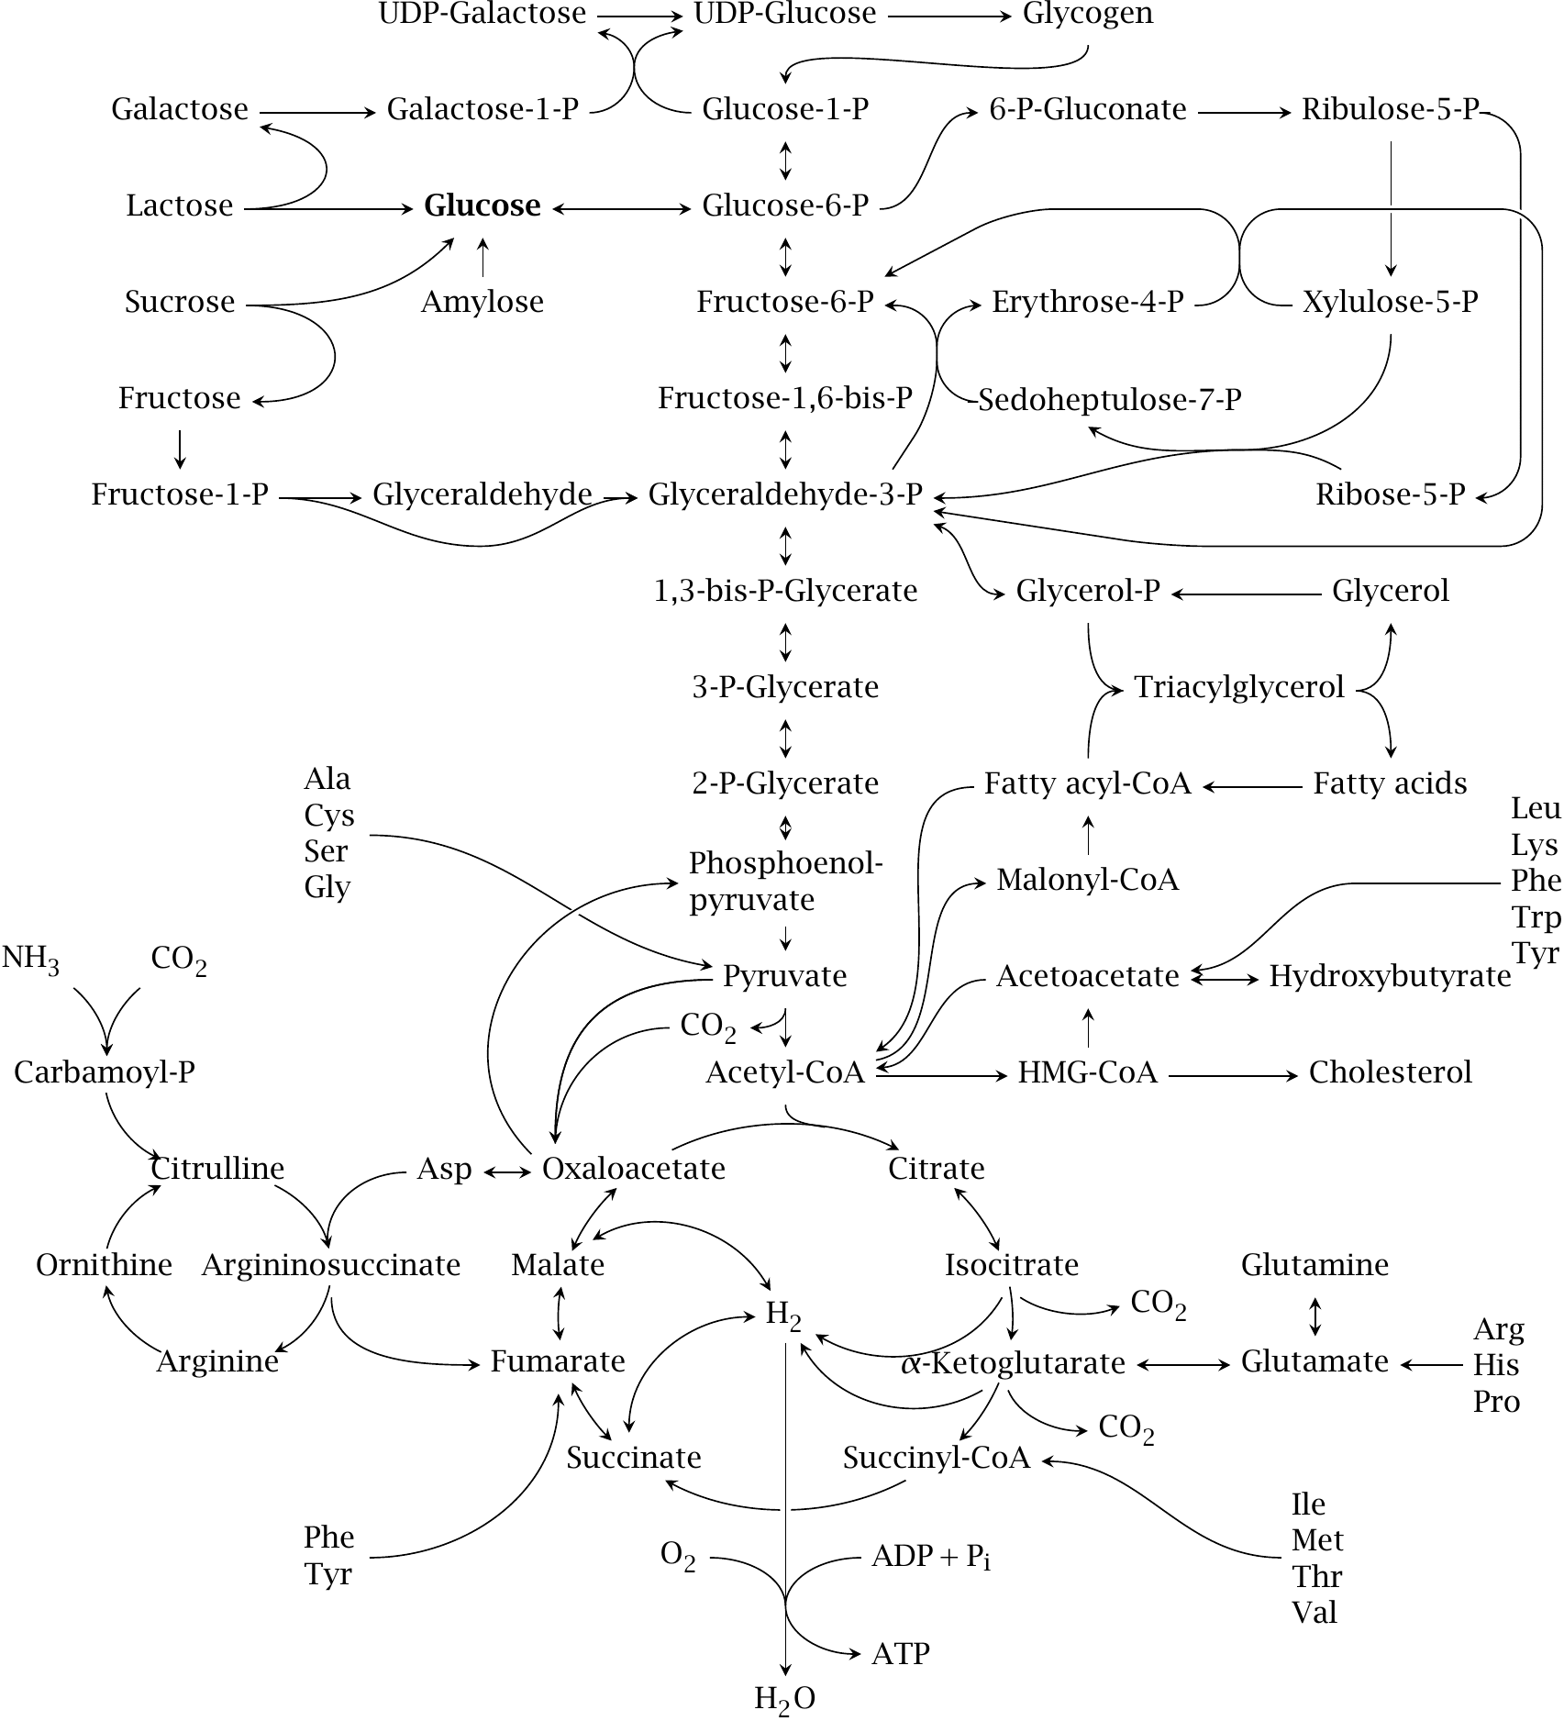
A metabolic map for Chem 333

Slide 23
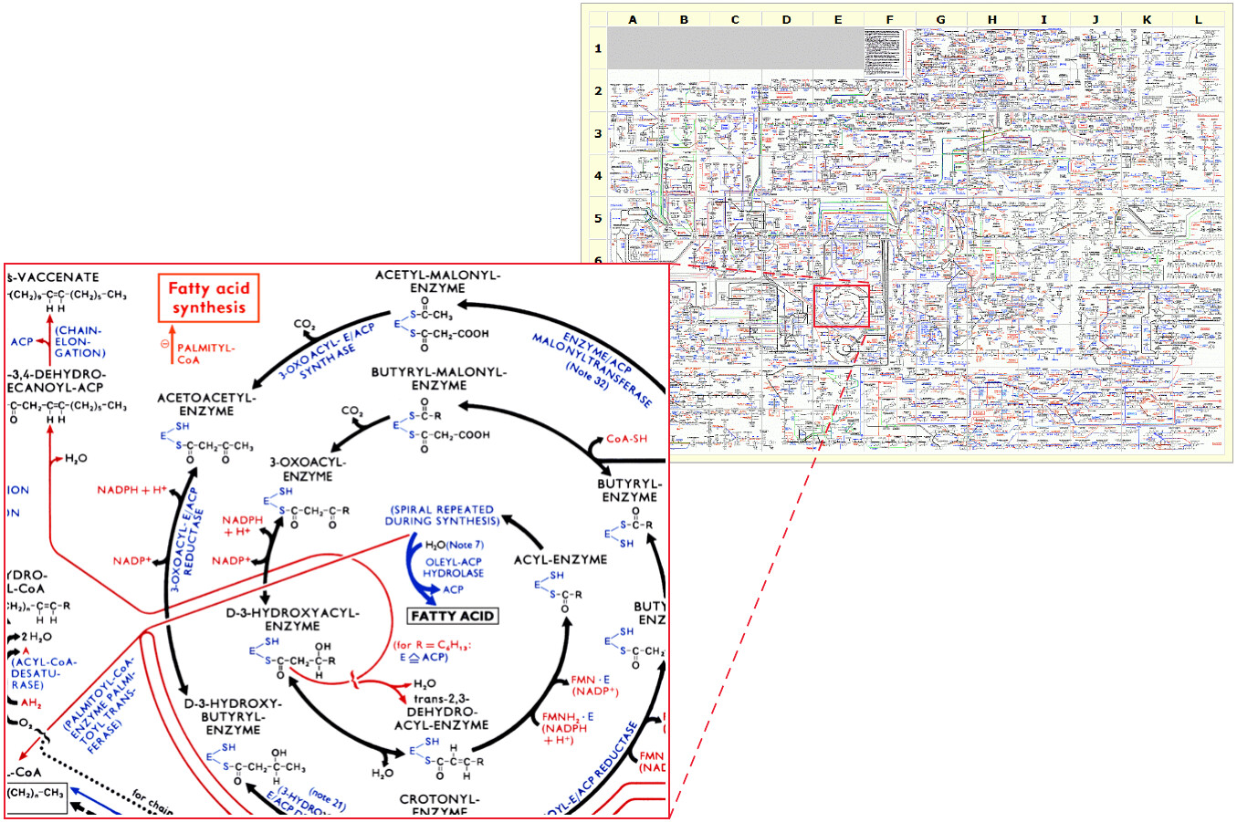
A more realistic metabolic map

